Slide 1

Extending spatial capture-recapture with the Hawkes process
Alec van Helsdingen
Supervisors: Dr Charlotte M. Jones-Todd and Prof Russell Millar

Slide 2
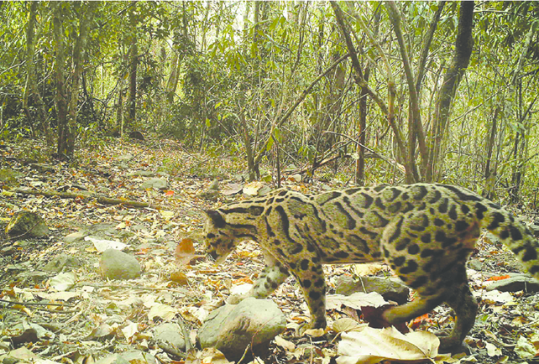
Background
Accurate estimates of animal populations are critical for conservation of endangered species
However many animals are elusive and/or dangerous to approach (e.g. leopards, tigers)
Ecologists often have recorded sightings of different individual animals and would like to know how many individuals have evaded detection
Estimates of the area over which each individual travels or occupies are also of interest to ecologists and conservationists
Image Credit: Clouded Leopard co-exists with six other felids in Royal Manas National Park, Bhutan Dhendup et al, 2016

Slide 3
Capture-Recapture (CR)
Basic idea of CR is to capture animals, “mark” them and by recapturing animals at later session(s) estimate the population
The process of capturing/marking can involve traps/tagging, cameras, hair snags, DNA etc
Assumes closed population, equal probabilities of captures
Notes:
Captures need not involve physical traps
Example: observe 100, later 60/120 are marked, point estimate is 200

Slide 4
Spatial Capture-Recapture (SCR)
Spatial Capture-Recapture (SCR) is a well-accepted method for estimating animal populations.
To use SCR, detectors (e.g. traps, cameras) must be set up across a study area and individual animals must be distinguishable.
Raw data is 3-way table of captures by individual, detector and session, as well as the 2D trap locations

Slide 5
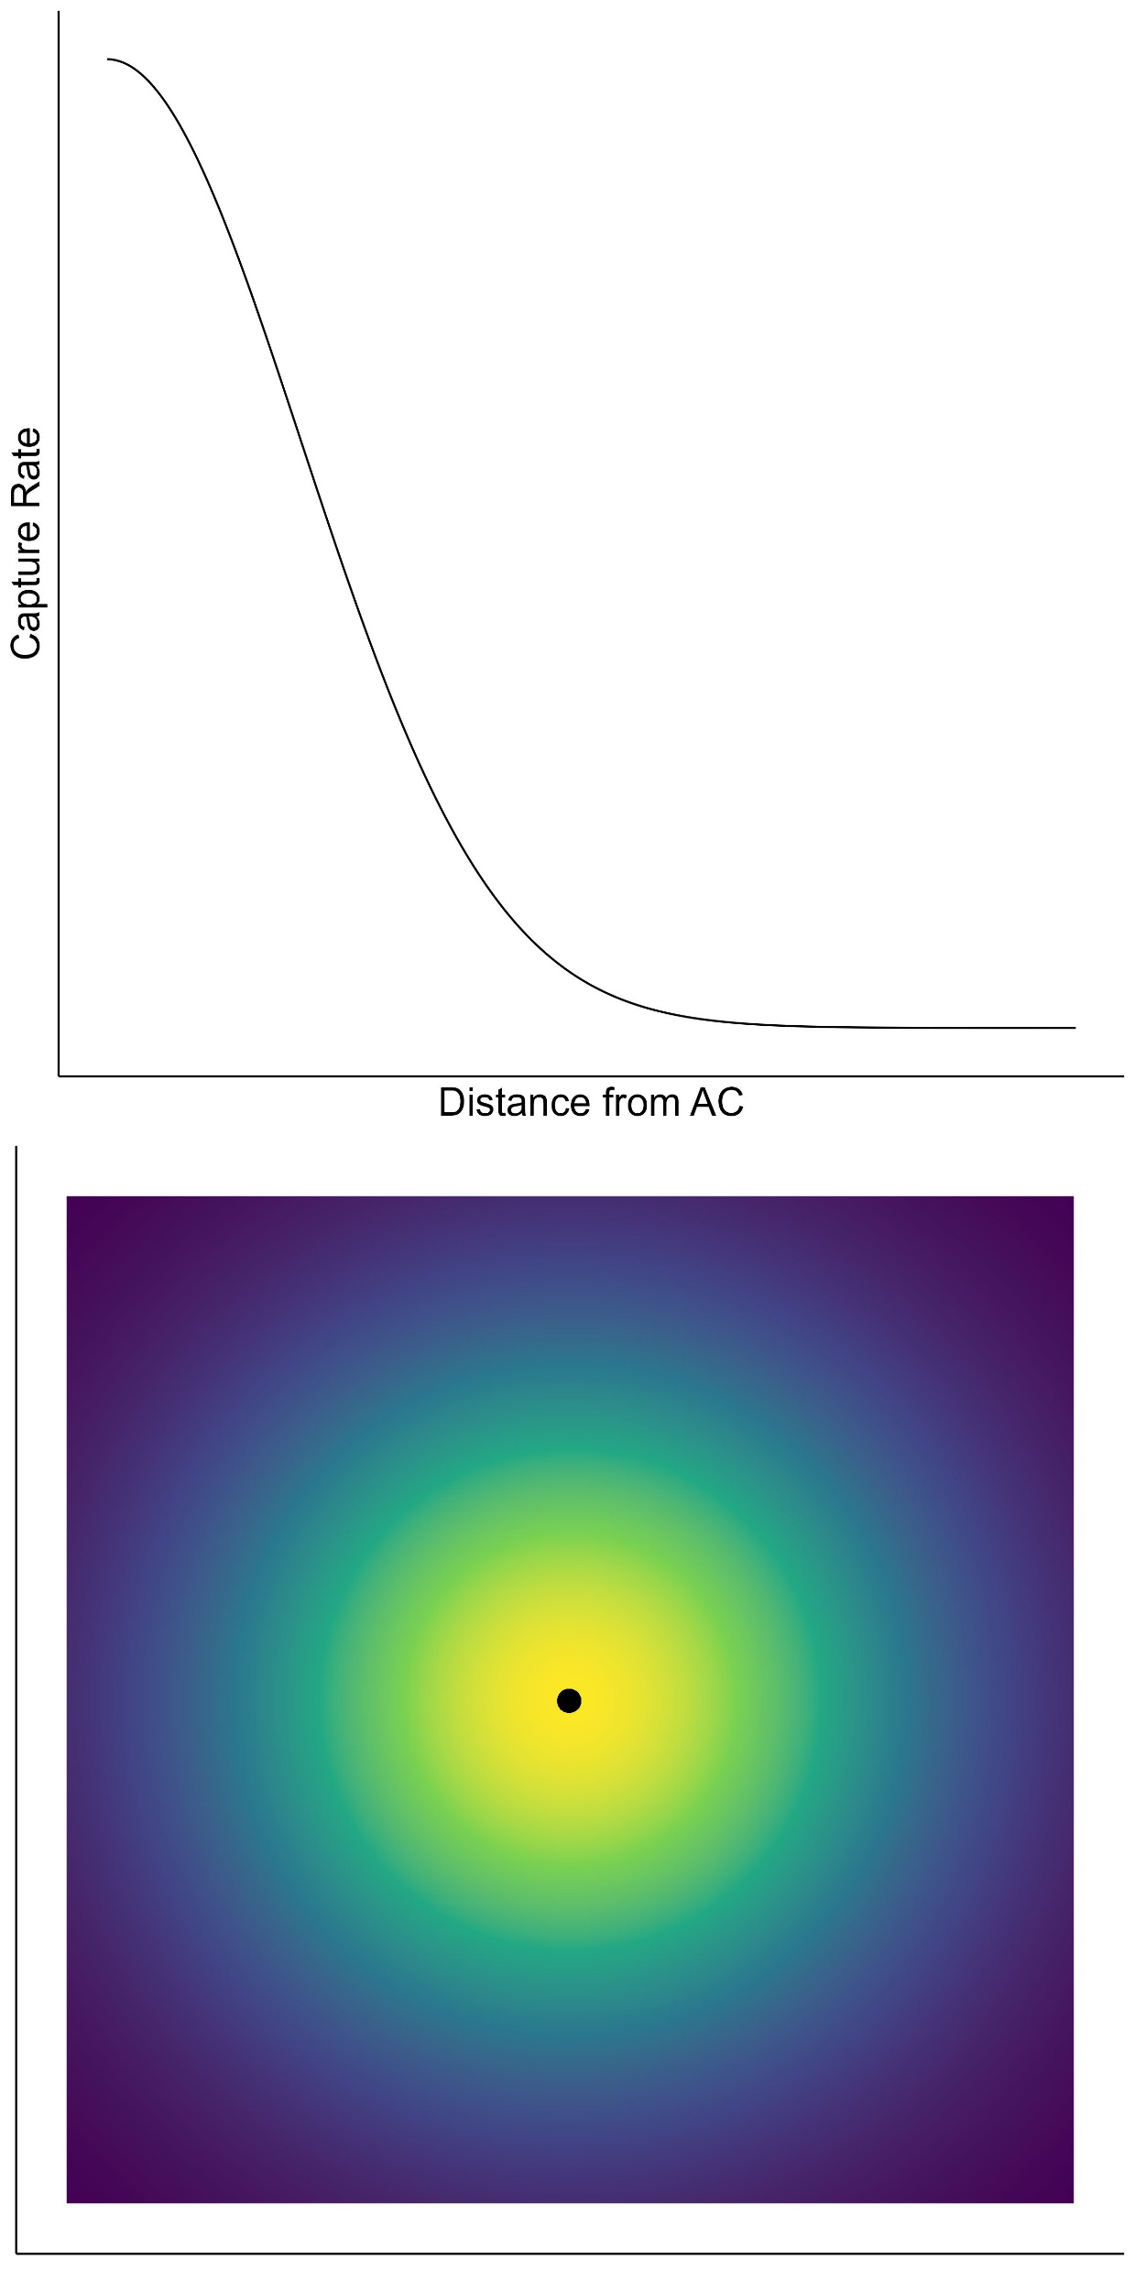
SCR Assumptions
SCR assumes that each animal has a fixed activity centre, and that each animal has a home range, usually a normal distribution
The expected counts at each detector are proportional to the density of the bivariate normal
Notes:
AC is black dot, at peak of biv. Normal

Slide 6
SCR Assumptions
SCR assumes that each animal has a fixed activity centre, and that each animal has a home range, usually a normal distribution
The expected counts at each detector are proportional to the density of the bivariate normal
Individual activity centers are a point pattern, distributed in a Poisson manner.
Detections are conditionally independent
Notes:
We can assume for simplicity a constant density of ACs, or use covariates

Slide 7
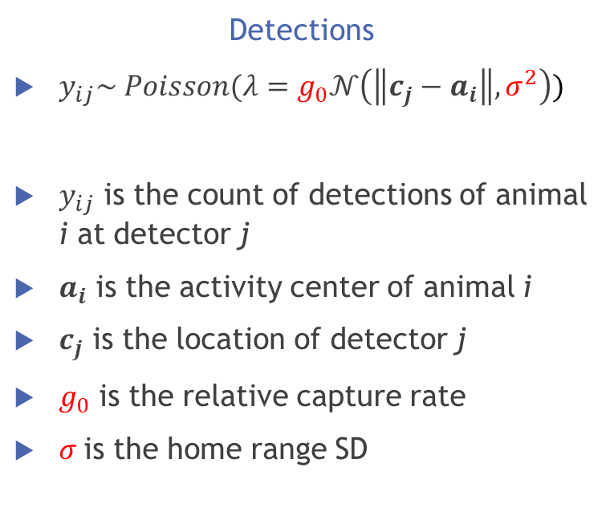
Basic SCR Formulation
Detections
$y_{ij}\sim Poisson(λ=g_{0}𝒩\left(\left\|c_{j}−a_{i}\right\|,σ^{2}\right))$
$y_{ij}$ is the count of detections of animal i at detector j
$a_{i}$ is the activity center of animal i
$c_{j}$ is the location of detector j
$g_{0}$ is the relative capture rate
$σ$is the home range SD

Slide 8
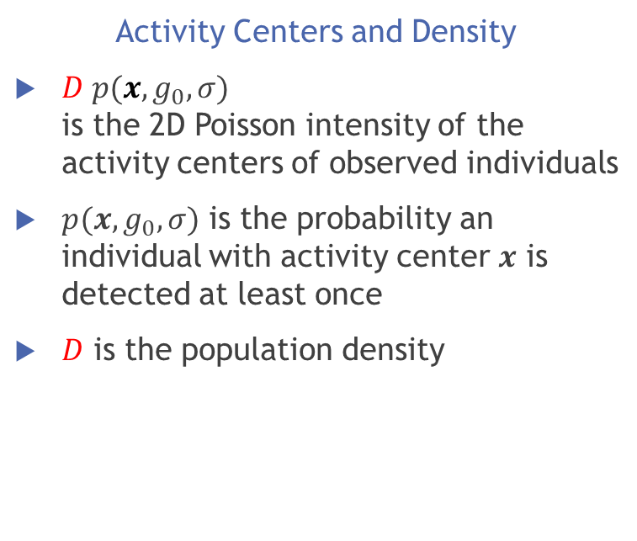
Basic SCR Formulation
Detections
$y_{ij}\sim Poisson(λ=g_{0}𝒩\left(\left\|c_{j}−a_{i}\right\|,σ^{2}\right))$
$y_{ij}$ is the count of detections of animal i at detector j
$a_{i}$ is the activity center of animal i
$c_{j}$ is the location of detector j
$g_{0}$ is the relative capture rate
$σ$is the home range SD
Activity Centers and Density
$D p(x,g_{0},σ)$ is the 2D Poisson intensity of the activity centers of observed individuals
$p(x,g_{0},σ)$ is the probability an individual with activity center $x$ is detected at least once
$D$ is the population density
Notes:
Three parameters: D density of animals, \sigma the HR size/s.d. and g_0 the relative rate of detection

Slide 9
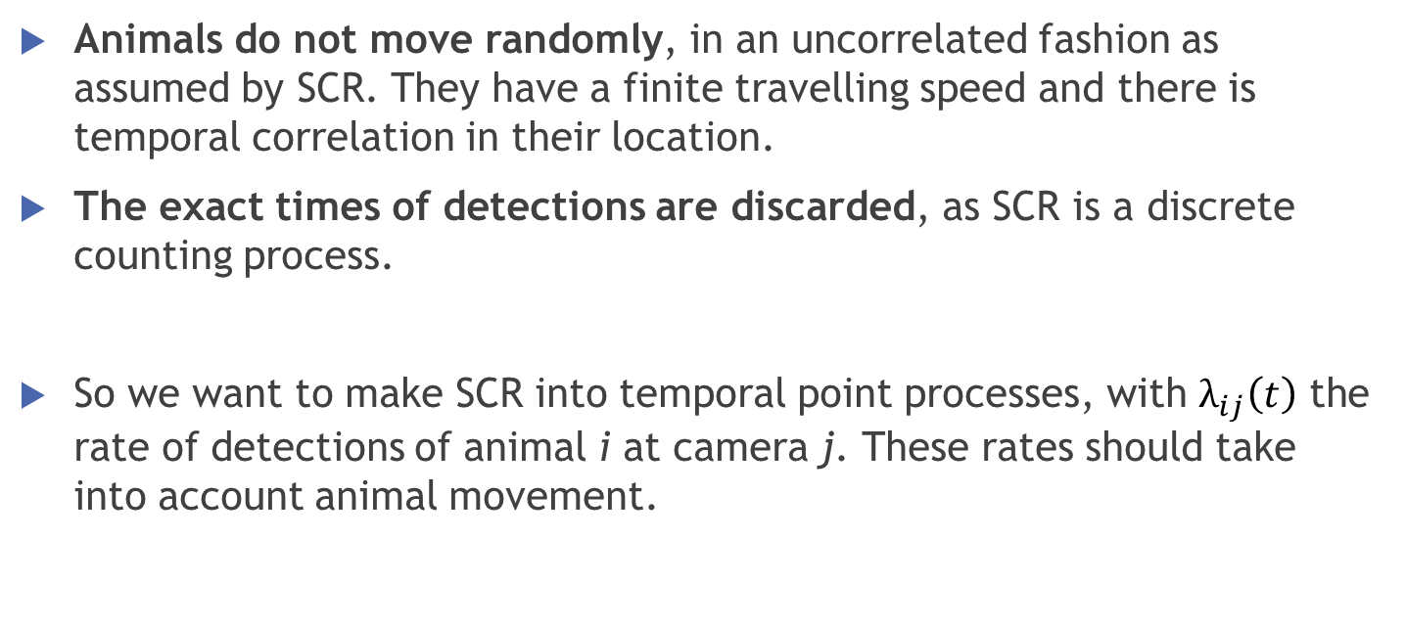
Limitations of SCR
Animals do not move randomly, in an uncorrelated fashion as assumed by SCR. They have a finite travelling speed and there is temporal correlation in their location.
The exact times of detections are discarded, as SCR is a discrete counting process.
So we want to make SCR into temporal point processes, with $λ_{ij}\left(t\right)$ the rate of detections of animal i at camera j. These rates should take into account animal movement.

Slide 10
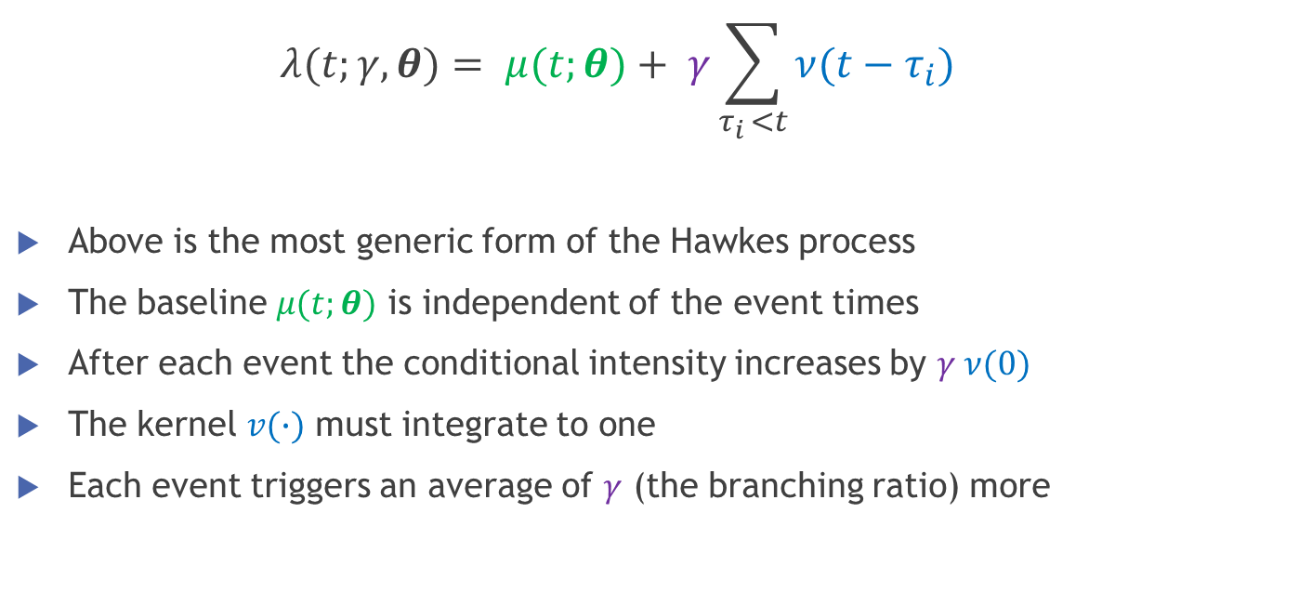
Hawkes Process
  $$λ(t;γ,θ)= μ(t;θ)+ γ\sum_{τ_{i }<t}{ν(t−τ_{i}) }$$
Above is the most generic form of the Hawkes process
The baseline $μ(t;θ)$ is independent of the event times
After each event the conditional intensity increases by $γ ν(0)$
The kernel $v(∙)$ must integrate to one
Each event triggers an average of $γ$ (the branching ratio) more
Hawkes, A. G. (1971). Spectra of some self-exciting and mutually exciting point processes. Biometrika, 58(1):83–90

Slide 11
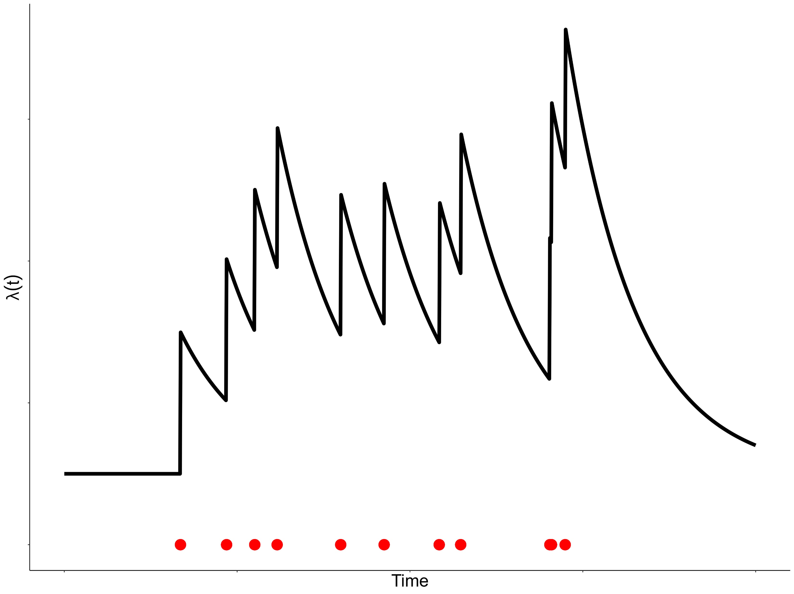
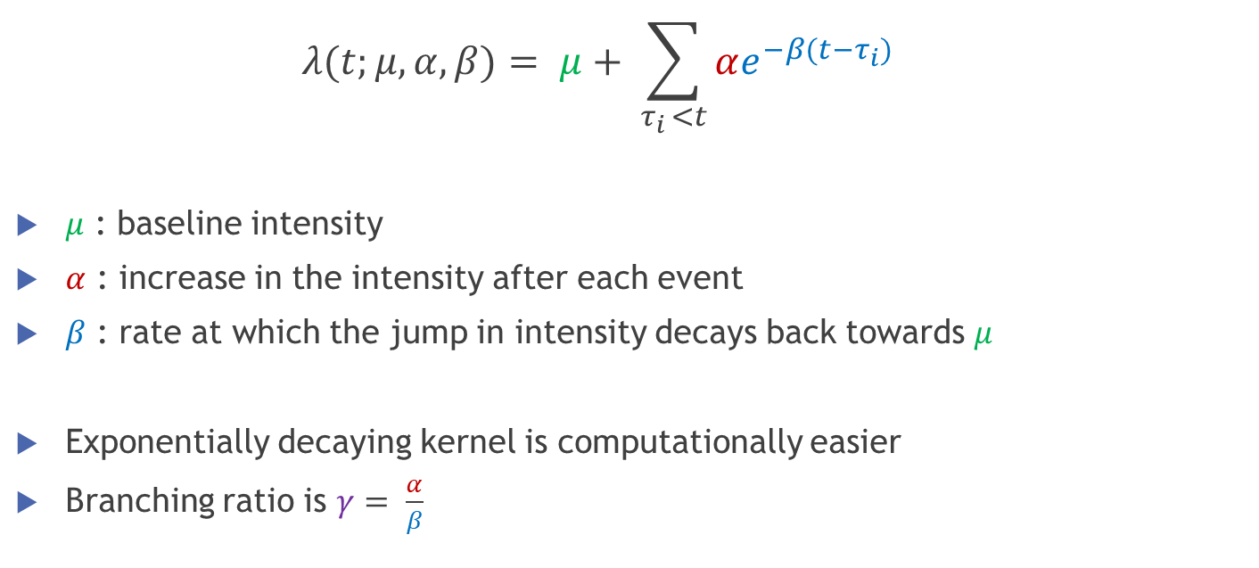
Classic Hawkes Process
  $$λ(t;μ,α,β)= μ+ \sum_{τ_{i }<t}{αe^{−β(t−τ_{i})}}$$
$μ$ : baseline intensity
$α$ : increase in the intensity after each event
$β$ : rate at which the jump in intensity decays back towards $μ$
Exponentially decaying kernel is computationally easier
Branching ratio is $γ= \frac{α}{β}$
Notes:
Initial intensity is \mu, after each events jumps by \alpha, decays back down at \beta

Slide 12
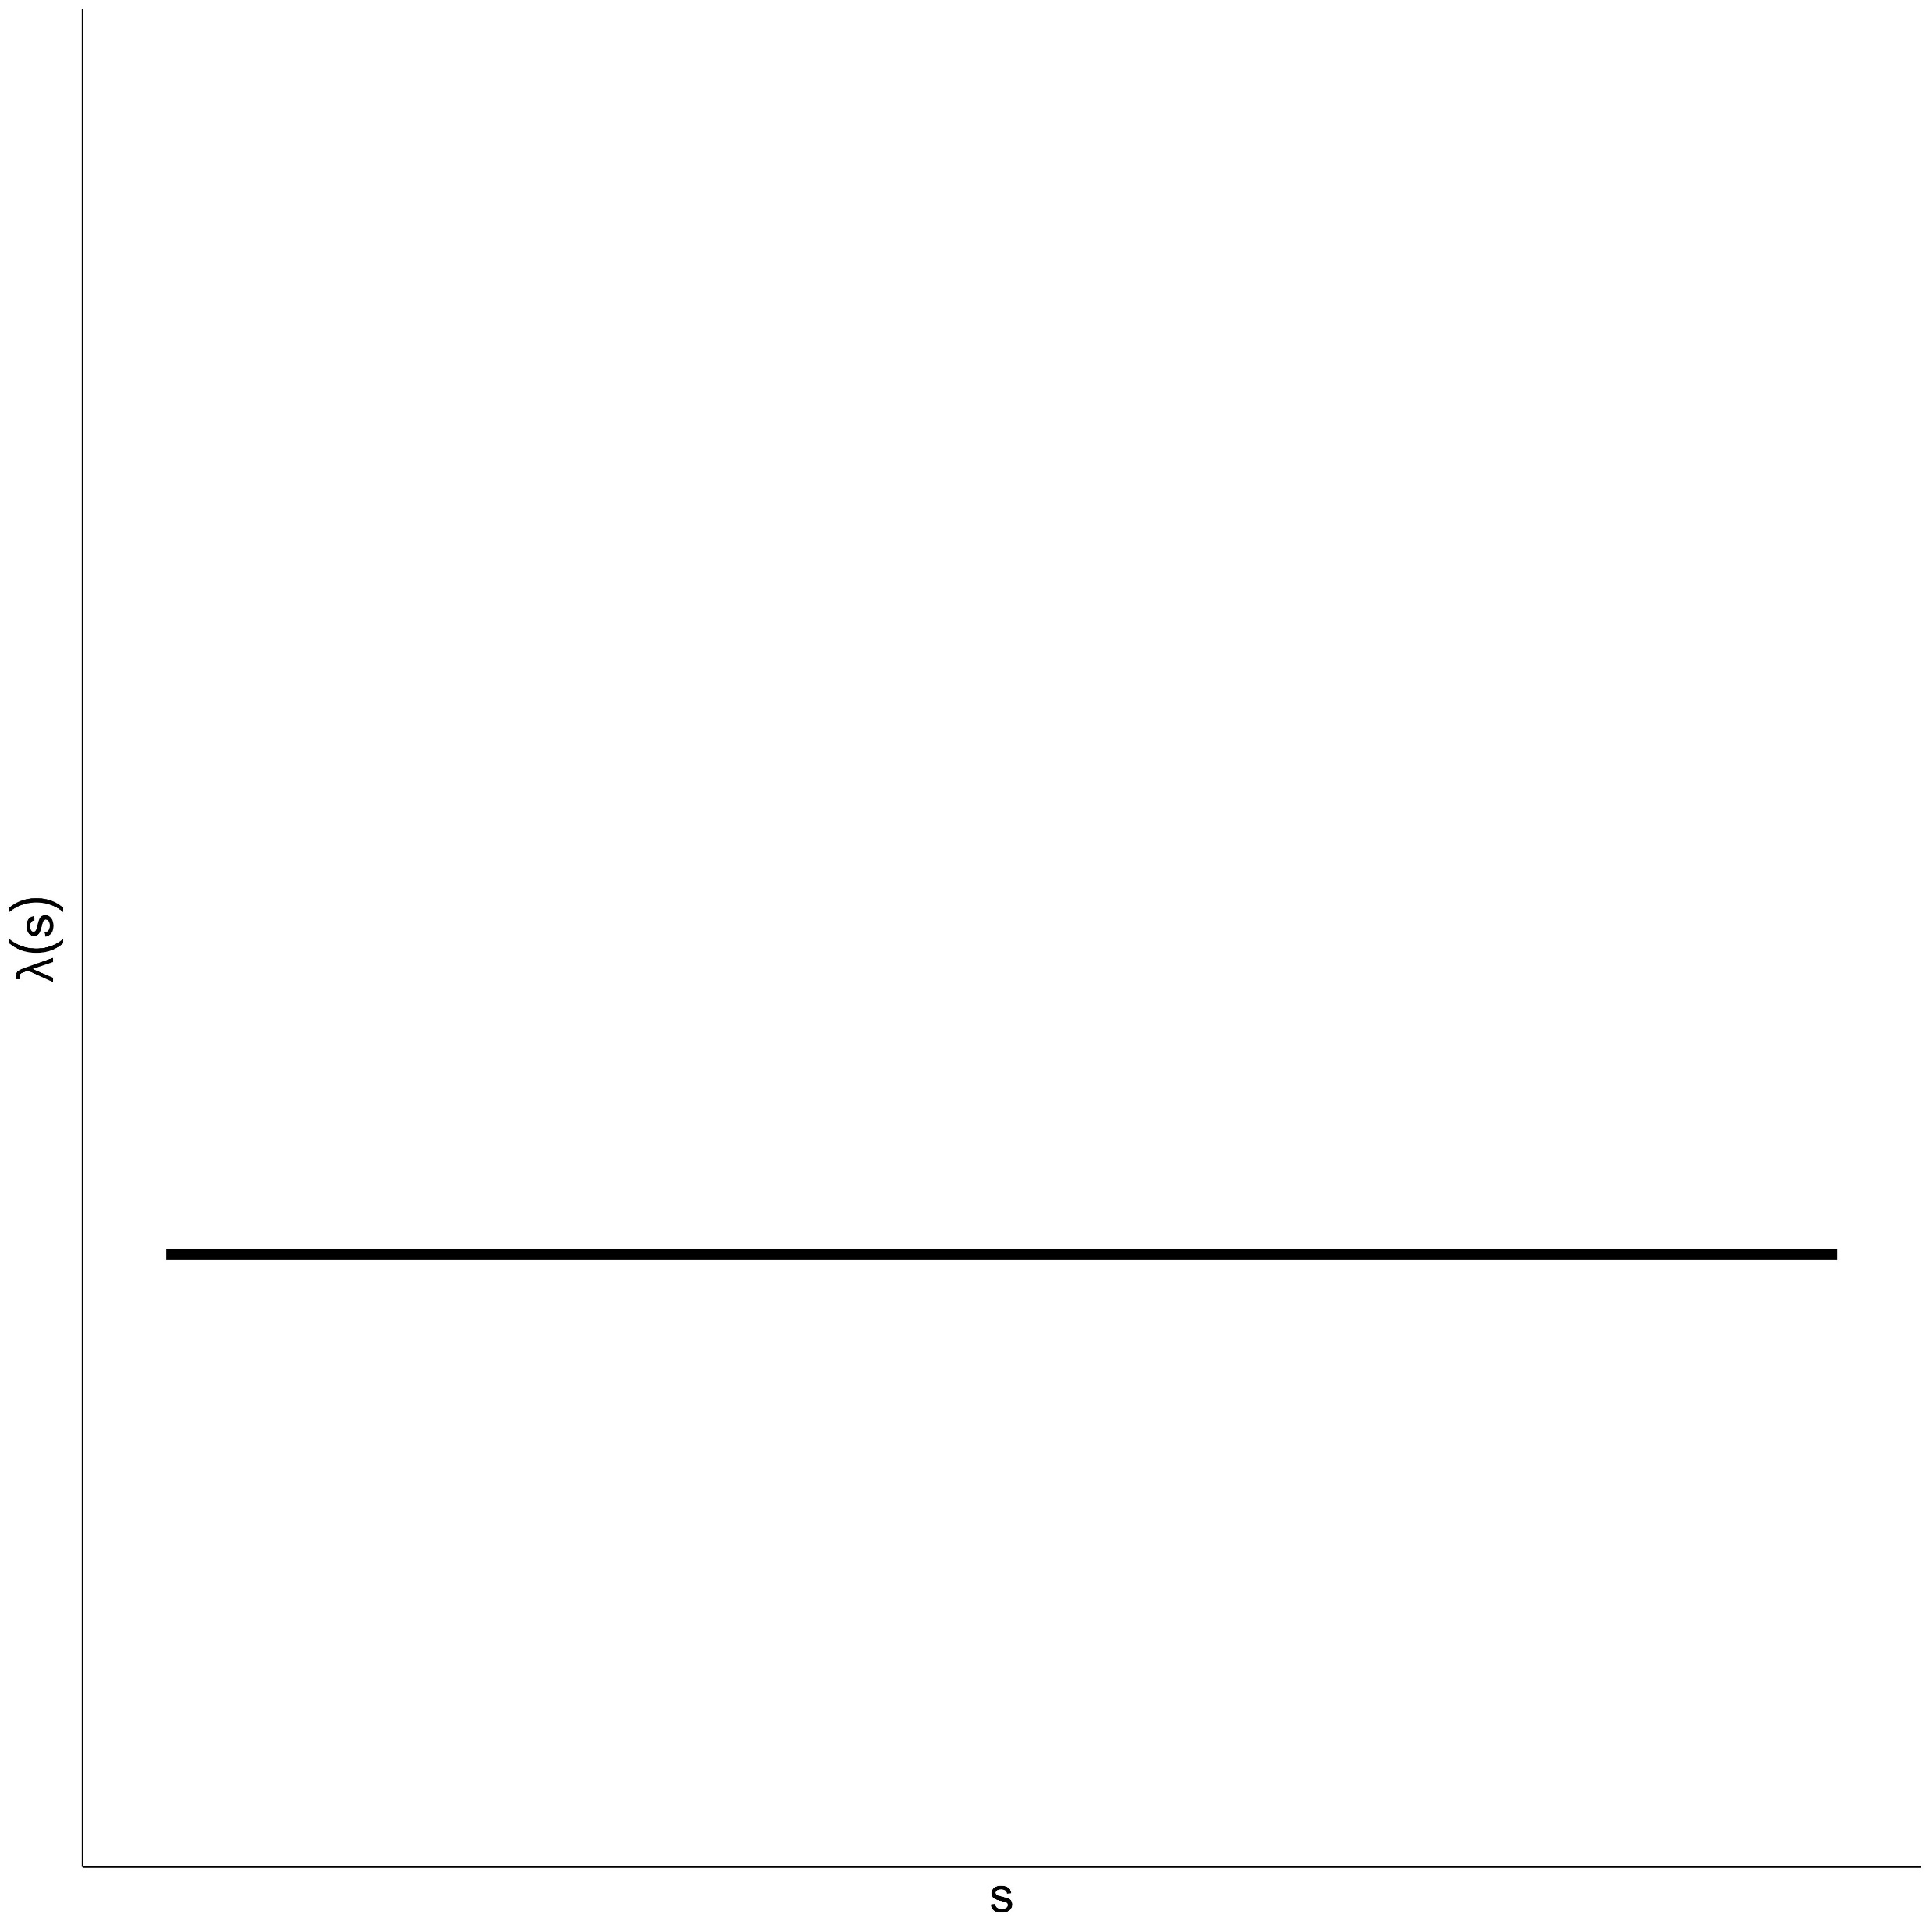
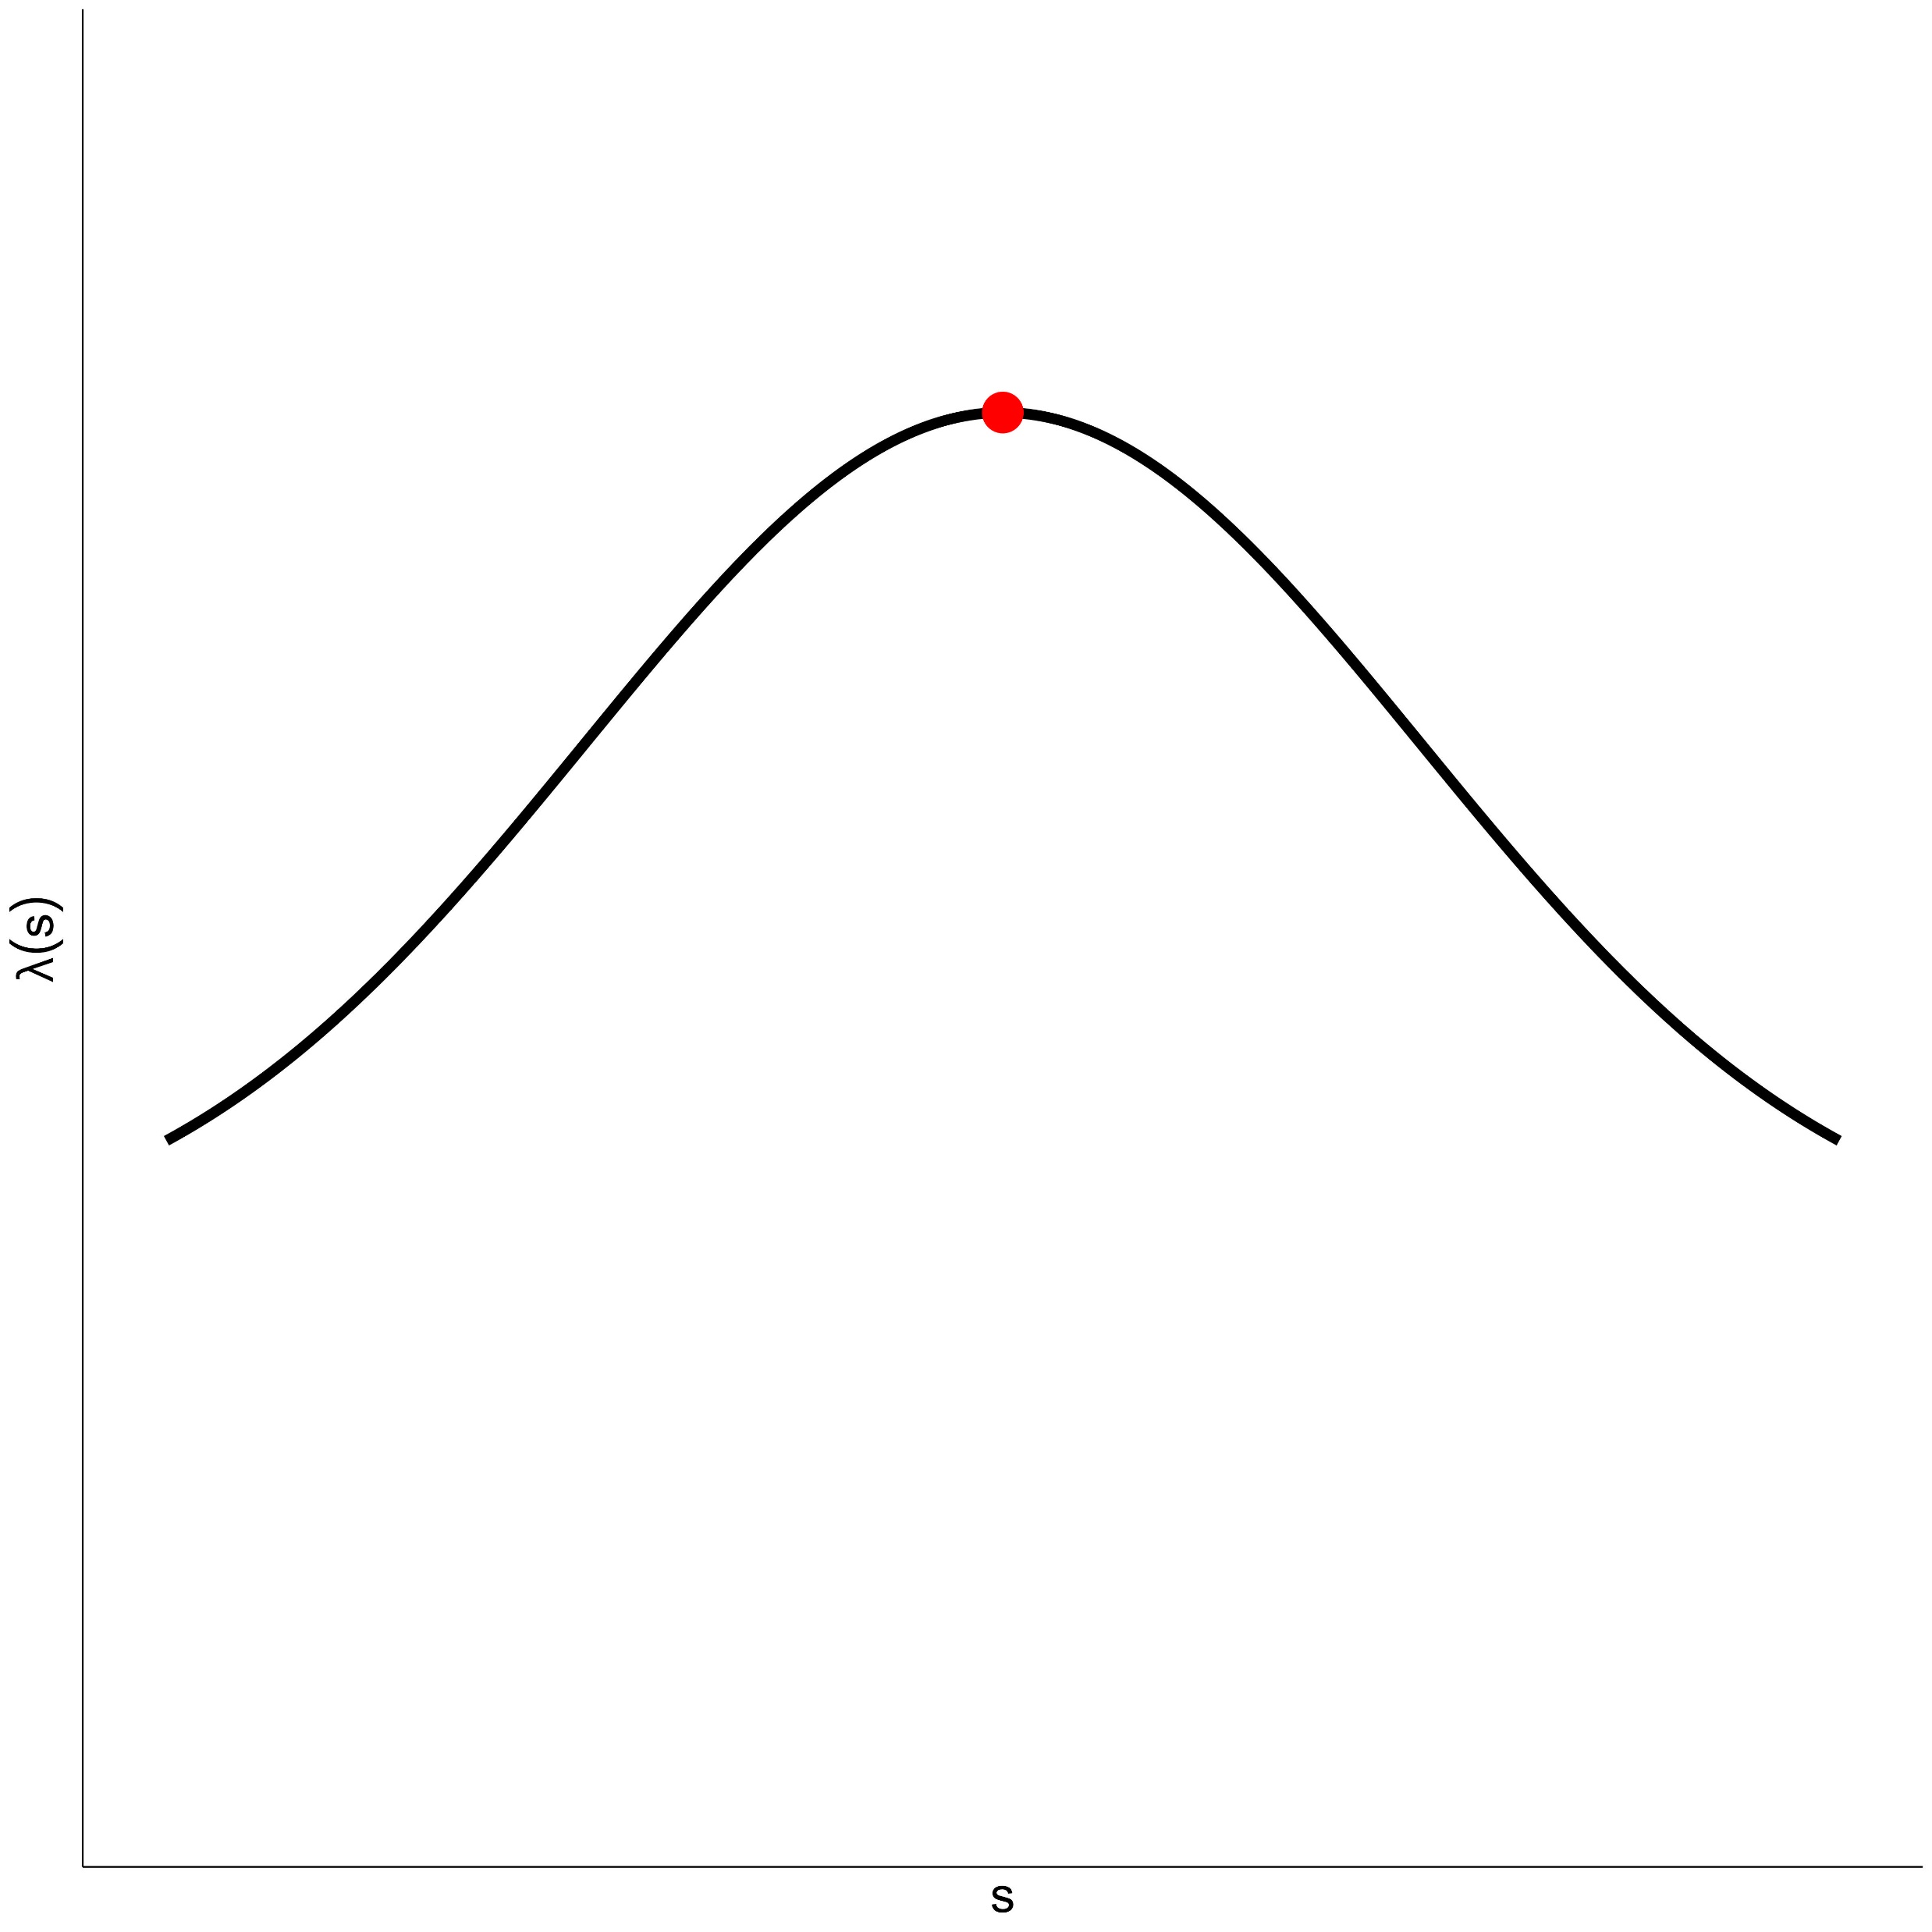
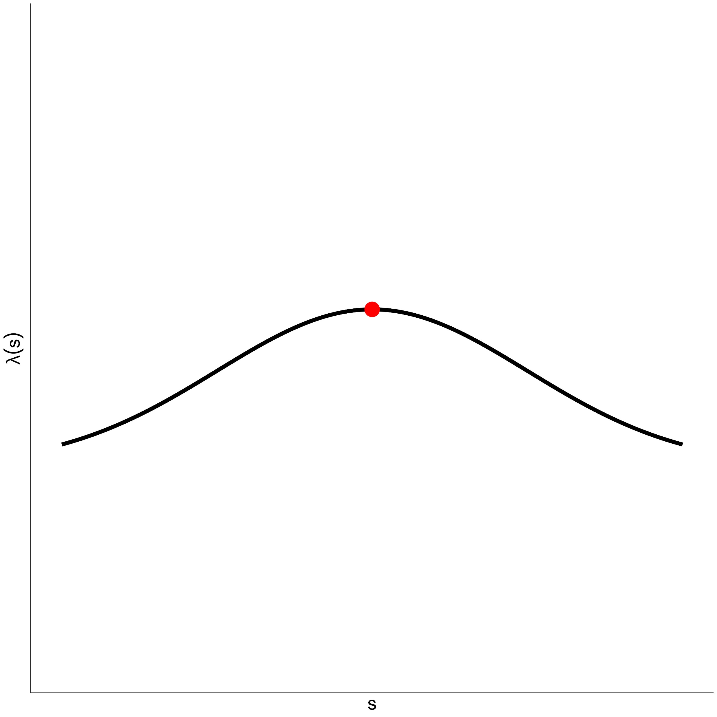
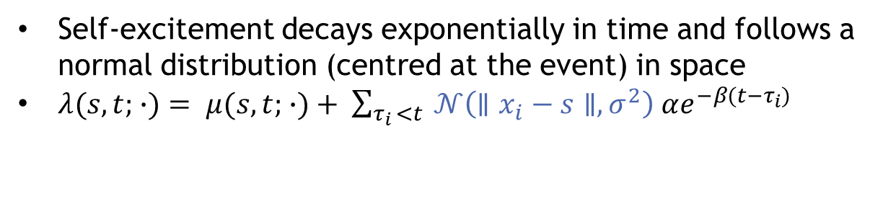
Spatio-temporal Hawkes Process
Self-excitement decays exponentially in time and follows a normal distribution (centred at the event) in space
$λ(s,t; ∙)= μ(s,t; ∙)+ \sum_{τ_{i }<t}{ 𝒩\left(∥x_{i}−s∥,σ^{2}\right) αe^{−β(t−τ_{i})}}$
Before event
t = 0
t = 1
Notes:
Normal spike (in space) decays exponentially in time

Slide 13
Hawkes Solution
If we see an animal somewhere, we expect to see it there at a higher rate in the near future, i.e self-excitement
So we could model detections like a spatial-temporal Hawkes process (except that detections only take place at cameras, rather than in continuous 2D space)
This approach has been attempted in a previous thesis¹
[1]: Kolev, A. A. (2020). Extensions of Self-Exciting Point processes with Applications in Seismology and Ecology. PhD thesis, University College London
Notes:
Kolev model is like a discrete version of ST Hawkes

Slide 14
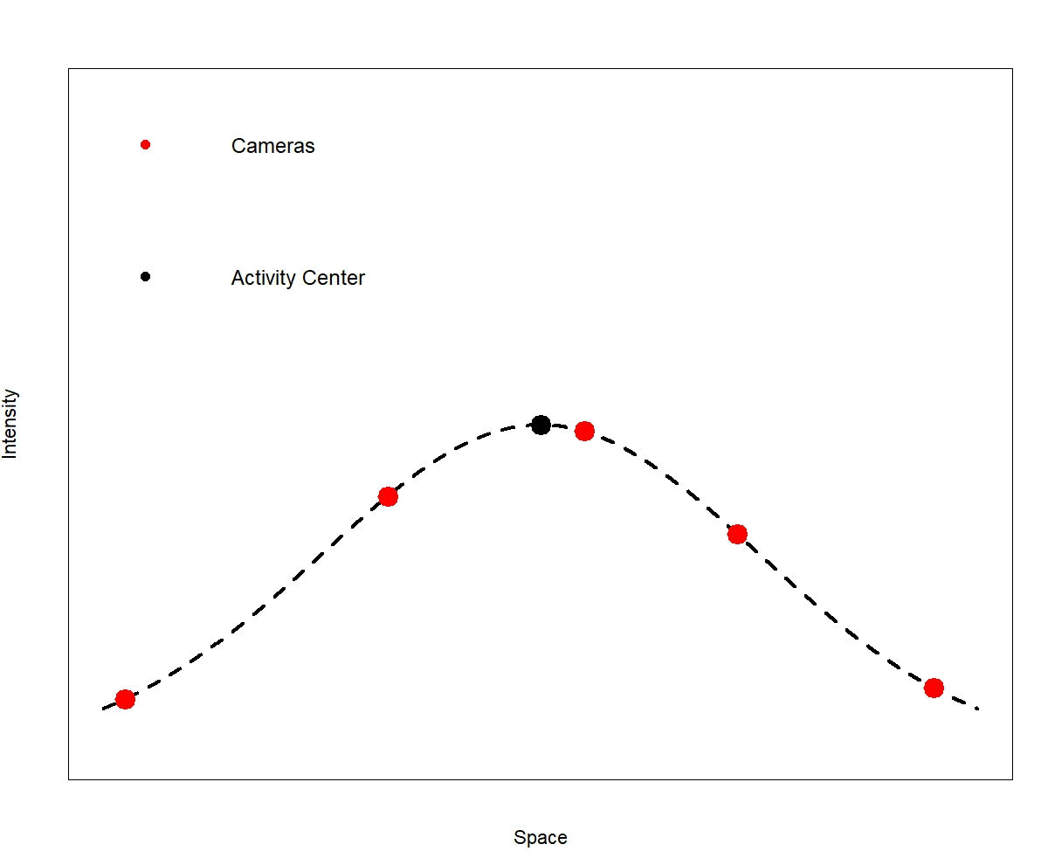
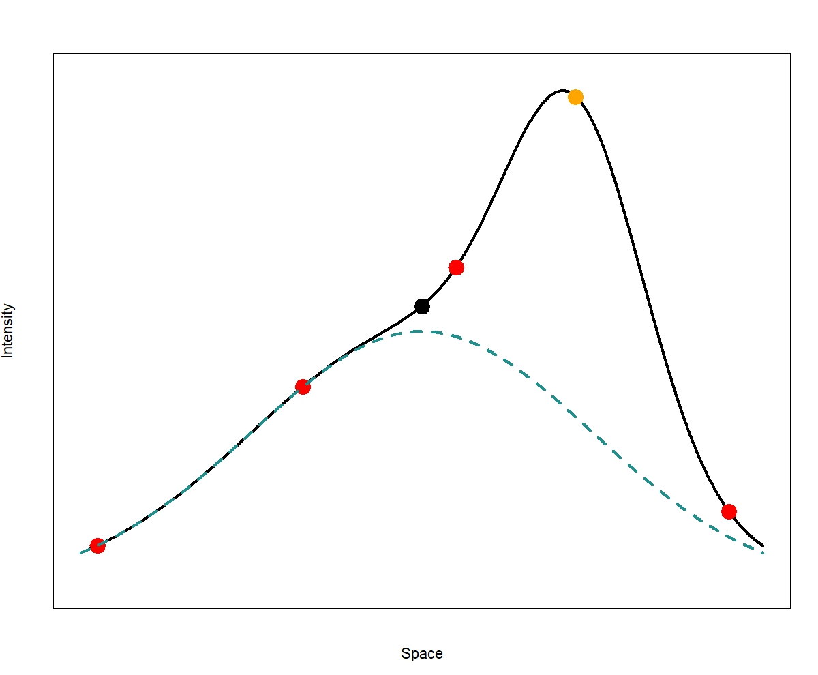
1D Example
No previous detections
After detection

Slide 15
Implication of this model
Intuitively, shortly after a detection, the animal is now less likely to be detected far away from where it was last detected.
However in this formulation, after a detection the intensity of detections will increase for all cameras, though it may be negligible at far-away cameras.

Slide 16
Implication of this model
Intuitively, shortly after a detection, the animal is now less likely to be detected far away from where it was last detected
However in this formulation, after a detection the intensity of detections will increase for all cameras, though it may be negligible at far-away cameras
The animal’s overall detectability should not change because it has been detected
This formulation is also known to result in positively biased population estimates.

Slide 17
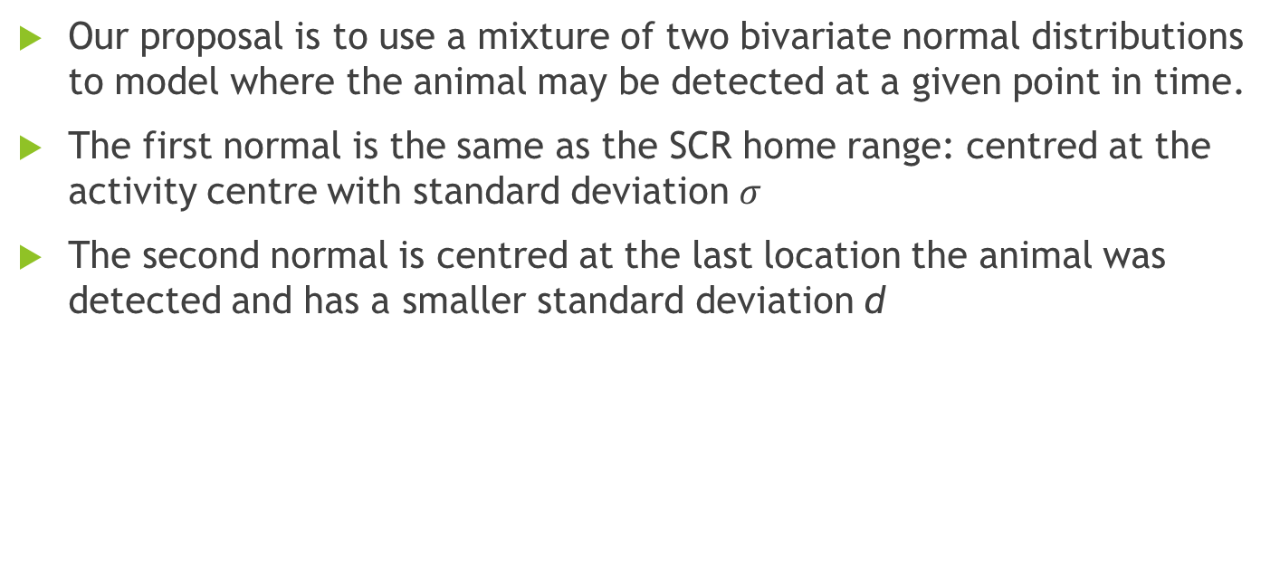
SESCR
Our proposal is to use a mixture of two bivariate normal distributions to model where the animal may be detected at a given point in time.
The first normal is the same as the SCR home range: centred at the activity centre with standard deviation $σ$
The second normal is centred at the last location the animal was detected and has a smaller standard deviation d
Notes:
SESCR: Self-Exciting Spatial Capture-Recapture

Slide 18
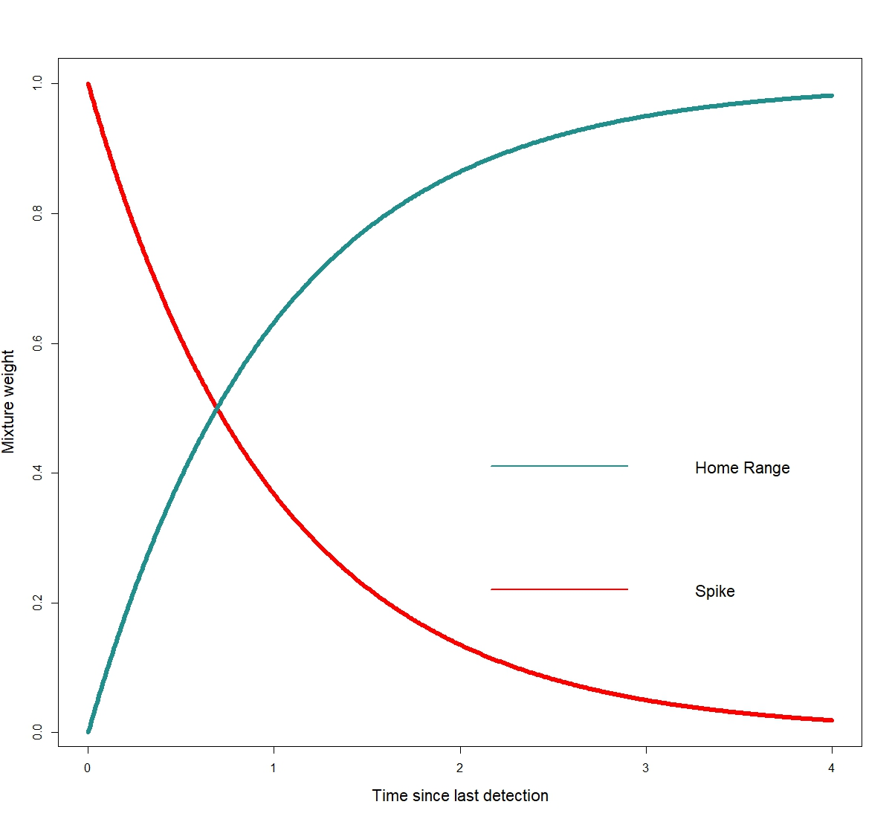
Mixture Weights
The mixture weight on the second normal distribution decays exponentially, as in a traditional Hawkes process

Slide 19
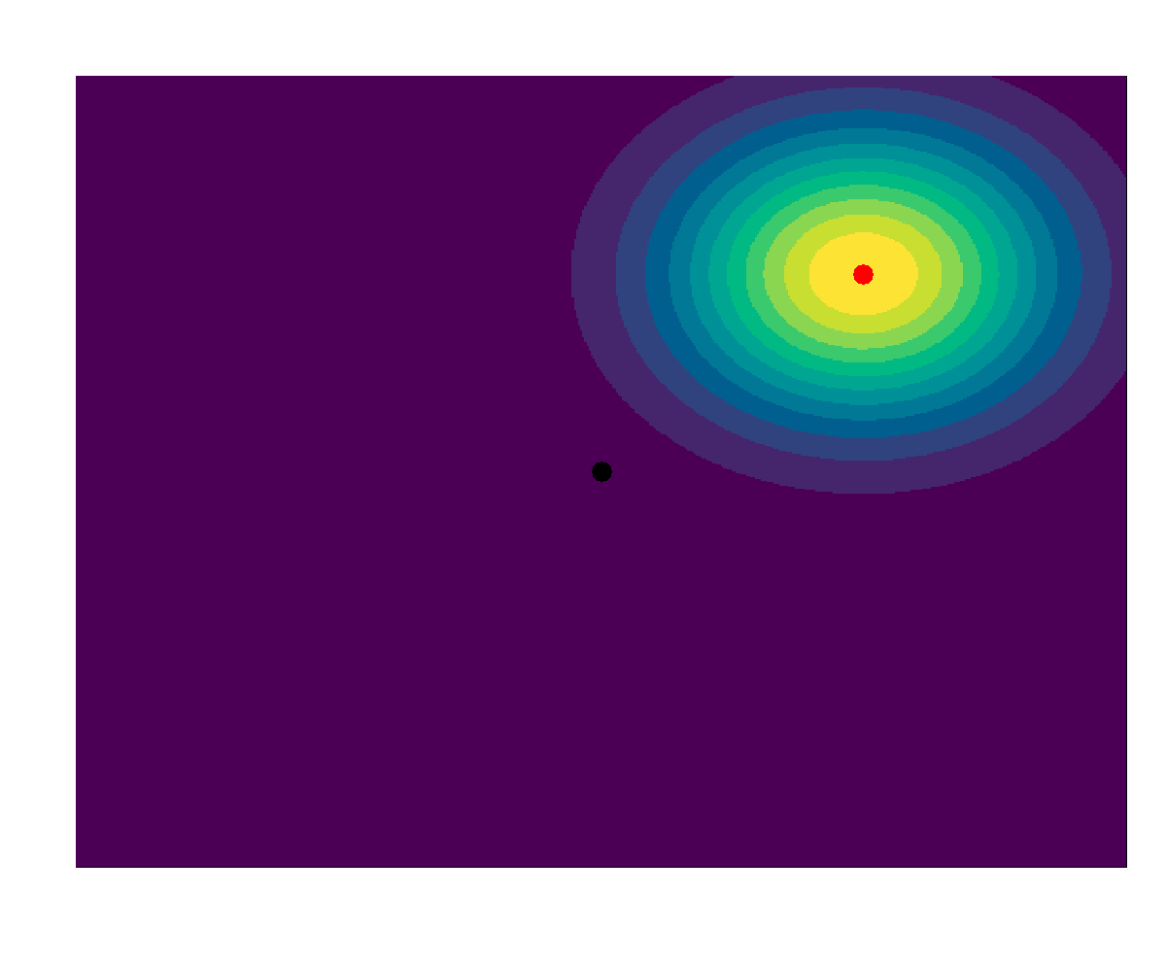
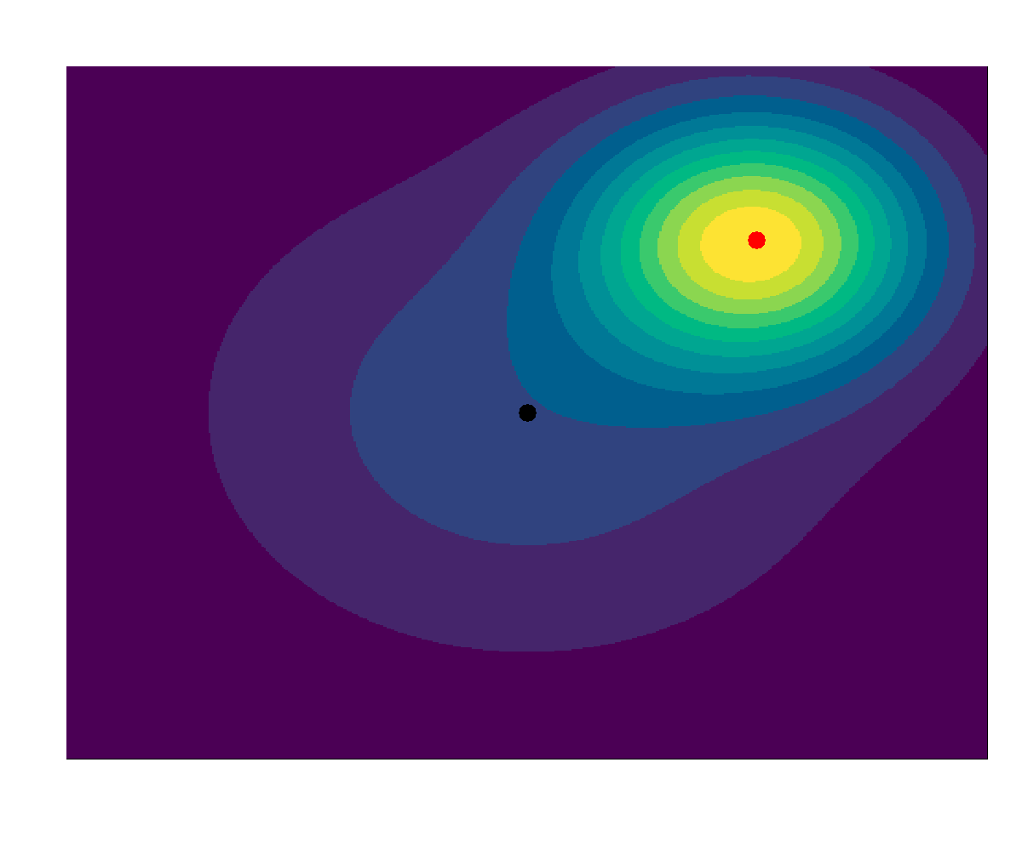
Example I
t = 0
t = 1

Slide 20
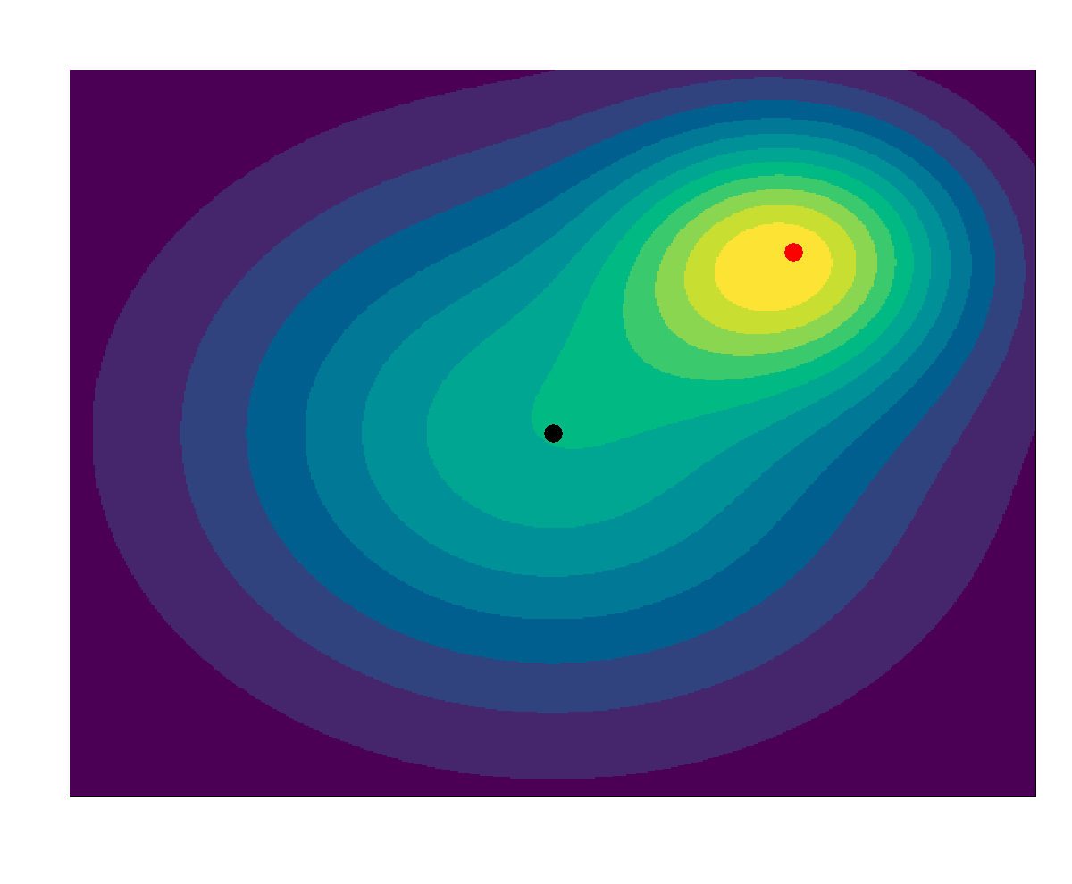
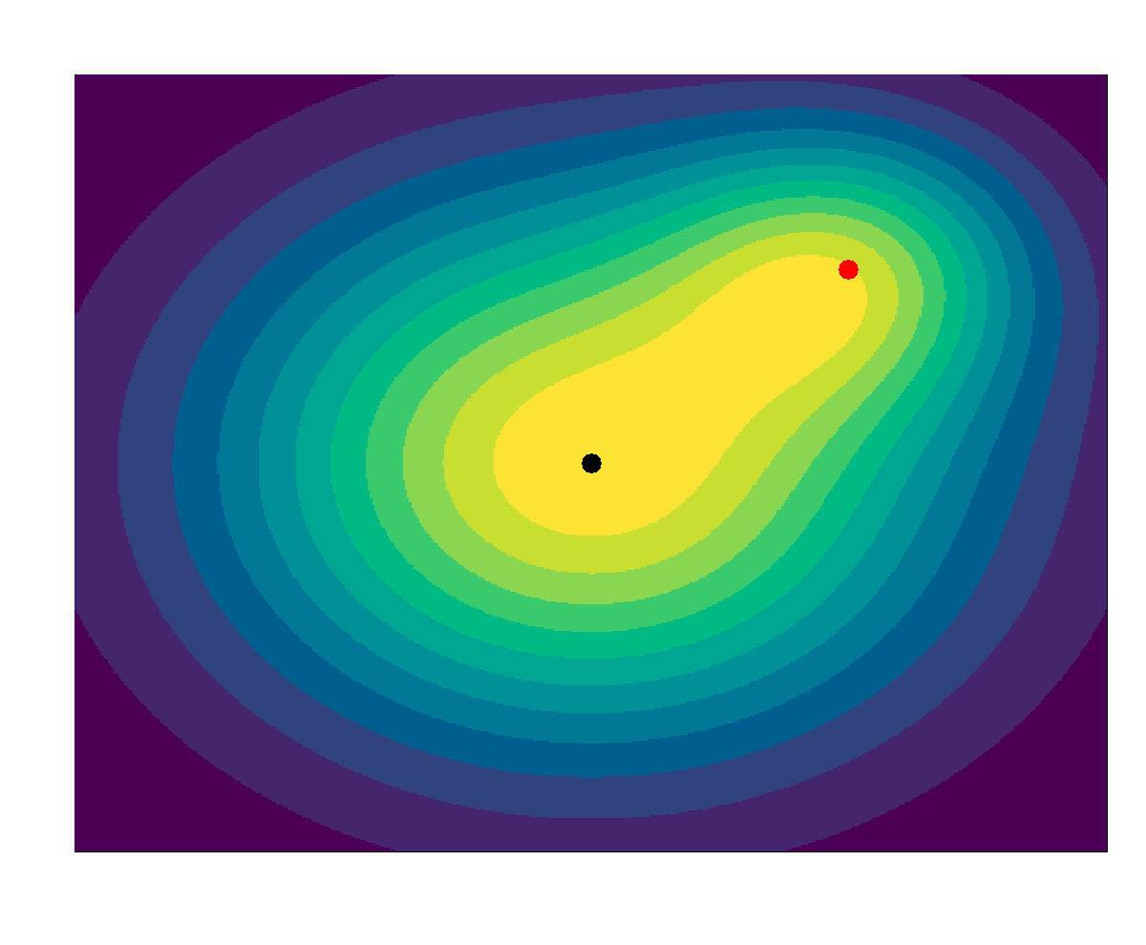
Example II
t = 2
t = 3
Notes:
Constant volume under curve

Slide 21
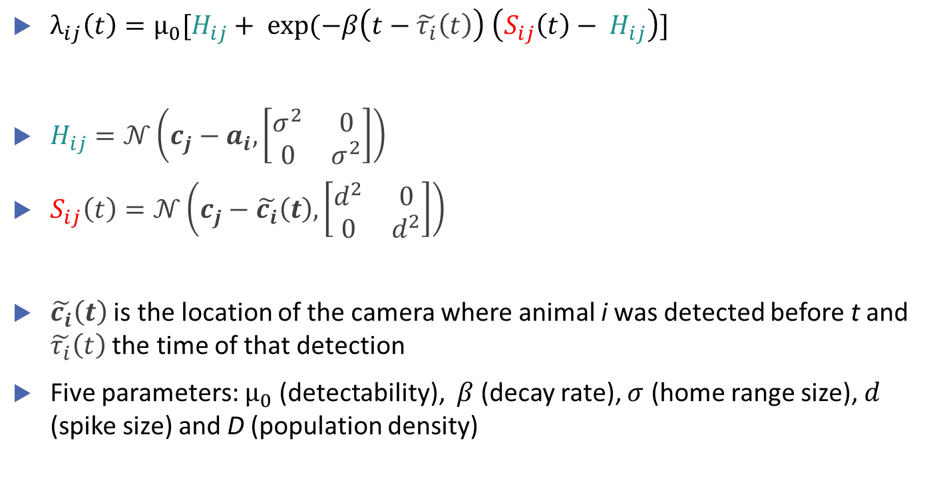
Mathematical Formulation
$λ_{ij}\left(t\right)=μ_{0}[H_{ij}+ exp⁡(−β\left(t−\tilde{τ_{i}}\left(t\right)\right) \left(S_{ij}\left(t\right)− H_{ij}\right)]$
$H_{ij}=𝒩\left(c_{j}−a_{i}, \left[\begin{matrix}σ^{2} & 0 \\ 0 & σ^{2}\end{matrix}\right]\right)$
$S_{ij}\left(t\right)=𝒩\left(c_{j}−\tilde{c_{i}}\left(t\right),\left[\begin{matrix}d^{2} & 0 \\ 0 & d^{2}\end{matrix}\right]\right)$
$\tilde{c_{i}}\left(t\right)$ is the location of the camera where animal i was detected before t and $\tilde{τ_{i}}\left(t\right)$ the time of that detection
Five parameters: $μ_{0}$ (detectability), $β$ (decay rate), $σ$ (home range size), $d$ (spike size) and D (population density)

Slide 22
Model Fitting
SCR is typically fit by MLE (marginalizing over the latent activity centres). The secr R package is popular.
Fitting SESCR by MLE (using TMB) sometimes resulted in biased estimates, so we are using a Bayesian framework and fitting with NIMBLE.

Slide 23
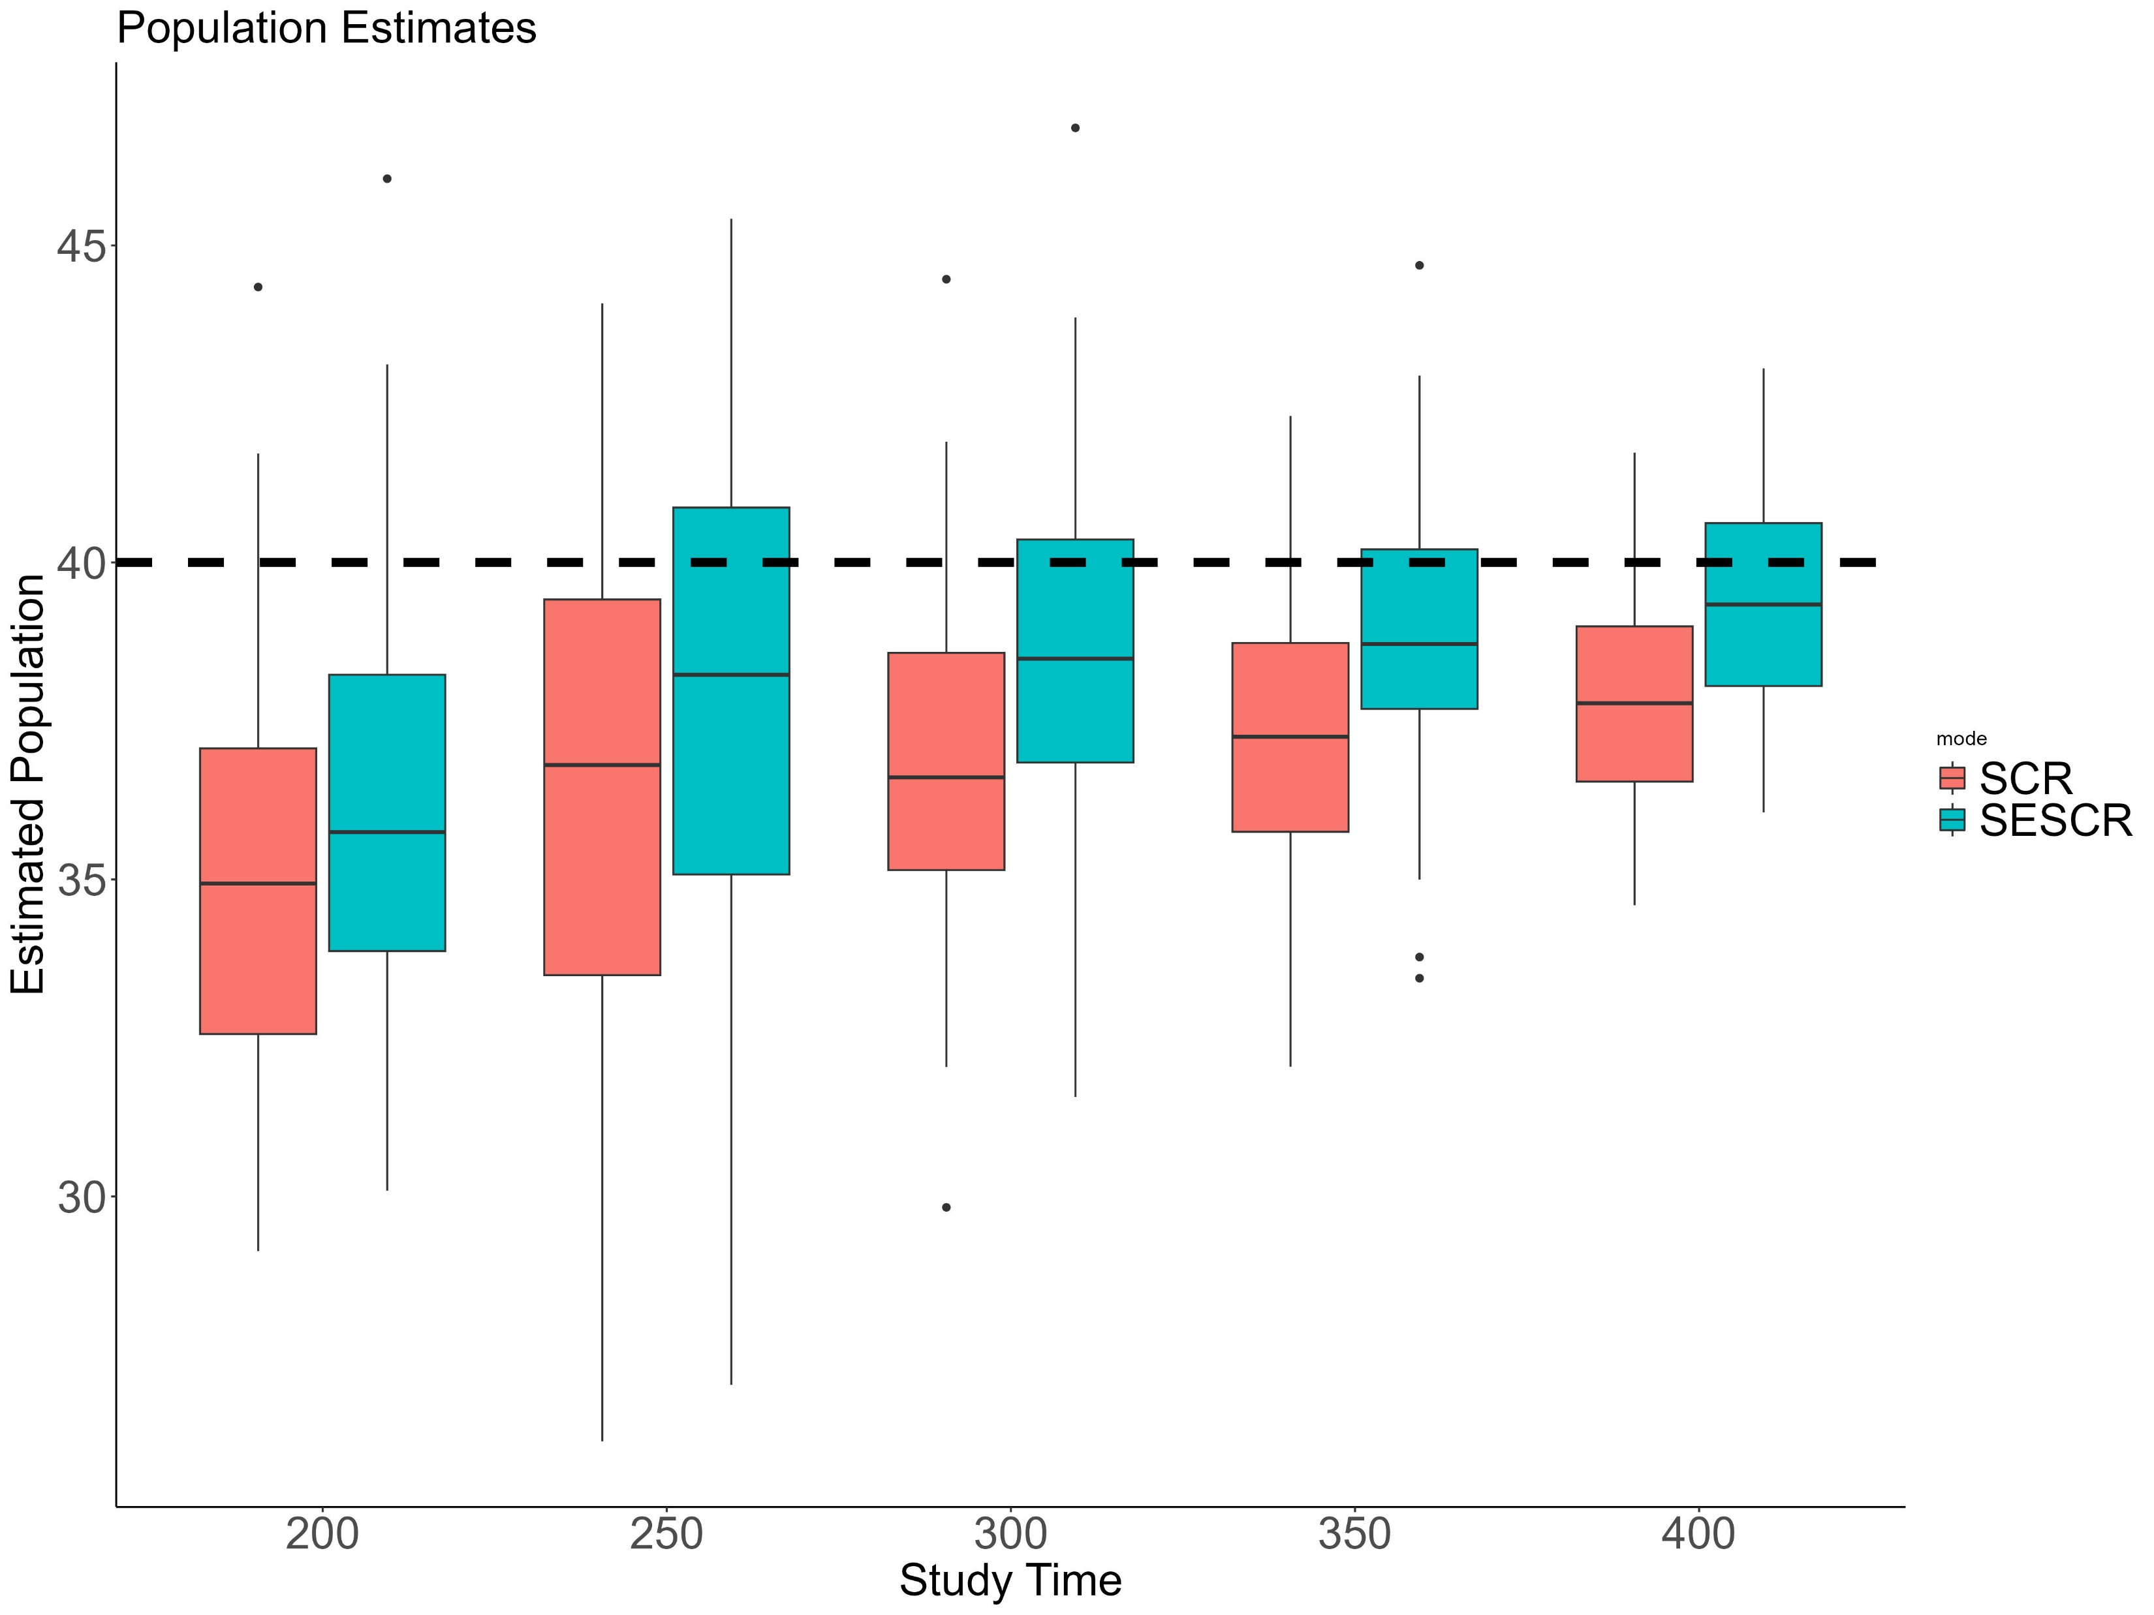
Simulation Results: Population Density
25 cameras in grid pattern
Study area is 1x1 square
Detections per simulation range from 52-213, mean 122
48 simulations for each study duration
Animals move according to an OU process

Slide 24
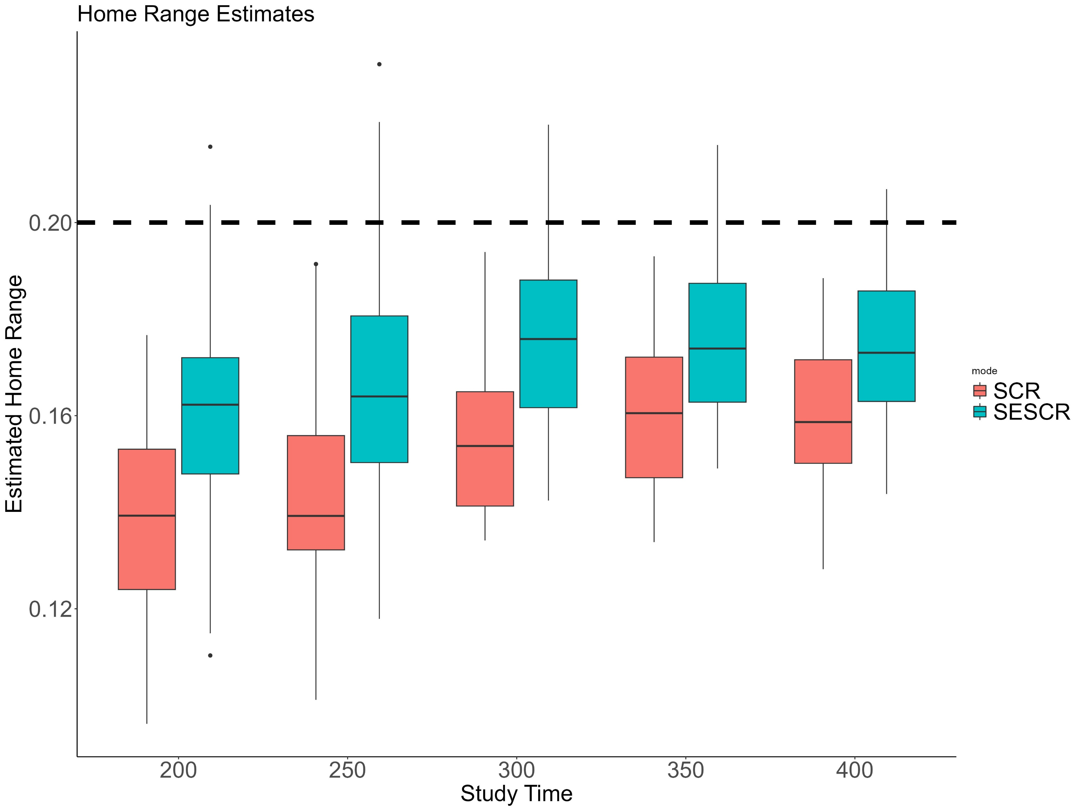
Simulation Results: Home Range Size
25 cameras in grid pattern
Study area is 1x1 square
Detections per simulation range from 52-213, mean 122
48 simulations for each study duration
Animals move according to an OU process
Notes:
OU process for animal movement. Our method less biased.

Slide 25
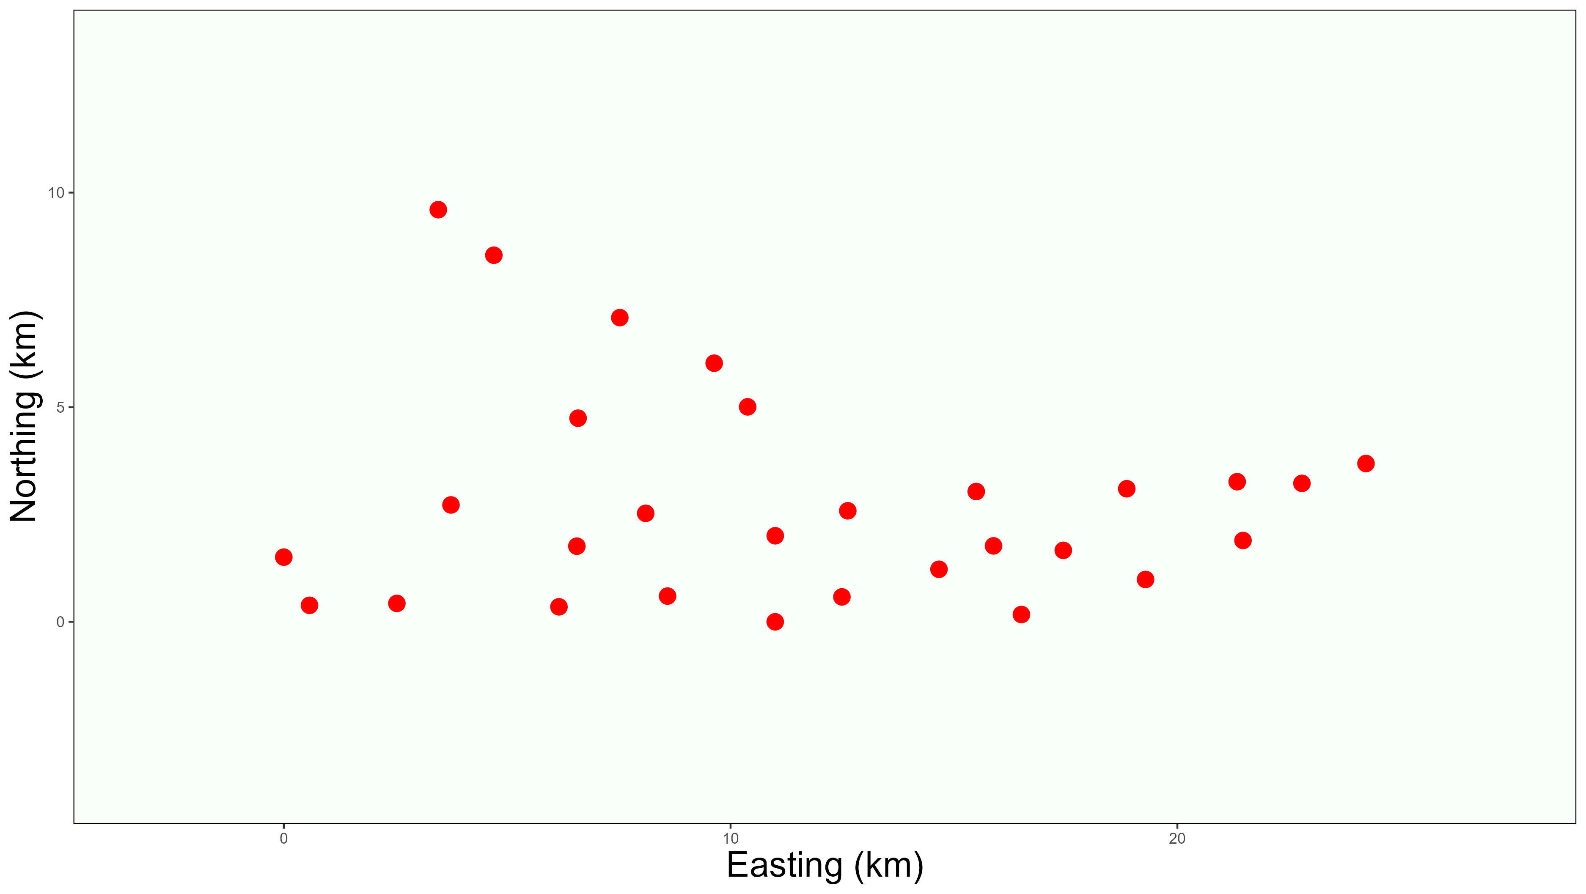
Case Study: Manas Leopards
In 2010-11, cameras were used to observe leopards in Manas, Bhutan over a 91 day period
Times of detections available to nearest day
K = 29 cameras
n = 22 observed individuals
82 observations in total
Goldberg, Joshua F. et al. (2016). Data from: Examining temporal sample scale and model choice with spatial capture-recapture models in the common leopard Panthera pardus [Dataset]. Dryad. https://doi.org/10.5061/dryad.mr1pt

Slide 26

Manas Results
Population Density (${km}^{−2}$)
Home Range Size ($km)$
Model | Mean | 95% CI
SCR | 26.291 | (16.399-42.153)
SESCR | 30.361 | (18.271-46.145)
Model | Mean | 95% CI
SCR | 113.63 | (93.715-137.77)
SESCR | 106.67 | (87.909-130.797)
Notes:
1000 units =24221.7 UTM meters

Slide 27

Manas Results
Population Density (${/100km}^{2}$)
Home Range Size ($km)$
Model | Mean | 95% CI
SCR | 4.48 | (2.80-7.18)
SESCR | 5.17 | (3.11-7.87)
Model | Mean | 95% CI
SCR | 2.75 | (2.27-3.34)
SESCR | 2.58 | (2.13-3.17)

Slide 28
Case Study: Nagarahole Tigers
In 2014-15, a similar study of tigers was performed in Nagarahole, India over a 45 day period
Times of detections available to nearest minute
K = 162 cameras
n = 86 observed individuals
355 observations in total
Dorazio RM, Karanth KU (2017) A hierarchical model for estimating the spatial distribution and abundance of animals detected by continuous-time recorders. PLOS ONE 12(5): e0176966. https://doi.org/10.1371/journal.pone.0176966

Slide 29
Nagarahole Results
Population Density (${km}^{−2}$)
Home Range Size ($km)$
Model | Mean | 95% CI
SCR | 74.950 | (60.438-92.948)
SESCR | 77.769 | (62.408-96.014)
Model | Mean | 95% CI
SCR | 62.067 | (57.926-66.505)
SESCR | 62.360 | (58.025-67.190)
Notes:
1000 units =27879 utm

Slide 30
Nagarahole Results
Population Density (${/100km}^{2}$)
Home Range Size ($km)$
Model | Mean | 95% CI
SCR | 9.64 | (7.78-12.0)
SESCR | 10.0 | (8.03-12.4)
Model | Mean | 95% CI
SCR | 2.23 | (2.08-2.39)
SESCR | 2.24 | (2.08-2.41)
Notes:
1000 units =27879 utm

Slide 31
Conclusion
SCR, while a useful method that has become widely accepted, makes physically implausible assumptions about animal movement that results in bias.
Our proposed method SESCR improves on SCR by making more realistic assumptions about animal movement and taking advantage of continuous-time data.
SESCR estimates of population and home range size were less biased than SCR in simulation studies.

