Slide 1


10-year
Traumatic Brain Injury trajectories from the BIONIC Study
Priya Parmar*
Alice Theadom
Patria Hume

Slide 2
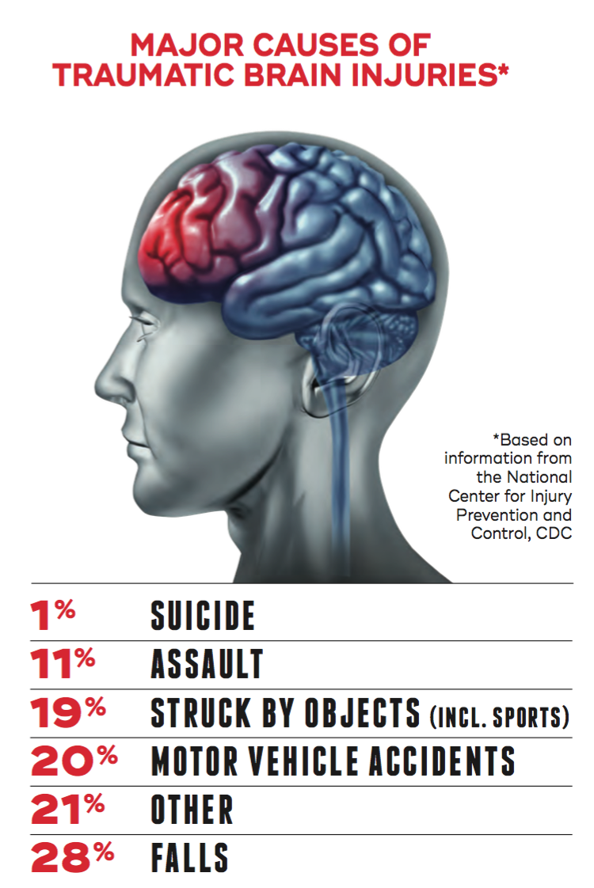
What is a TBI?
https://qbi.uq.edu.au/concussion/what-traumatic-brain-injury

Slide 3
What is a TBI?
Can be caused by a forceful bump, blow, or jolt to the head or body, or from an object that pierces the skull and enters the brain.
https://qbi.uq.edu.au/concussion/what-traumatic-brain-injury

Slide 4

The research study
In 2009, HRC funded a study (BIONIC) to find out the frequency of TBI in a nationally representative population and to follow-up all patients over six months to explore the effects of TBI.
The original funding application was based on published estimates of the size of the problem. Halfway through recruitment, the actual number of cases of TBI in the BIONIC study was 34% higher than anticipated, clearly highlighting the importance of this study.
This application aims to ensure that the additional cases are identified and assessed, to capture accurate incidence rates per annum and to complete a further follow-up assessment at 12-months for all BIONIC participants.
Data was recorded at baseline (time of TBI event), 1, 6, and 12-months post TBI event.

Slide 5

TBI Burden
(cases per 100,000)
Total incidence = 790
Mild cases = 749
Moderate/severe = 41

Slide 6
Variables collected
Variables recorded included number of TBIs, severity of TBI, cause of event, demographic characteristics, additional injuries and comorbidities with key outcomes relating to cognition and mood (PCS and HADS scales)
The year following a brain injury has been revealed as the critical recovery period, therefore it is important to follow patients up to 12 months post injury to obtain a realistic picture of outcomes and burden of TBI.
Additional funding was sourced to follow-up this cohort at 4, 8 and 10-years post TBI.

Slide 7
The outcomes of interest
The most consistently recorded data at baseline, 1, 6, and 12-months, 4, 8 and 10-years post TBI event was HADS Depression and Anxiety Total Scores
N = 1,298 TBI patients recruited at baseline

Slide 8
The outcomes of interest
The most consistently recorded data at baseline, 1, 6, and 12-months, 4, 8 and 10-years post TBI event was HADS Depression and Anxiety Total Scores
N = 1,298 TBI patients recruited at baseline
Visit number (months) | Sample size (HADS)
0 (baseline) | 212
1 | 269
6 | 261
12 | 317
48 | 221
96 | 186
120 | 168

Slide 9

What the clinicians want

Slide 10

“I’ll have an order of
descriptive statistics, pretty visualisations, anything complex on the side – oh, and statistical significance, an extra helping
of significance”
statistics

Slide 11


Slide 12

Stage 1
Appeasing the clinical crowd

Slide 13
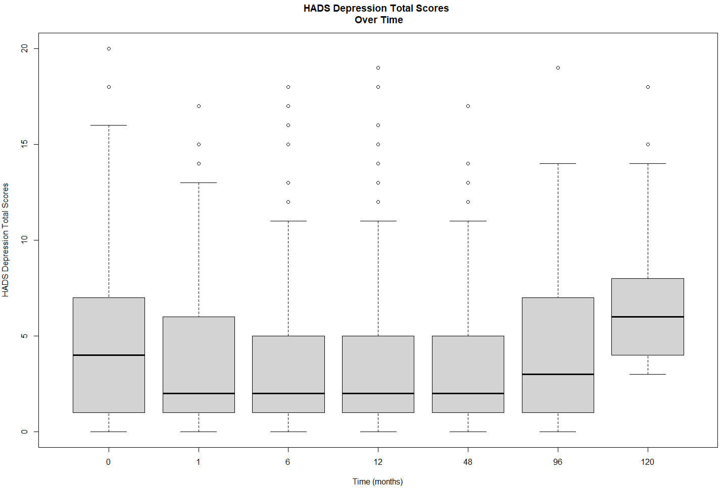

Slide 14
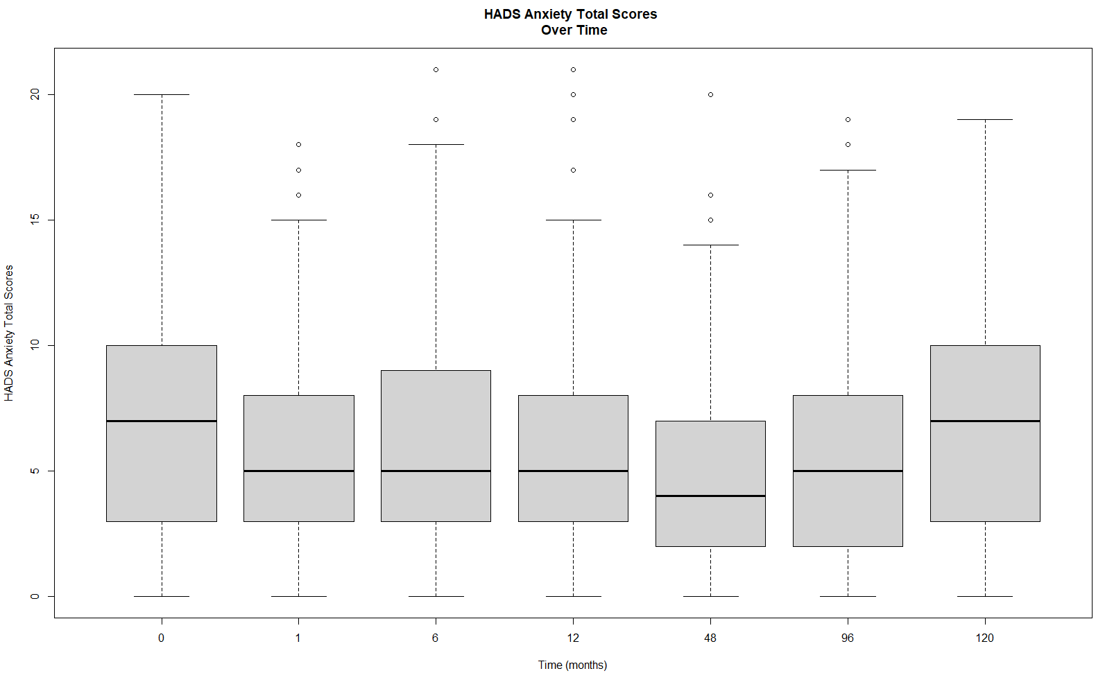

Slide 15

Stage 2
Annoying the clinicians

Slide 16
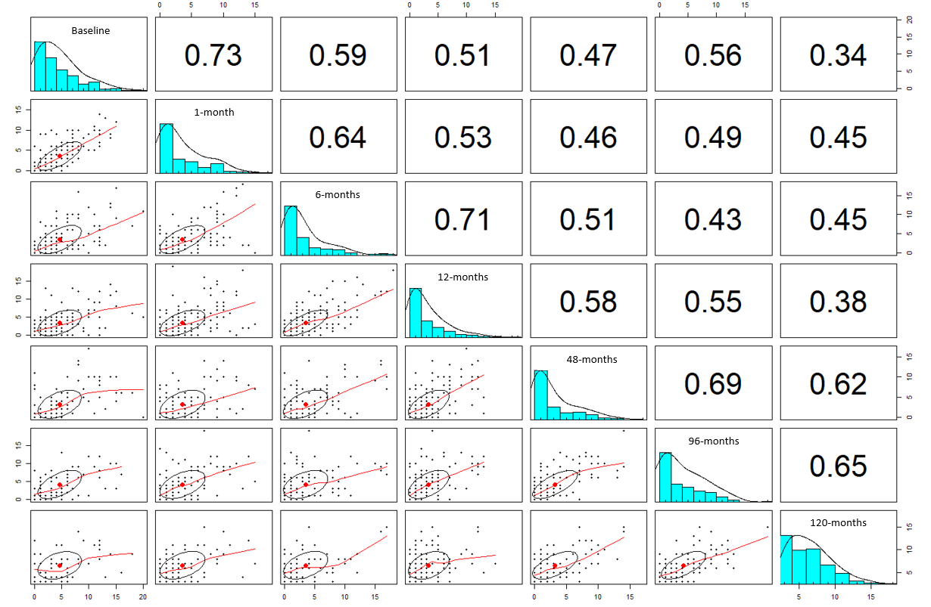
DEPRESSION

Slide 17
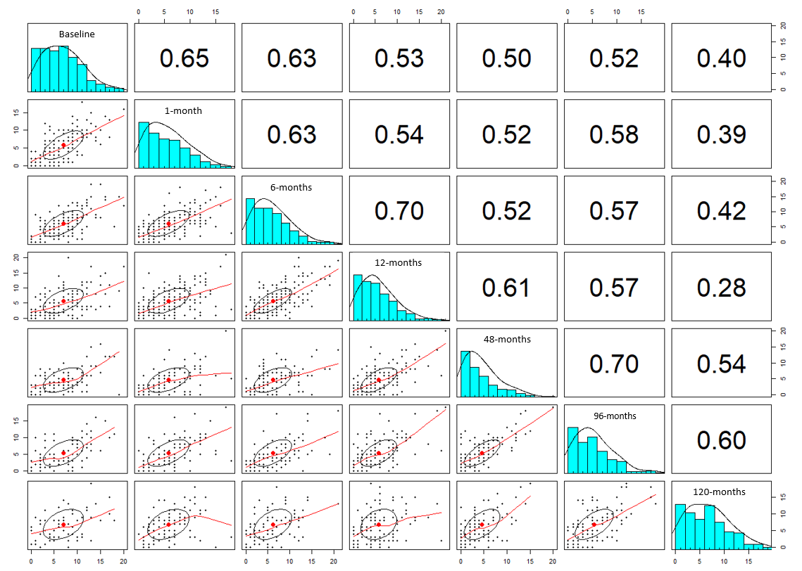
ANXIETY

Slide 18
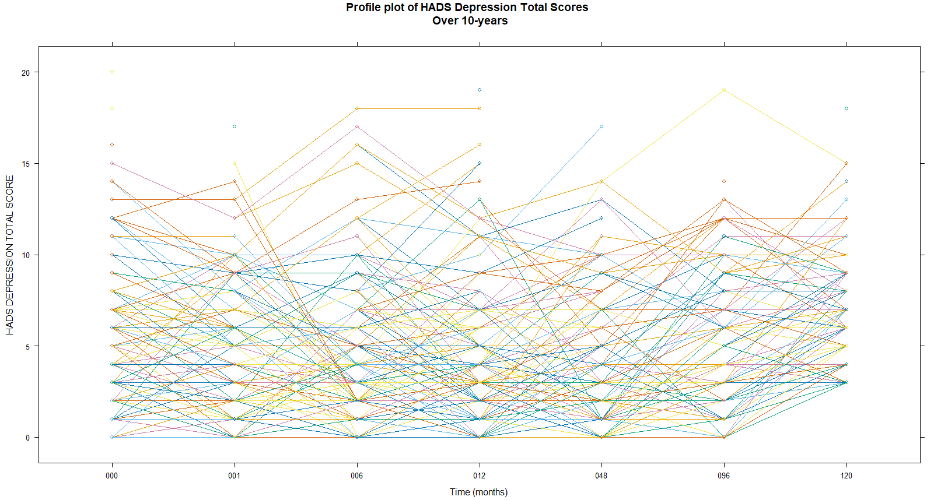

Slide 19
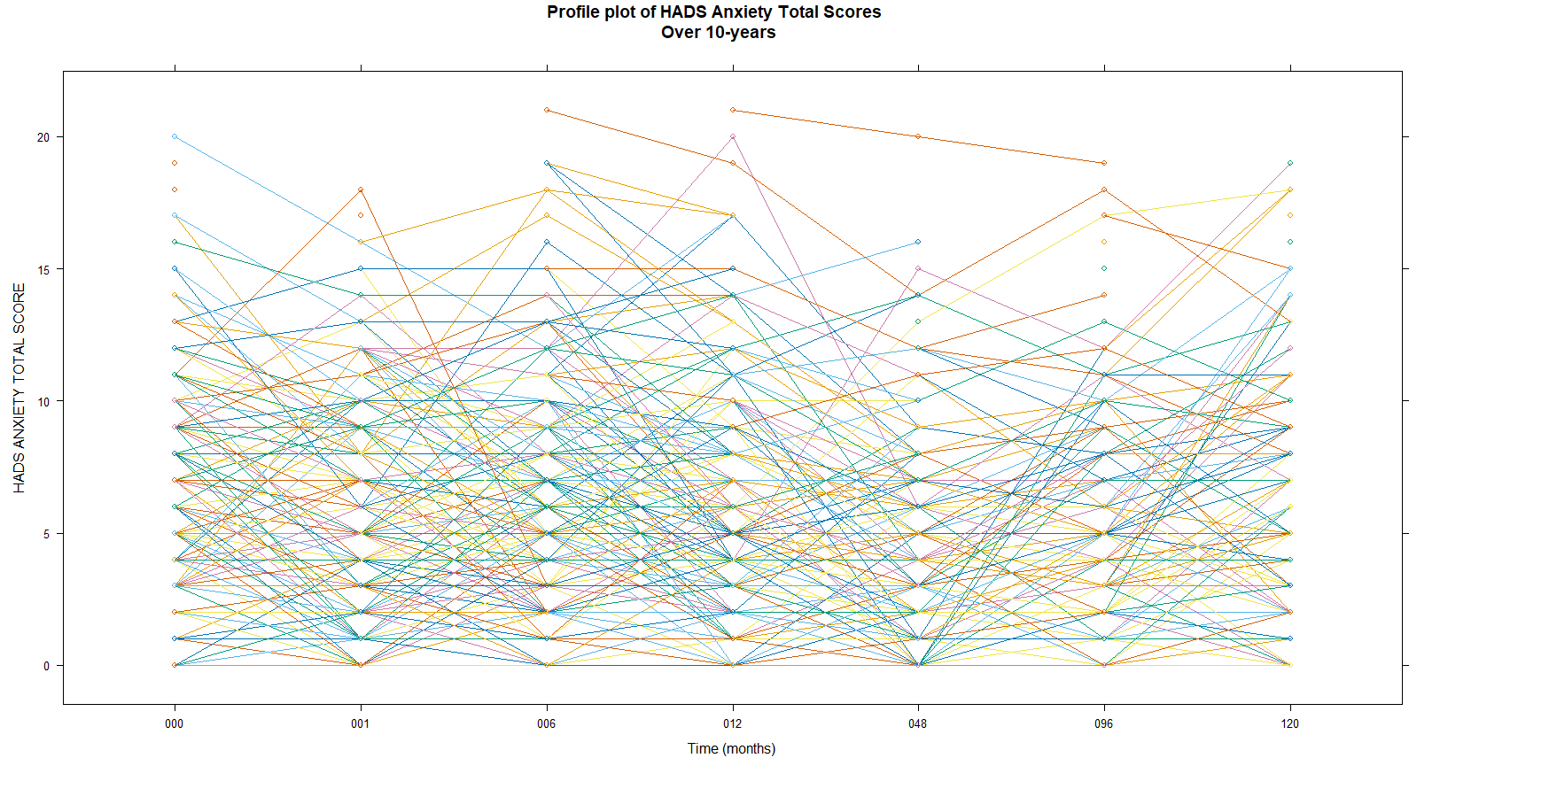

Slide 20
Stage 2.5
Appeasing the clinical crowd (again)

Slide 21
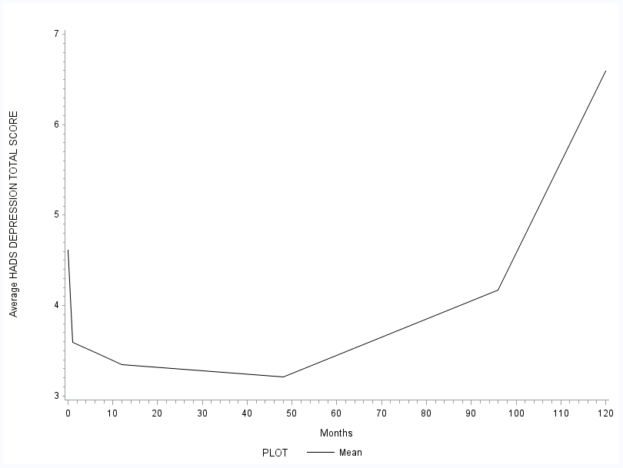
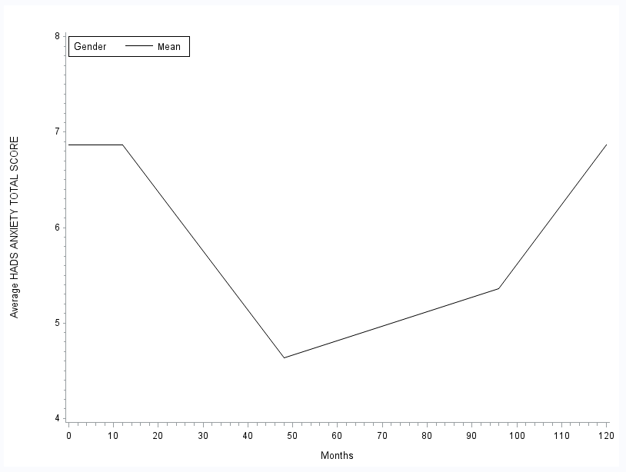
comparing Depression and Anxiety trajectories Over Time
Depression
Anxiety

Slide 22
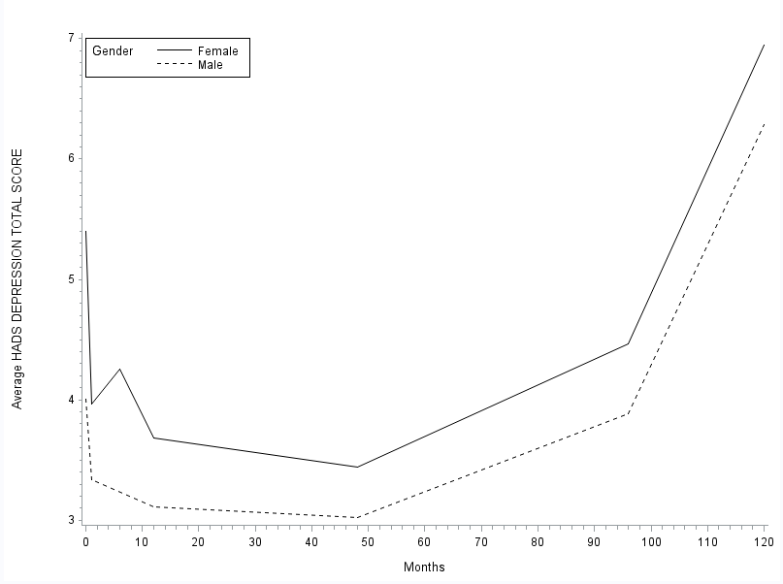
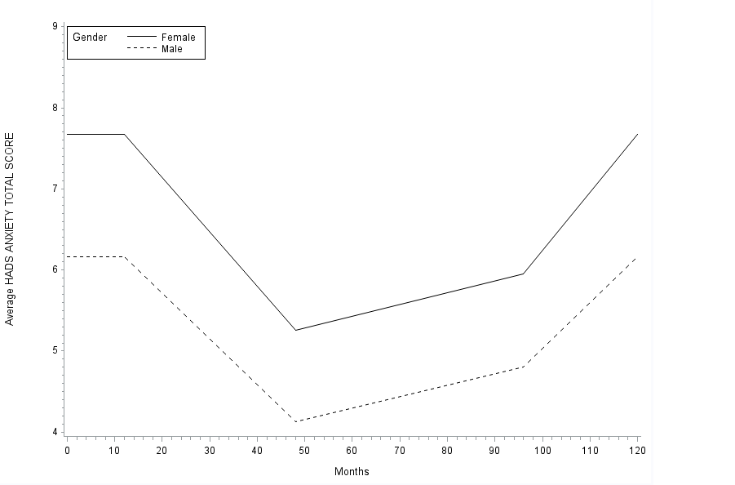
comparing Depression and Anxiety trajectories Over Time
By Gender
Depression
Anxiety

Slide 23
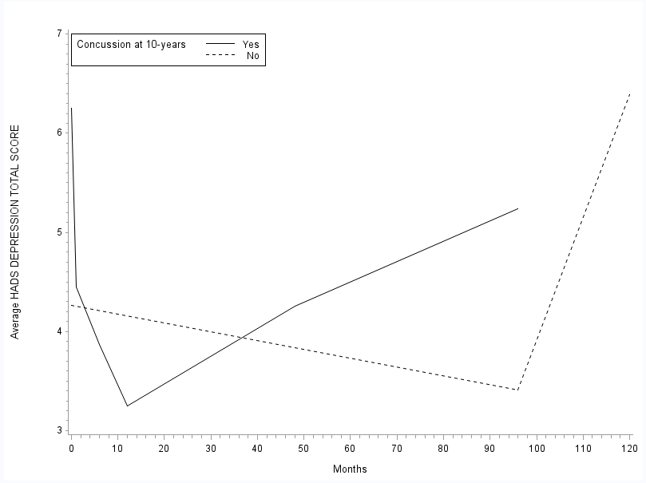
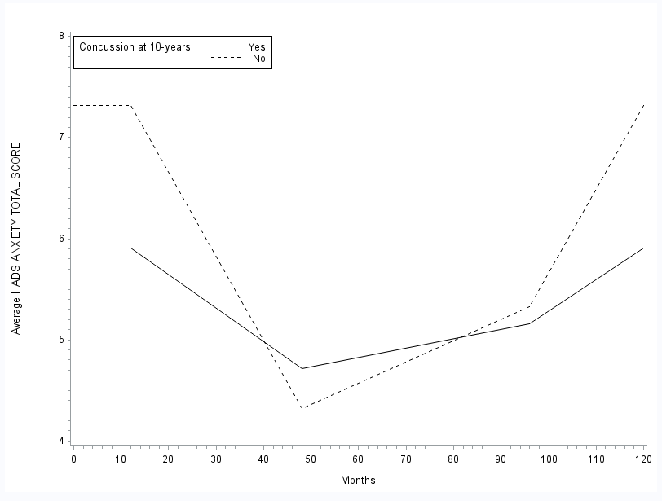
comparing Depression and Anxiety trajectories Over Time
Dependent on 10-year Concussions
Depression
Anxiety

Slide 24
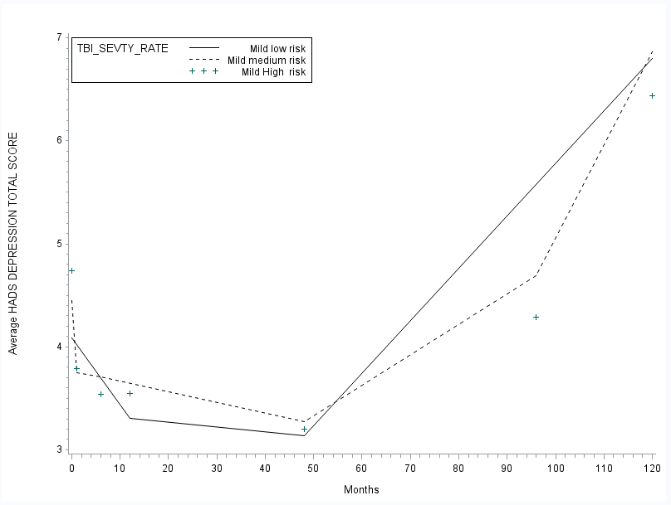
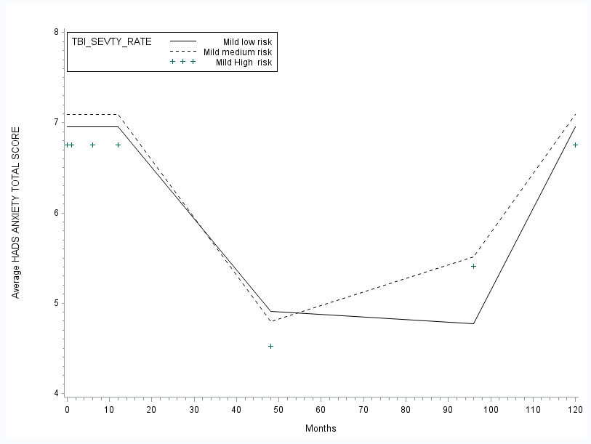
comparing Depression and Anxiety trajectories Over Time
Dependent on TBI Severity Rates
Depression
Anxiety

Slide 25


“regression model with anything complex on the side - thanks”
$$\log\left({HADS Total Score}_{i}\right)= β_{0}+{Xβ}_{i}$$
Started with a simple fixed effects Poisson GLM, using a stepwise selection model to identify significant predictors of depression, noting that months (baseline (0), 1, 6, 12, 48, 96, and 120) was “our” key covariate

Slide 26
Possible Predictors of Depression
AGE
ETHNICITY
SEX
NUMBER OF
TBI EVENTS
TBI SEVERITY
RATE
MECHANISTIC CAUSE OF TBI
RECURRENT TBI EVENT
(WITHIN 4 YEARS)
PAST TBI EVENT (WITHIN 4 YEARS)
MARITAL STATUS (OVER 4 YEARS)
MEDICAL CONSULTATION WITHIN 24 HOURS OF FIRST TBI
TBI MEDICAL RECORD
ADDITIONAL INJURIES
EDUCATION STATUS (OVER 4 YEARS)
EMPLOYMENT STATUS (OVER 4 YEARS)
OTHER FORMS OF EMPLOYMENT (OVER 4 YEARS)
COMORBID CONDITIONS (OVER 4 YEARS)
MENTAL HEALTH DIFFERENCES (OVER 4 YEARS)
LEARNING DISABILITIES (OVER 4 YEARS)
CONCUSSION WITHIN 10-YEARS (and if yes, NUMBER OF CONCUSSIONS)
TIME (MONTHS SINCE FIRST TBI)

Slide 27

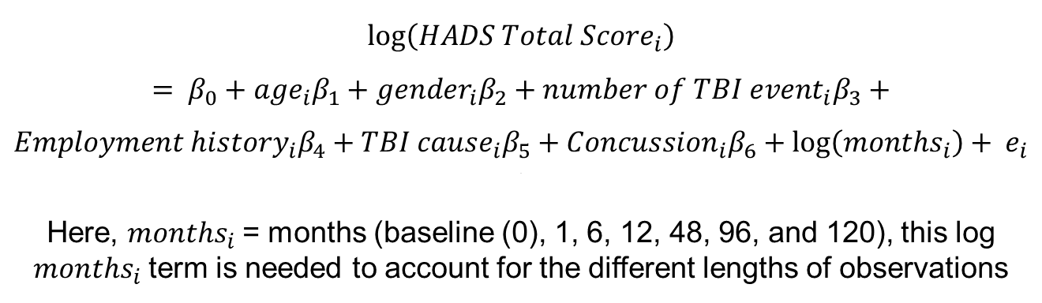
Discussing alternative approaches
$$\log\left({HADS Total Score}_{i}\right)= β_{0}+{age}_{i}β_{1}+{gender}_{i}β_{2}+{number of TBI event}_{i}β_{3}+$$
$${Employment history}_{i}β_{4}+{TBI cause}_{i}β_{5}+{Concussion}_{i}β_{6}+\log\left({months}_{i}\right)+ e_{i}$$
\\
Here, ${months}_{i}$= months (baseline (0), 1, 6, 12, 48, 96, and 120), this log ${months}_{i}$term is needed to account for the different lengths of observations
Built this up to a generalised linear mixed model, accounting for per-patient random effects and an autoregressive covariance matrix accounting for an individual's repeated measures over time

Slide 28

Stage 3
Upsetting the clinical crowd

Slide 29

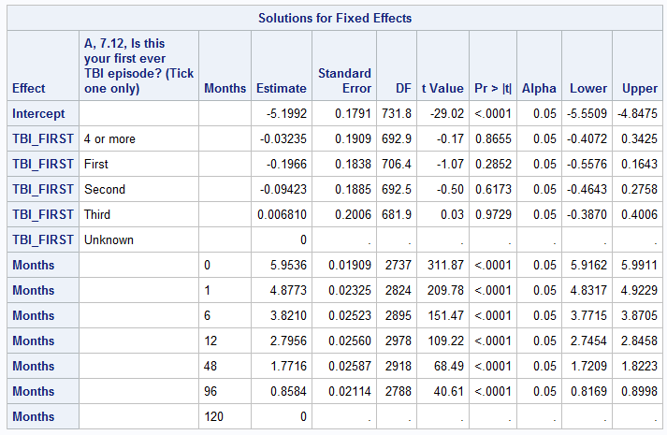
Using SAS
PROC GLIMMIX PCONV=1E-4 PLOTS=ALL DATA=temp;
class REG_NUM TBI_FIRST Months;
model HADS_DEP = TBI_FIRST Months/DIST=POISSON OFFSET=Time SOLUTION DDFM=KR CL oddsratio;
RANDOM _residual_ / SUBJECT=REG_NUM TYPE=AR(1) VCORR;
OUTPUT out=res pred=pred student=resid;
RUN;

Slide 30
Predictors of Depression
AGE
ETHNICITY
SEX
NUMBER OF
TBI EVENTS
TBI SEVERITY
RATE
MECHANISTIC CAUSE OF TBI
RECURRENT TBI EVENT
(WITHIN 4 YEARS)
PAST TBI EVENT (WITHIN 4 YEARS)
MARITAL STATUS (OVER 4 YEARS)
MEDICAL CONSULTATION WITHIN 24 HOURS OF FIRST TBI
TBI MEDICAL RECORD
ADDITIONAL INJURIES
EDUCATION STATUS (OVER 4 YEARS)
EMPLOYMENT STATUS (OVER 4 YEARS)
OTHER FORMS OF EMPLOYMENT (OVER 4 YEARS)
COMORBID CONDITIONS (OVER 4 YEARS)
MENTAL HEALTH DIFFERENCES (OVER 4 YEARS)
LEARNING DISABILITIES (OVER 4 YEARS)
CONCUSSION WITHIN 10-YEARS (and if yes, NUMBER OF CONCUSSIONS)
TIME (MONTHS SINCE FIRST TBI)

Slide 31
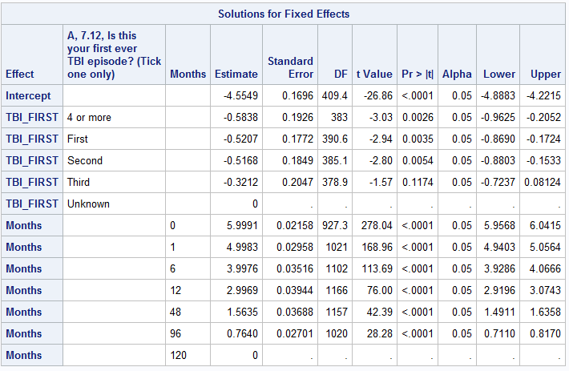
Predictors of Anxiety
PROC GLIMMIX PCONV=1E-4 PLOTS=ALL DATA=temp;
class REG_NUM TBI_FIRST Months;
model HADS_ANX = TBI_FIRST Months/ DIST=POISSON OFFSET=Time SOLUTION DDFM=KR CL oddsratio;
RANDOM _residual_ / SUBJECT=REG_NUM TYPE=AR(1) VCORR;
OUTPUT out=res pred=pred student=resid;
RUN;

Slide 32
Predictors of Anxiety
AGE
ETHNICITY
SEX
NUMBER OF
TBI EVENTS
TBI SEVERITY
RATE
MECHANISTIC CAUSE OF TBI
RECURRENT TBI EVENT
(WITHIN 4 YEARS)
PAST TBI EVENT (WITHIN 4 YEARS)
MARITAL STATUS (OVER 4 YEARS)
MEDICAL CONSULTATION WITHIN 24 HOURS OF FIRST TBI
TBI MEDICAL RECORD
ADDITIONAL INJURIES
EDUCATION STATUS (OVER 4 YEARS)
EMPLOYMENT STATUS (OVER 4 YEARS)
OTHER FORMS OF EMPLOYMENT (OVER 4 YEARS)
COMORBID CONDITIONS (OVER 4 YEARS)
MENTAL HEALTH DIFFERENCES (OVER 4 YEARS)
LEARNING DISABILITIES (OVER 4 YEARS)
CONCUSSION WITHIN 10-YEARS (and if yes, NUMBER OF CONCUSSIONS)
TIME (MONTHS SINCE FIRST TBI)

Slide 33

Stage 4
Providing the clinical solution

Slide 34
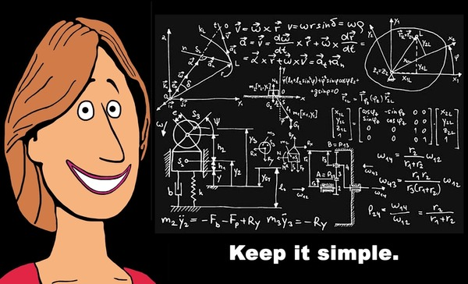
What clinicians think statisticians do

Slide 35
Overall Summary
The number of TBI events (within 1-year of incident TBI) and time since the event (particularly 10-years) post event were statistically significantly associated with higher levels of depression and anxiety.
Interesting findings → NO significant effects of ethnicity, age, gender, education, employment or TBI severity on depression and anxiety scores

Slide 36
Any Questions?

