Slide 1
Multivariate spatial models in ecology using basis functions
David Warton, Elliot Dovers, Jakub Stoklosa (UNSW Sydney)

Slide 2
Multivariate spatial models in ecology using basis functions
Multivariate spatial model for biodiversity
Fit a log-Gaussian Cox process using mgcv
Multivariate point process models for co-occurrence
Basis functions
Factor analytic models

Slide 3
Multivariate spatial models in ecology using basis functions
Multivariate spatial model for biodiversity
Fit a log-Gaussian Cox process using mgcv
Multivariate point process models for co-occurrence
Basis functions
Factor analytic models

Slide 4
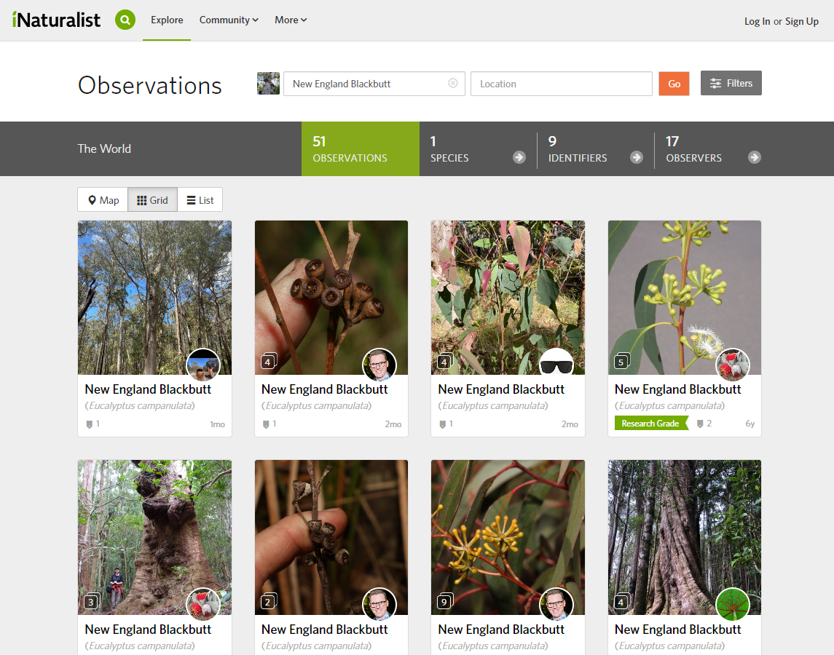
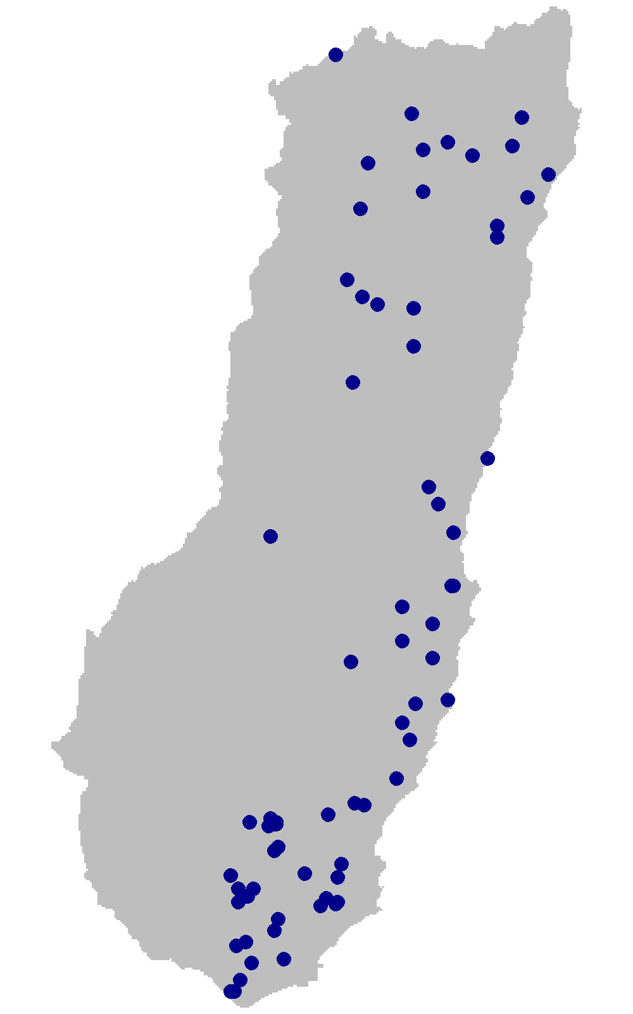
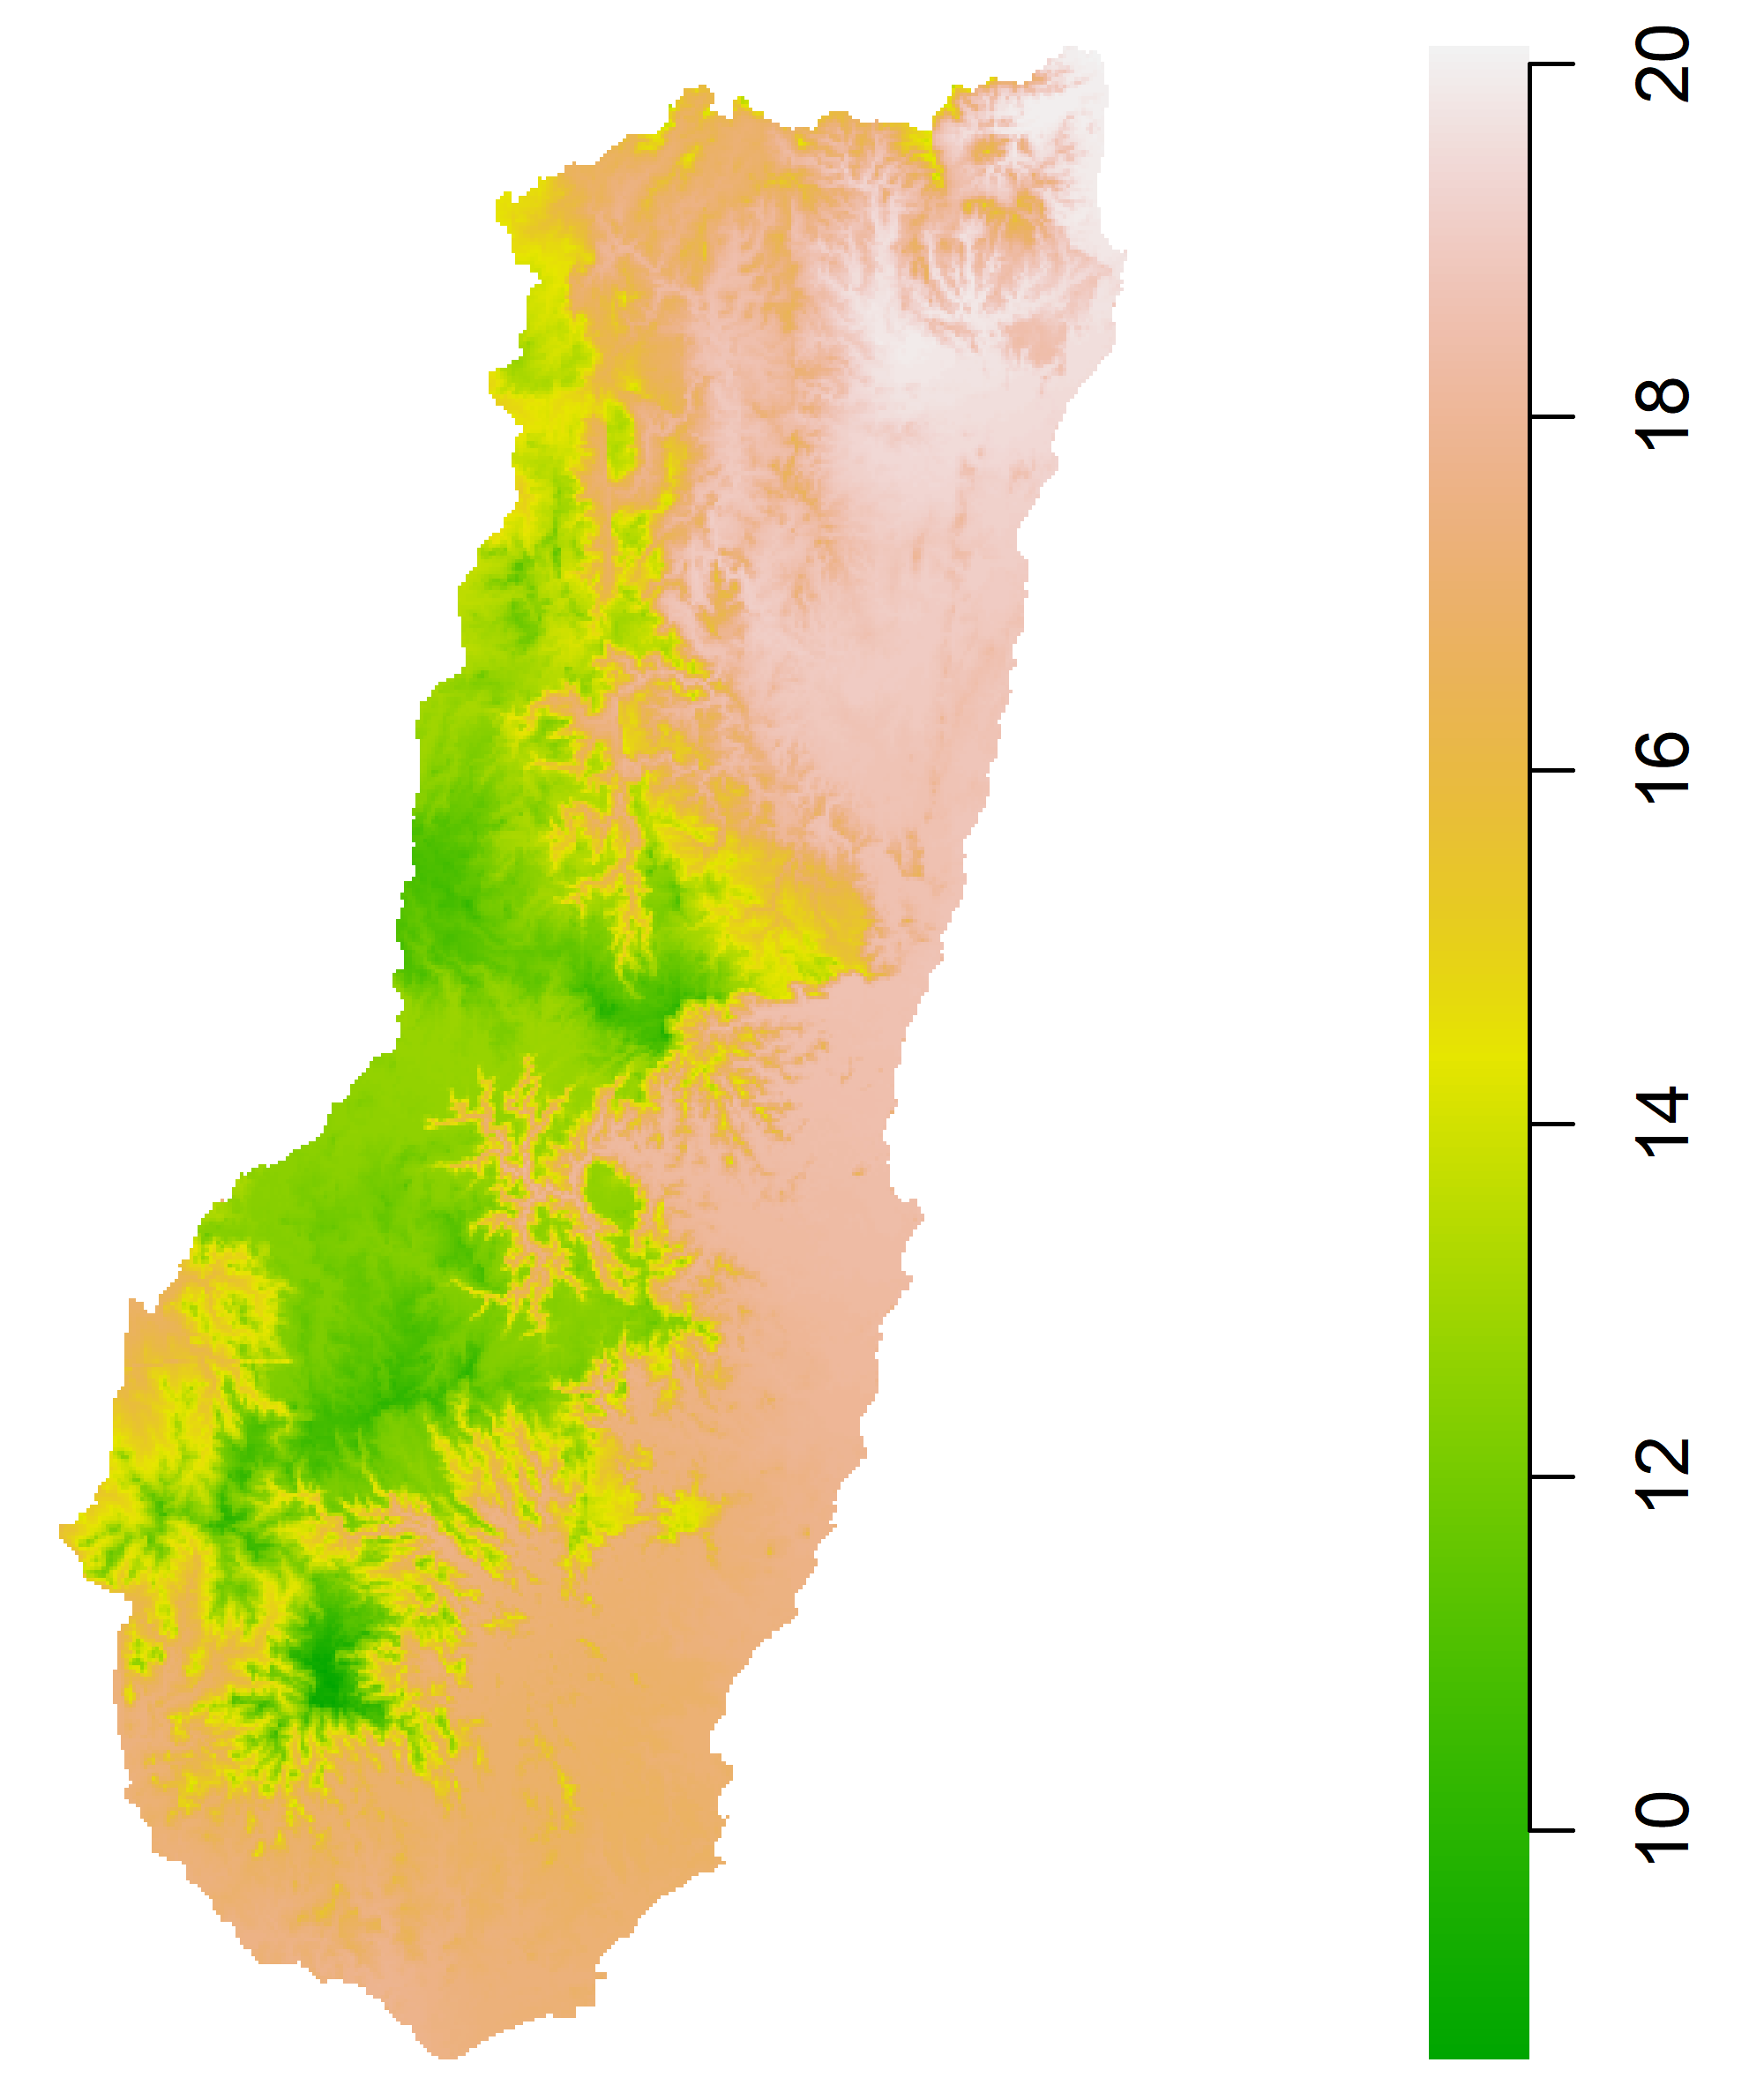
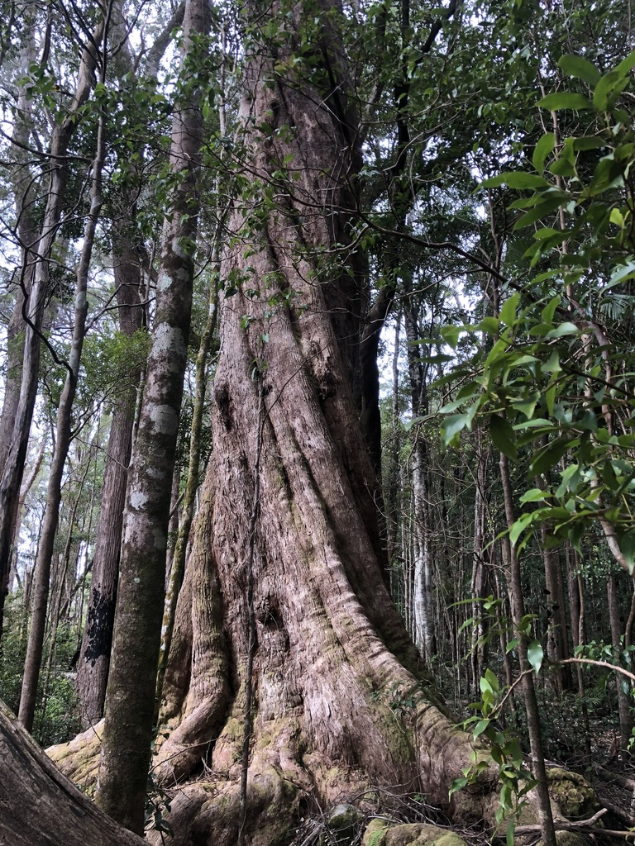
Climate Change Effects on Species Distribution
How might Eucalyptus campanulata respond to a changing climate?
~
Photo: Samuel Frankel

Slide 5
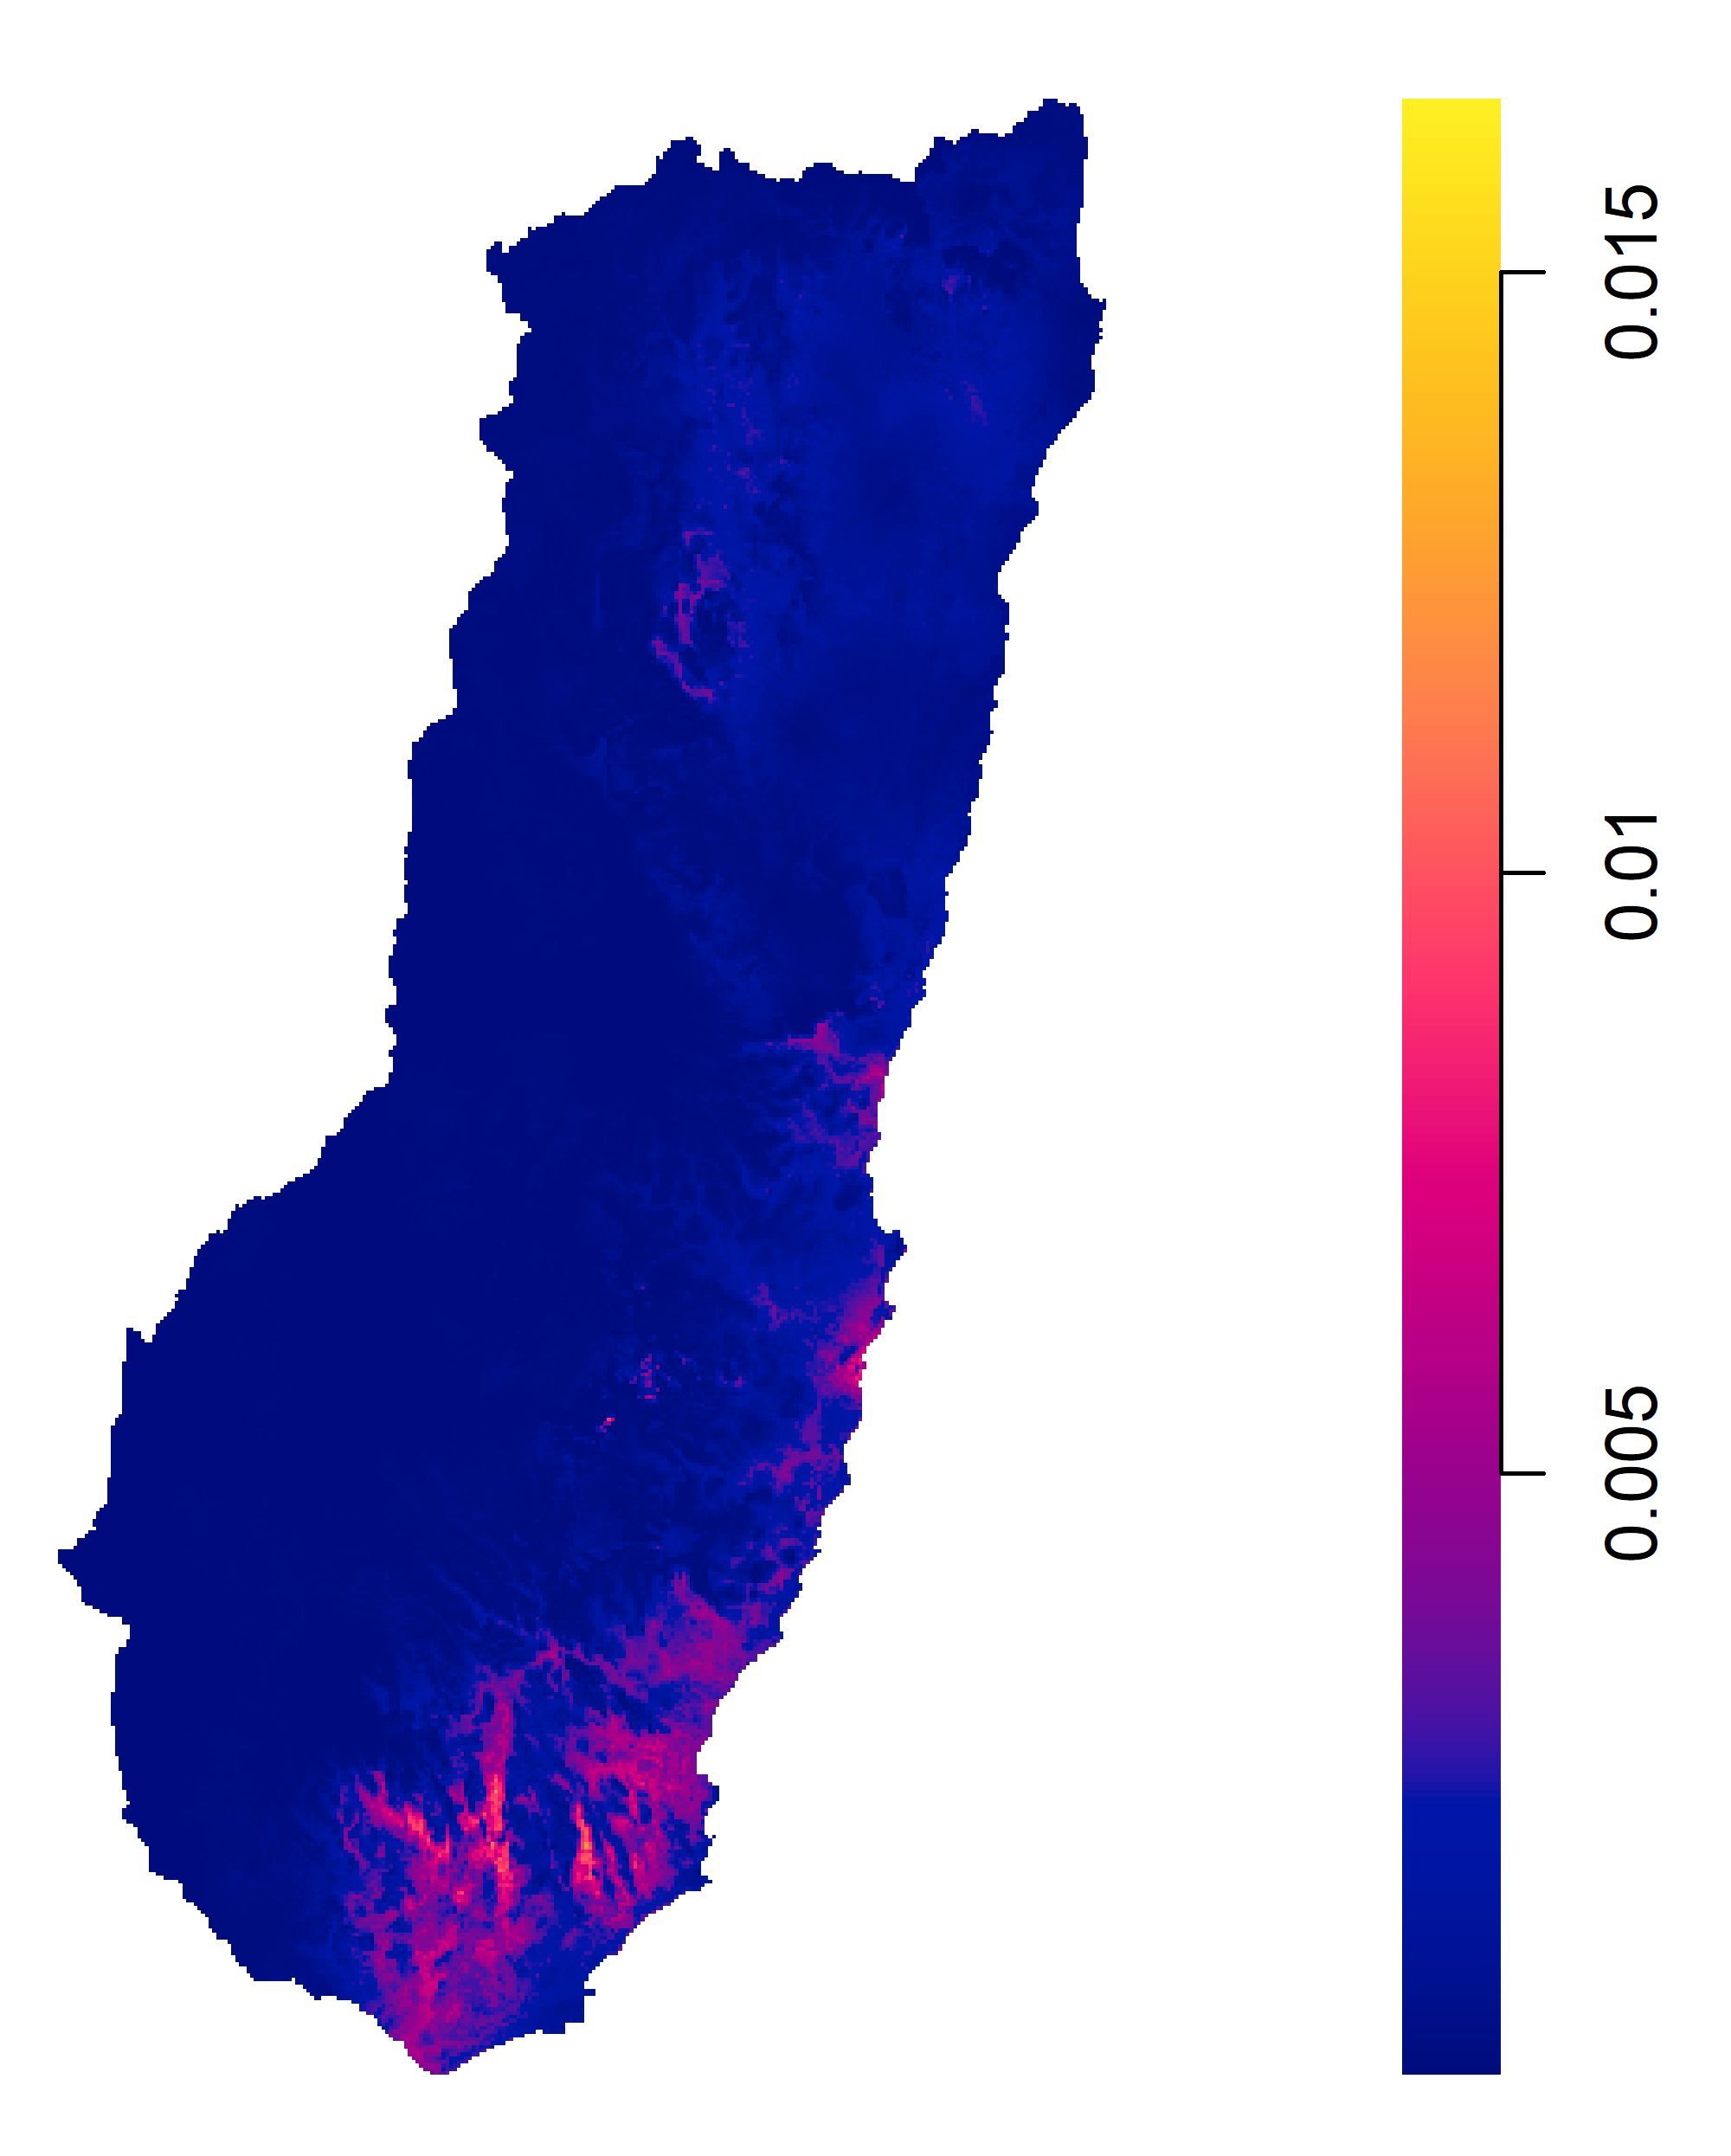
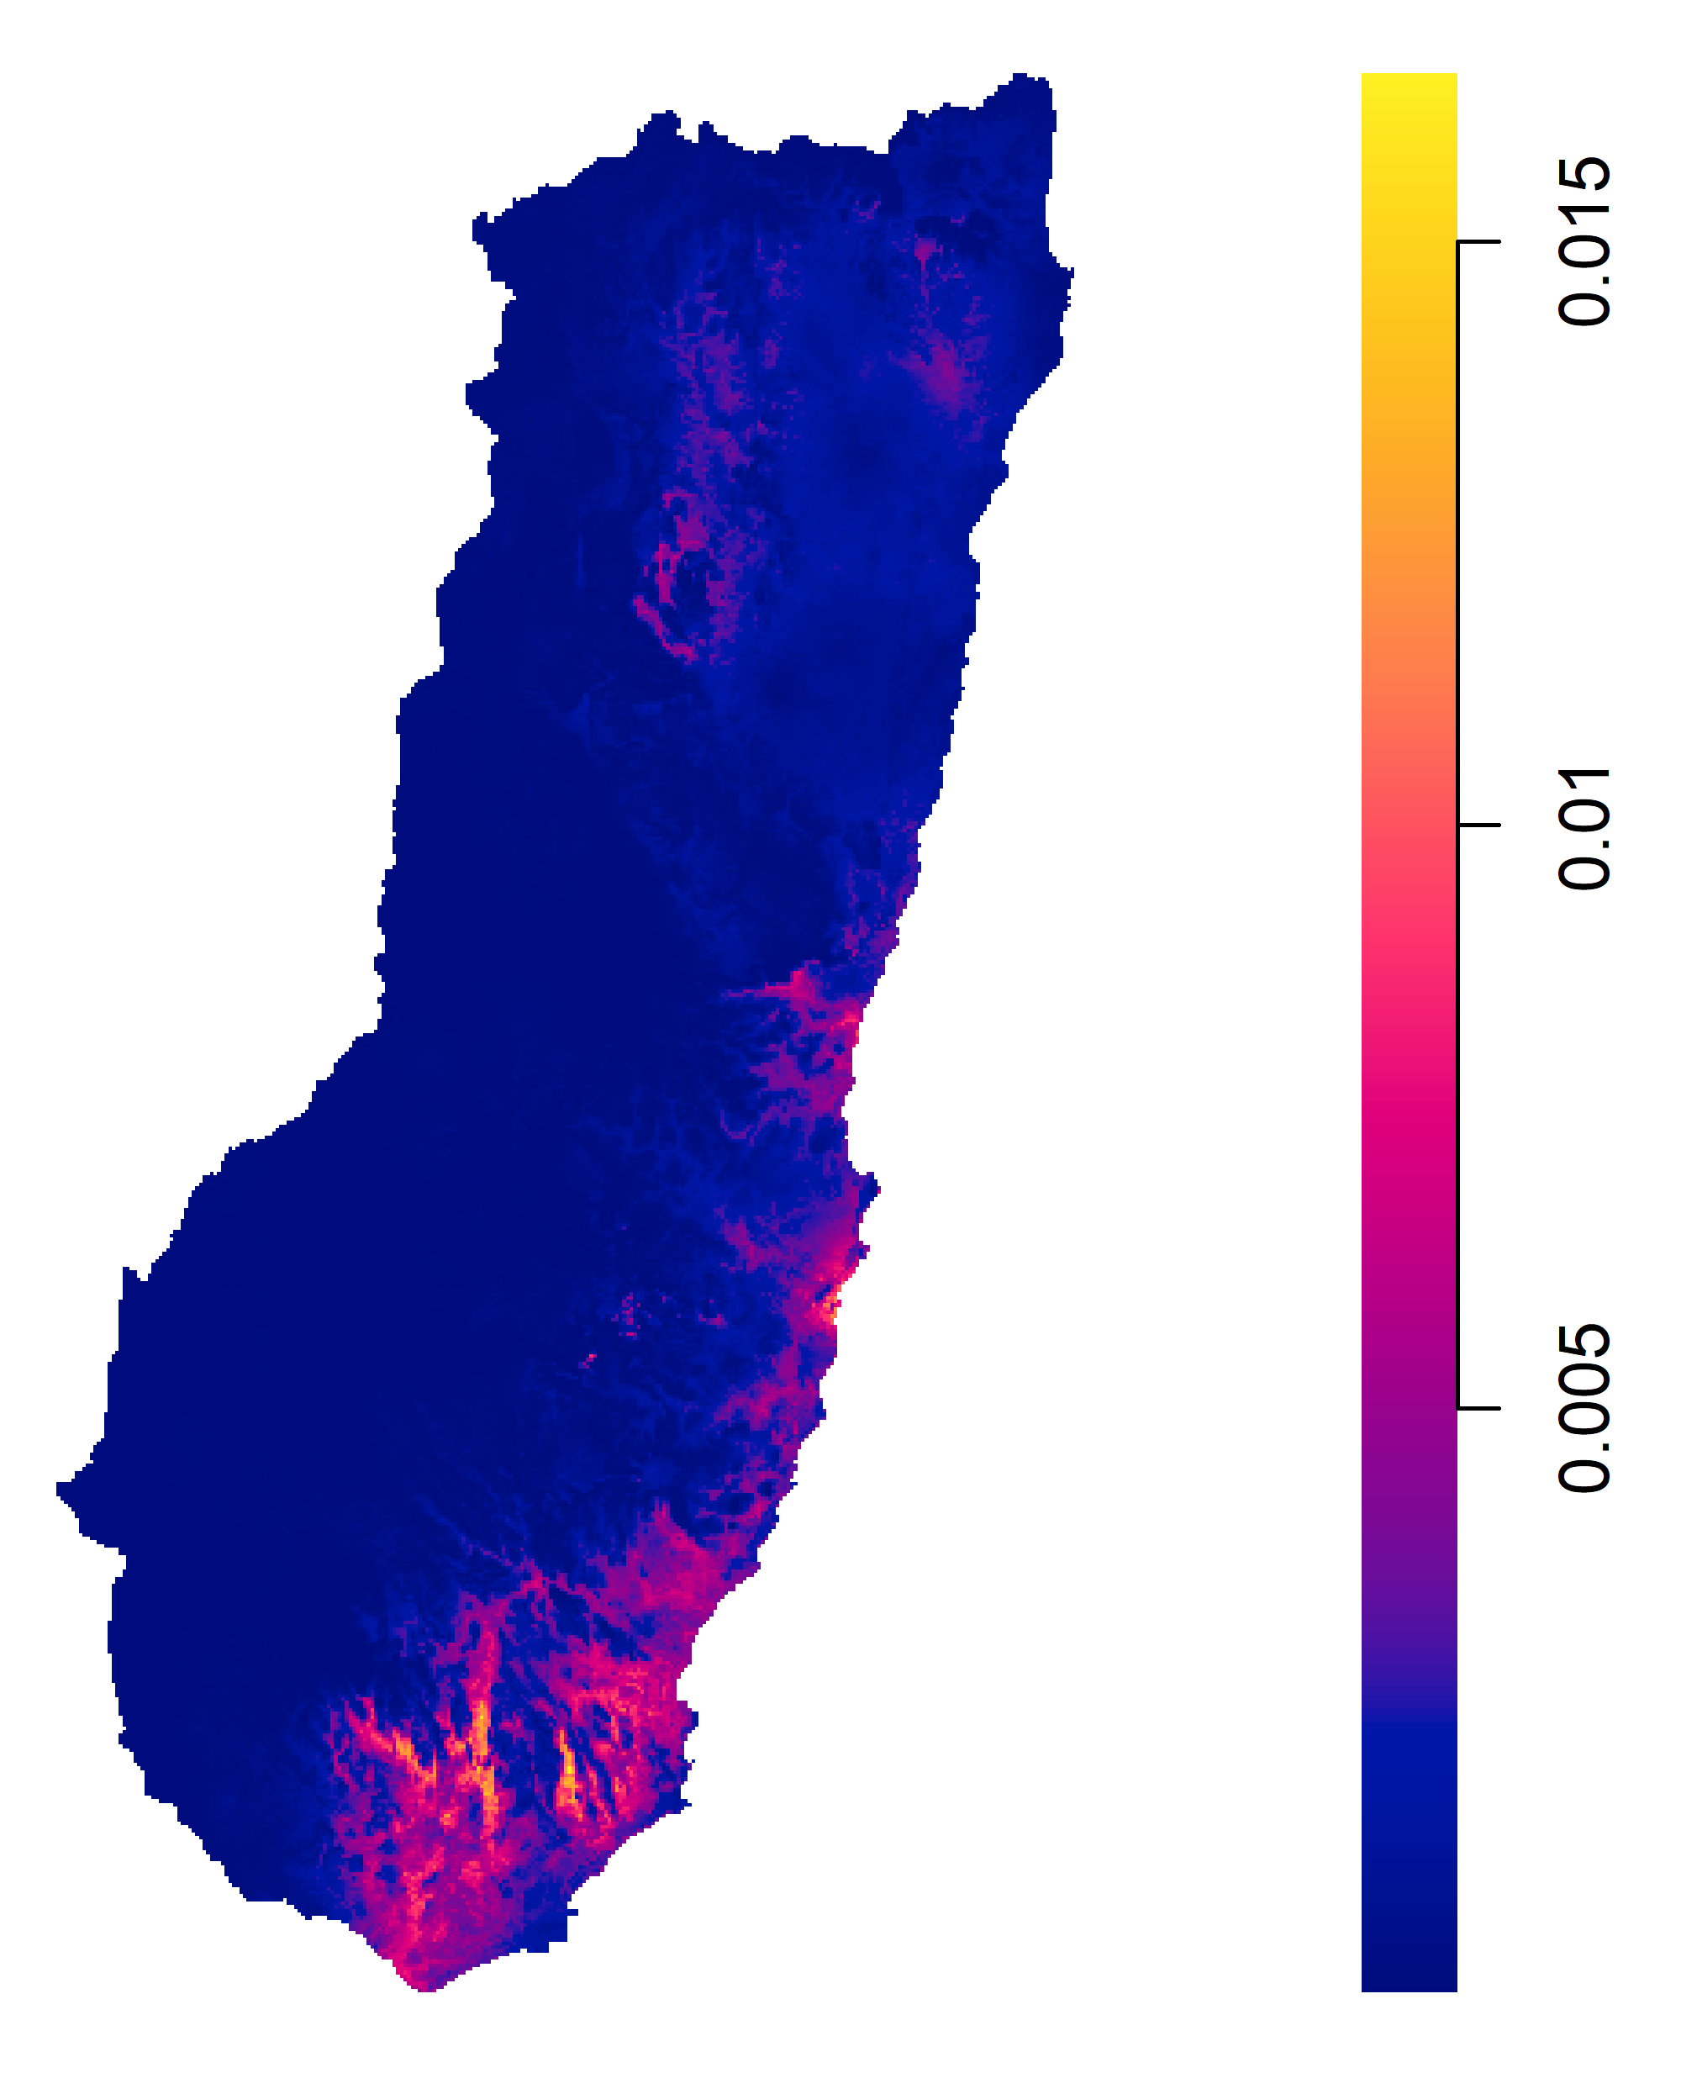
Climate Change Effects on Species Distribution
How might Eucalyptus campanulata respond to a changing climate?
+1.5°C
Photo: Samuel Frankel

Slide 6
Climate Change Effects on Species Distribution

Slide 7
Climate Change Effects on Species Distribution
How do we integrate this?
And this?

Slide 8
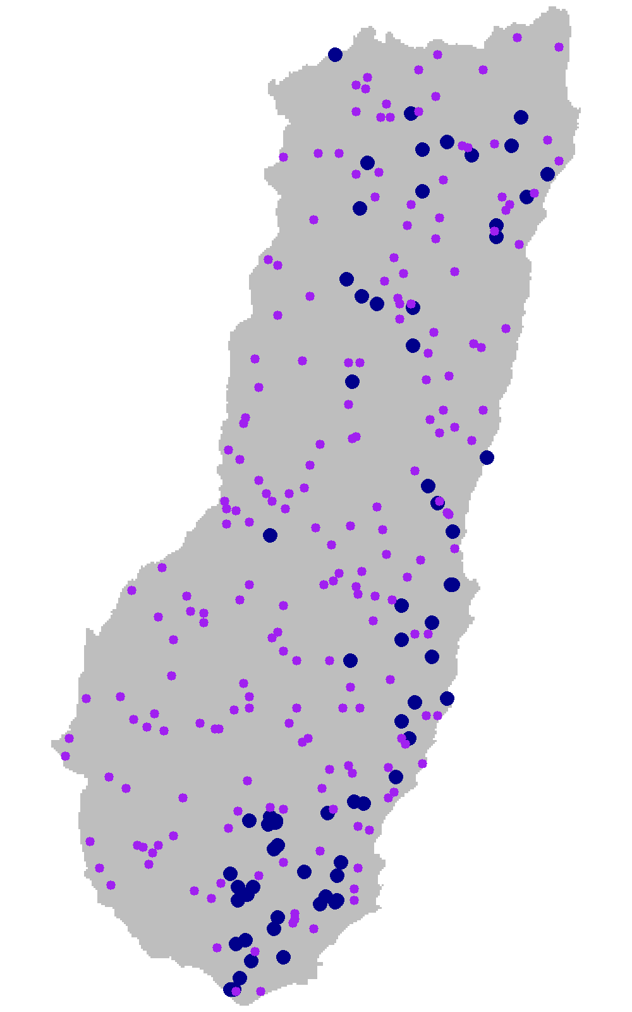
Climate Change Effects on Species Distribution
numerical integration
(weighted) Poisson likelihood
(Berman & Turner 1993)

Slide 9
Climate Change Effects on Species Distribution
as in the spatstat package (Baddeley et al. 2002)

Slide 10
Climate Change Effects on Species Distribution
How do we deal with this?

Slide 11
Multivariate spatial models in ecology using basis functions
Multivariate spatial model for biodiversity
Fit a log-Gaussian Cox process using mgcv
Multivariate point process models for co-occurrence
Basis functions
Factor analytic models

Slide 12
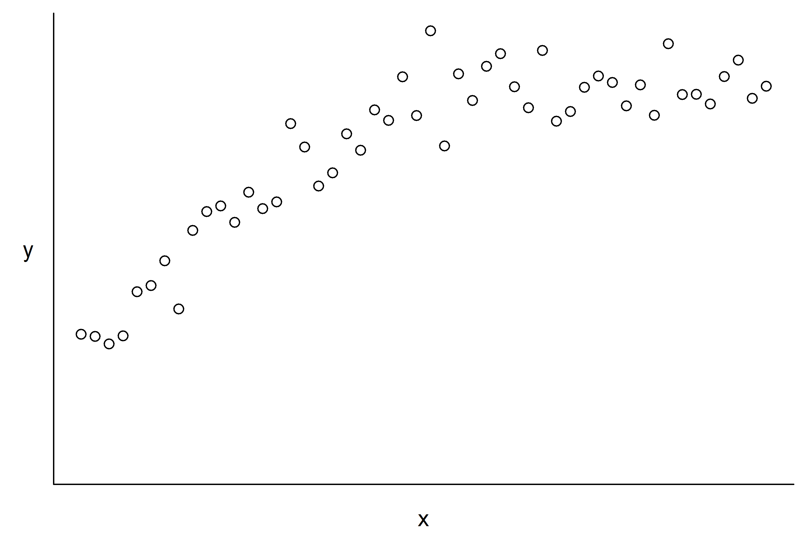
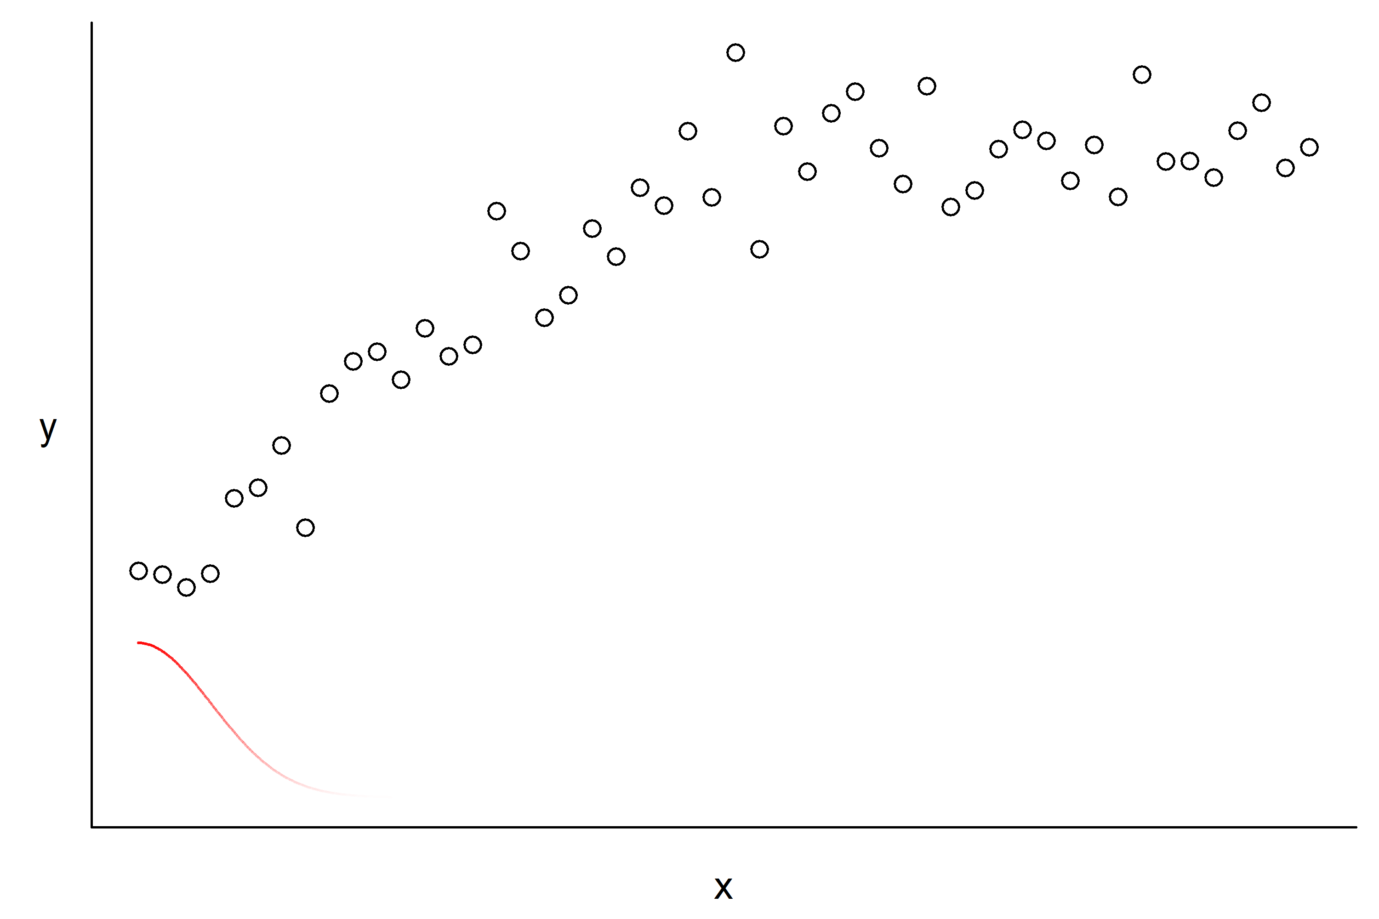
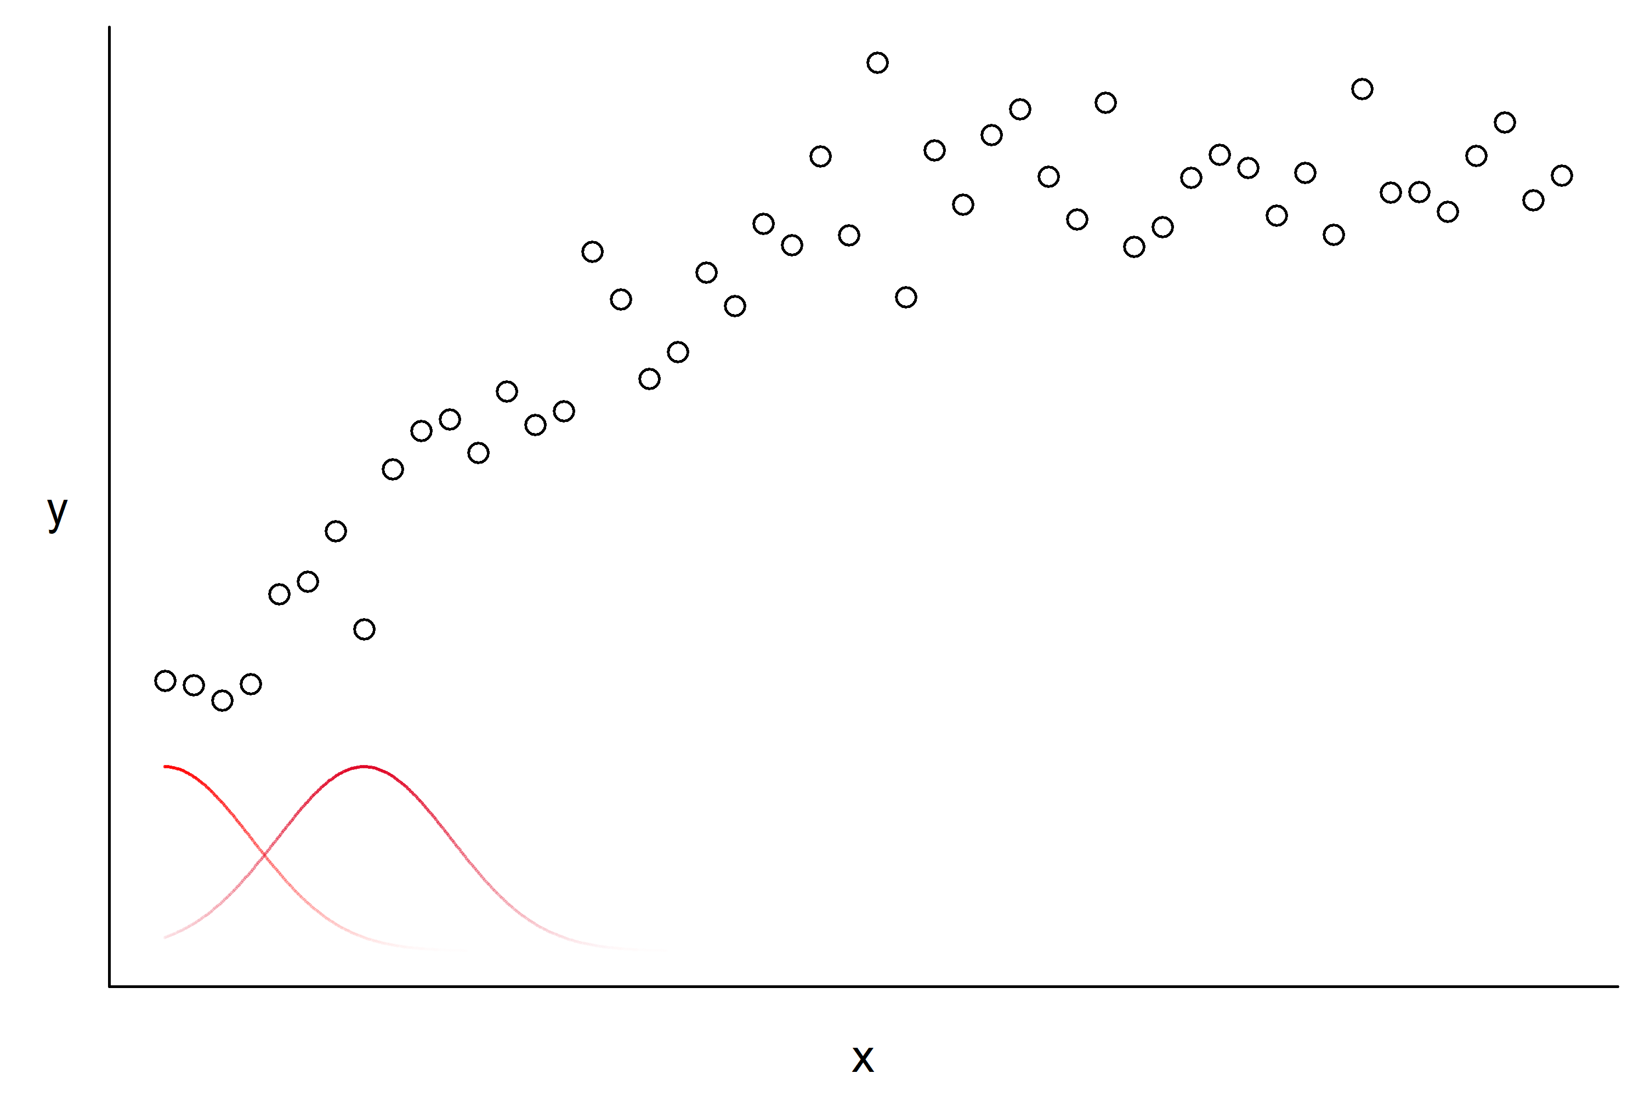
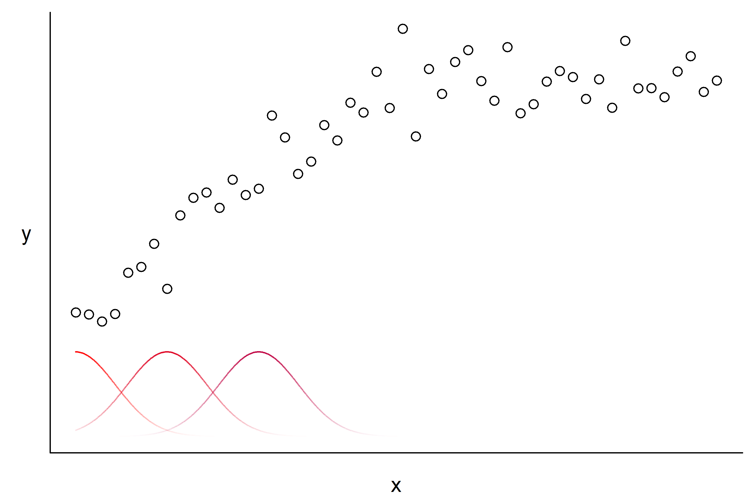
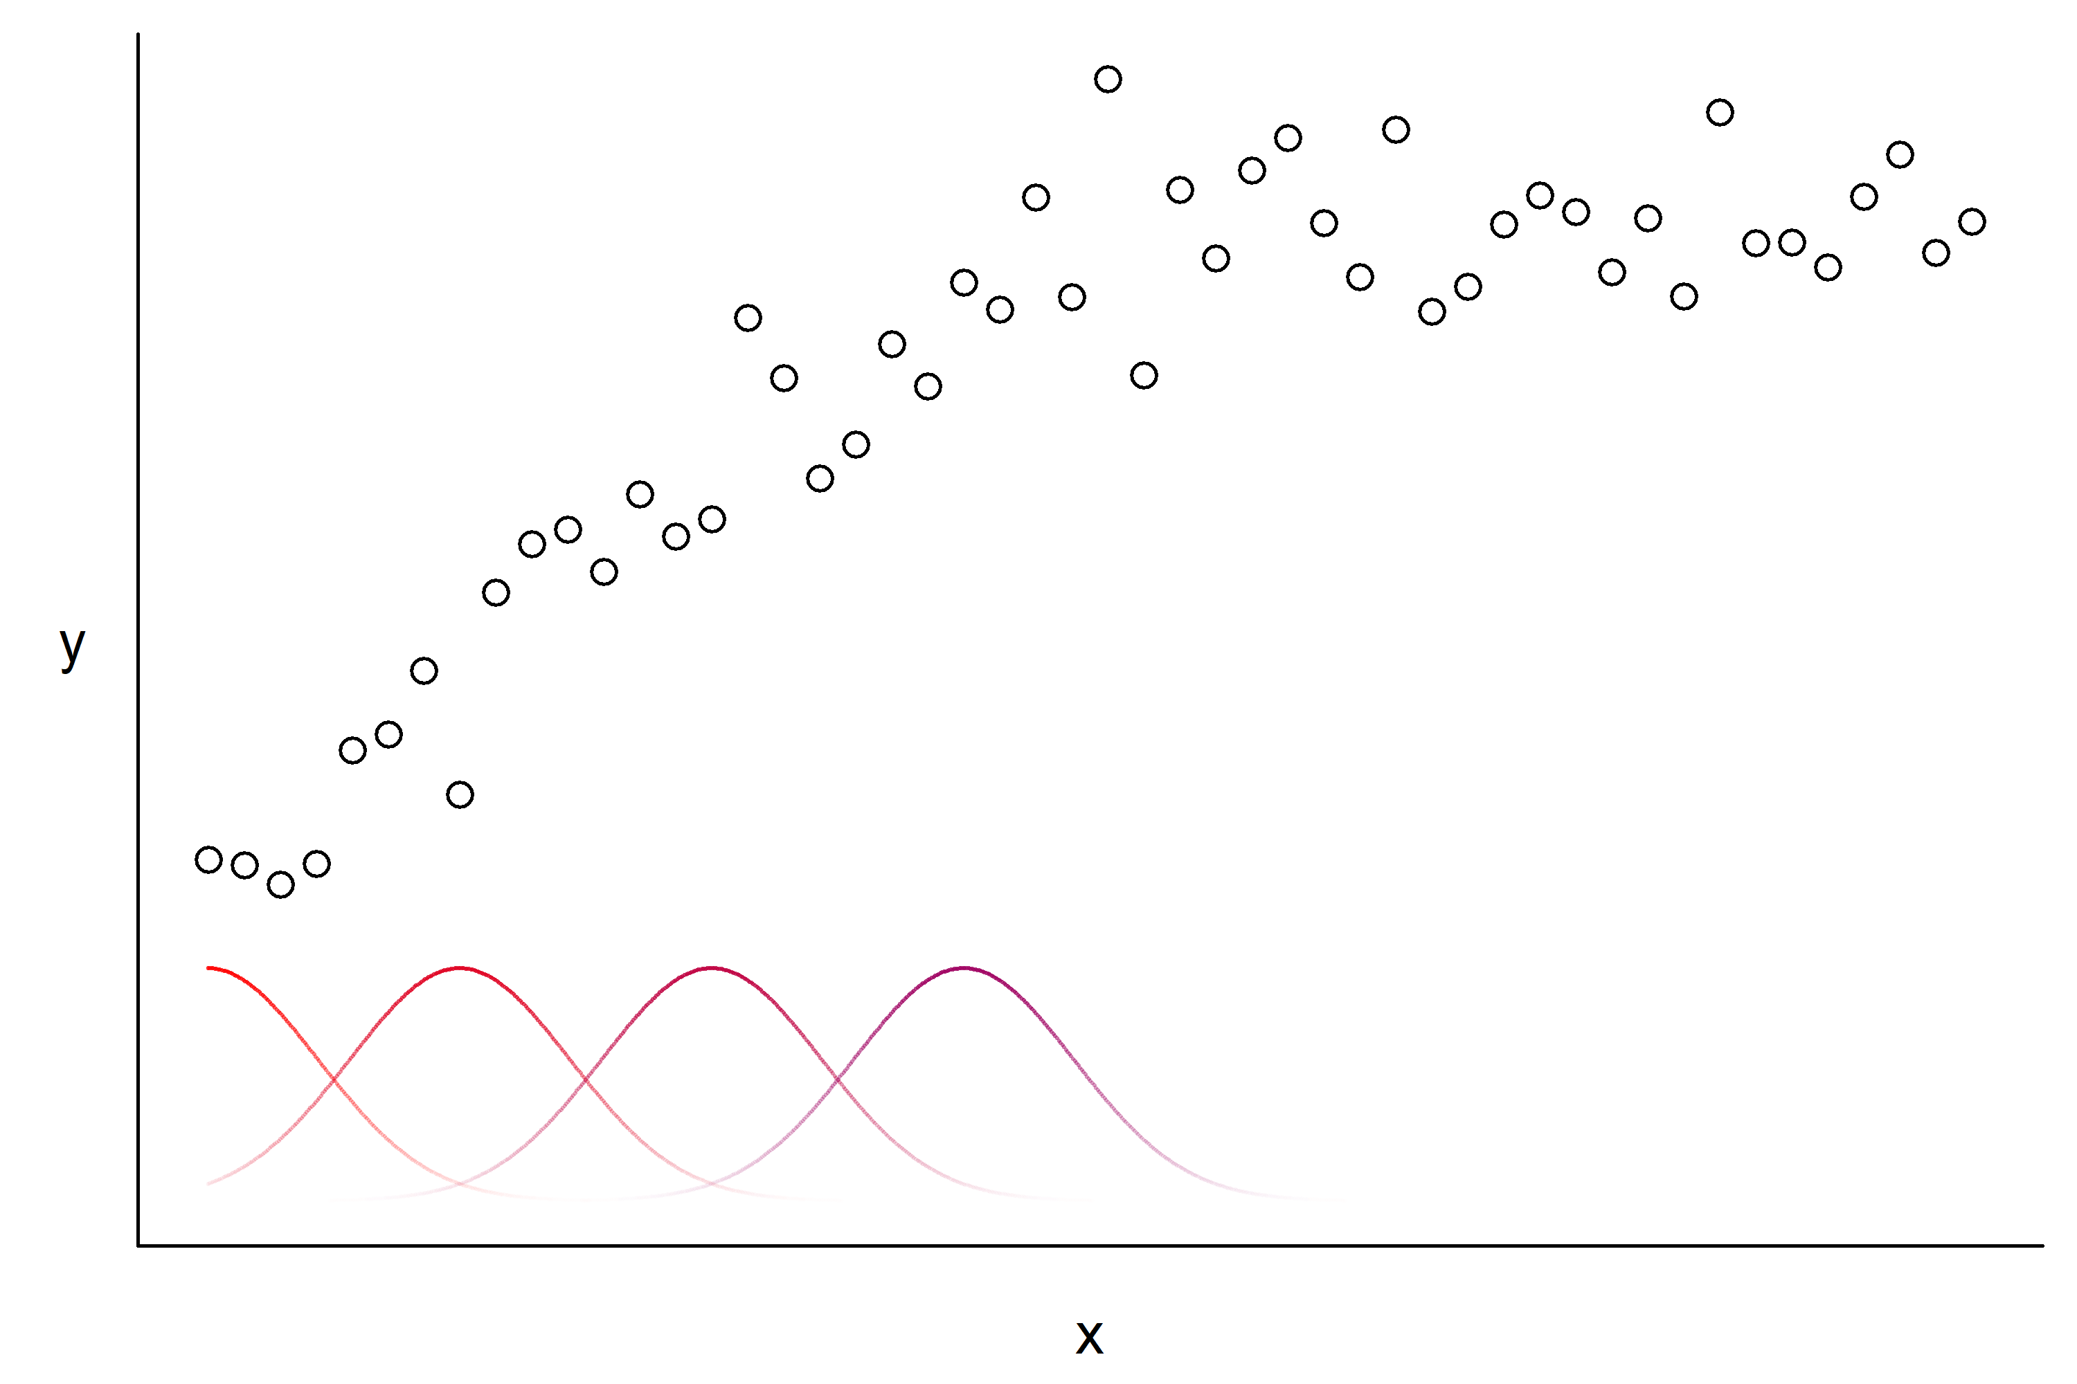
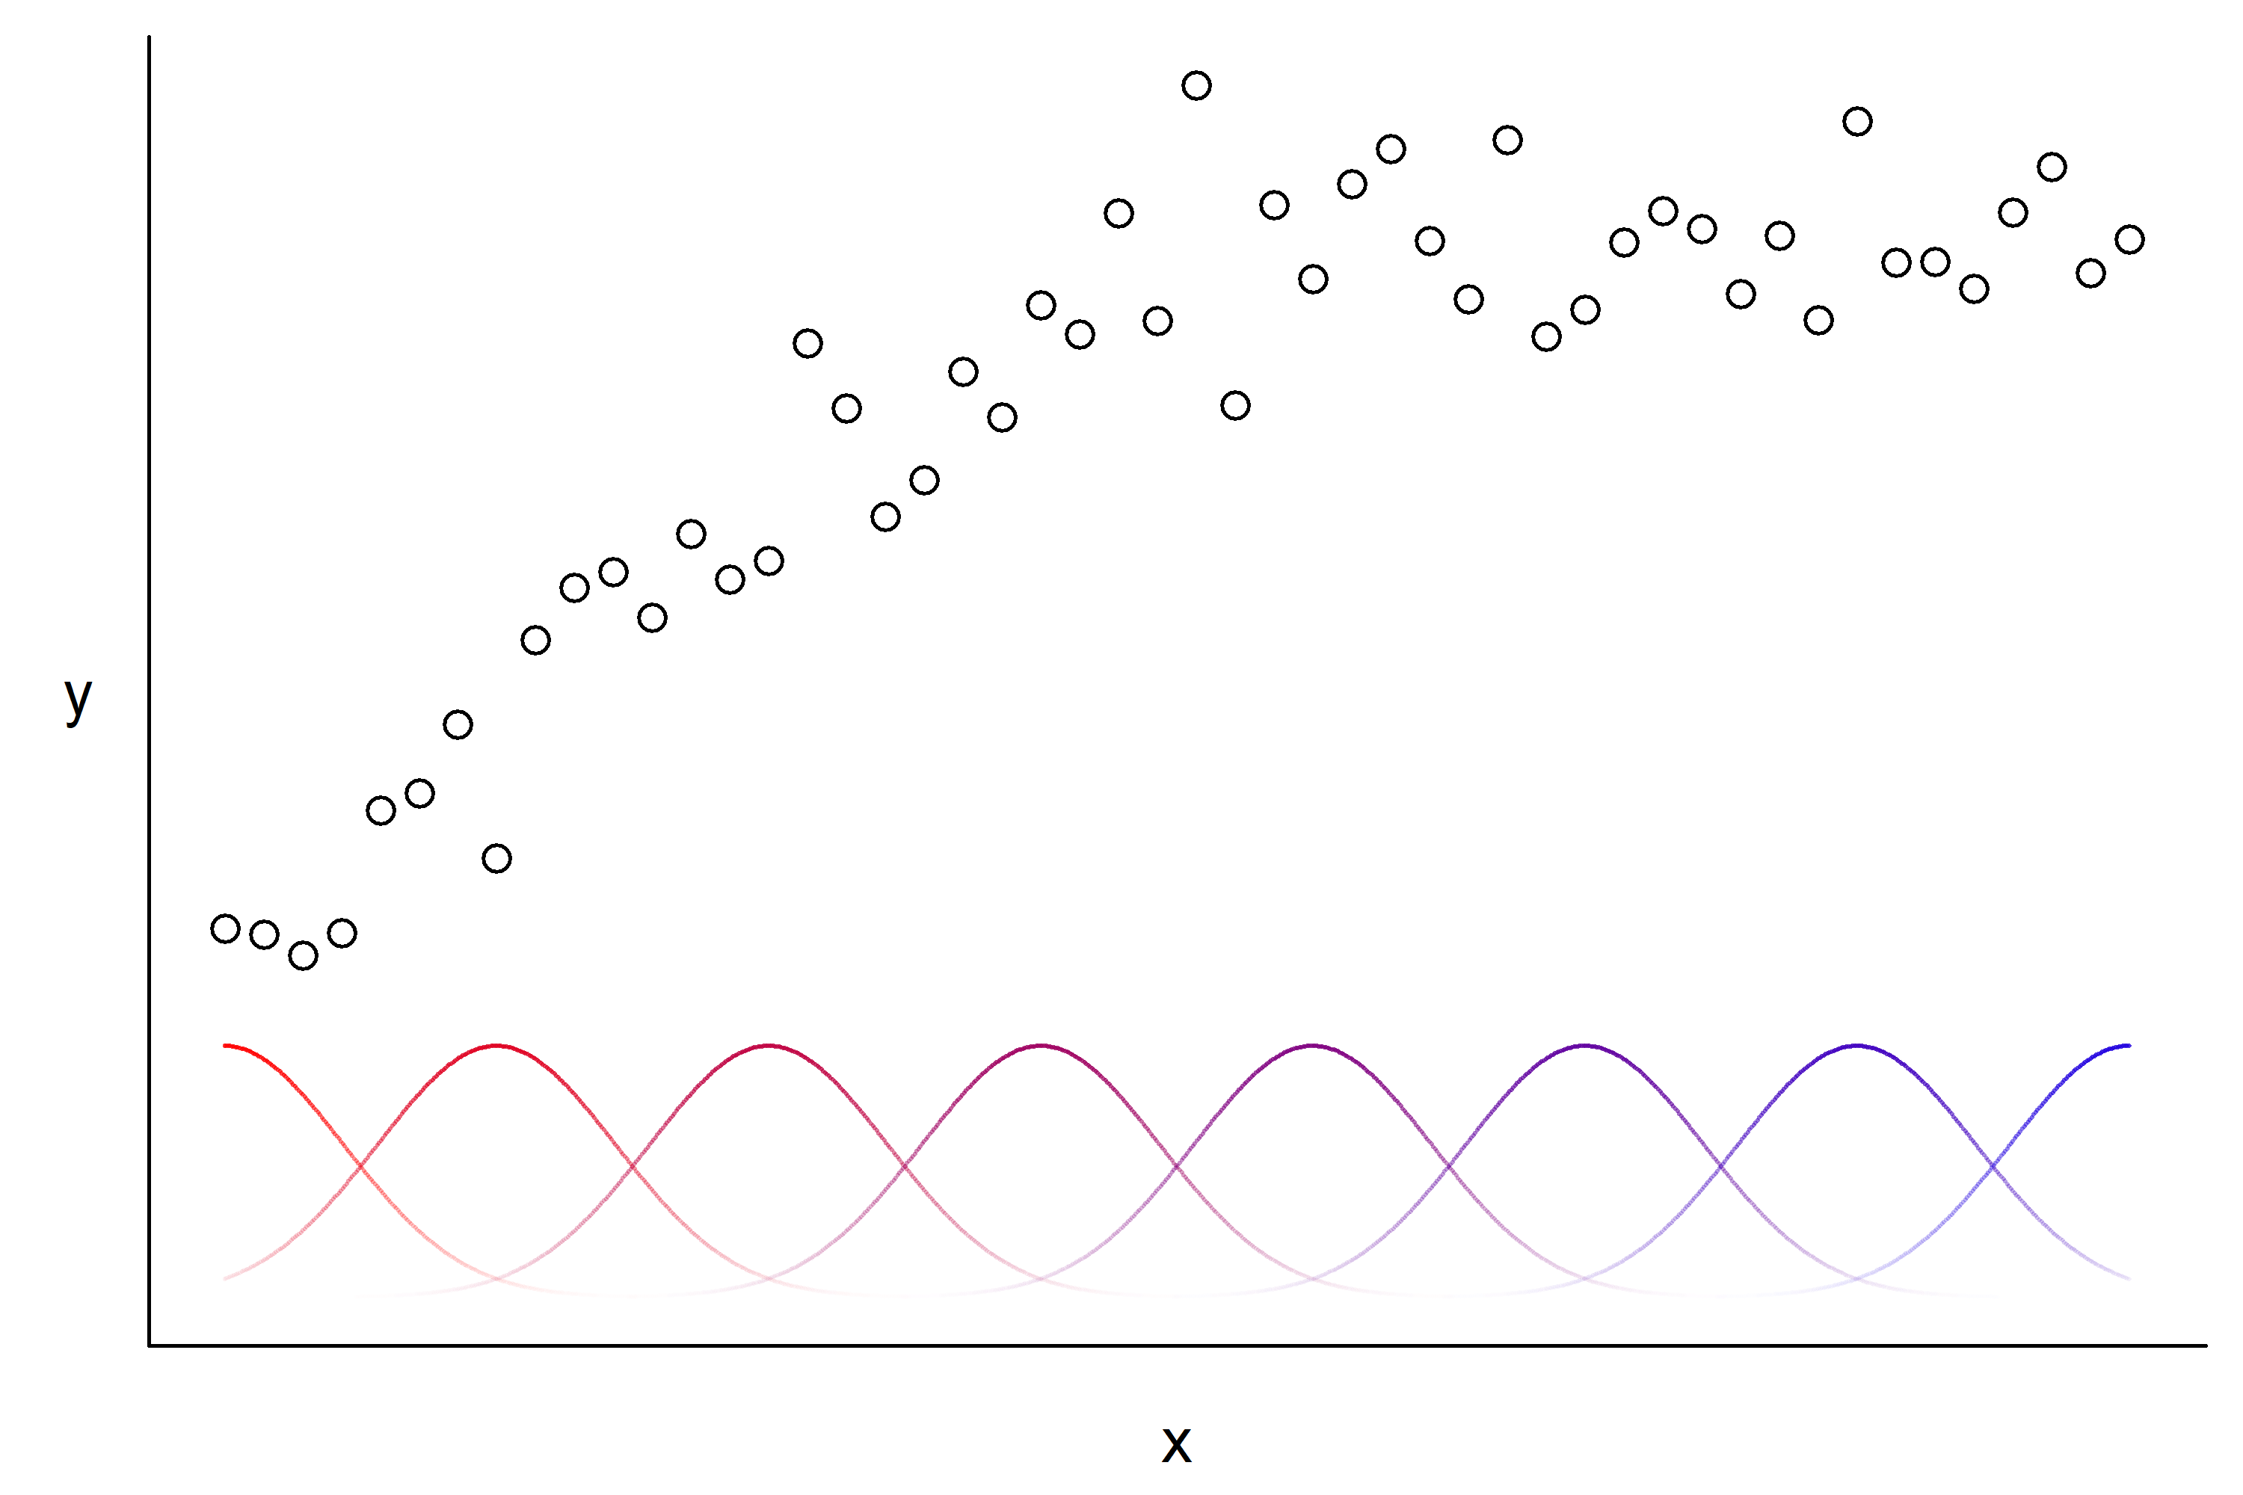
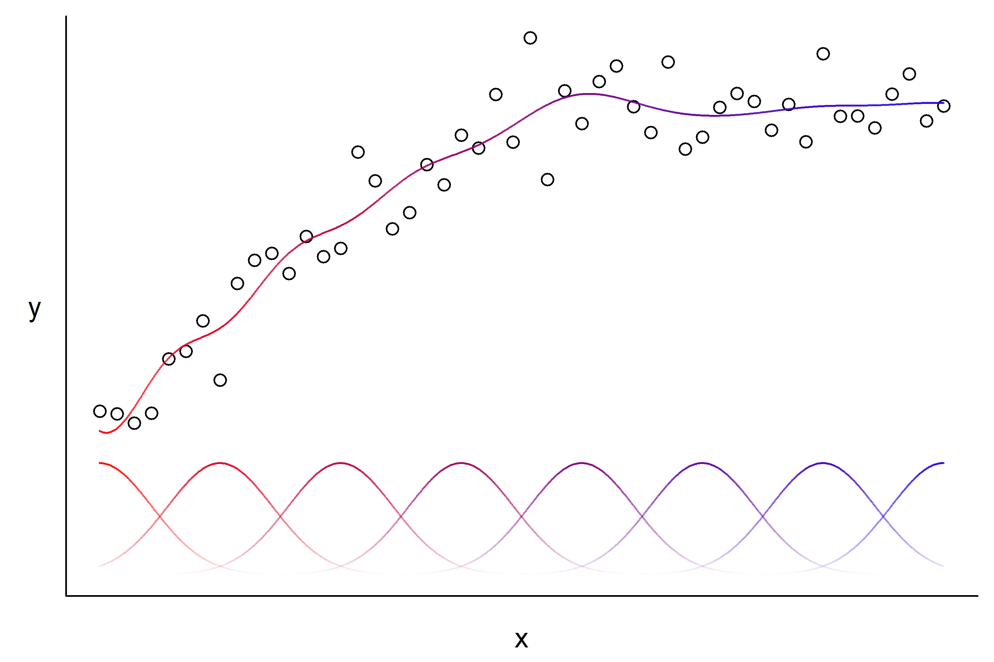
Basis functions: 1D case
f(x)
B(x)

Slide 13
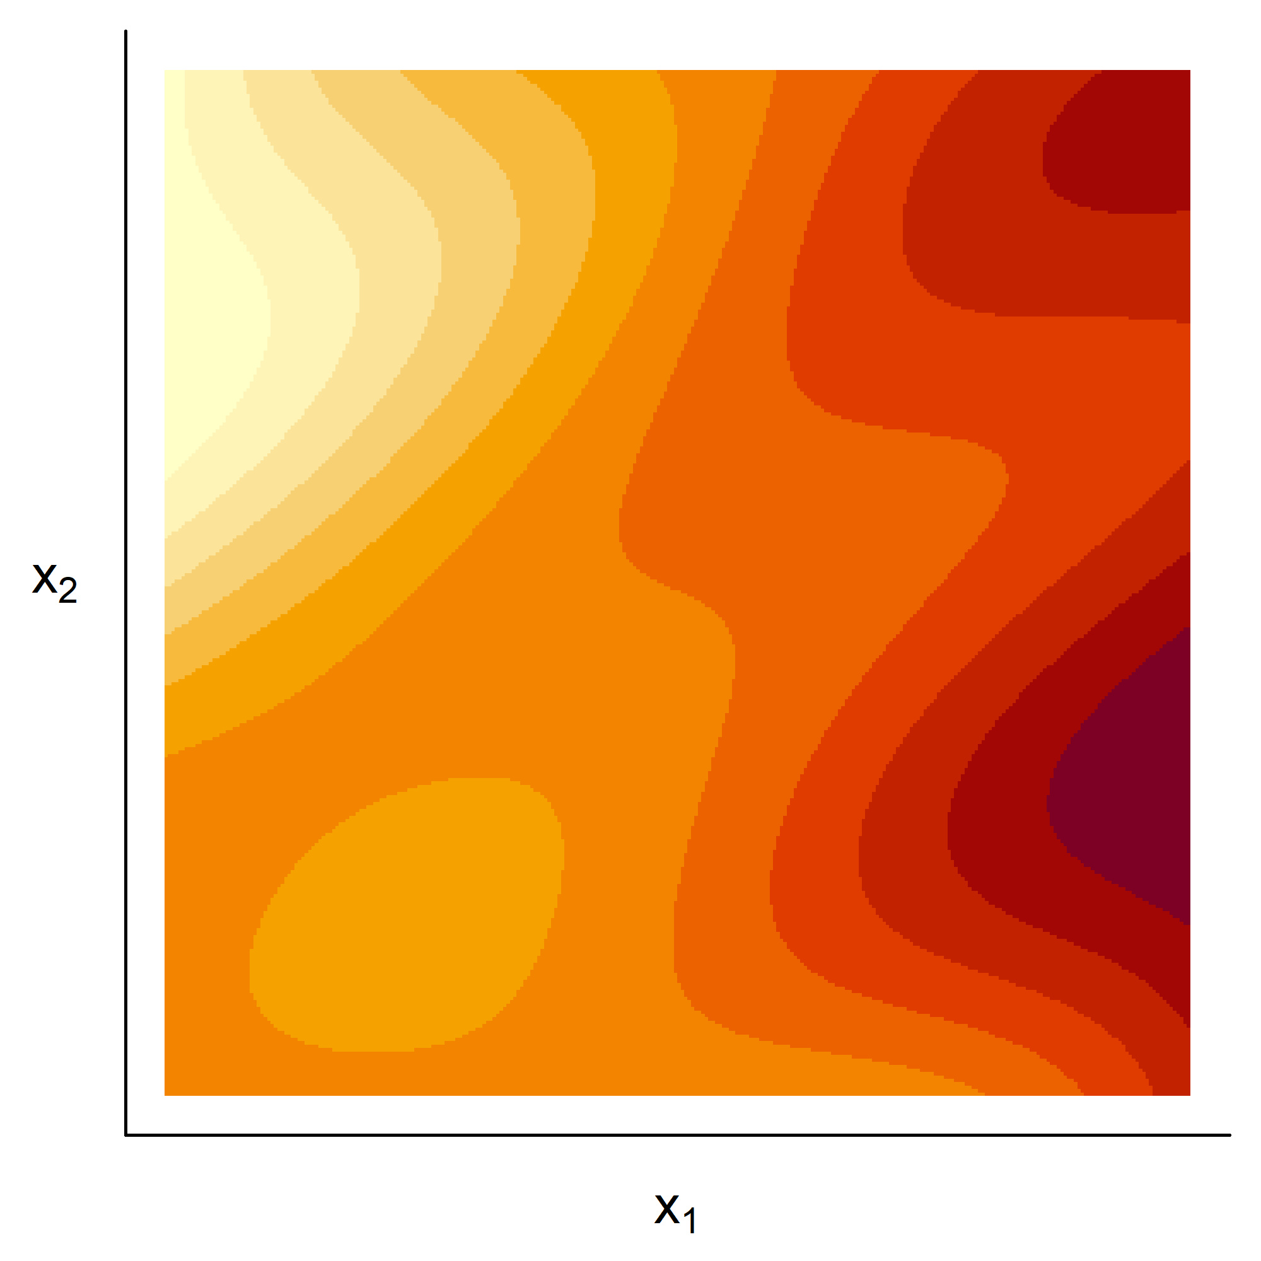
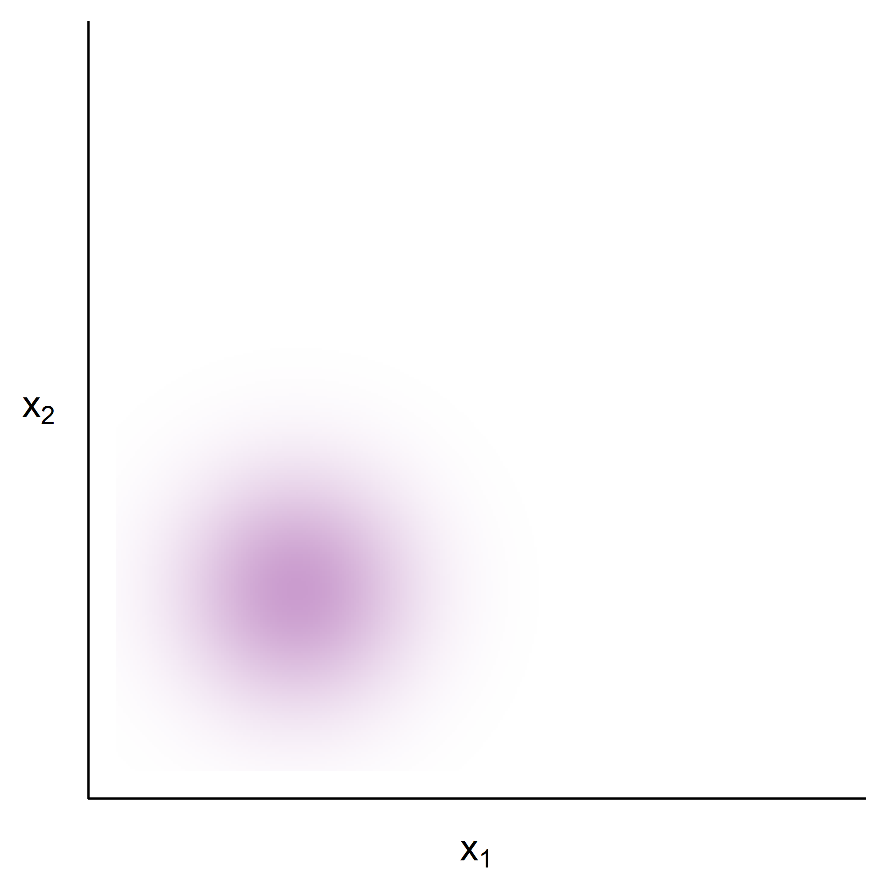
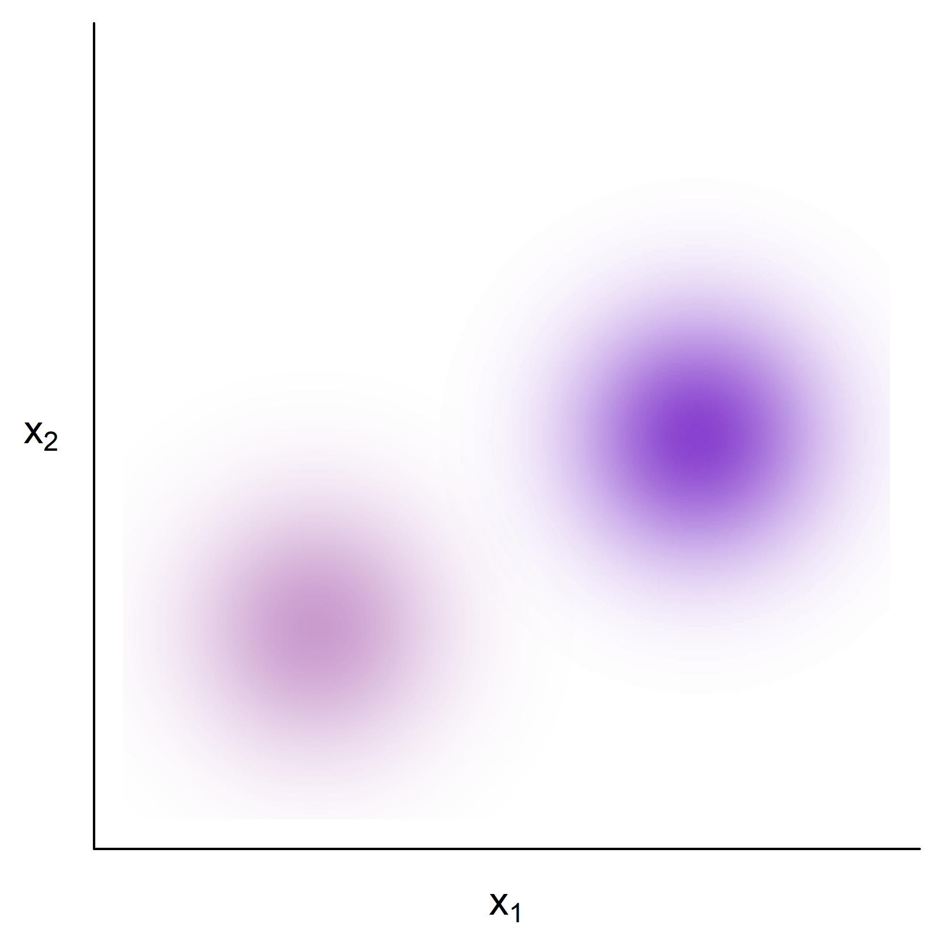
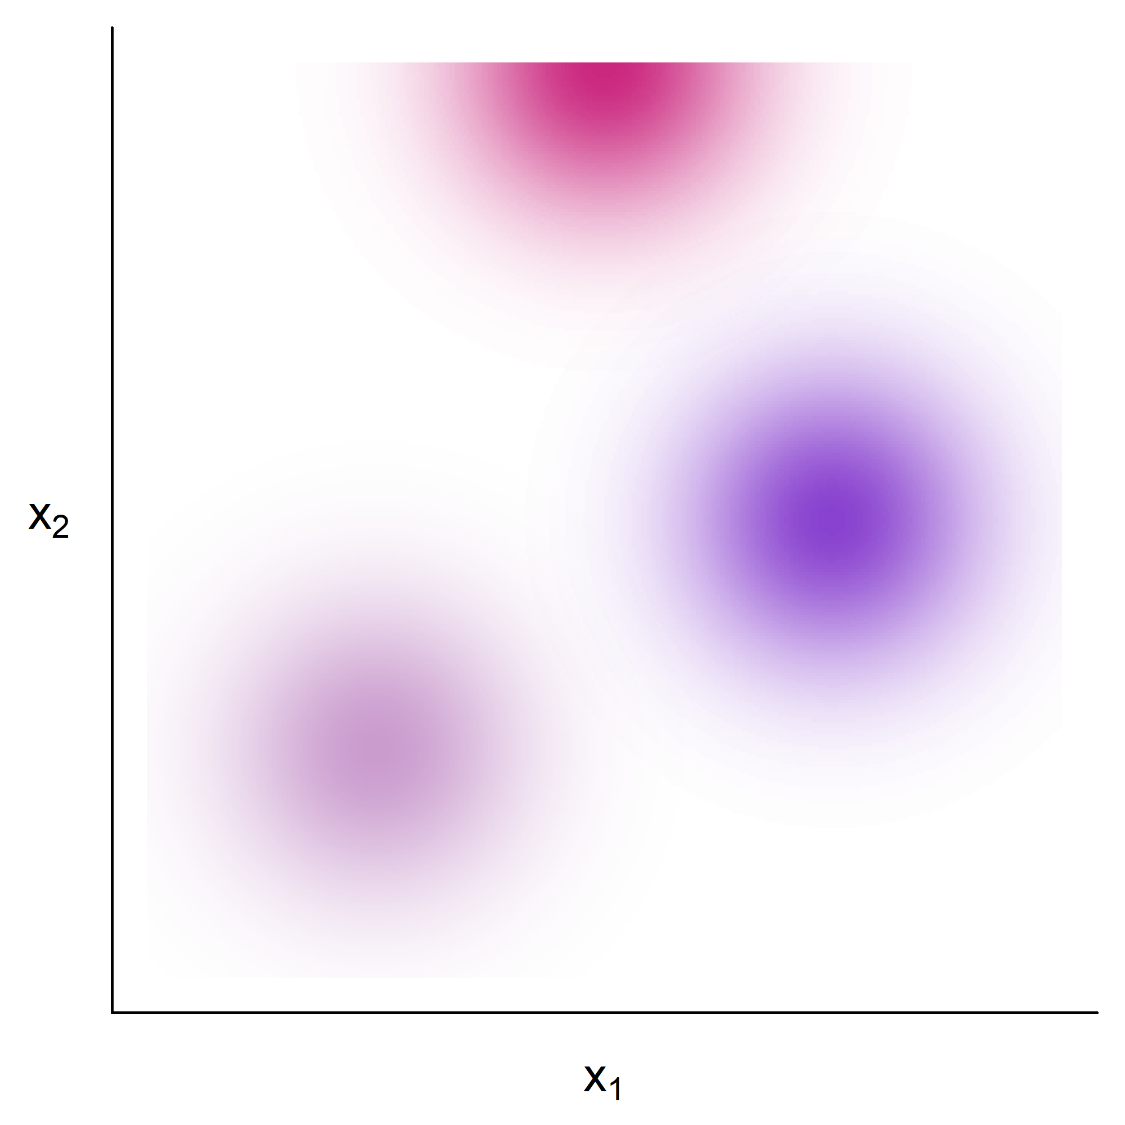
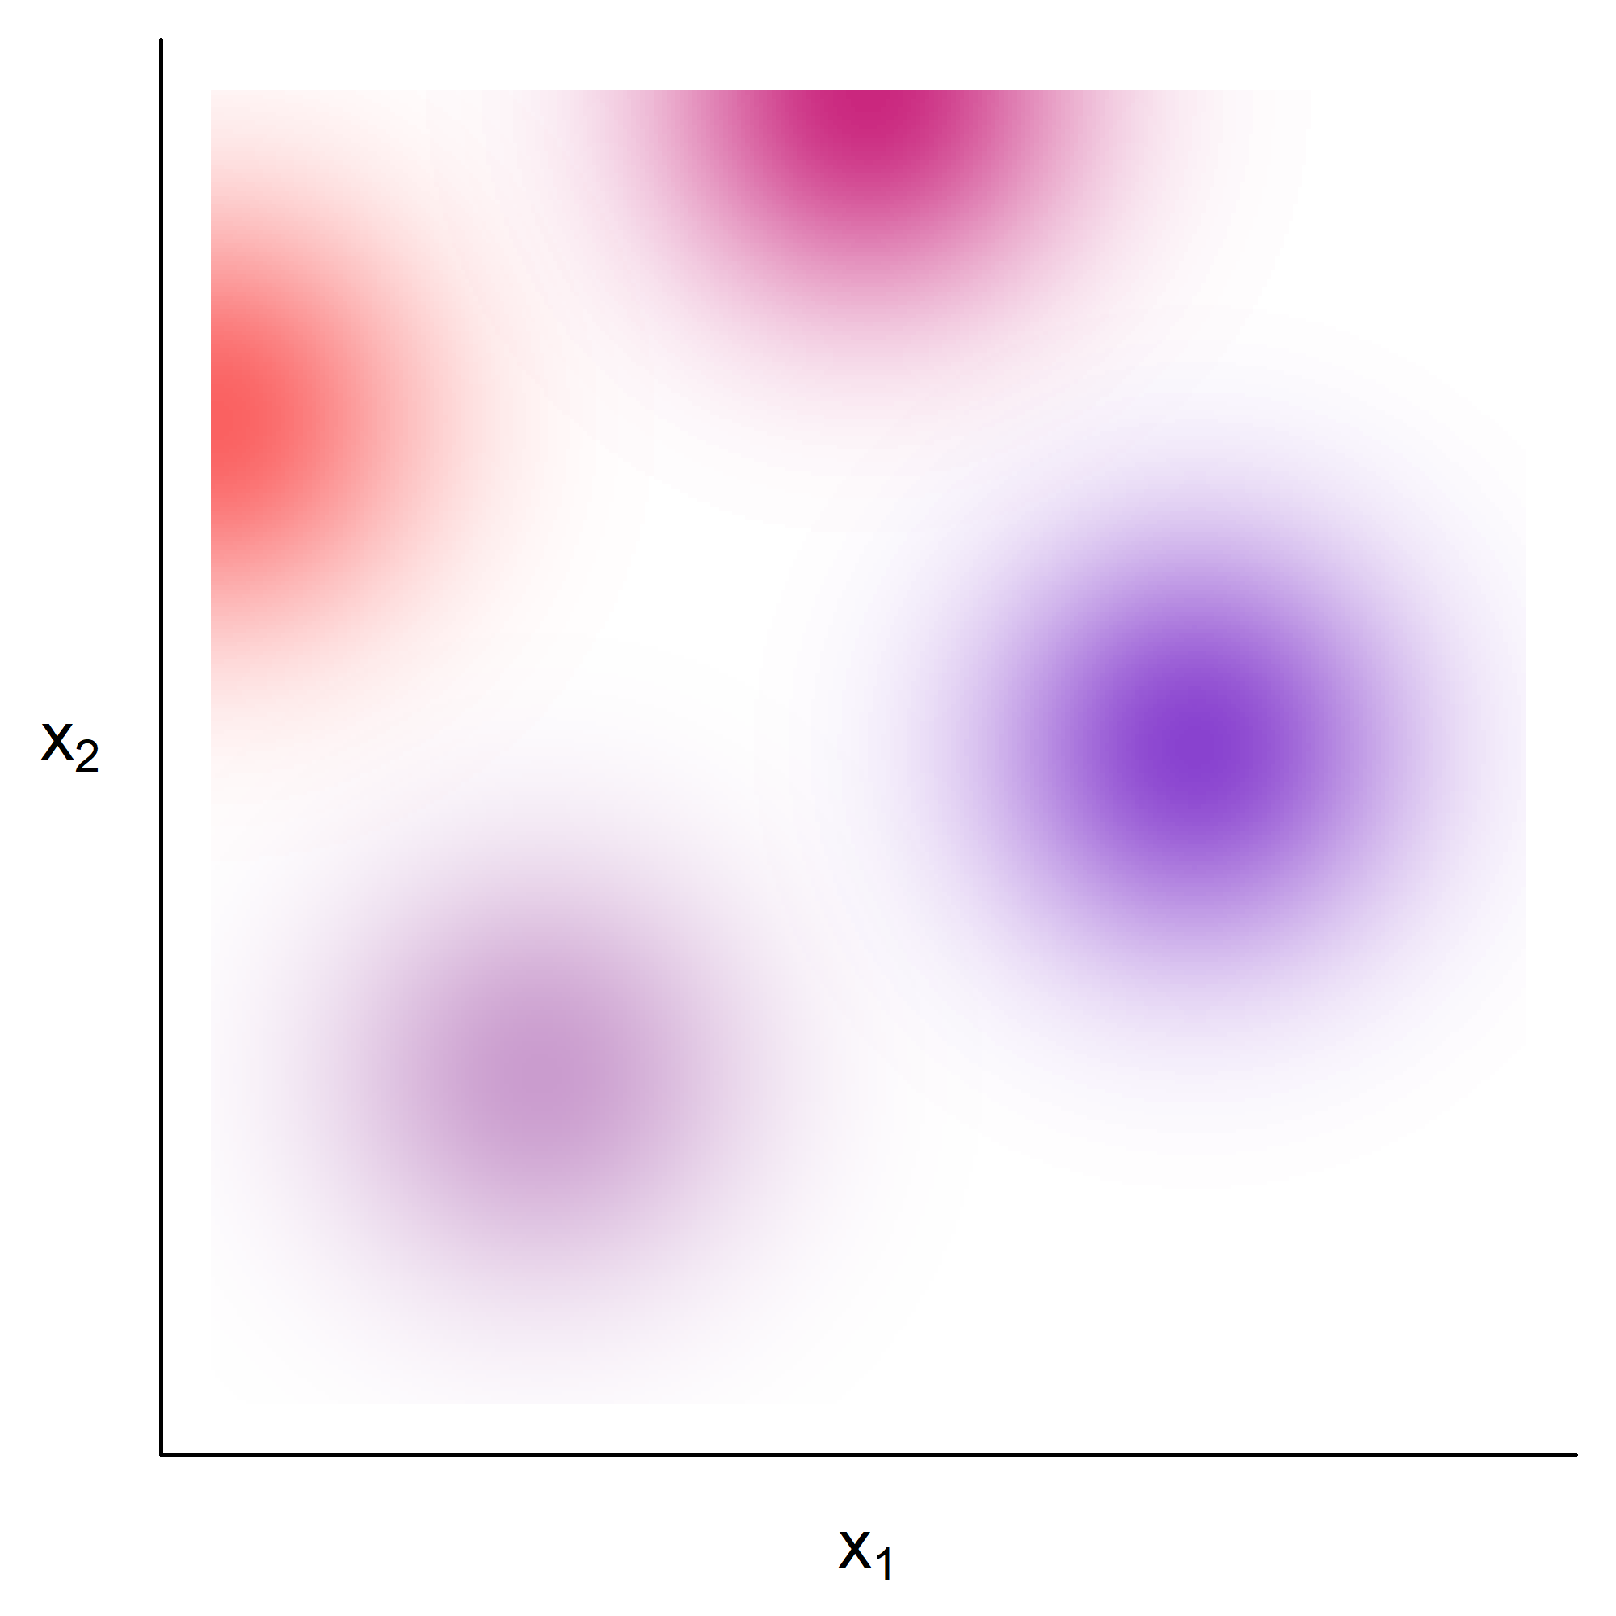
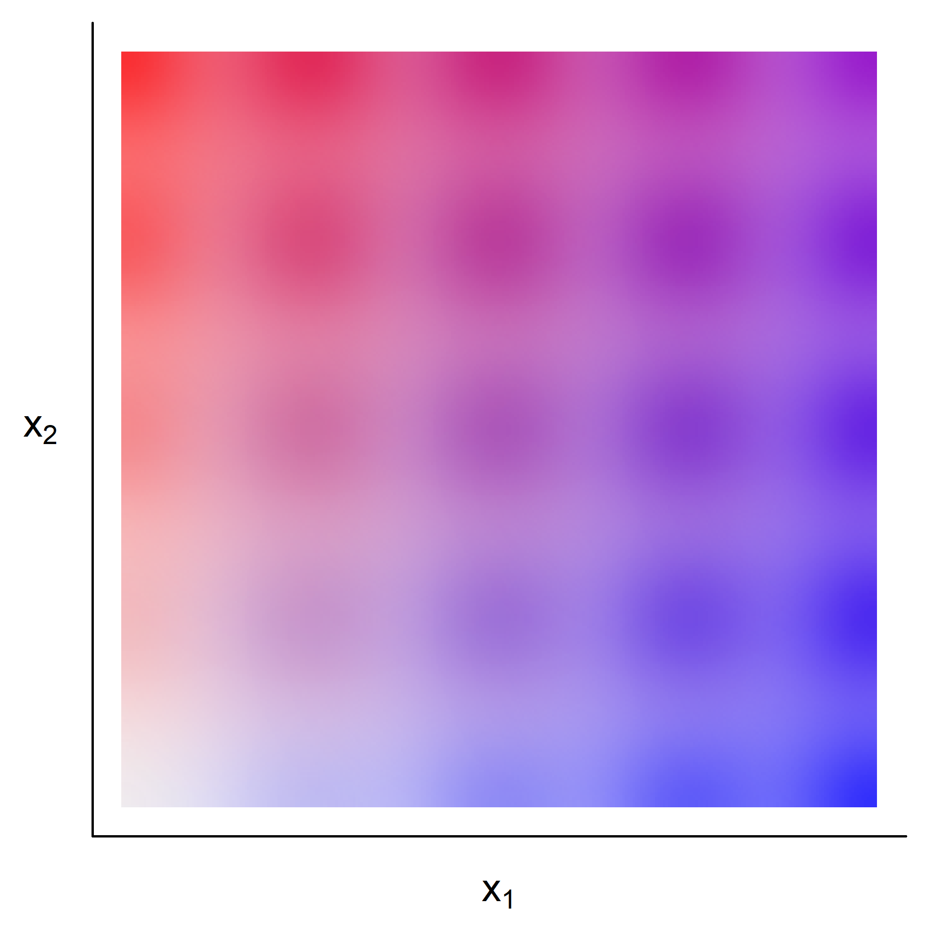
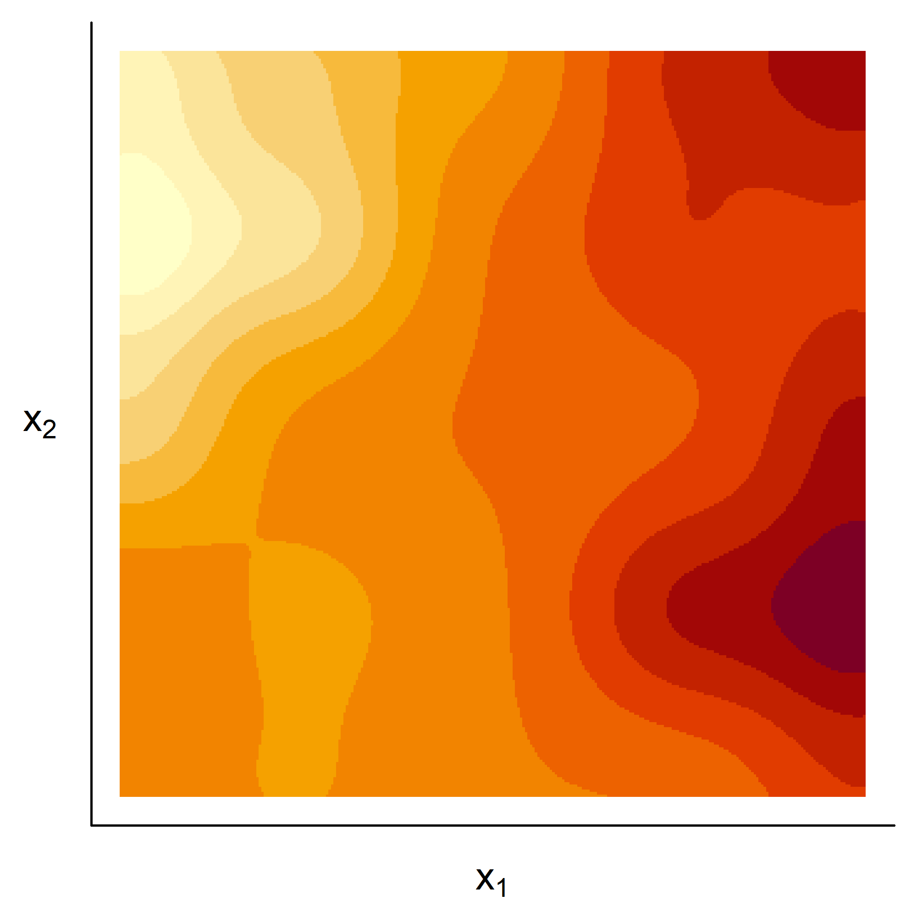
Basis functions: 2D case

Slide 14
Ummm… is this a GAM or a spatial model?
It’s either!
One person’s mean structure could be another person’s correlated error
Cressie 1988

Slide 15
Basis functions = faster spatial modelling

Slide 16
How to choose basis functions?
(Kammann & Wand 2003)
(also see “predictive processes”, Banerjee et al 2008)

Slide 17
Multivariate spatial models in ecology using basis functions
Multivariate spatial model for biodiversity
Fit a log-Gaussian Cox process using mgcv
Multivariate point process models for co-occurrence
Basis functions
Factor analytic models

Slide 18
Fitting a log-Gaussian Cox Process using mgcv…

Slide 19
Fitting a log-Gaussian Cox Process using mgcv… works!
(Dovers et al. in press)

Slide 20
Multivariate spatial models in ecology using basis functions
Multivariate spatial model for biodiversity
Fit a log-Gaussian Cox process using mgcv
Multivariate point process models for co-occurrence
Basis functions
Factor analytic models

Slide 21
Multivariate spatial models in ecology using basis functions
Multivariate spatial model for biodiversity
Fit a log-Gaussian Cox process using mgcv
Multivariate point process models for co-occurrence
Basis functions
Factor analytic models

Slide 22
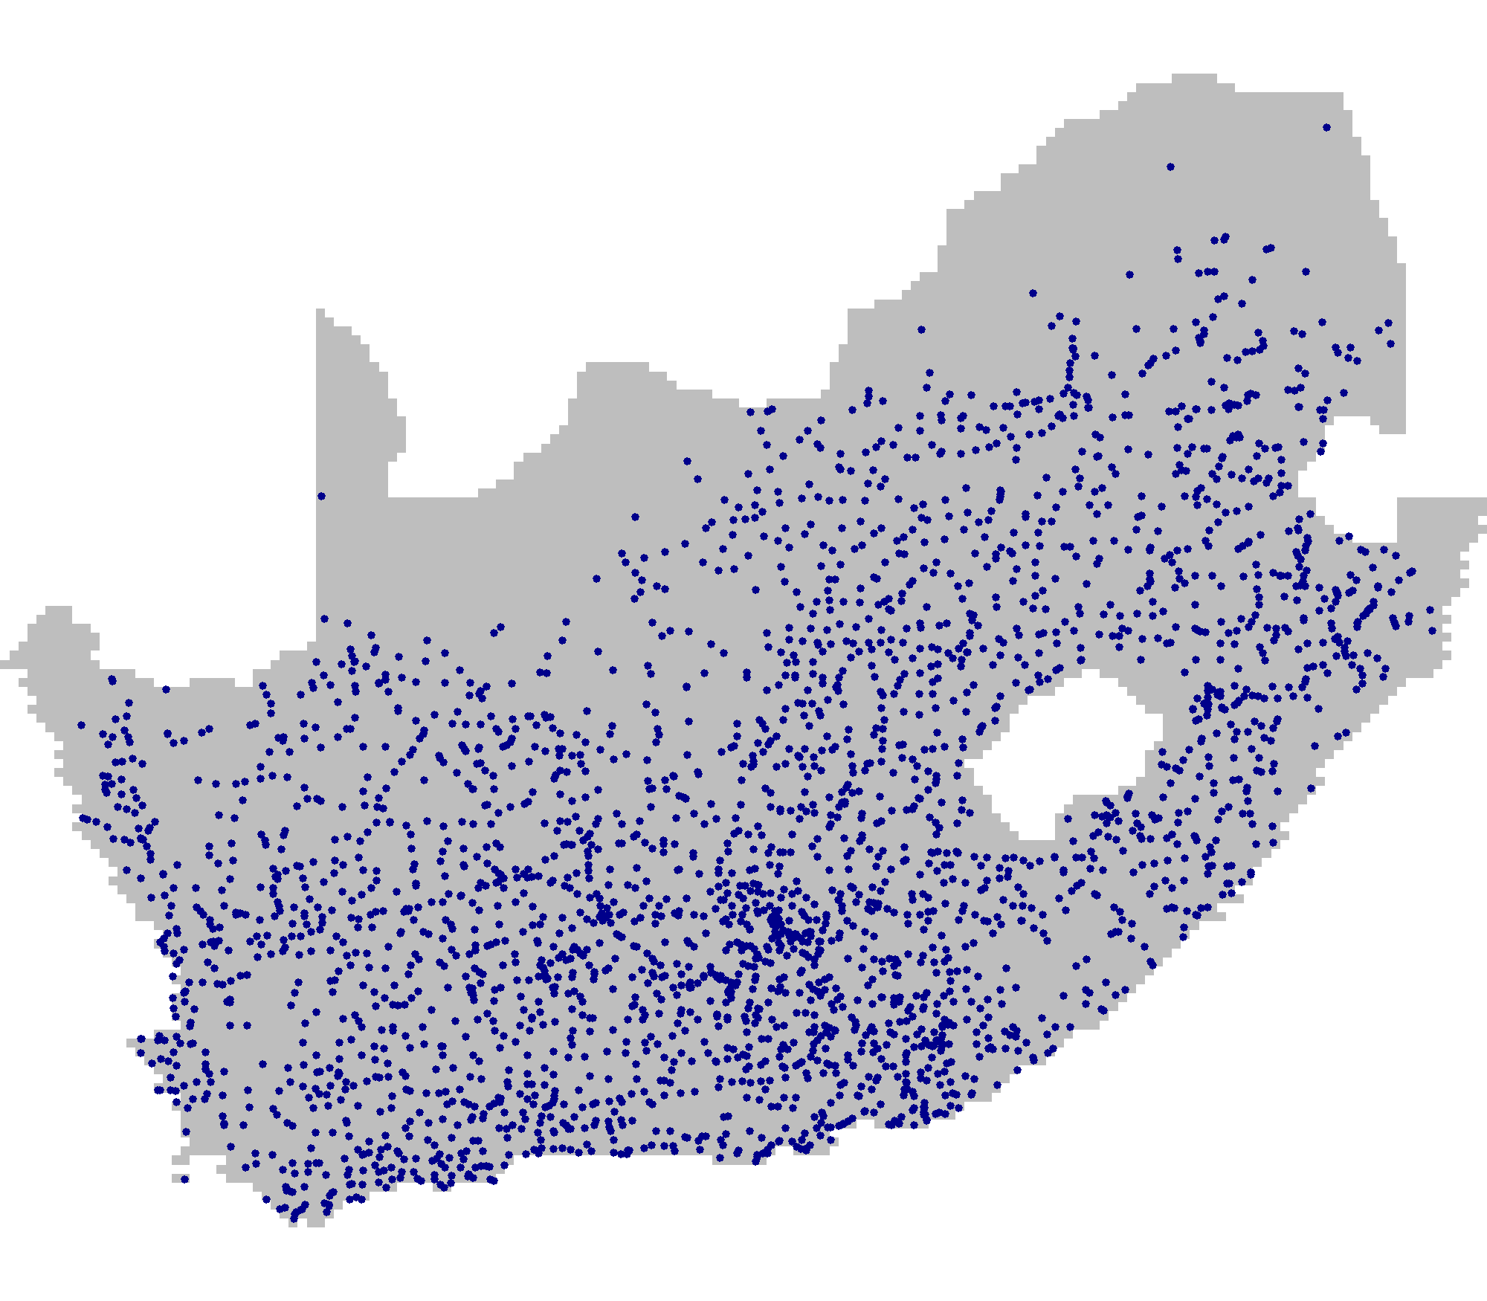
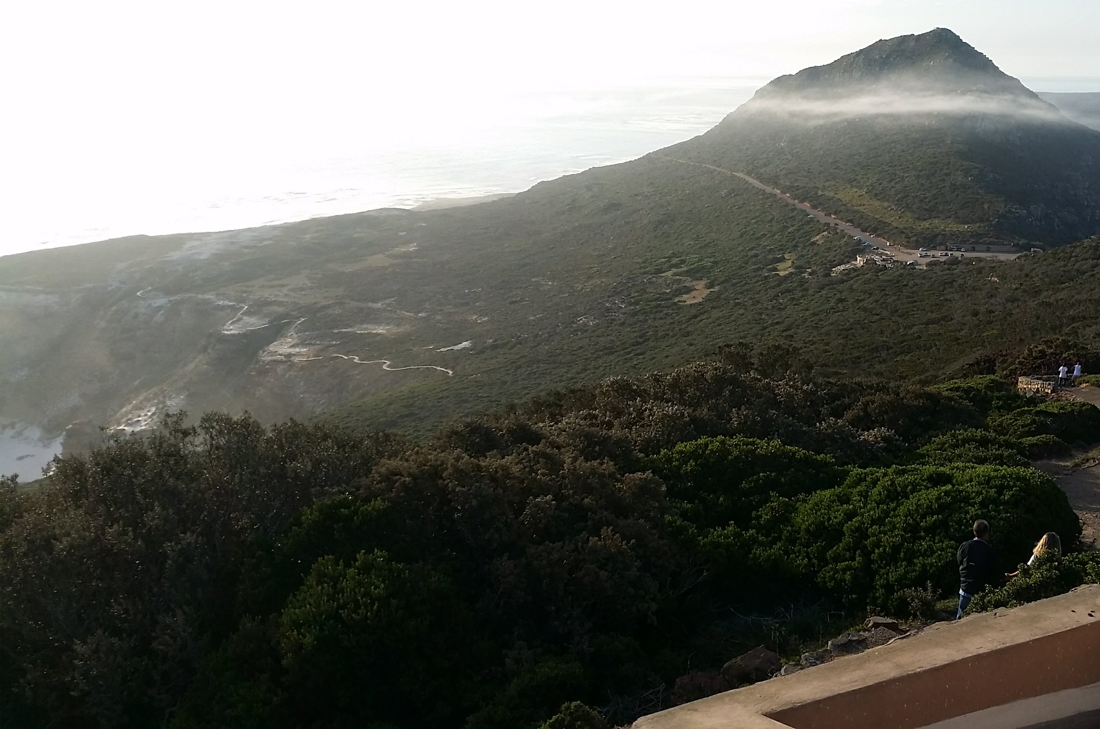
Mapping plant biodiversity trends in South Africa

Slide 23
Mapping plant biodiversity trends in South Africa

Slide 24
Multivariate spatial models in ecology using basis functions
Multivariate spatial model for biodiversity
Fit a log-Gaussian Cox process using mgcv
Multivariate point process models for co-occurrence
Basis functions
Factor analytic models

Slide 25
Factor analytic model also known as generalised latent variable model

Slide 26
Factor analytic model also known as generalised latent variable model

Slide 27
Generalised latent variable model software

Slide 28
Multivariate spatial models in ecology using basis functions
Multivariate spatial model for biodiversity
Fit a log-Gaussian Cox process using mgcv
Multivariate point process models for co-occurrence
Basis functions
Factor analytic models

Slide 29
Multivariate spatial models in ecology using basis functions
Multivariate spatial model for biodiversity
Fit a log-Gaussian Cox process using mgcv
Multivariate point process models for co-occurrence
Basis functions
Factor analytic models

Slide 30
Mapping plant biodiversity trends in South Africa
Basis functions
Factor analytic term

Slide 31
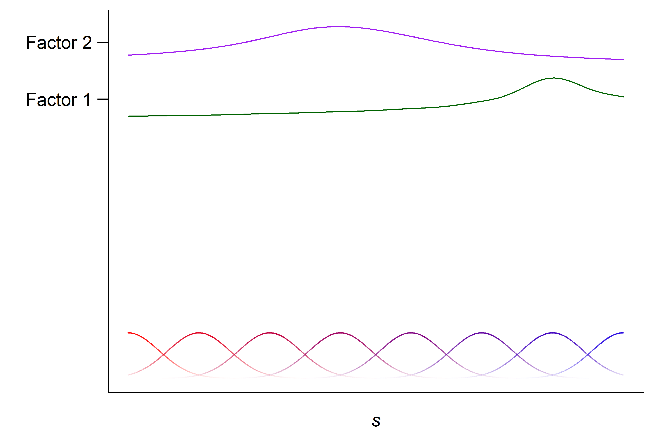
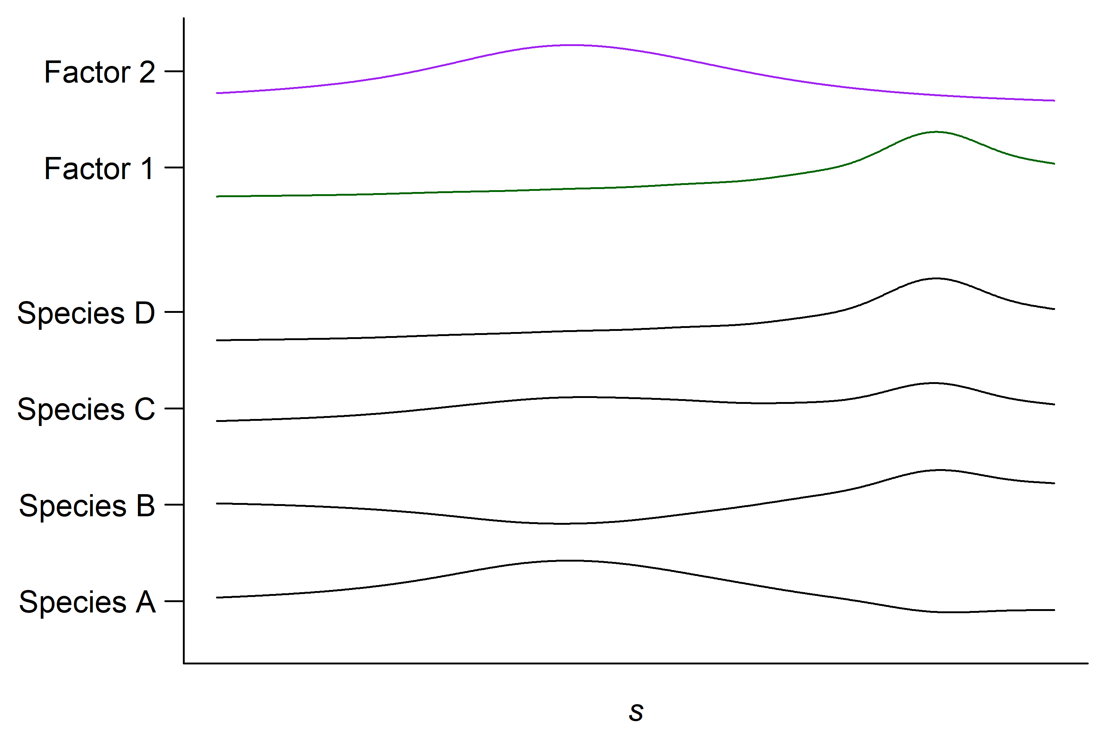
Mapping plant biodiversity trends in South Africa
(Hui et al. 2023)
(also see Tikhonov et al. 2020)

Slide 32
Mapping plant biodiversity trends in South Africa

Slide 33
Multivariate spatial models in ecology using basis functions
Multivariate spatial model for biodiversity
Fit a log-Gaussian Cox process using mgcv
Multivariate point process models for co-occurrence
Basis functions
Factor analytic models

Slide 34
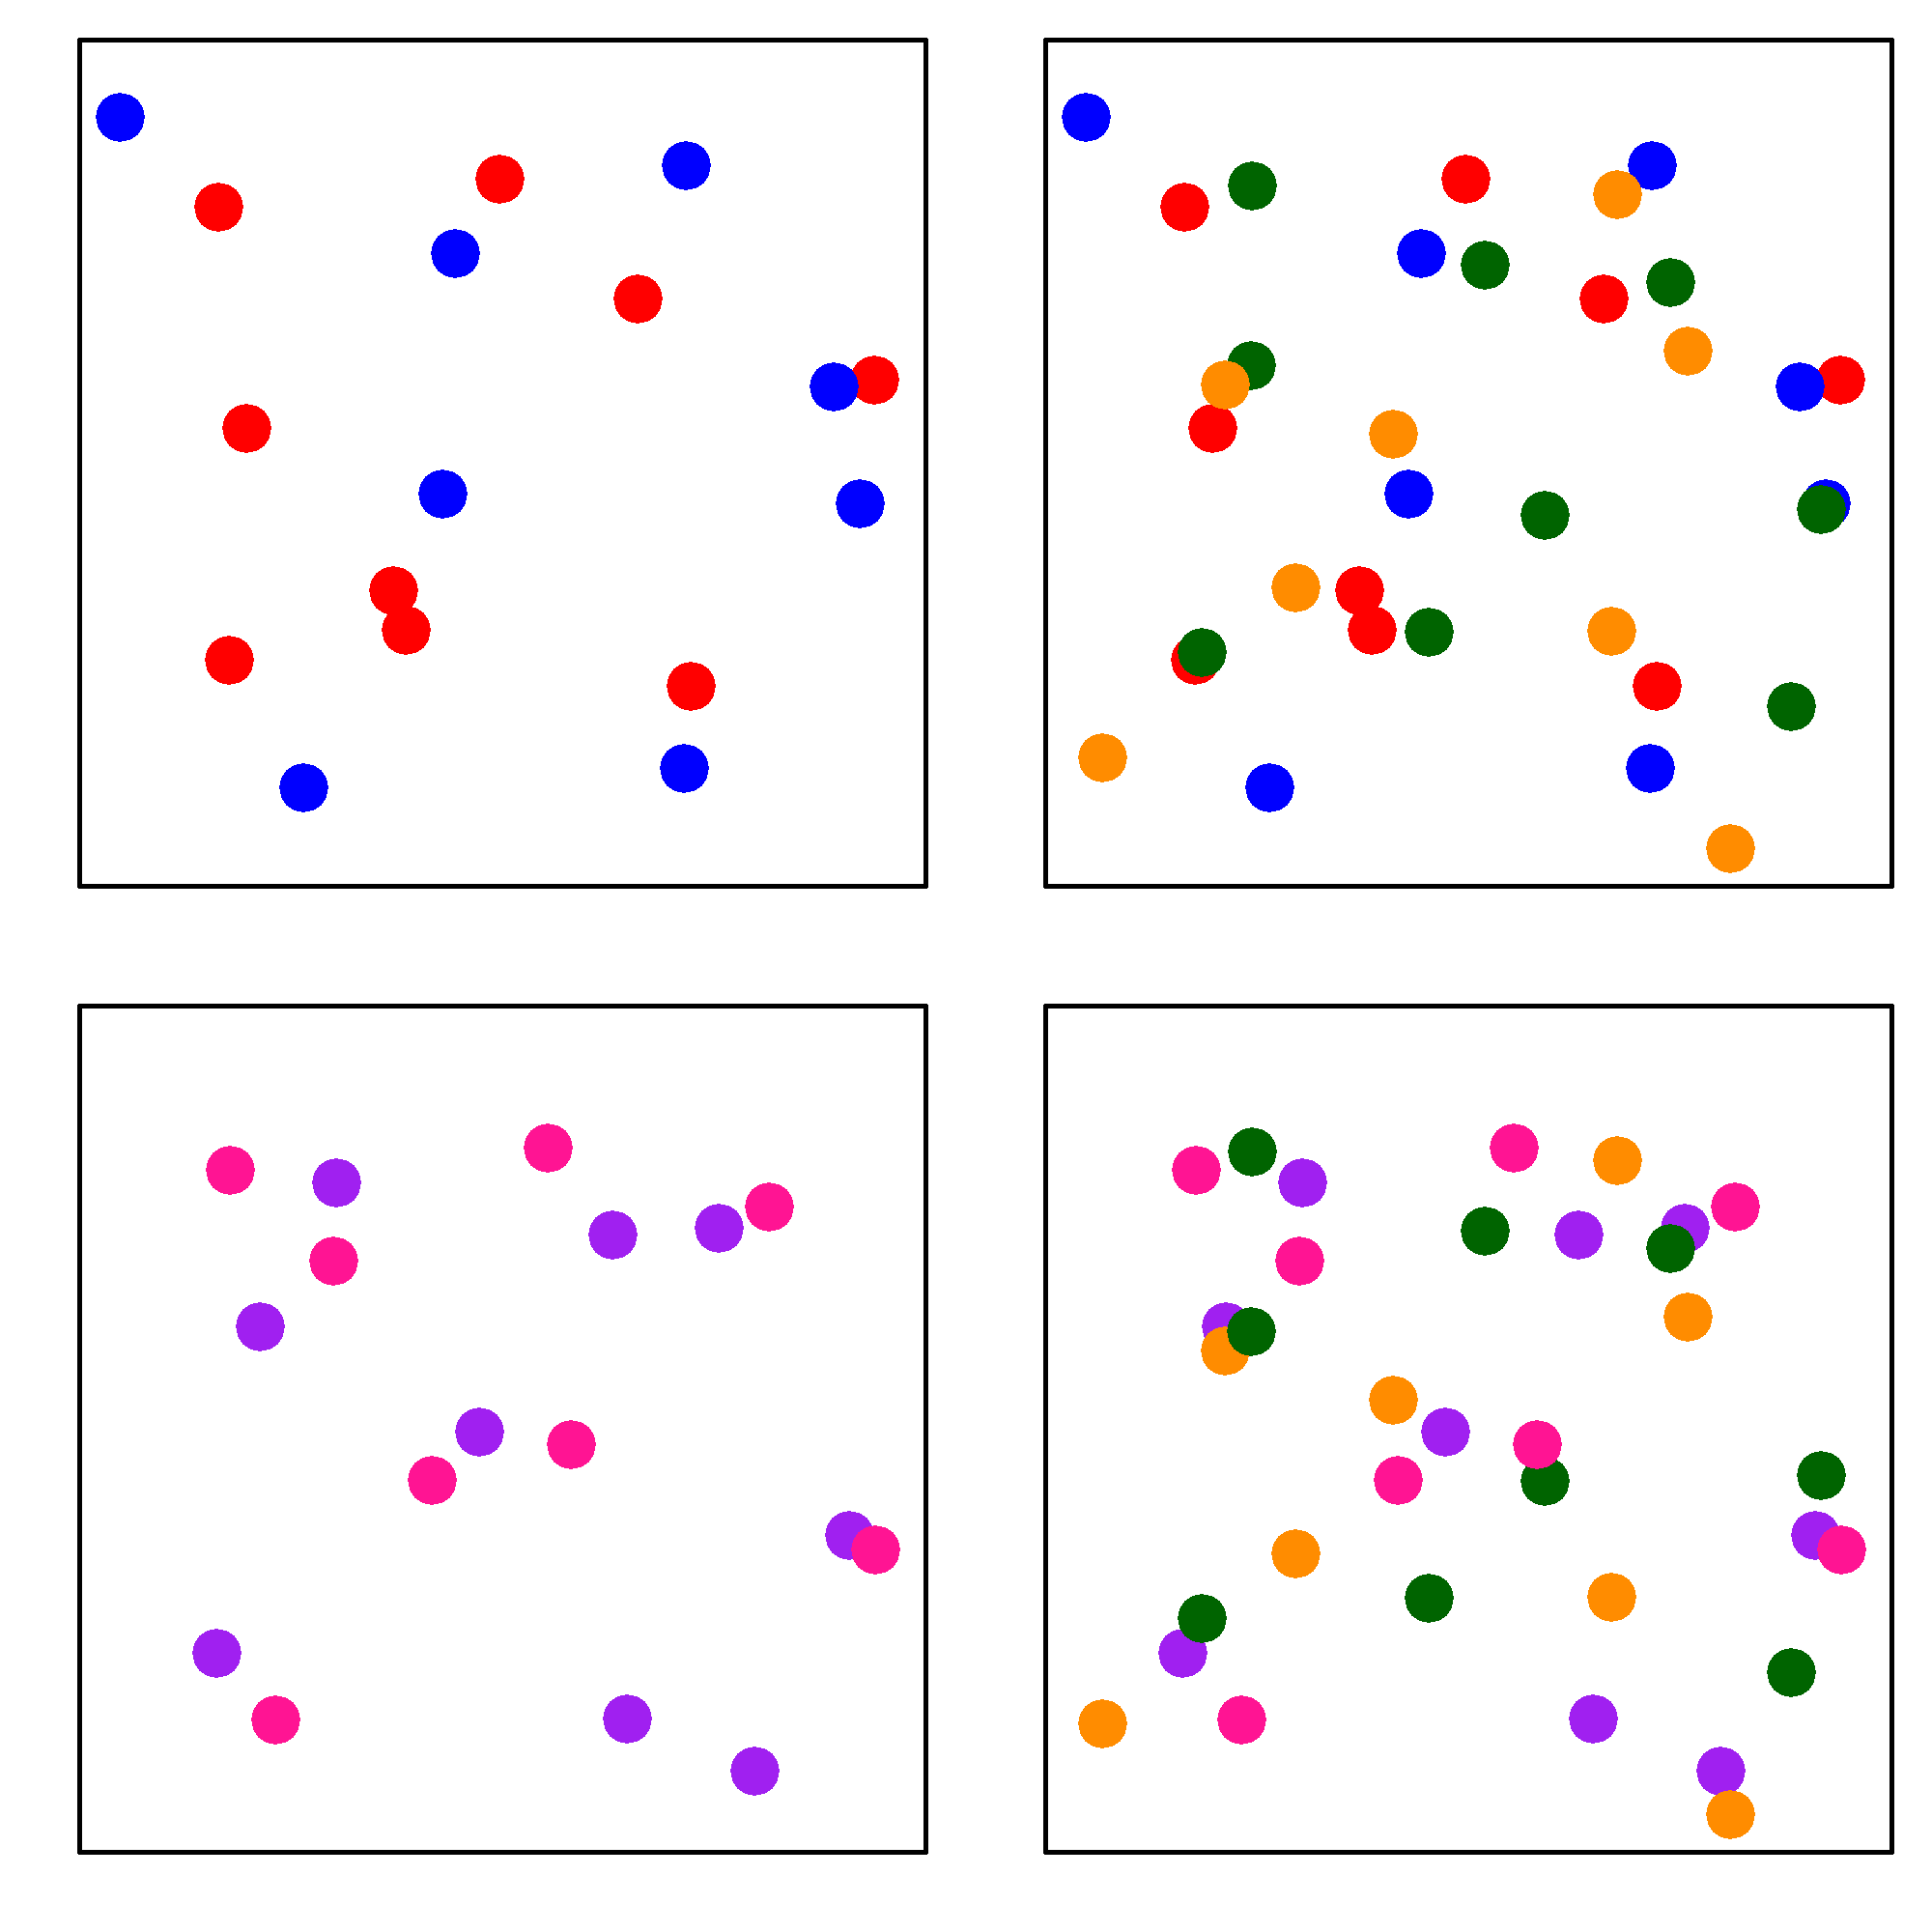
Mapping plant biodiversity trends in South Africa
α-diversity (species richness)
β-diversity
(species turnover)
(Whittaker 1972)

Slide 35
Mapping plant biodiversity trends in South Africa
α-diversity
β-diversity

Slide 36
Mapping plant biodiversity trends in South Africa

Slide 37
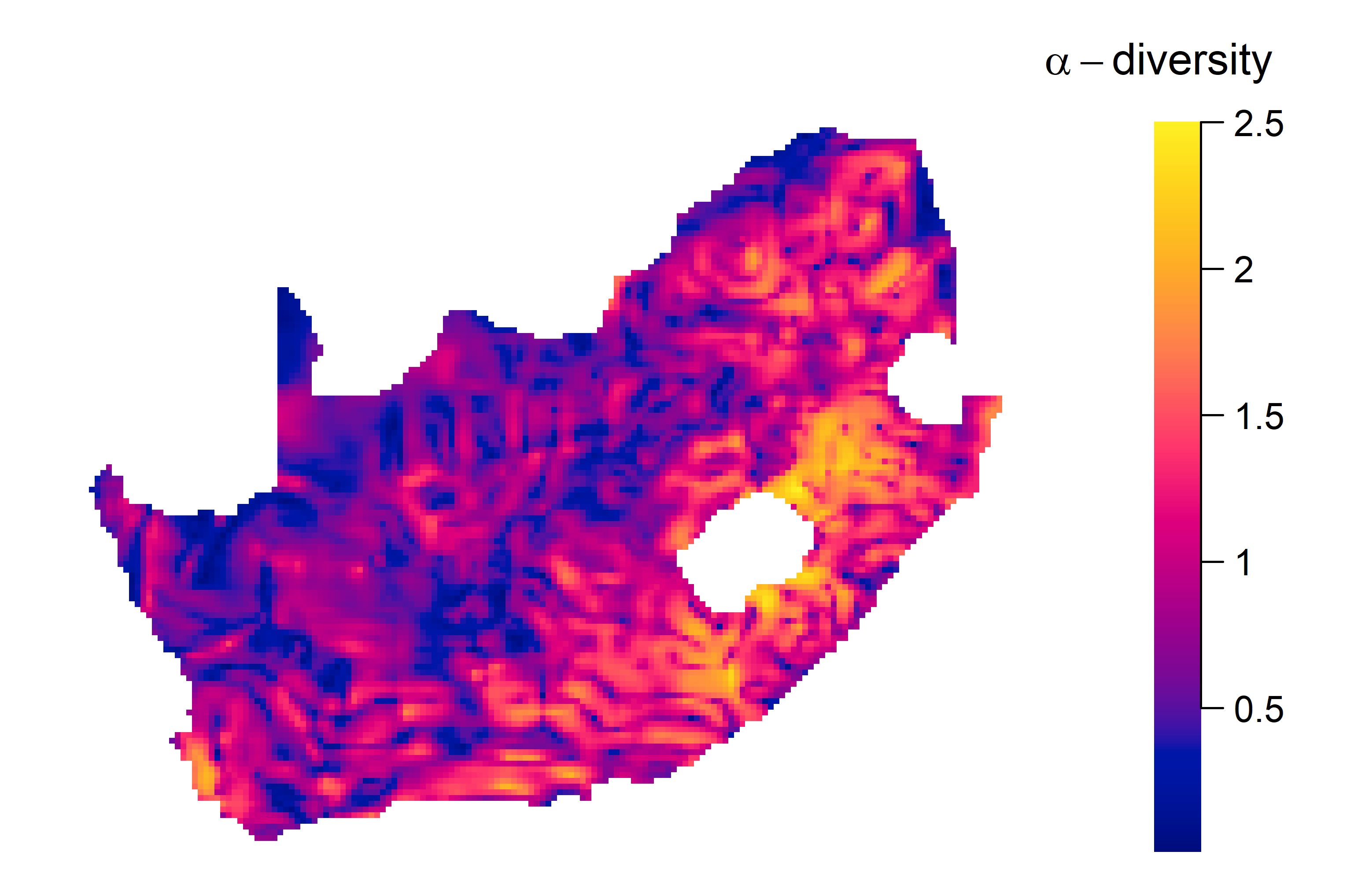
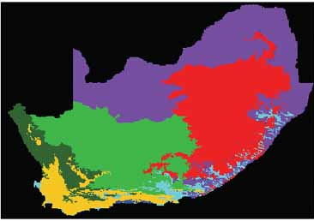
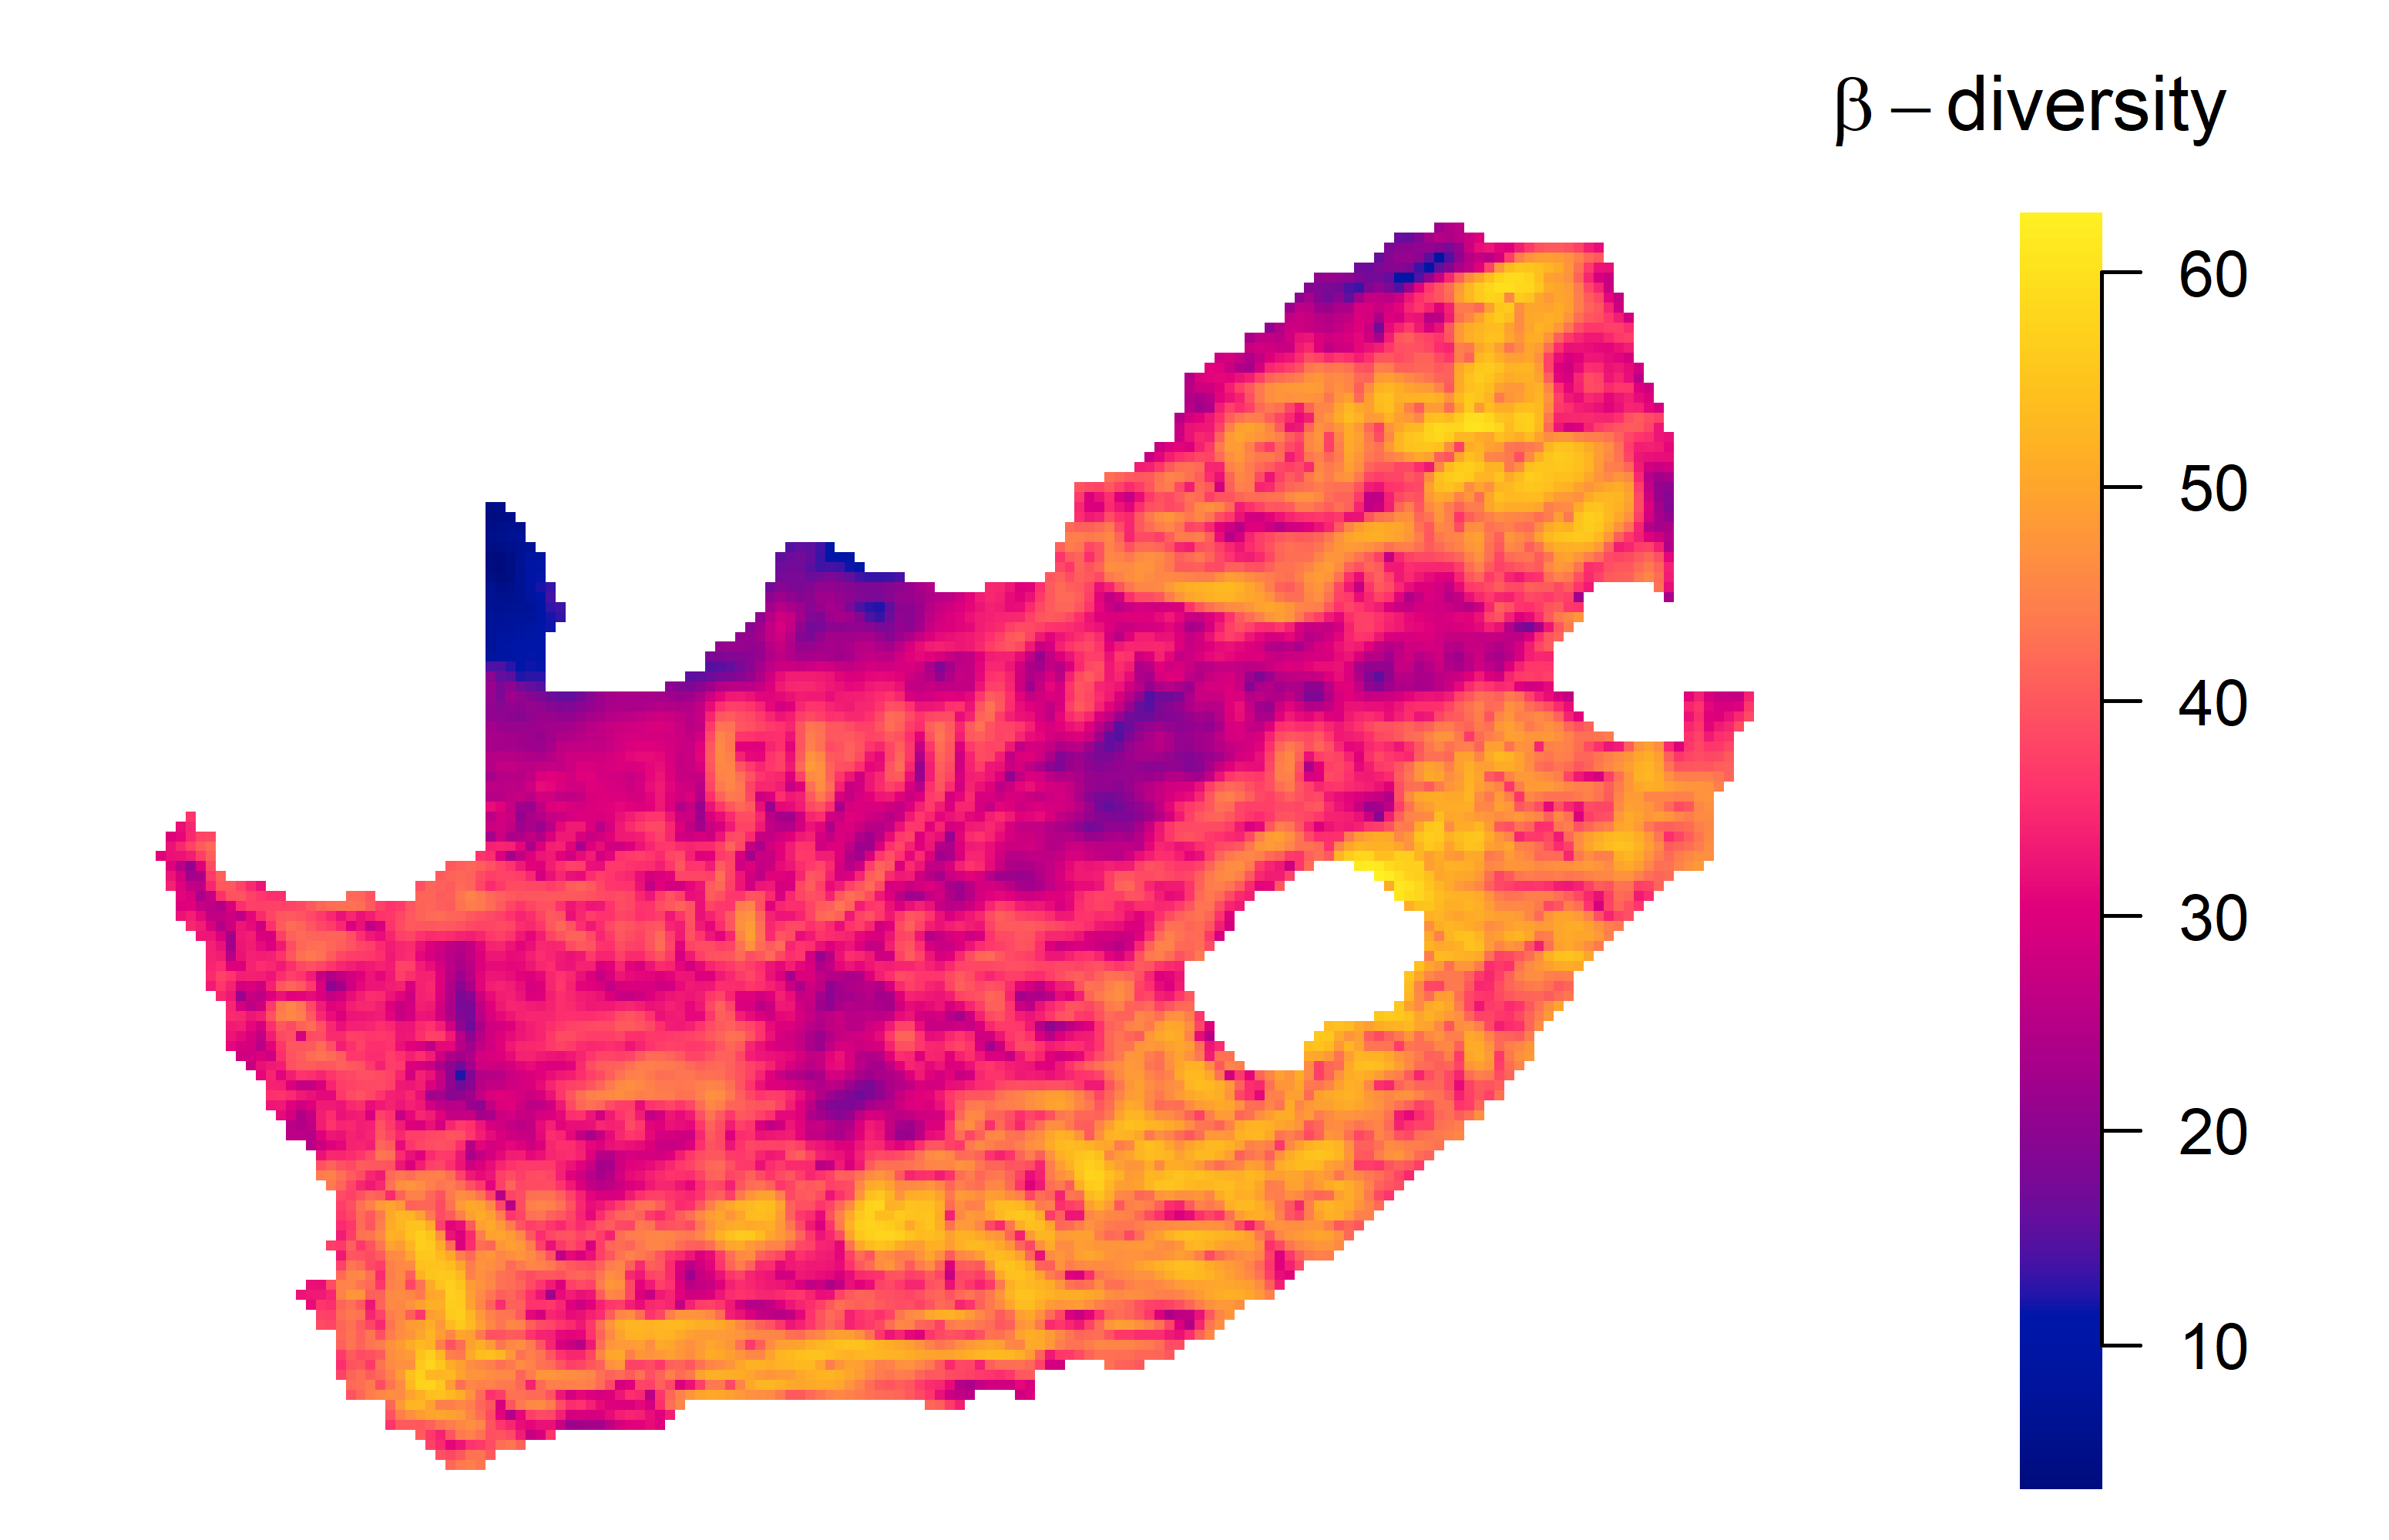
Mapping plant biodiversity trends in South Africa
34% of variation in α-diversity explained
24% of variation in β-diversity explained

Slide 38
Multivariate spatial models in ecology using basis functions
Multivariate spatial model for biodiversity
Fit a log-Gaussian Cox process using mgcv
Multivariate point process models for co-occurrence
Basis functions
Factor analytic models

Slide 39
Multivariate spatial models in ecology using basis functions
Multivariate spatial model for biodiversity
Fit a log-Gaussian Cox process using mgcv
Multivariate point process models for co-occurrence
Basis functions
Factor analytic models

Slide 40
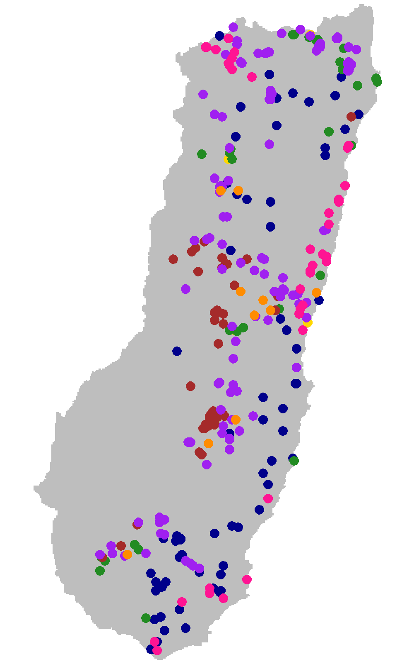
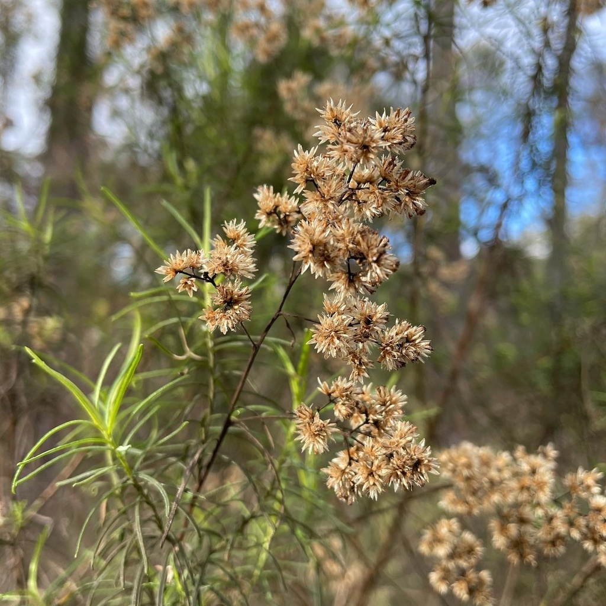
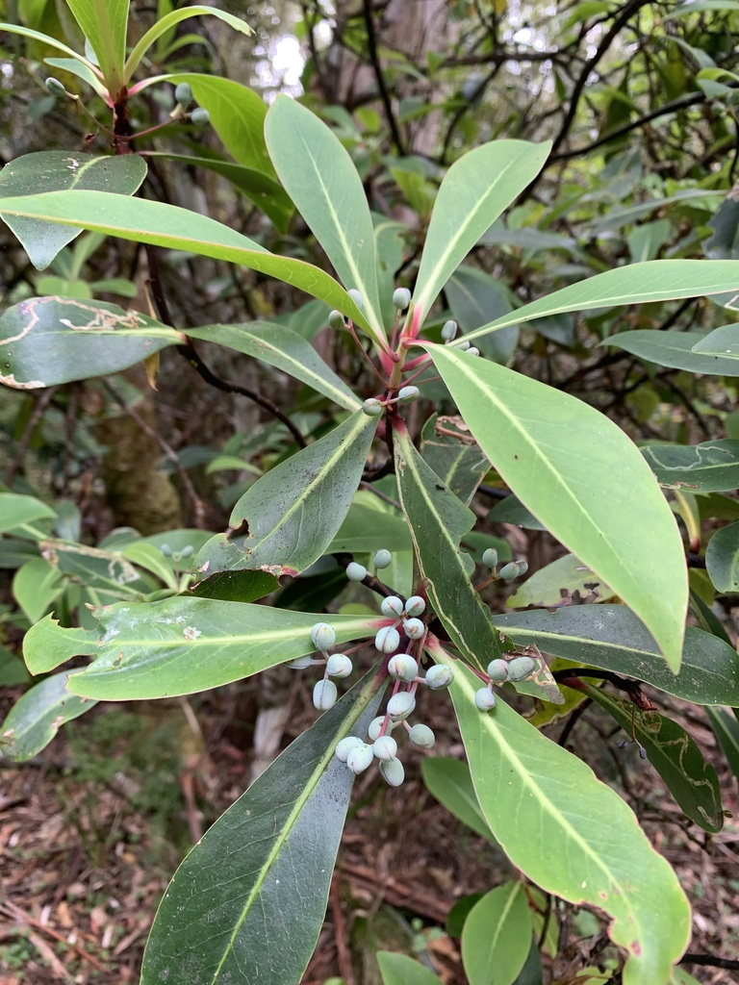
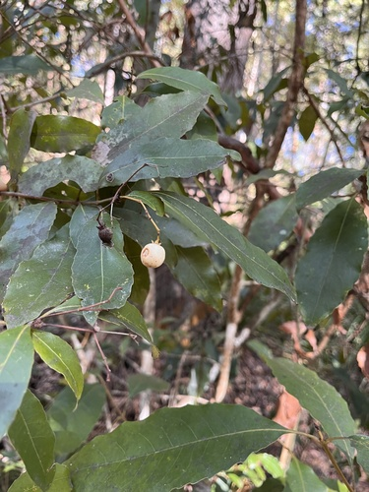
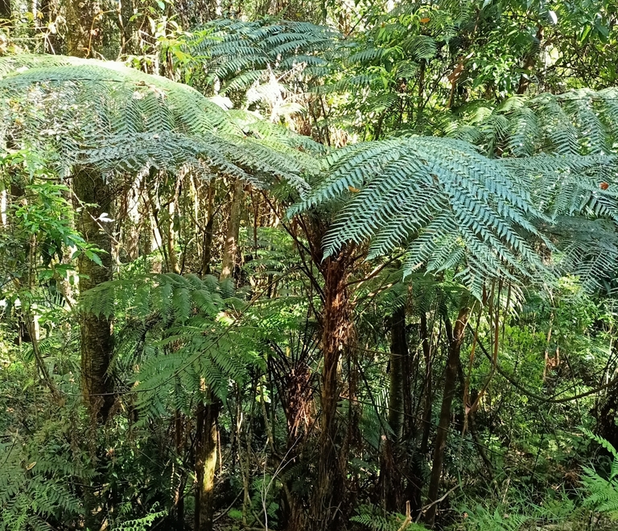
Multivariate point process models for biodiversity
missing predictors
observer bias
missing predictors + observer bias

Slide 41
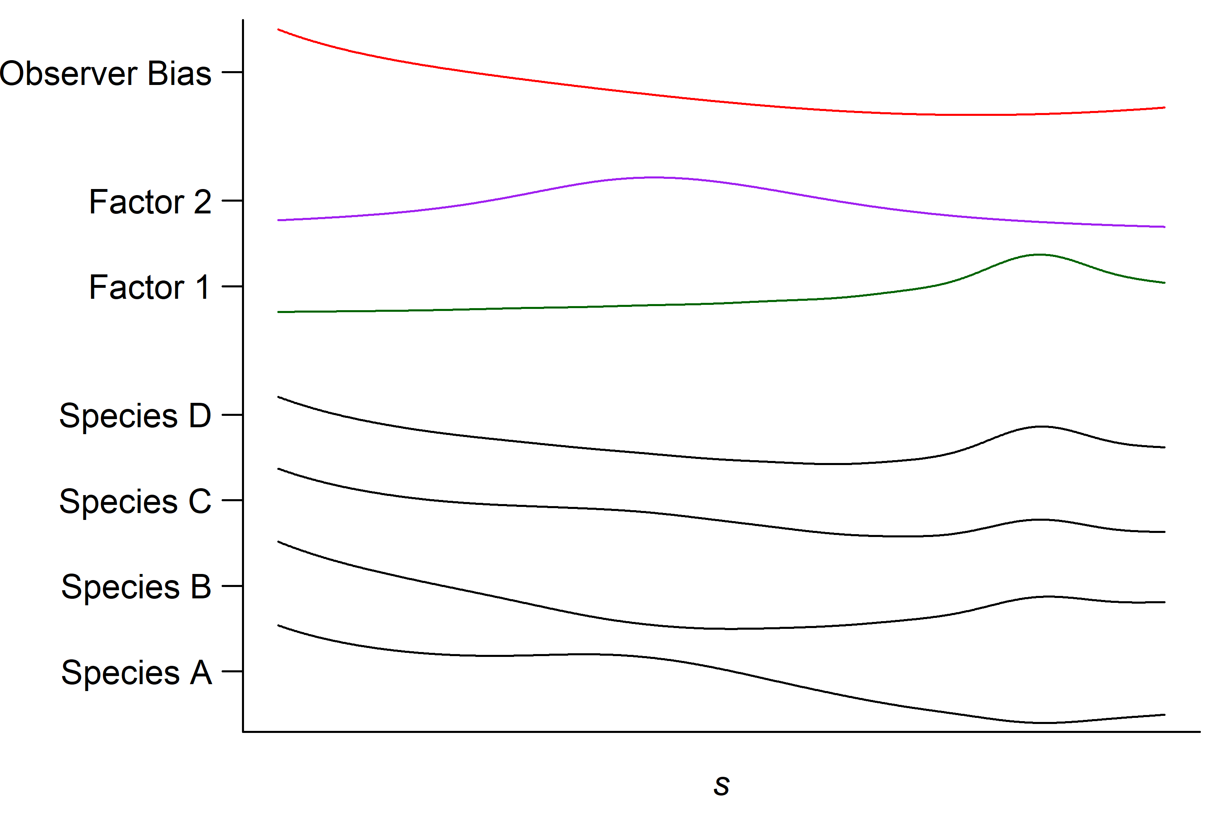
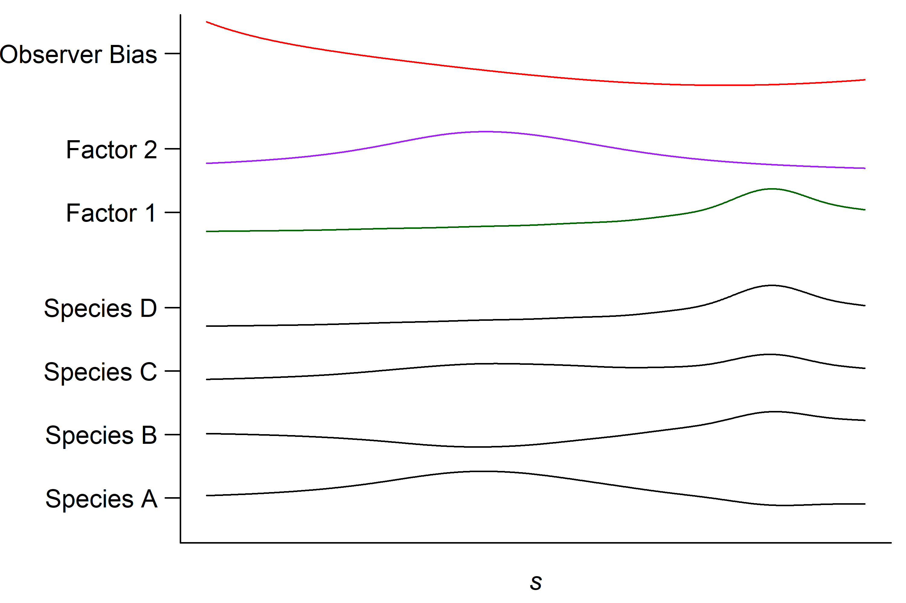
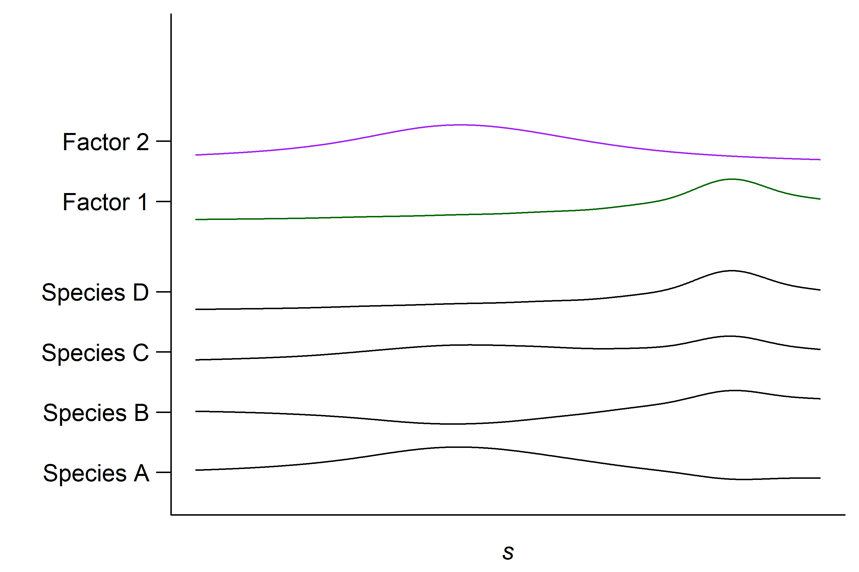
Correcting for observer bias using a multivariate model
assumption!

Slide 42
Multivariate spatial models in ecology using basis functions
Multivariate spatial model for biodiversity
Fit a log-Gaussian Cox process using mgcv
Multivariate point process models for co-occurrence
Basis functions
Factor analytic models

Slide 43
Multivariate point process models for biodiversity
basis functions
factor analytic term
numerical integration

Slide 44
Multivariate point process models for biodiversity

Slide 45
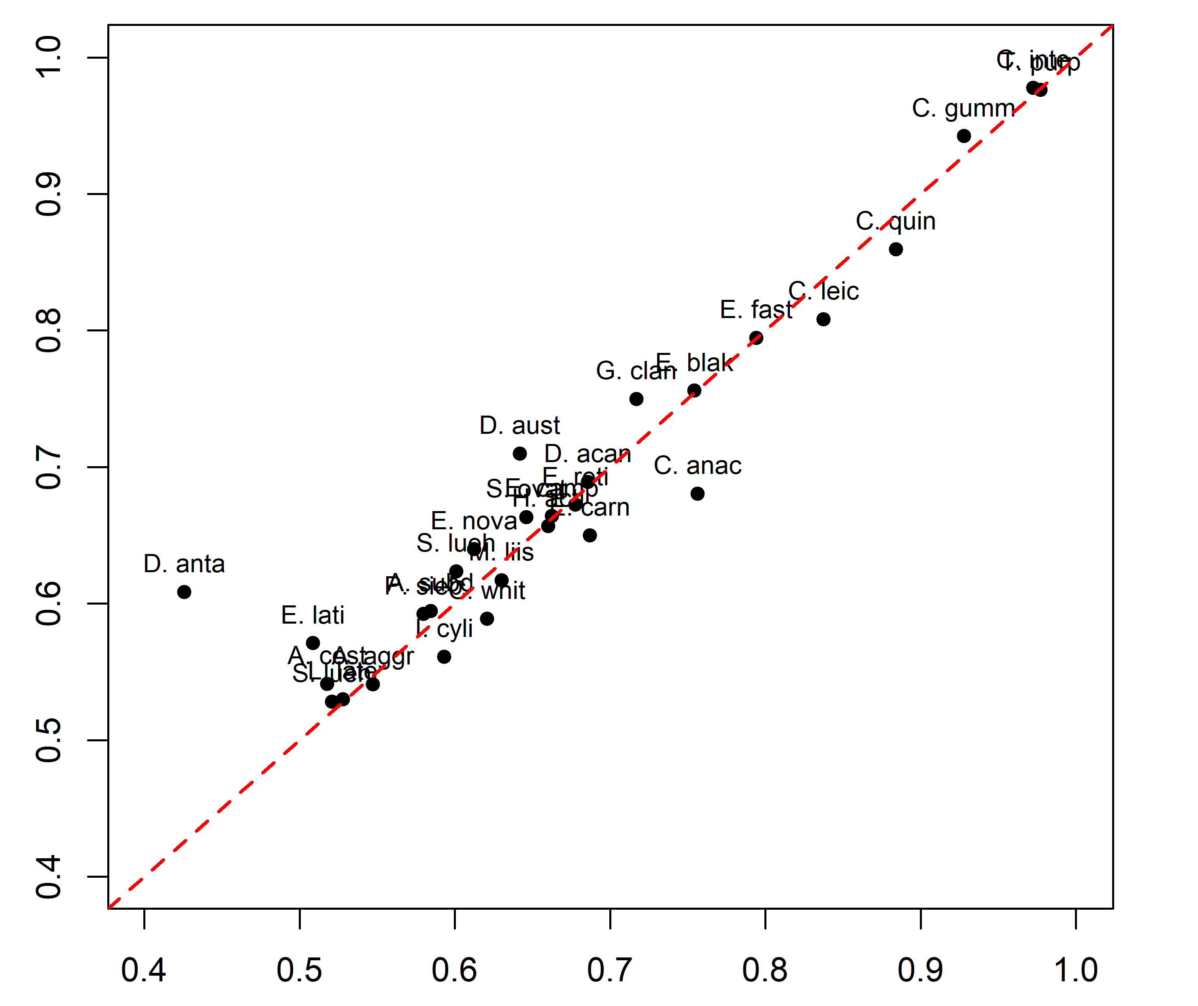
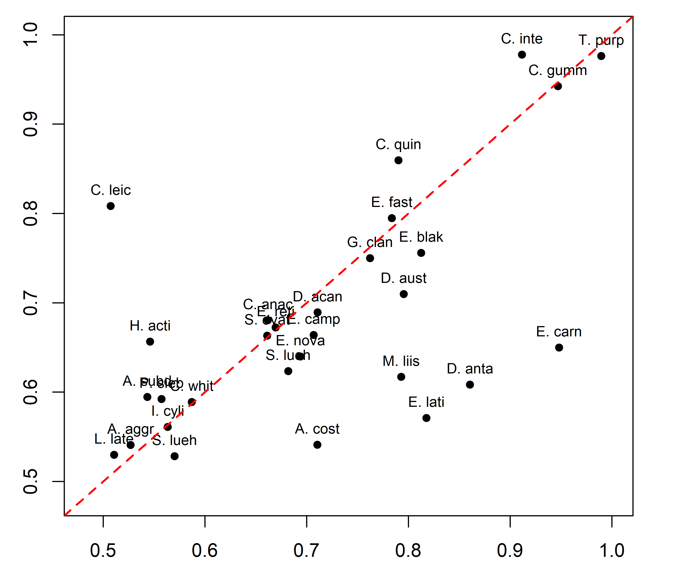
Correcting for observer bias?
multi-LGCP (bias correction)
multi-LGCP (bias correction)
multi-LGCP
LGCP (single species)

Slide 46
Multivariate spatial models in ecology using basis functions
Multivariate spatial model for biodiversity
Fit a log-Gaussian Cox process using mgcv
Multivariate point process models for co-occurrence
Basis functions
Factor analytic models

Slide 47
Multivariate spatial models in ecology using basis functions
Multivariate spatial model for biodiversity
Fit a log-Gaussian Cox process using mgcv
Multivariate point process models for co-occurrence
Basis functions
Factor analytic models

Slide 48
Multivariate spatial models in ecology using basis functions
Multivariate spatial model for biodiversity
Fit a log-Gaussian Cox process using mgcv
Multivariate point process models for co-occurrence
Basis functions
Factor analytic models

Slide 49
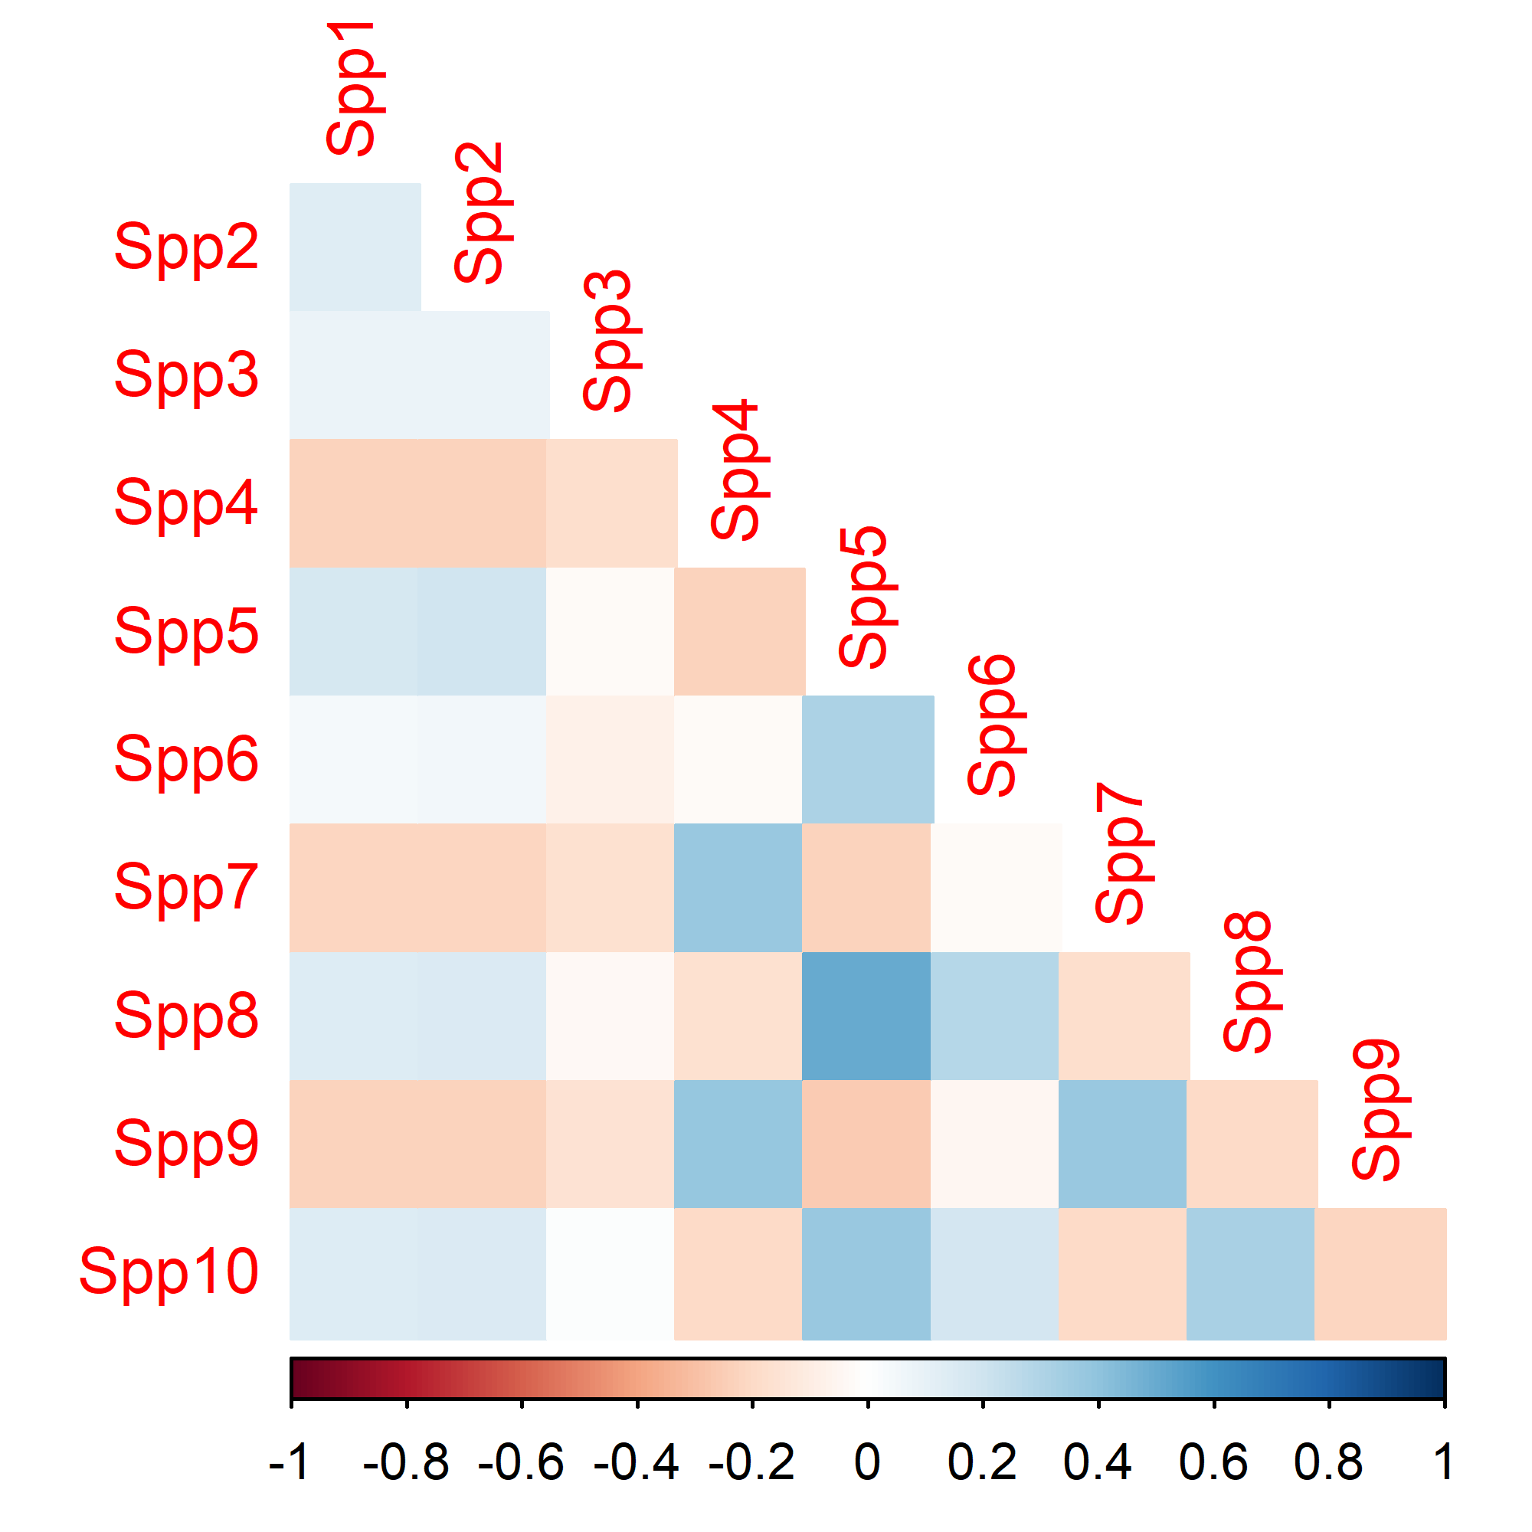
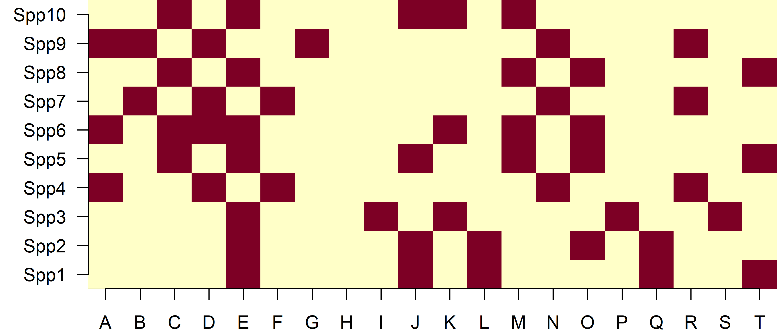
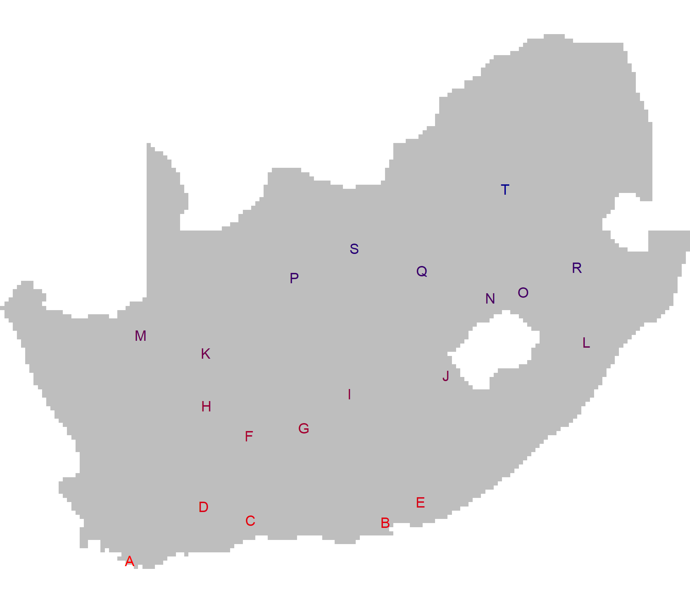
Co-occurrence from a generalised latent variable model

Slide 50
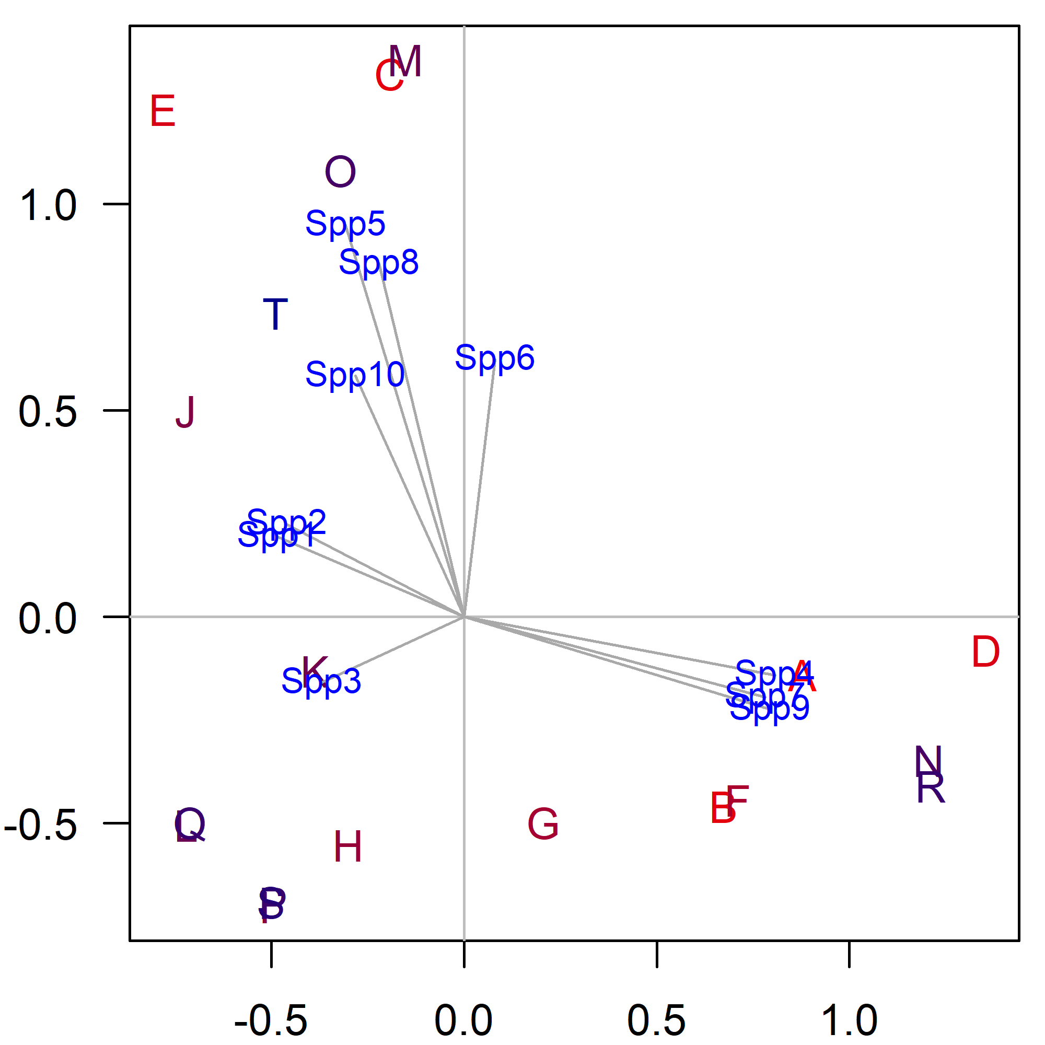
Co-occurrence from a generalised latent variable model
(also see Pledger & Arnold 2014)
Can we do this for point event data?

Slide 51
Can we infer co-occurrence from point event data?

Slide 52
Multivariate spatial models in ecology using basis functions
Multivariate spatial model for biodiversity
Fit a log-Gaussian Cox process using mgcv
Multivariate point process models for co-occurrence
Basis functions
Factor analytic models

Slide 53
Inferring co-occurrence from point event data

Slide 54
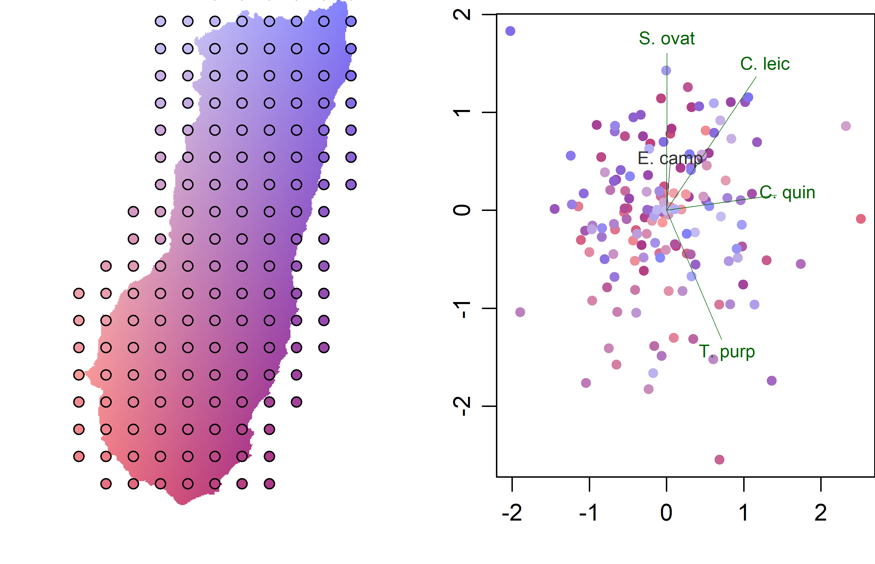
Inferring co-occurrence from point event data

Slide 55
Inferring co-occurrence from point event data

Slide 56
Future work

Slide 57
Acknowledgements

