Slide 1
Toward PAN-CRI Māori Data Governance Principles

Slide 2
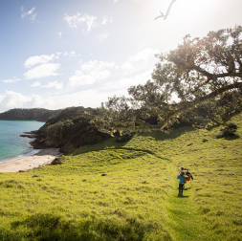
Acknowledging Nga tangata o te whenua in this korero
Notes:
Acknowledging those here in the room today
- Mana Whenua, the local people, Ngati Kawa
- AgResearch’s partner Te Pu Oranga Whenua, Lisa
- Lisa has discussed tikanga, what good practice looks like, my focus today is really digging into pieces of work done to attempt to procedularise these MDS principles in primarily non-maori environments; i.e. the crown research institutes.
- the focus is very much going to be on some work that I’ve done with lisa on describing concrete, actionable best practices during the data lifecycle, and I will also discuss on Linley Jesson’s behalf a significant piece of work that she has led in developing a shared set of principles for the 7 CRI’s

Slide 3

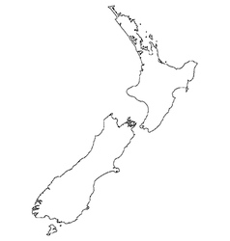

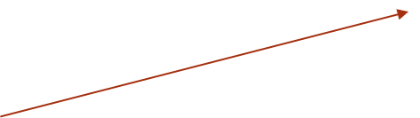
Grandads Beef
Regenerative Farming
Tracey Bayliss
Tū Te Pō Tū Te Ao – Beef & cosmeceuticals
Kiri Edwards
Thornton Whanau Trust -
Diverse landblocks, (Raupunga)
Theresa Thornton
Waingaroa Hapū Farms – Leased farmland
Meti Hughes & Jaleesa Osborne
Pukeiahua Trust – land occupation
Kimai Huriama
Ngāti Pāhauwera Devel. Trust & Paroa Trust
Iwi land development
Bonnie Hatami
Ora Innovation Group
Skincare product development with Mamaku
Karen Renata
Karatea Whānau Farm – Finishing farm
Taruke Karatea
Te Hanga Trust –Sheep Milking
Roma Balzer
Ngaporo Waimarino Forest Trust & Pipiriki Inc. – Pine Forest / Manuka / Mamaku
Smith Warbrick & Associates
Lisa Warbrick
TakiToa (Inter-Regional)
Lisa & Tracey
Notes:
I have been working closely with Lisa, who in this context was wearing her hat as one of 3 pou ->leaders of te pu orange whenua, which is an interregional collective of Māori Agribusinesses which are led by Wahine (the ladies)

Slide 4
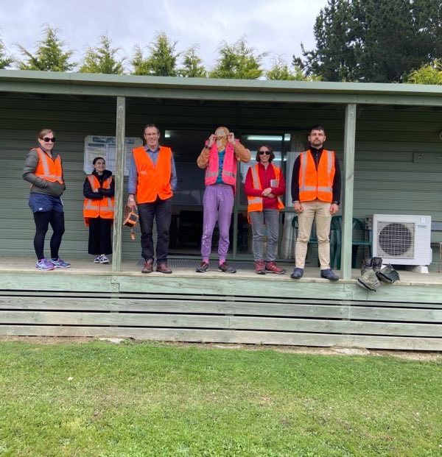
Embedded cultural partnership
Fully funded by the research programme
Relationship building
Genuine co-innovation
‘He aha te mea nui o te ao? Māku e kī atu, he tangata, he tangata, he tangata’
What is the most important thing in this world? It is people, it is people, it is people.
Notes:
Hugely influential in how this programme played out, and where we ended up with a co-innovation data lifecyle framework, leading to the idea that this ongoing conversational characteristic of data providers vs. data users be flipped on its head…formalizing the opportunity to take a more collective approach
How was this enabled?
- Fortnightly informal hui
- Regular formal workshops, wananga, seminars and workshops, and noho marae hosted by both partners
Co-design - Outcomes driven by reciprocity, transdisciplinarity, and continuous co-design, development and implementation

Slide 5
Timeline
CRI data managers become increasingly aware of implications of MDS
2018
2023
Māori Data Sovereignty principles arguably framed in Māoridom from as early as the 1970’s
2016 Wai262 acknowledged: Māori sovereignty over Taonga, and addresses the ownership and use of Mātauranga Māori
2020 Wai2522 indicates that data about Taonga is also Taonga
Pan-CRI MDGov working group established
Pan-CRI + TPOW + IGI SLMMC proposal – what makes data tikanga?
Pan-CRI MDGov principels ratified by Te Ara Putaiao
Te Kahui Raruanga release MDGov framework – Stats NZ begin implementing across Gov. agencies
Co-designed data gov. lifecycle in review
Notes:
This is a very VERY brief outline of salient points, and the main message I want to takeaway from this slide is, the fact that, from our point view within the CRI’s, and others in the cri’s the challenge was, how do we implement and operationalize existing principles for maori data governance? And this included more high level, pan cri- activities such as the Pan CRI MDG working group to develop shared principles, but also more grass roots research programmes that focus on co-innovation an understanding of what ‘good’/ or ‘tikanga’ looks like in terms of how we think about and work with data from the ground up.
At the same time, the iwi-leaders group in te kahui Raraunga were developing the framework that was released a few short months.

Slide 6
Te Kāhui Raraunga

Slide 7
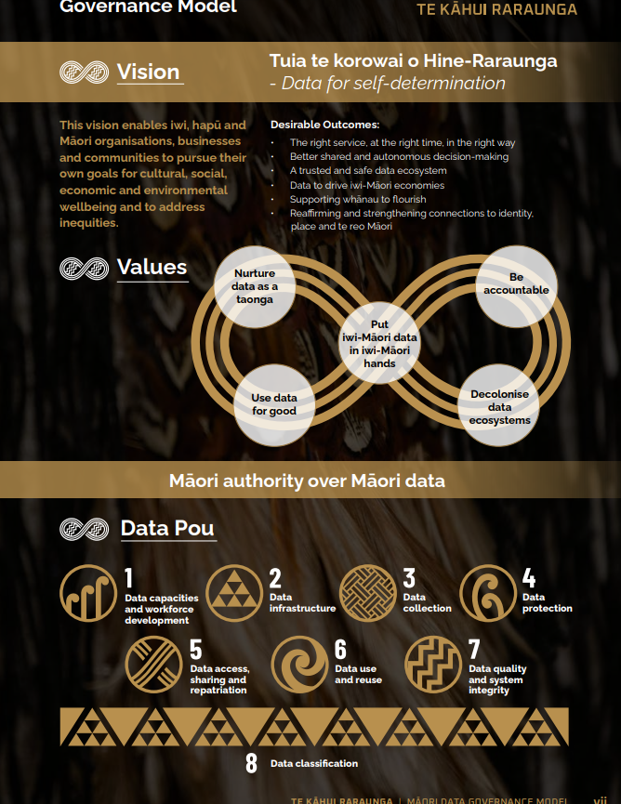
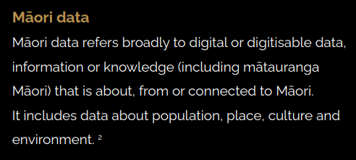
Te Kāhui Raraunga Māori Data Governance model
https://www.kahuiraraunga.io/maoridatagovernance
Notes:
Te Kahui Raruanga Co-Designed a Māori Data Governance frameoworkwith the Crown led by Dr Tahu Kukutai
*This data governance model has just come out
*serious thinking from Data Iwi Leaders group
*stats NZ are in partnership with Te Kahui Raraunga to see this enacted
The stated objective is that this framework will build on MDS principles and “design, operationalize and implement what good governance look like for good data” – Dr Tahu Kukutai
Acknowledging this is a whole korero which is not mine to speak to, I encourage you to check this out online, but some key points and phrases
“fixation with privacy and personal data doesn’t address the fundamental issues with data that is conceived of and belongs to the collective – we need a new way of thinking about data” -> this co-design approach is the foundation of our work in AgR…

Slide 8
Pan-CRI Maori Data Governance

Slide 9
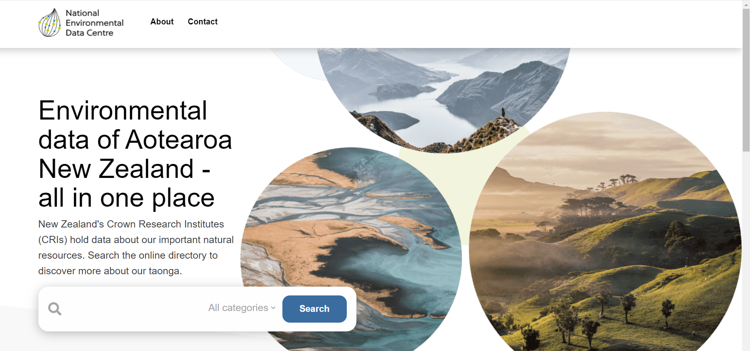
National Environmental Data Centre
CRI’s explicitly acknowledge that [some of the] data we hold is taonga
Sovereignty of these taonga is guaranteed by Te Tiriti
Notes:
CRIs hold considerable amounts of data. Much of this data is about Māori, about the environments Māori have relationships with or about species considered taonga. Sovereignty of these taonga is guaranteed by Te Tiriti, but it is only recently that CRIs have started to consider the implications of what this means
Here we directly STATE ‘search the directory to discover more about our taonga’ we are acknowledging across the cri’s that the data we hold is taonga

Slide 10
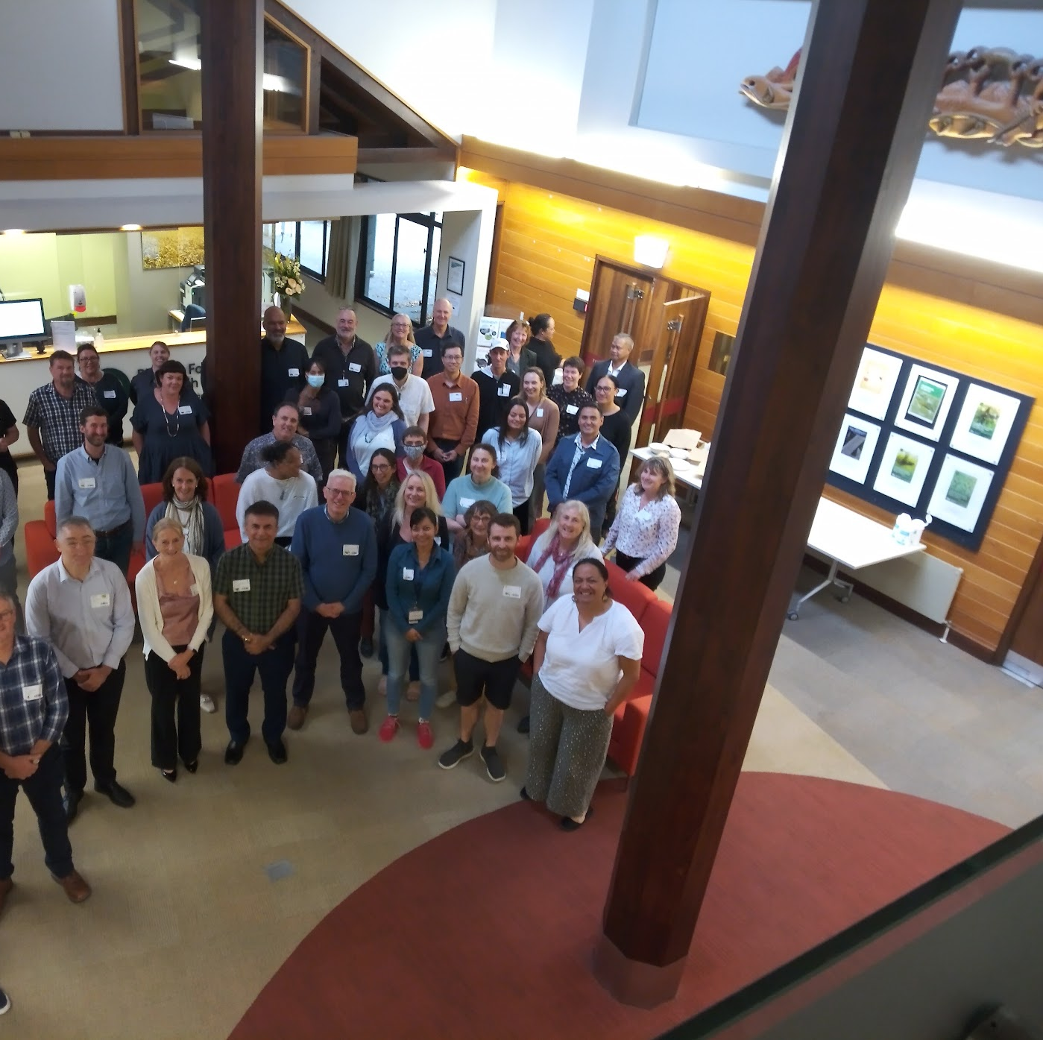
Convening the governance Group
Notes:
2018 Ramona Radford – Māori Relationships Manager at Scion contributed to MBIE data platform bidding workshop stood up and talked about WAI262 and why it was important
Linley Jesson went back to PFR and got some internal SSIF funding to do an audit of processes around Māori data in PFR
Nauman Maqbool in AgR developed data governance principles document which left ample space for inclusion of pirnciples as they developed
In Manaaki Whenua have a Māori Data Governance Group
key players in other CRI’s leading out initiatives… e.g.
NIWA, GNS also active in setting up NEDC
Then Linley decided to go big with Stacey’s support ultimately got pan CRI buy-in and sponsorship through Te Ara Pūtaiao (directors of the Maori research and partnerships departments across all the CRI’s) – pan-CRI Maori Data governance working group really got going ~2021
Although initially made up of data managers and scienctists, over time this has evolved, and the working group now consists of data users, data managers, Maori researchers, and Maori engagement managers

Slide 11
Ratified, Pan-CRI Principles for Māori Data Governance
P1 - We are good Te Tiriti partners with Māori and with other stakeholders to guide all aspects of the data life cycle
P2 - We collect, manage and use data within ethical frameworks
P4 - We collect, manage and use data within legal frameworks
P5 - We collect, manage, use and share data for the benefit of Aotearoa New Zealand
P3 - We collect data for scientific endeavours
Notes:
- these principles have been tested with broader CRI community who are interested in taonga data
- ratified by Te Ara Putaiao October 2023

Slide 12
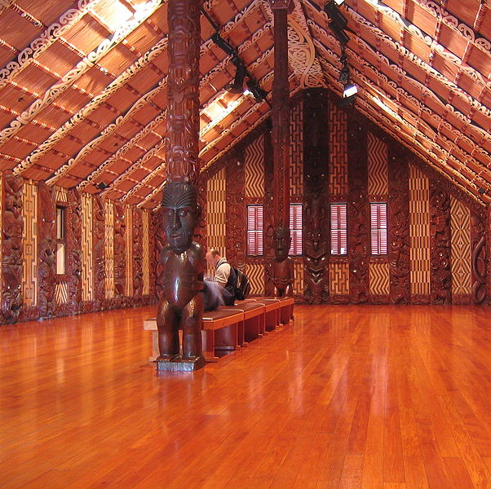
What next? Pou 8…What data…
should be classified as Māori data,
is of special significance to specific Māori collectives
is for Māori, about Māori, by Māori
requires special legal or extralegal protections
can generate economic opportunities (e.g., commercialisation)
is sensitive because, if disclosed or misused, has a greater risk of resulting in harm
Notes:
Māori data classification framework is urgently needed, rather than a series of ad hoc, disconnected organisational decisions and practices. Such a classification should prioritise Māori values and tikanga (e.g., tapu, noa, mana, hau, mauri) and relational ways of thinking about data, and be Māori-led and designed. It is critical to know which data:
For stats nz, pou 8 is the priority…. Summary of stats nz priorities. They are encouraging agencies to do this work too.
As PFR is not a Crown agency (hence why we have to enter contracts when dealing with Crown agencies such as MFAT or MPI), PFR is not ipso facto bound by the legal obligations of the Crown, such as the need to comply with Te Tiriti o Waitangi. Nor is PFR legally bound to comply with Te Tiriti o Waitangi by virtue of the Crown Research Institutes Act 1992 (except in relation to property transfers) or the Crown Entities Act 2004.
Although PFR is under no legal obligation to comply with Te Tiriti o Waitangi, I note, however, that the Annual Letter of Expectations for 2023/24 received from our shareholding minister, The Honourable Doctor Ayesha Verrall, does contain the following direction:
“… it is expected that entities will: ….. Give effect to Te Tiriti O Waitangi obligations and expectations, …”.
Whilst a shareholding minister’s expectations do not amount to legal obligations, they are backed up by the power of the majority shareholder to dismiss any or all PFR’s directors. In this regard I note that “Minister dismisses the board” is classified as a “Catastrophic” consequence in the PFR Risk Framework and so anything that could trigger such a dismissal would warrant careful consideration by PFR management.

Slide 13
AgResearch: Digital Innovation Case study
Notes:
Integrated Technologies and data

Slide 14



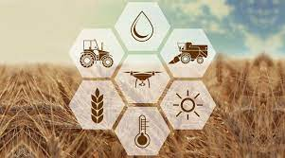
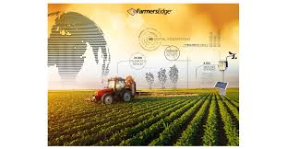

Imagining Digital Innovation
The vision is that of informed, timely decision making is based on the idea of passing information from different technologies to create an integrated story, both on farm and through the value chain
Notes:
BUT
- often on intensive primary sector usecases
- smaller scale
- What is the value proposition for sheep/beef sector?

Slide 15
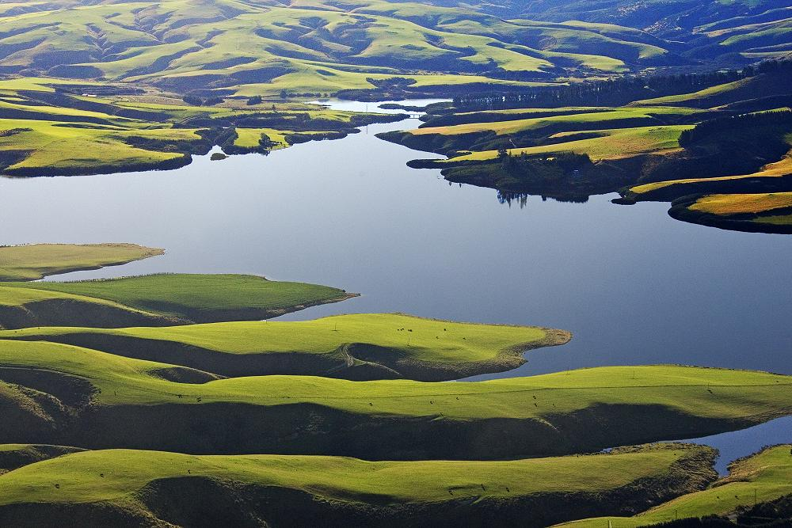
But…
Uptake of digital technologies remains slow and challenged in many contexts… e.g. NZ Agritech ITP report 2020, Shepherd et al. 2018, Stevens et al. 2023 including:
Complexity of data, tech and relationships
Data ownership, use and trust,
Unclear benefits/Not appropriate for enduser
Lack of openness, interoperability and standards for tech + data
Capability
Scale and remoteness of NZ back country farming systems
Speciation of Data science roles
Wolfert et al. 2023
Notes:
Learn by doing, waipori virtual fencing project
- tech providers run the gamut of farmer focused/solutions to tech companies wanting to hold data to make money to entrepeuneurs in it for profi

Slide 16
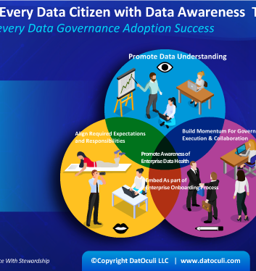
So, What if, instead of users and providers of data and technologies, all actors have ‘citizenship’
“A digital innovation ecosystem…concerns flows of technology and information across people and organisations…value creation is intimately linked to value distribution amongst shareholders in the network” (4)
Challenges <- underlying lack of full partnership, trust and transparency in the trajectory of big data applications (5,6,7)
Interventions<-enhance the agency of all data citizens including farmers, Māori, providers of data technology and other consumers of data (8)
Constraints <- include a lack of embedded ethical frameworks for the governance of data (9)
Notes:
What is else is happening?
How can there be a ‘social licence to practice’ in a space where many of us feel like we are missing something?

Slide 17
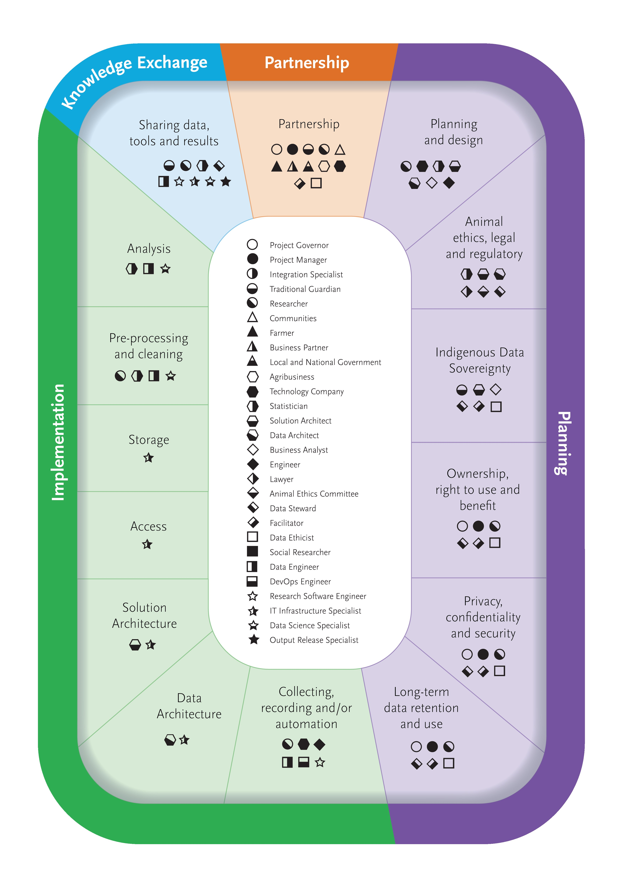
Citizen Inclusive Lifecycle
Describes roles and responsibilities
Guidelines for
  When and with whom to engage
  Explaining the process across and between citizens
Helps ensure we are doing the ‘right’ thing as a crown owned organization
  Proceduralise data ethics
  De-risks science process
Notes:
Relationships underpin smooth transitions through the stages
through providing a checklist of ethical, technical, & legal steps
Explicitly defines, and keeps safe, ALL citizens involved in data throughout the process
Engaged citizens able to see when, where, what and why actions are taken
Think about how we can manage this -> not just the way that IBM manages the lifecycle; if we think about objectives around
- Address some of the technical and social barriers to adoption
- Strategic cultural and business partnerships
- The role of relationships during that lifecycle becomes emergent, which is why the transdisciplinary nature of the project enabled novel discovery – completion of the ‘task’ is relatively trivial (doable), the challenge is in that output actually adding value to ALL the citizens needs’ and reality.

Slide 18
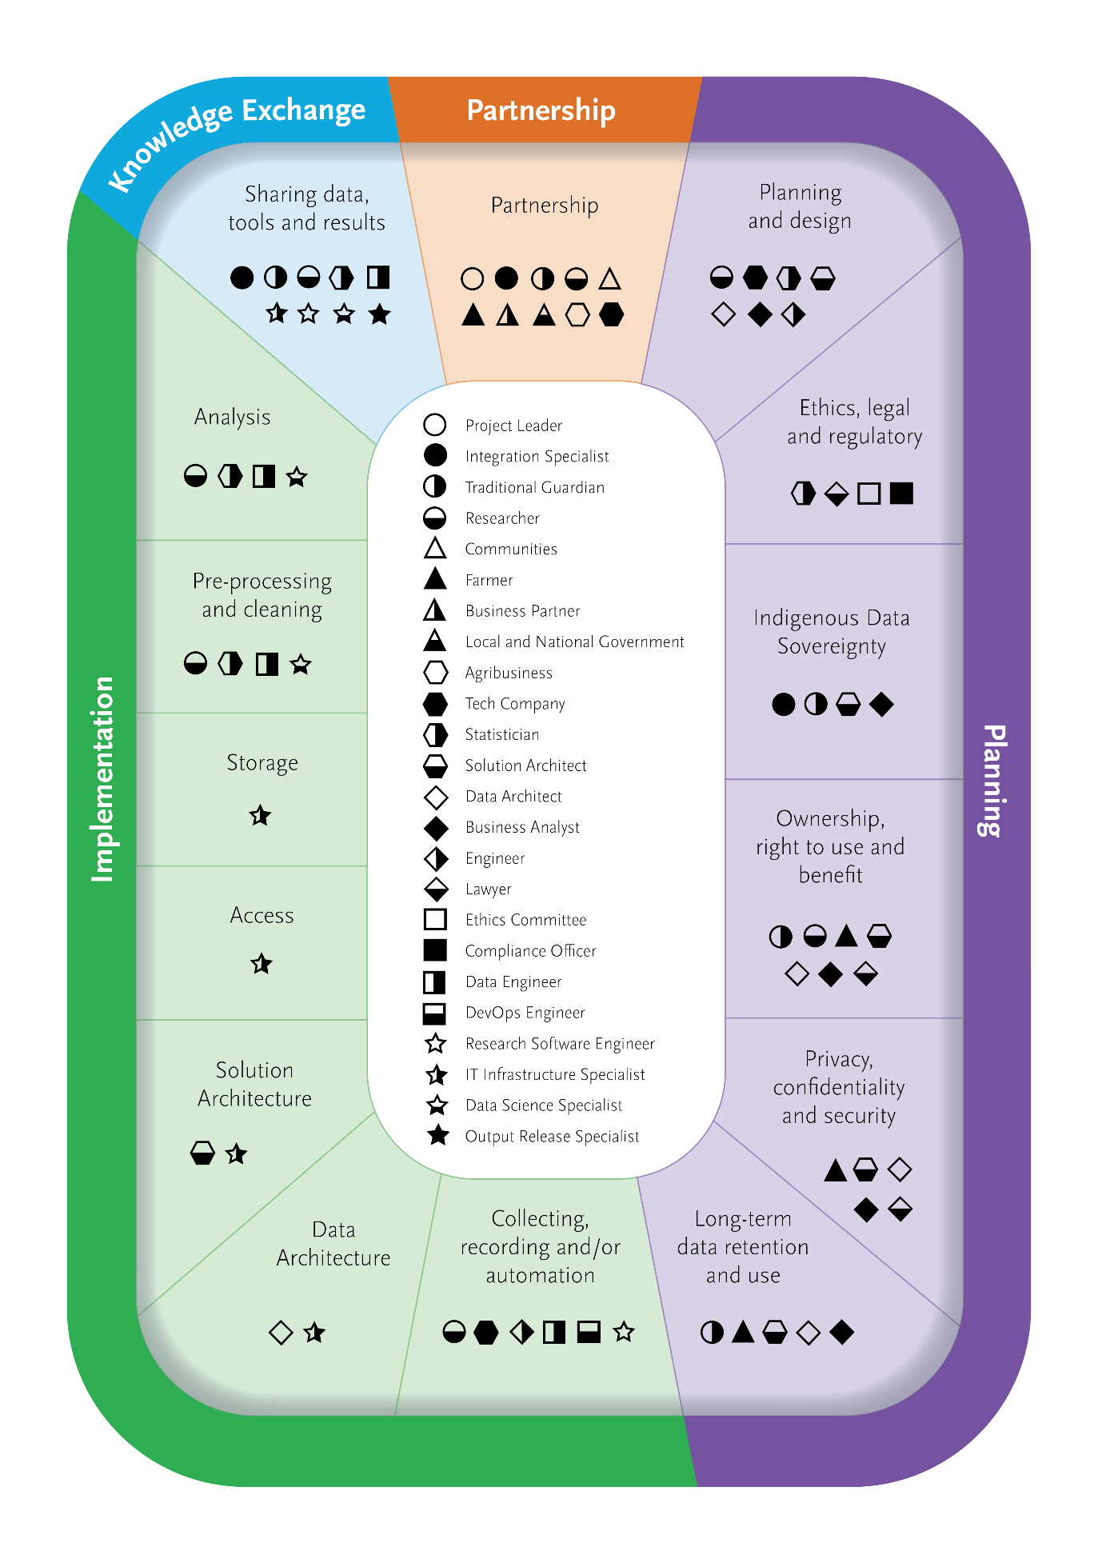
Four main Stages

Slide 19
Segments within Stages

Slide 20
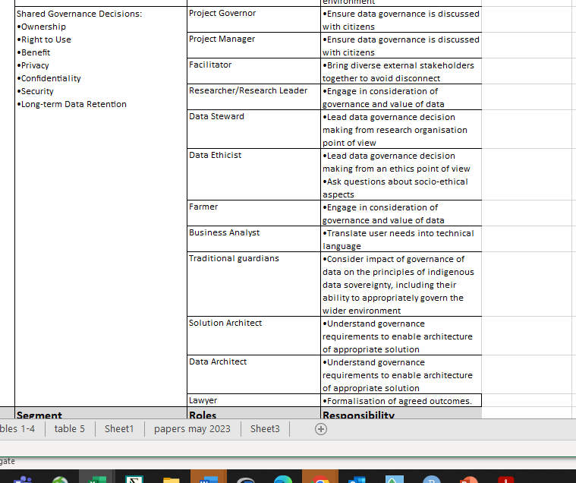
Roles and Responsibilities within each Segment

Slide 21

Summary
Principles of Māori Data Sovereignty of increasing concern in NZ
CRI’s hold taonga data
Need to work together with our partners to develop and implement good governance practices
Notes:
Data awareness is everyone’s responsibility and
Data ethics is everyone’s concern
Return to Dr Tahu Kukutai… “we need new ways of thinking about data…. And Mātauranga Māori and other indigenous knowledge systems provide a foundation for this”

Slide 22
references
Shepherd, Turner et al. 2018
Agritech report 2023
Osinga et al. 2022
Wolfert et al. 2023
Jakku, Taylor et al. 2019
Klerkx, Jakku et al. 2019
Newton, Nettle et al. 2020
Jakku, Taylor et al. 2019
Kamilaris and Prenafeta-Boldu, 2018

Slide 23
This is the end

Slide 24

Partnerships
The need for consistent engagement with partners throughout the project is even more essential – otherwise the output risks ‘missing the mark
And when you start talking about strategic and cultural partnerships…
  these ideas around ethical and responsible governance of data pop out.
  Along with a need to engage with other CRI’s and government agencies about data ethics, innovation and data sovereignty
“This fixation with privacy and personal data doesn’t address the fundamental issues with data that is conceived of and belongs to the collective – we need a new way of thinking about data, and te ao Māori and other indigenous knowledge systems provide a foundation for this”
Dr Tahu Kukutai
Notes:
Farmers, supply chain, consumers

Slide 25
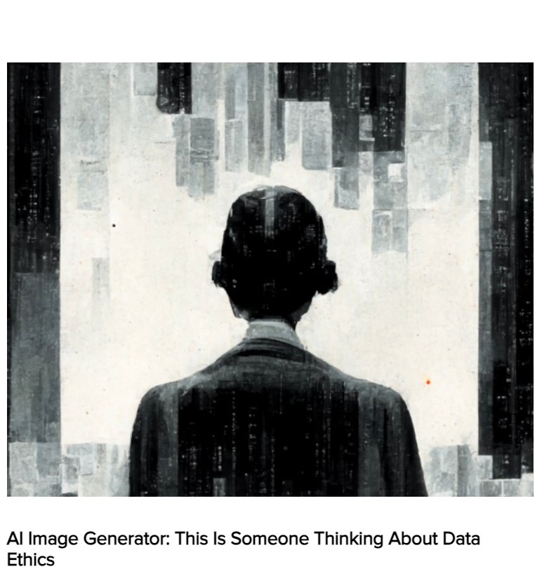
All Citizens are responsible
https://dataethics.eu/ai-image-generator-this-is-someone-thinking-about-data-ethics/ , 15.8.22 retried 17.10.23
Data increasingly underpins decisions being made for, with and by all citizens every day.
Stats NZ
  2023 new interim centre for ethics and innovation
  Collaboration with Te Kahui Raraunga
Data continues to be harvested and used without unbiased oversight
Harvard business review – genAI and ethics cannot be a ‘nice to have’
China exclude google because of data governance
Notes:
Data awareness is everyone’s responsibility and
Data ethics is everyone’s concern
Return to Dr Tahu Kukutai… “we need new ways of thinking about data…. And Mātauranga Māori and other indigenous knowledge systems provide a foundation for this”

Slide 26
Waipori Station virtual fencing project: Integrating technologies and data
Notes:
Do flyover here, talk about the conference we have taken this to
Waipori Station is a significant backcountry station in Central Otago that is owned by Landcorp Farming Limited, a state-owned enterprise of the New Zealand government. Its brand name is Pāmu, Te Reo Māori word 'to farm’.
Its catchment includes several waterways that ultimately feed into Lake Mahinerangi and Sinclair Wetlands, and is intersected by the traditional lands of several Hapu in the Kai Tahu Iwi
The land comprises tussock clad slopes that are populated by beef cattle and sheep.
Technologies being explored were primarily virtual fencing/gps collars, NRT instream water quality sensors, with data also entering from weather stations and modelled information.

Slide 27
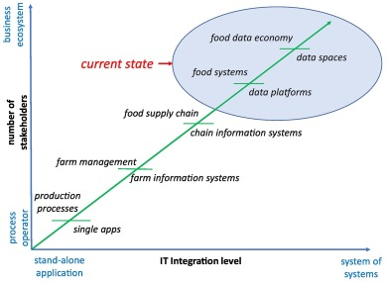
Complexity
Digital innovation projects can be orders of magnitude more complex than non-digital innovation projects – there is a lot to take into consideration
Wolfert et al. 2023

Slide 28
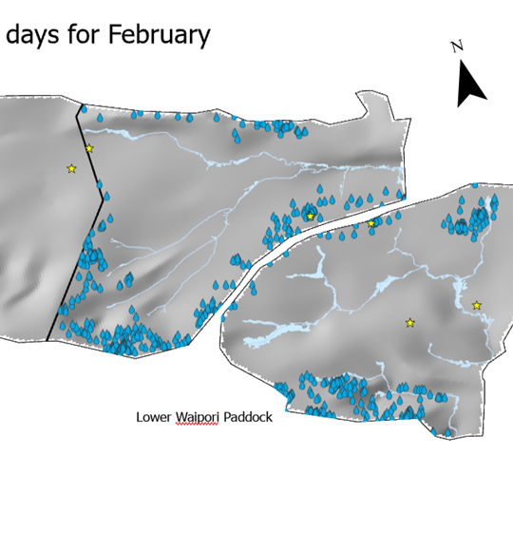
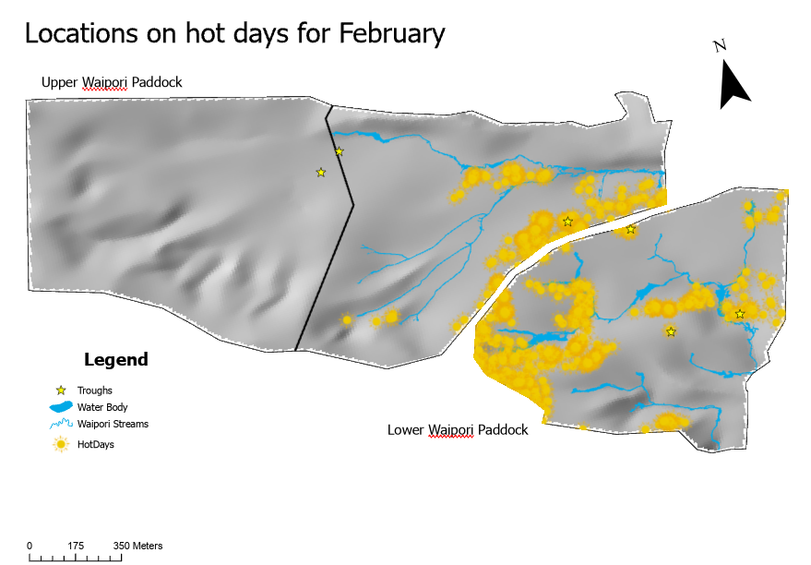
Weather and animal movement

Slide 29
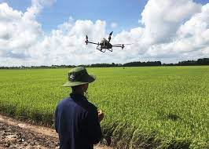
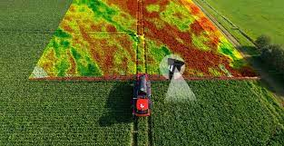
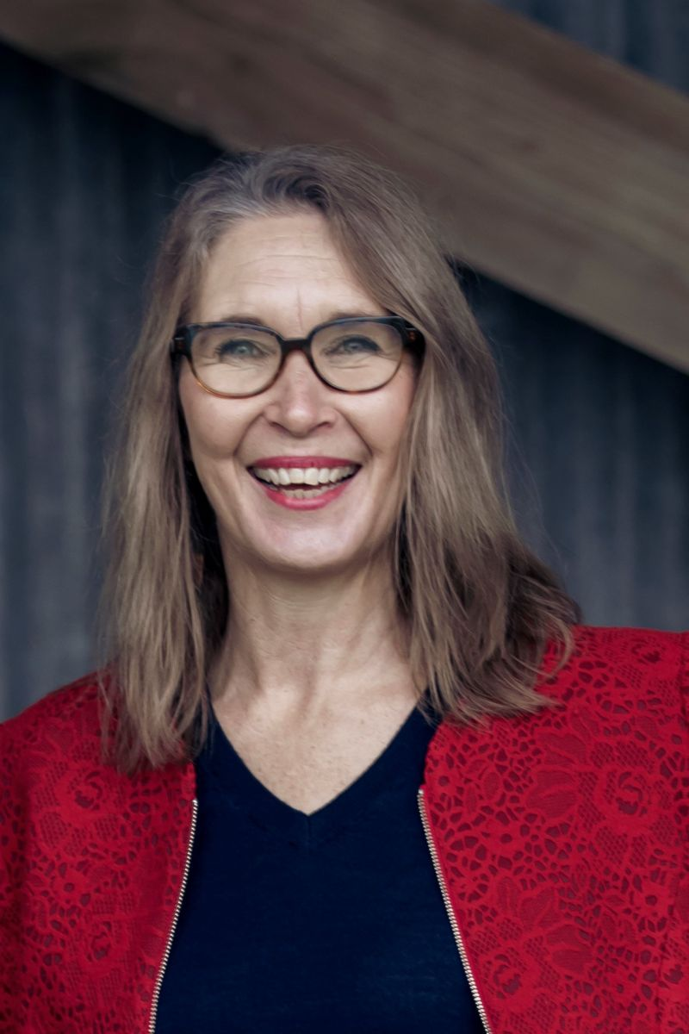
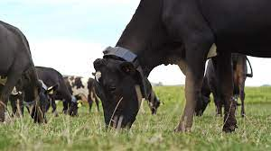
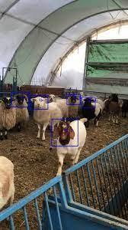
Agri-tech
Proliferation of technologies and platforms including computer vision, precision technologies and GPS
“2023 has seen an explosion of on-farm agri-technologies”
DairyNZ 2023 report
“We are confident in the aspiration to grow the contribution to New Zealand’s economy to $8 billion by 2030”
Bridget Hawkins, Chair of AgriTech NZ
Wolfert et al. 2023

Slide 30
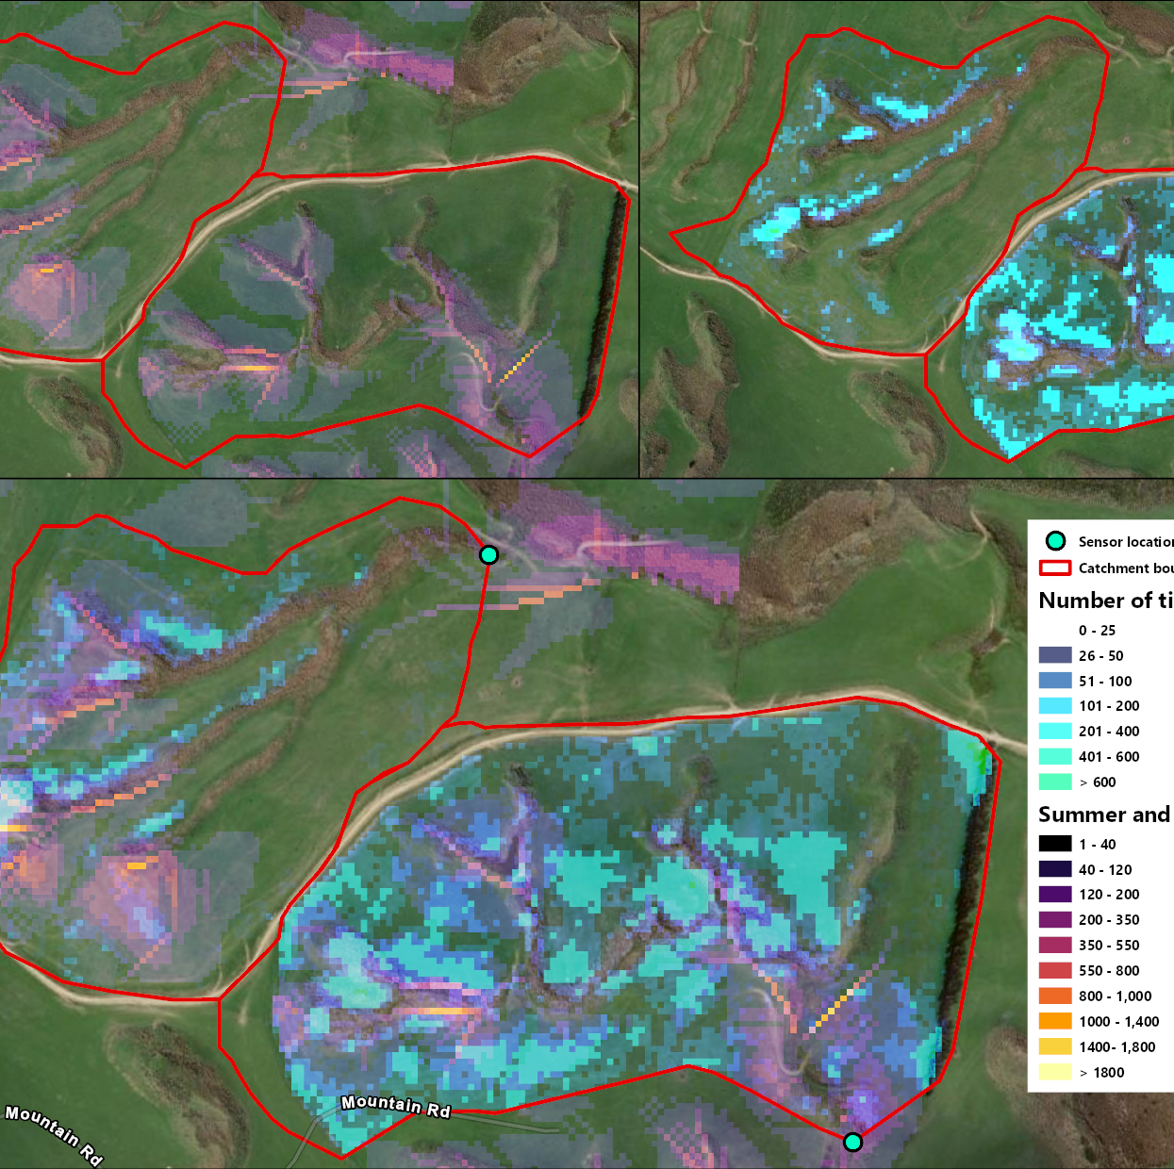
Risk and landscape utilisation

Slide 31
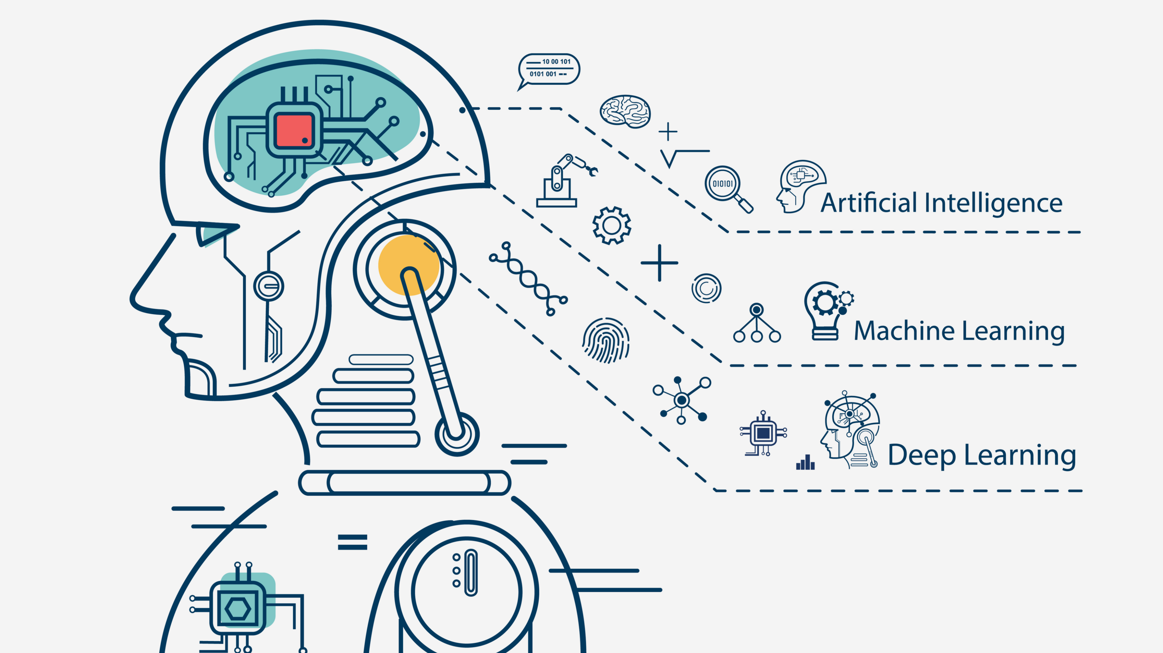
Focus on Data
Data is the enabler for advanced analytics, forecasting and artificial Intelligence (AI) for
  automation,
  real-time decision making,
  personalisation and customisation,
  risk management and compliance,
  continuous improvement innovation cycle.
https://www.europeanlawinstitute.eu/fileadmin/user_upload/p_eli/Publications/ELI_Innovation_Paper_on_Guiding_Principles_for_ADM_in_the_EU.pdf

Slide 32
Testing technologies

Slide 33
Background and Goals

Slide 34
‘He aha te mea nui o te ao? Māku e kī atu, he tangata, he tangata, he tangata’
What is the most important thing in this world? It is people, it is people, it is people.

Slide 35
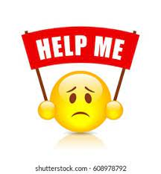
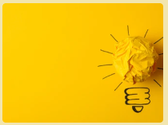
The changing role of science
If scientists, who spend their lives working in research spaces are struggling to make sense of the complexities, this must also be a challenge for others
We need to improve our processes and understanding so that we are better positioned to support the sector
“Digitalisation is bringing change to all parts of science, from agenda setting to experimentation, knowledge sharing and public engagement.”
Notes:
Evolution of our understanding of what a ‘good’ solution would look like, and what the barriers to developing that were when in fact, the solution was much more heavily driven by the people in the process and their requirements, needs and way that they already do things (familiar)

