Slide 1

LISA WARBRICK
Ngāti Awa, Ngāti Rangitihi, Te Atihaunui a Pāparangi
lisa@orangawhenua.nz / lisa@igi.nz
Ko wai au?
Mama, Nana, Bestie, First Born, Advocate, Agitator, High Maintenance
Multi-Disciplinary Researcher
Pou Arataki - Te Pū Oranga Whenua
Kahui – Te Pua Taketake (Indigenous Genomics)
Notes:
Acknowledge James and Team. Acknowledge relationship with Esther
Disclaimer – do not speak on behalf of all Māori, do not consider myself subject matter expert….I’ll leave that to others

Slide 2
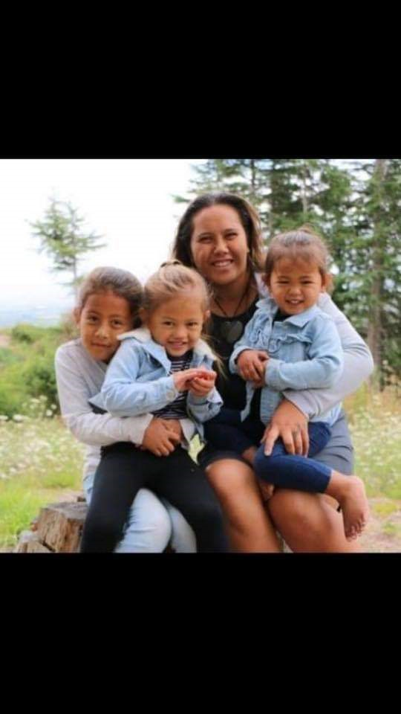
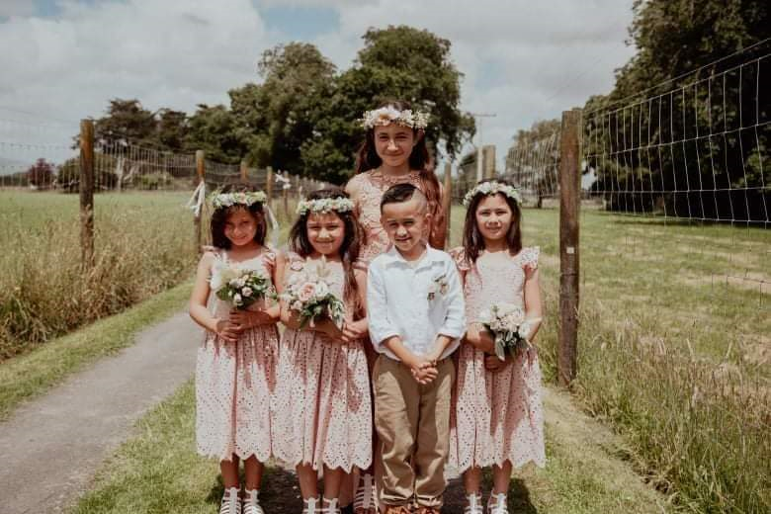
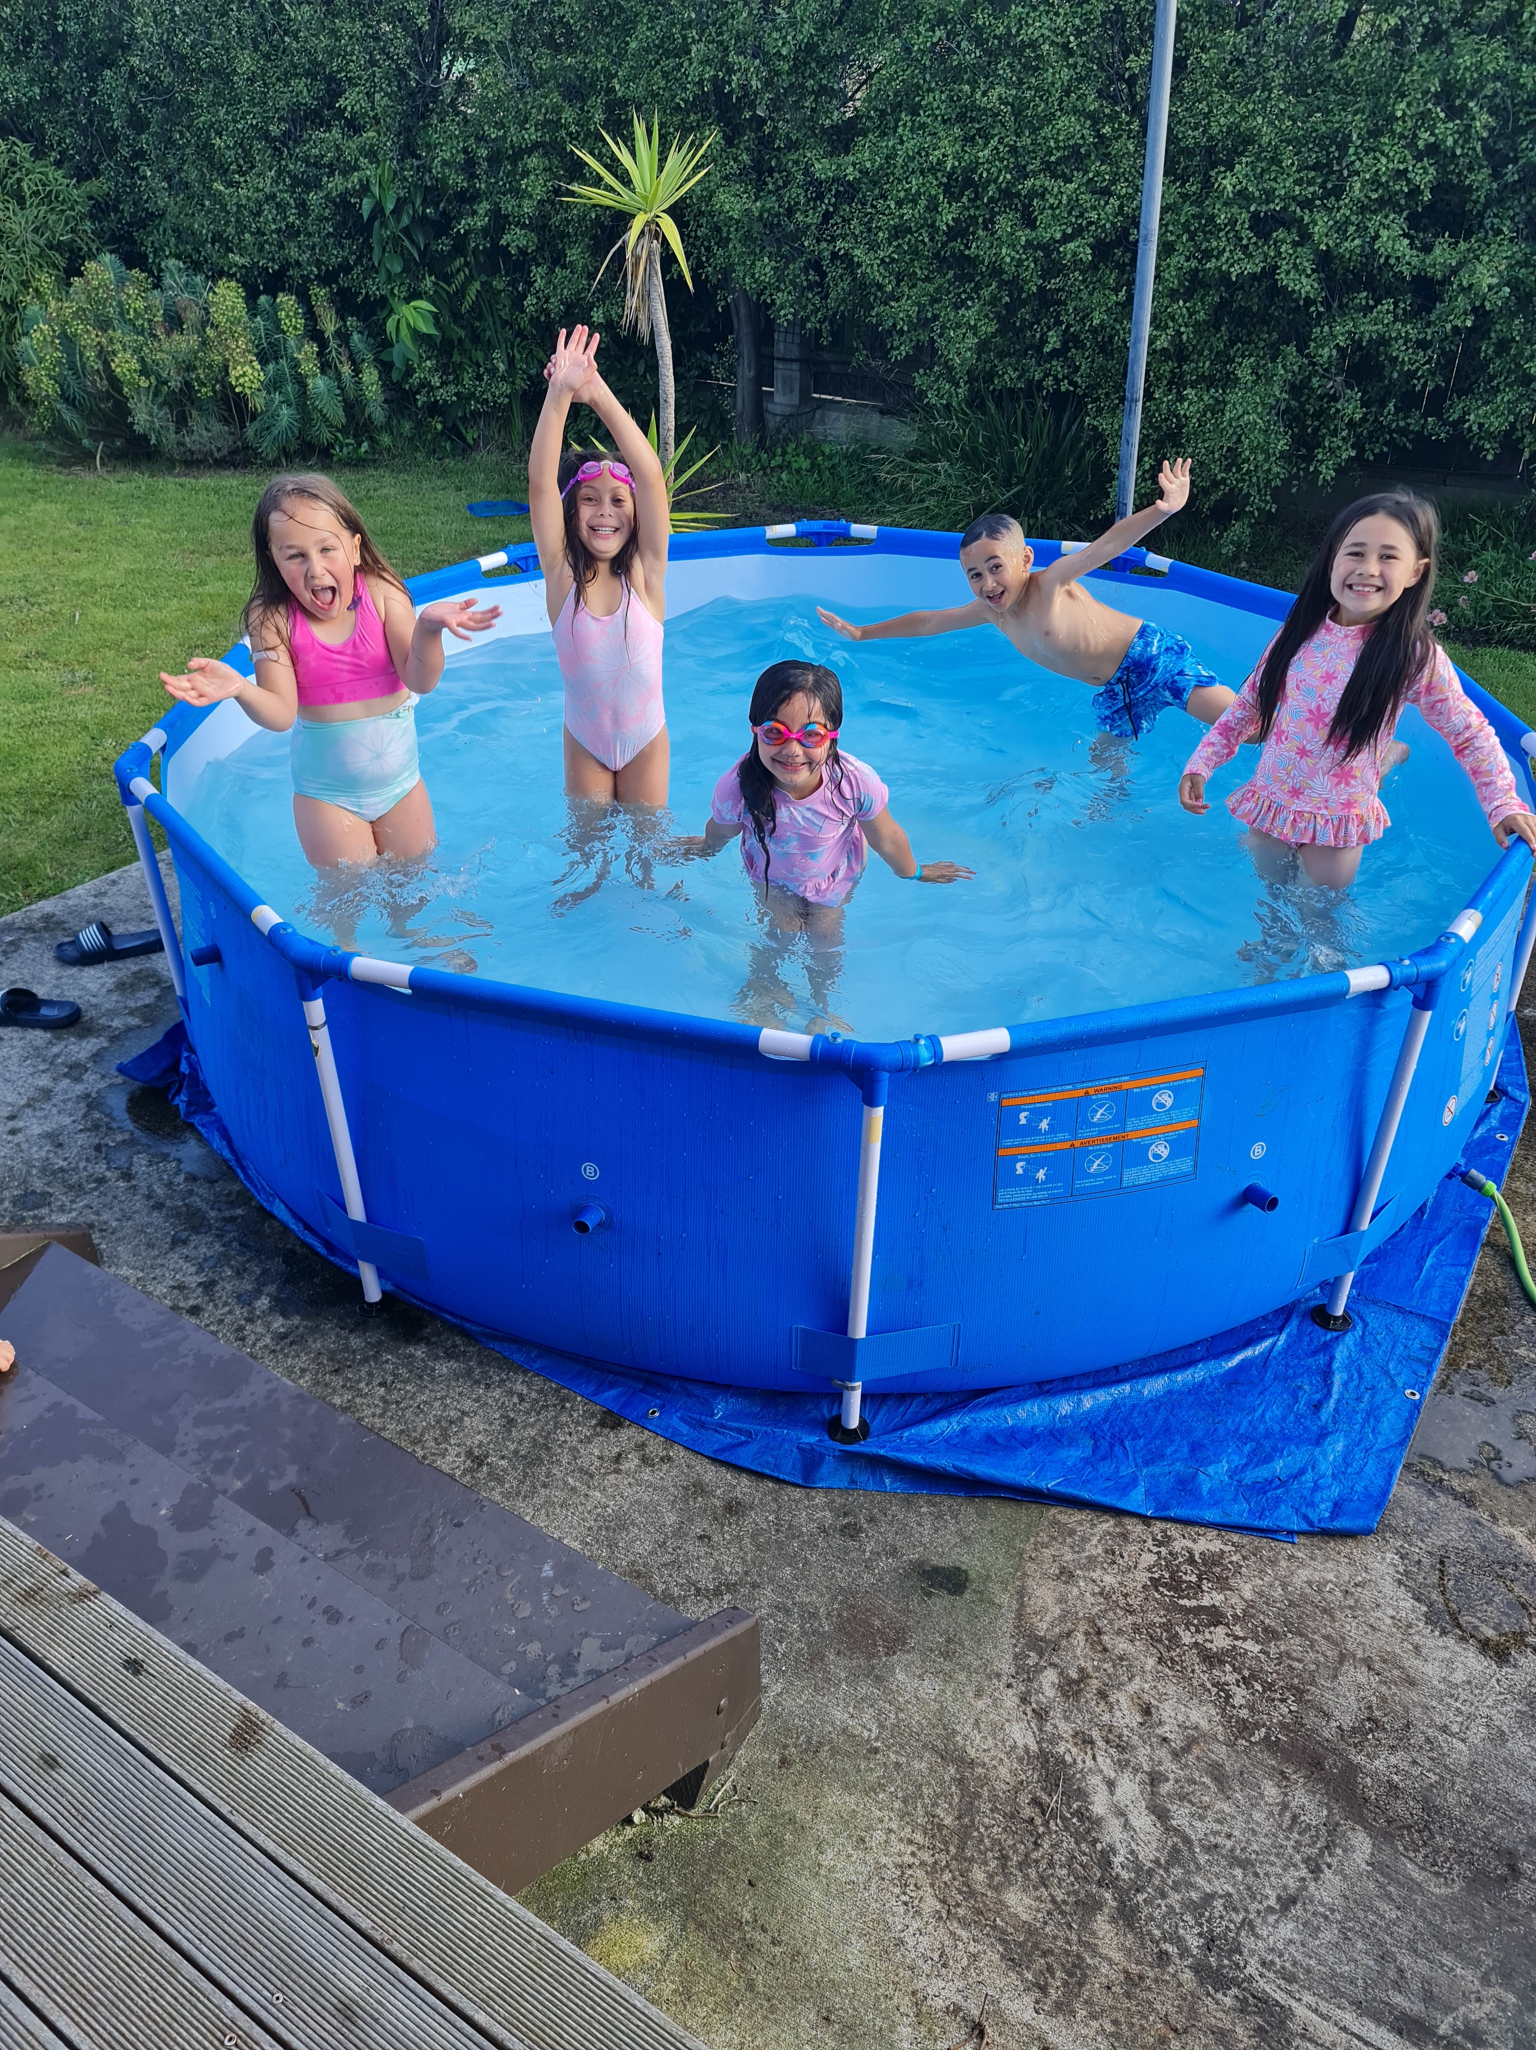
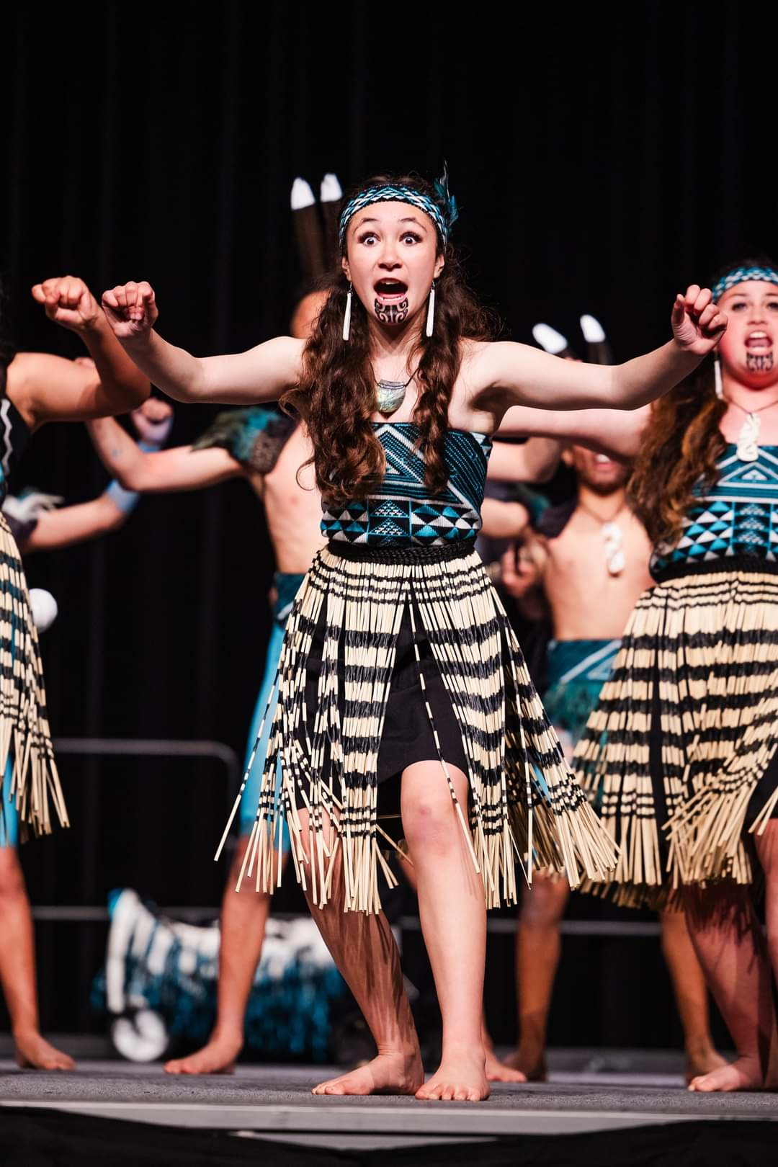


Slide 3




TE PUA TAKETAKE
Indigenous Genomics Institute
(Te Kurataiaho Kapea)
Notes:
Genomics Aotearoa – Te Nohonga Kaitiaki: Guidelines for research on taonga species
culturally informed ethical guidelines to connect Māori concepts and expectations of kaitiakitanga to the context of genomics

Slide 4
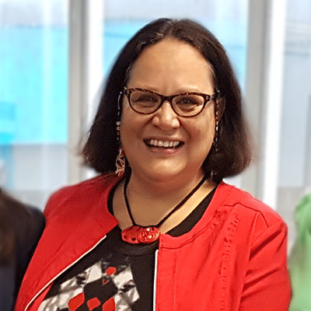
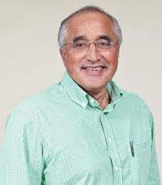



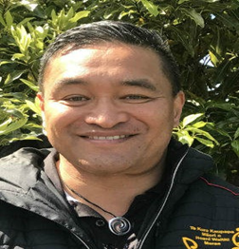
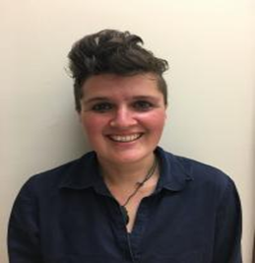

ACKNOWLEDGE
Aroha Te Pareake Mead
A political scientist who works across disciplines on indigenous rights and sustainable development issues
Professor Taiarahia Black
A widely respected Te Reo Māori and mātauranga Māori expert in academia, Te Ao Māori and with his iwi. Tai currently works at Te Whare Wānanga o Awanuiārangi.

Slide 5


Slide 6
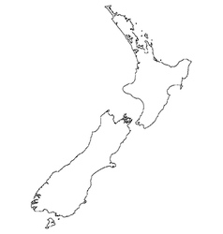


Grandads Beef
Regenerative Farming
Tracey Bayliss
Tū Te Pō Tū Te Ao – Beef & cosmeceuticals
Kiri Edwards
Mauri Tu – Te Reo me o nga tikanga (Inter-regional)
Katarina Mataira
Thornton Whanau Trust -
Diverse landblocks, (Raupunga)
Theresa Thornton
Pukeiahua Trust – land occupation
Kimai Huriama
Ngāti Pāhauwera Devel. Trust & Paroa Trust
Iwi land development
Bonnie Hatami
Ora Innovation Group
Skincare product development with Mamaku
Karen Renata
Karatea Whānau Farm – Finishing farm
Taruke Karatea
Te Hanga Trust –Sheep Milking
Roma Balzer
Ngaporo Waimarino Forest Trust & Pipiriki Inc. – Pine Forest / Manuka / Mamaku
Smith Warbrick & Associates
Lisa Warbrick
TakiToa – mobile abattoir (Inter-Regional)
Lisa & Tracey
E Oho Consultancy - Policy (Inter-Regional)
Lara Taylor

Slide 7
MĀORI, DATA & SOVEREIGNTY: WEAVING THE THREADS
(IN THE CONTEXT OF DATA SCIENCE)

Slide 8
OUTLINE
MĀORI?
DATA – AND WHAT?
SOVEREIGNTY - OKAAAY

Slide 9
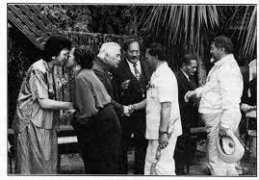
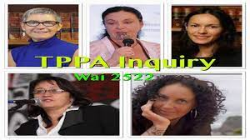
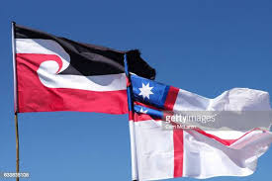
MĀORI
History of colonisation – trauma, disconnection, mistrust
TREATISES & CLAIMS
- Wai262
- Wai2522
- Te Tiriti o Waitangi
- He Whakaputanga (Declaration of Independence)
- Mataatua Declaration

Slide 10
WAI 262 -
Key Chapters of the Ko Aotearoa Tēnei Report
Chapter 1 : Taonga Works and Intellectual Property
Chapter 2 : Genetic and Biological Resources of Taonga Species
Chapter 3 : Relationship with the Environment
Chapter 4 : Taonga and the Conservation Estate
Chapter 5 : Te Reo Māori
Chapter 6 : When the Crown Controls Mātauranga Māori
Chapter 7 : Rongoā Māori
Chapter 8 : The Making of International Instruments
Notes:
The Waitangi Tribunal released its report in 2011 into the Wai 262 claim, recommending wide-ranging reforms to laws and policies affecting Māori culture and identity and calling for the Crown-Māori relationship to move beyond grievance to a new era based on partnership.
﻿
Ko Aotearoa Tēnei ('This is Aotearoa' or 'This is New Zealand') is the Tribunal's first whole-of-government report, addressing the work of more than 20 Government departments and agencies.

Slide 11
DATA SOURCE
Mātauranga Māori:
Purakau (stories)
Waiata (songs)
Toi Māori (art)
Karakia (prayer)

Slide 12
DATA ACCESS
Where do you get this kind of data?
How can you tap into mātauranga Māori?
- Partnerships and Collaboration – AgResearch, Manaaki Whenua, Scion
- Co-design
- Terms & Conditions
- Hoa Haere
- Marae based research

Slide 13
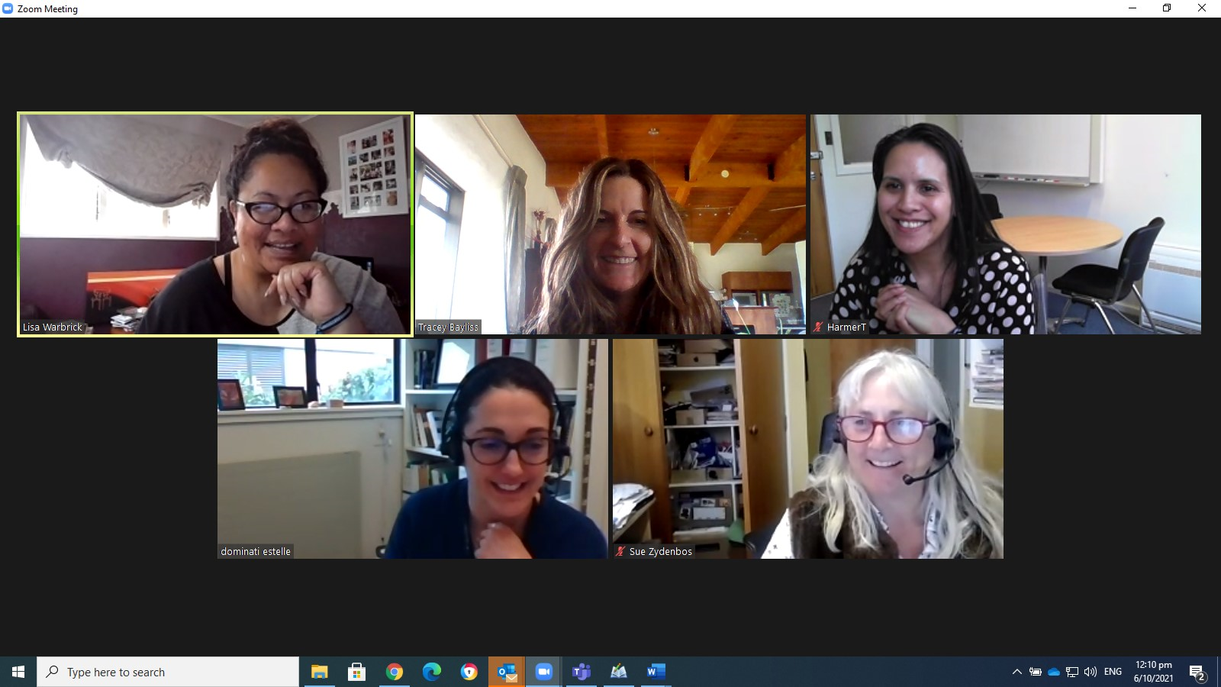
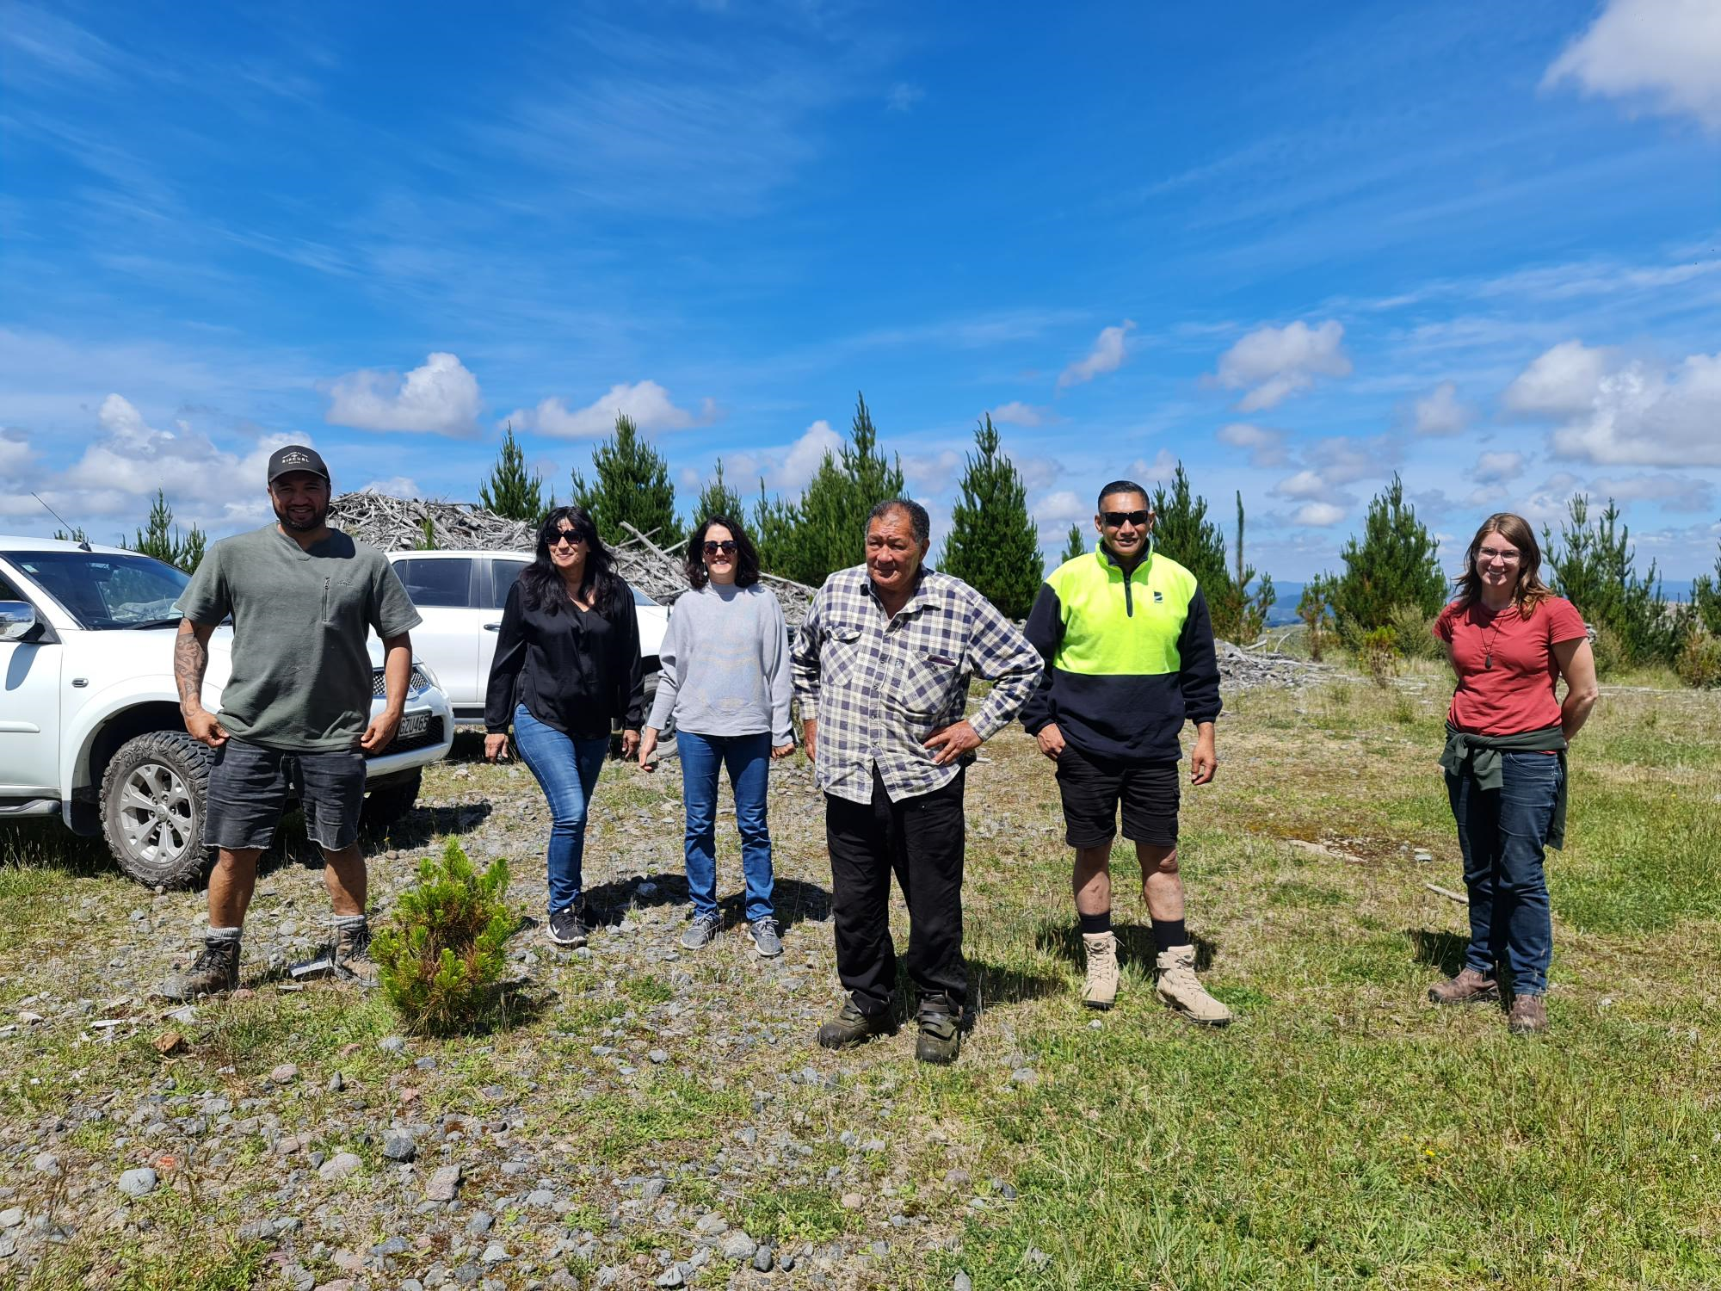
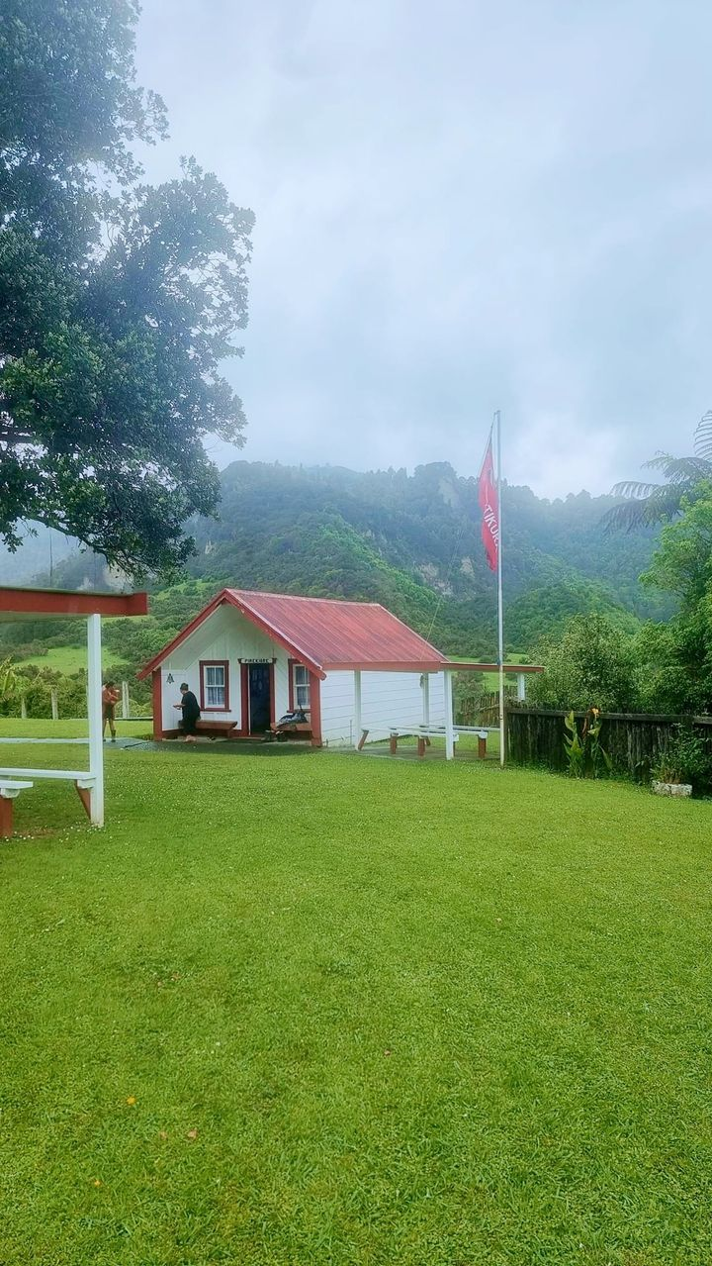
PARTNERSHIP HEAD AGREEMENT:
Mātauranga Māori includes traditional and contemporary Māori knowledge and knowledge systems, traditional and contemporary Māori cultural expressions, the use of te reo Māori, kawa and tikanga. Mātauranga Māori is likely to be contributed to a Collaborative Project as Background IP.

Slide 14
DATA QUALITY
-How do you know?
-What makes data tika(accurate/right) & pono (true/valid)?
-Measure of such….

Slide 15
DATA QUALITY
- Led by owners of data source
- Holistic inclusion
- Intergenerational value
- More than the numbers

Slide 16
SOVERIEGNTY
Tino Rangatiratanga – self determination
Mana Motuhake – independence
Rights & Interests - protection

Slide 17
MĀORI DATA SOVEREIGNTY
Today's shifts:
- Māori land settlements
- Generation savvy
- Crown funding

Slide 18
