Slide 1


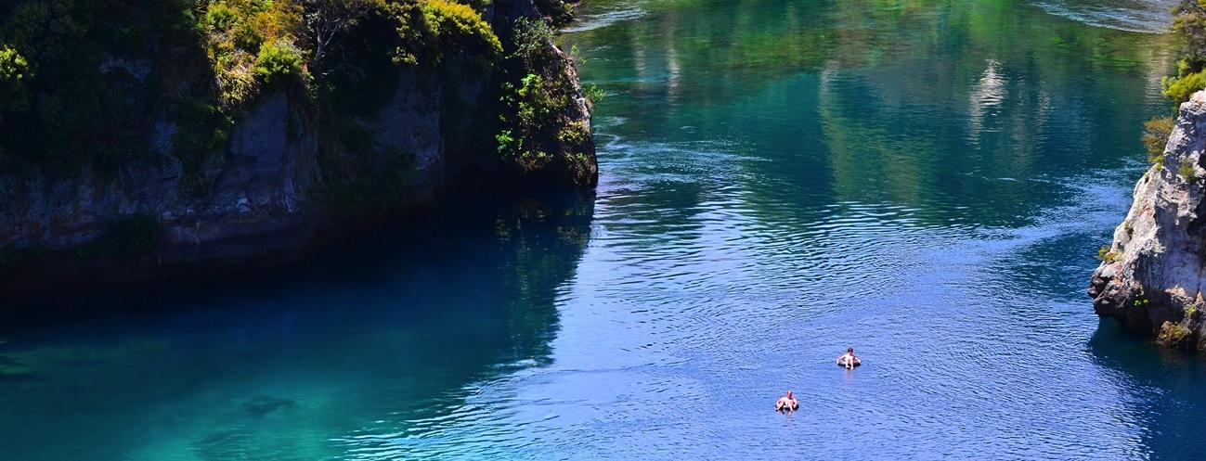

Estimating power to detect change in contaminants in rivers.
A.D.L. Noble¹, R.W. McDowell^{1,2}, O. Ausseil³, D. Hamilton⁴, M. Kittridge⁵
¹ AgResearch, Lincoln, New Zealand
² Lincoln University, Lincoln, New Zealand
³ Aquanet, Wellington, New Zealand
⁴ Australian Rivers Institute, Griffith University, Brisbane, Australia
⁵ Headwaters Hydrology

Slide 2


The Problem:
There is concern over the environmental state of the waterways in NZ.
Mitigation measures are being mandated by Regional Councils to improve the water quality.
Can we estimate the power to predict a given change in contaminant concentration after a mitigation regime has been introduced?
https://environment.govt.nz/what-government-is-doing/areas-of-work/freshwater/work-programme/
“Start making immediate improvements so water quality improves within five years”.
Few stretches of river are routinely monitored so how much sampling do we need to carry out to be able to measure change?
@OurLandandWater

Slide 3
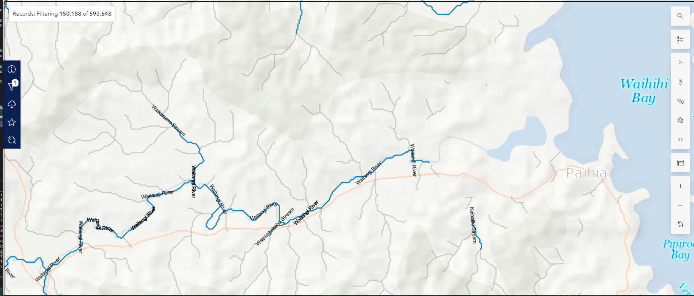
The Problem:
There are almost 600,000 river “reaches” in New Zealand
  A reach is a stretch of river between two points where tributaries enter, they could be metres or kilometres long.
Around 130,000 of these are stream order 3 or higher.
https://data-niwa.opendata.arcgis.com/search?tags=freshwater
@OurLandandWater

Slide 4
Data Sources - LAWA Data
The Land, Air, Water Aotearoa (LAWA) has a database of water quality measures for around 1500 sites in New Zealand.
Of these we have used ~ 750 sites for 8 indicators :- Black Disc, DRP, E coli, NH₄, NO₃, Total P, Total N and Turbidity.
These have up to a 30 year time span although some have not been collected regularly throughout that time.
Flow is a useful predictor of most quality measures BUT
  Few sites (~330) have reliable flow and concentration data at the same time to enable flow to be included in the models.
  Flow would also need to be predicted for the unsampled sites which would need to be predicted.
@OurLandandWater

Slide 5
River Environment Classification New Zealand (2010) - REC Data
In addition a River Environment Classification database is available from the National Institute of Water and Atmospheric Research (NIWA). This includes many variables measured both local to the site and upstream.
  These data are available both for the monitored sites and all other reaches on the New Zealand river system.
  The entire river system includes a little less than 600,000 sites
  We have restricted our analysis to sites River Order 3 and larger and outside National Parks
  ~ 130,000 sites
@OurLandandWater

Slide 6
The process
Log Concentration
Vs Date
SD vs REC variables for monitored sites
REC variables for unmonitored sites
Linear Model
Estimate residual standard deviation
Random Forest to model standard deviations
Predict standard deviations
GAM Model

Slide 7
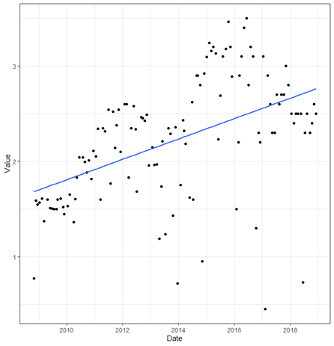
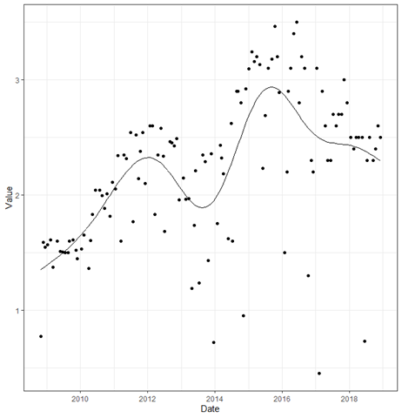
Model 1
Modelling trend in the recorded data for each site for each indicator.
Hence estimating the standard deviation of the detrended series.
Models include both a simple linear model and a Generalised Additive Model (GAM).
Clearly the standard error for the linear model will be larger than for the GAM.
The aim is not a “perfect model” if the variability is underestimated then power will be overestimated and years of sampling could be wasted.
R² of 20% to 60% are typical
Response variable is the concentration.
@OurLandandWater

Slide 8
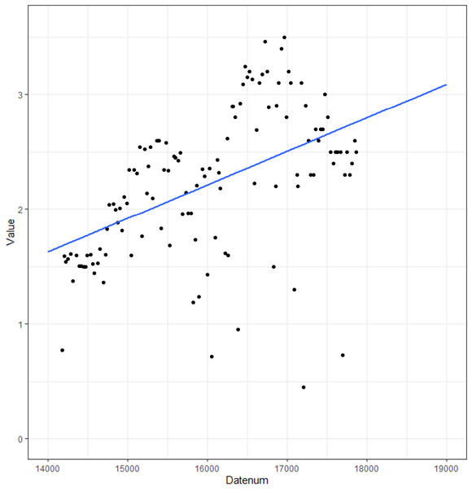
Model 2
Modelling the predicted level of the indicator from the linear model.
  The GAM is not stable enough for this extrapolation
Use the linear model to predict the mean level at a point in time “now”.
Then
Use the auxiliary data to model the predicted mean levels for the unsampled sites
@OurLandandWater

Slide 9
Model 3
Modelling the standard deviations from the GAM using the auxiliary data from the REC database.
This model is then used to predict the standard deviation of the distribution of the random element (variability around the trend) of a model for all sites, including the unmonitored ones.
@OurLandandWater

Slide 10
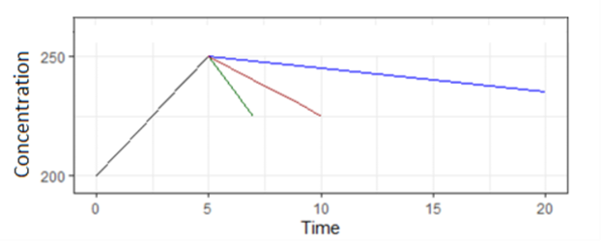
Estimation of power
Given a percentage improvement and time period a linear trajectory is defined.
Data points along that line at the chosen sampling frequency are interpolated.
Random noise is added to those points with the predicted standard deviation for that reach.
A linear model is fitted and the slope tested for significance.
The “noise” is simulated 1000 times and the proportion of significant results is the power.
@OurLandandWater

Slide 11
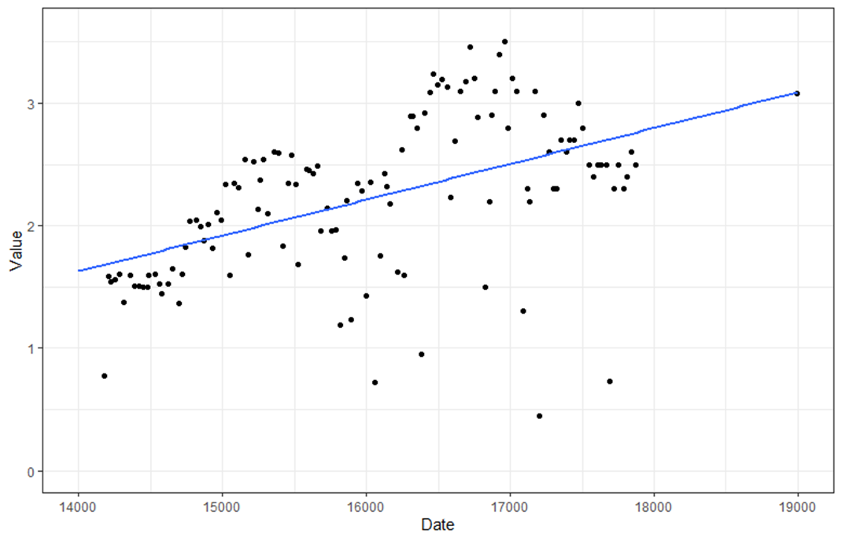
Example for a monitored site
Linear model for the trend is fitted to the data and the predicted value “now” obtained.
The standard deviation of the variability around the line is also found although a GAM is used for that as it allows for non linearity in the series if it is present.
@OurLandandWater

Slide 12
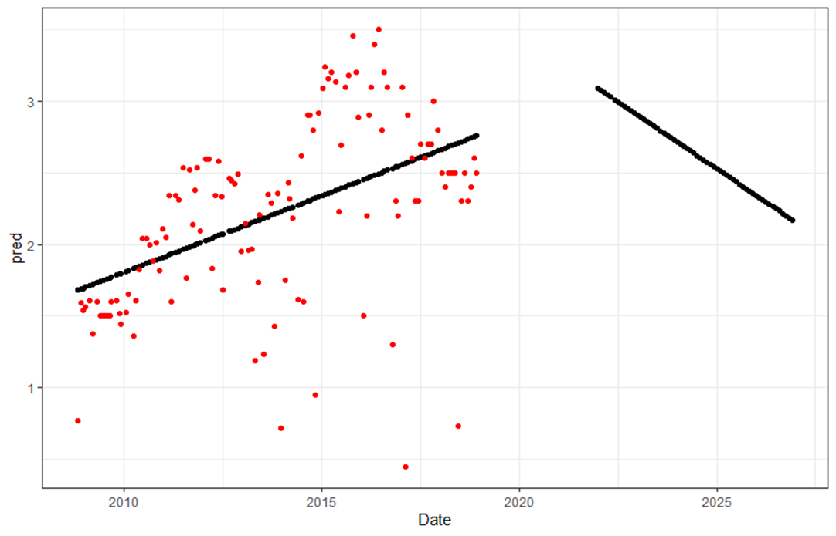
Power estimates
A linear trend for the reduction is added to the data. Points are interpolated along this line for frequency of sampling.
A 30% change over 5 years with monthly monitoring (60 sampling occasions) is shown for example.
@OurLandandWater

Slide 13
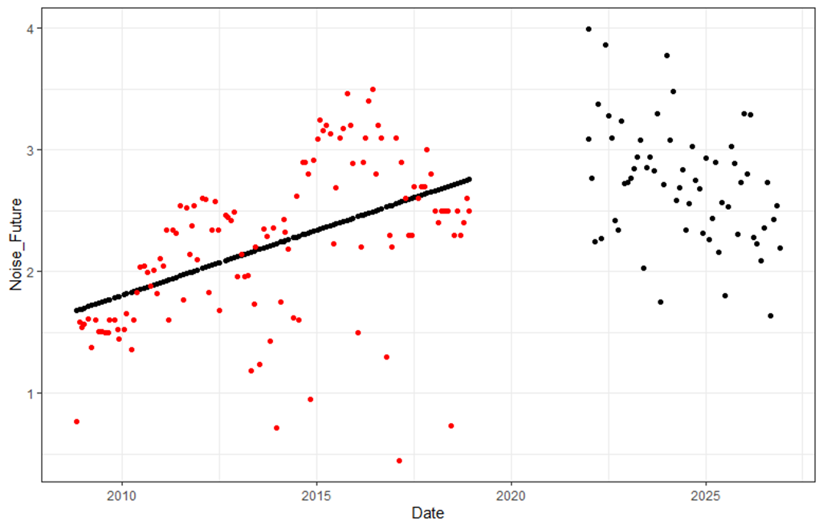
Power estimation
“Noise is added to the “Future” data to reflect the variability in the original series.
A linear model is fitted to the noisy future data and the slope of the line is tested. This is repeated many (1000) times and the proportion significant is found.
This is our estimate of power.
@OurLandandWater

Slide 14
Unsampled sites
For the sampled sites we can used direct estimates from the data for each site.
We can also use the estimated values from the auxiliary data.
For the unsampled sites the same process is carried out for the future data.
  The predicted level and standard deviation of the distribution of the data around the line are modelled using the auxiliary data.
  The significance of the slope of the linear trend with noise is found.
@OurLandandWater

Slide 15
The web application
https://www.monitoringfreshwater.co.nz
@OurLandandWater

Slide 16
Lakes and groundwater
Similar, but not identical, exercises are being carried out for lakes and groundwater.
The principal is the same
The detailed modelling varies with different data availability
Lakes and groundwater have different physical processes that need to be considered
@OurLandandWater

Slide 17
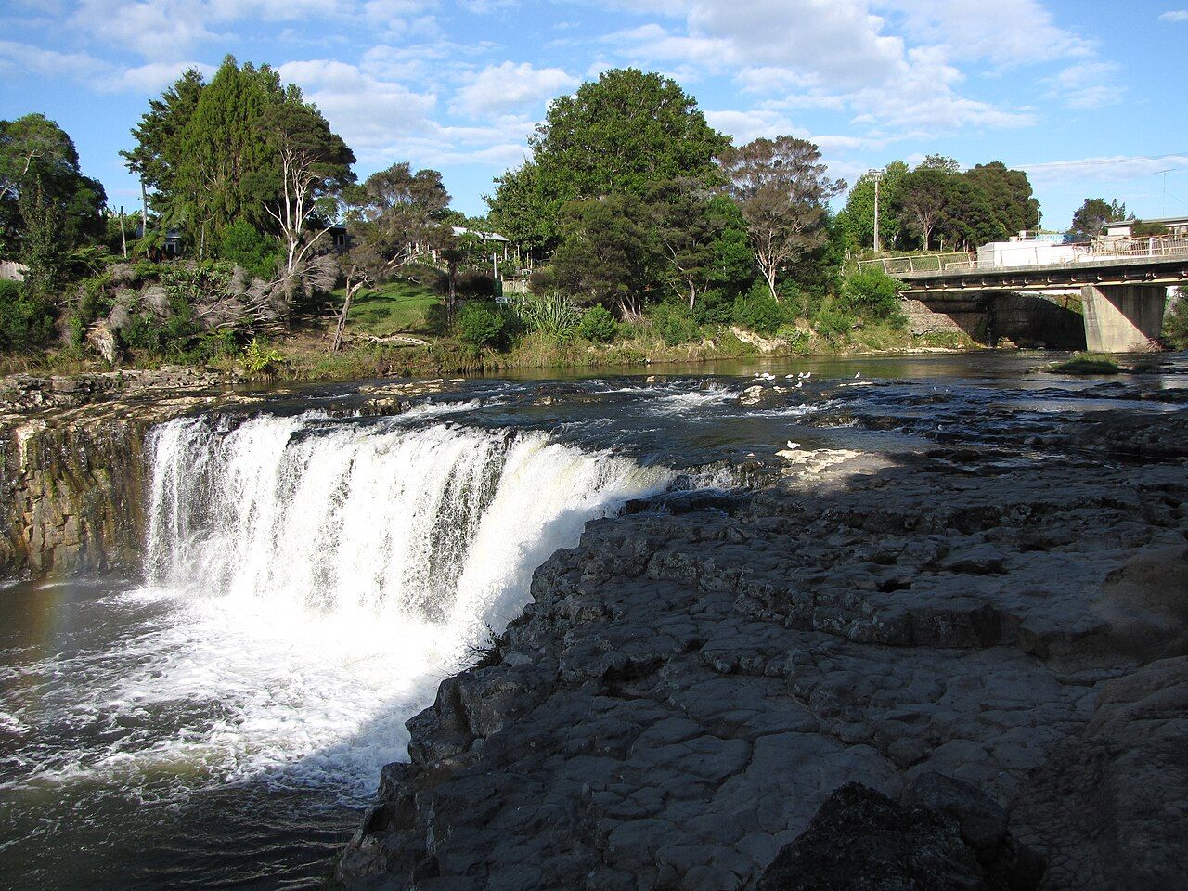
Questions ??
Thank you
@OurLandandWater

