Slide 1
Using cellular composition estimated from bulk gene expression data to suggest cellular level markers for melanoma survival
IBS-AR 2023
Min Zhang, Vivi Arief, Geoff McLachlan, Quan Nguyen, Kaye Basford
Notes:
Alternative: “cell type composition/proportion”?

Slide 2
Objectives
Investigative use of a combination of data visualization techniques and statistical methods
- help understand progression for complex diseases
Notes:
which cell type to look at, help prediction.

Slide 3
Melanoma: a complex disease
Malignancy of melanocytes, most fatal skin cancer
Australia and New Zealand the highest incidence
Immune checkpoint blockade, molecular targeted therapy
Understand melanoma patient variations, novel markers

Slide 4
Data
TCGA skin cutaneous melanoma RNA-seq and clinical data
- 450 samples (102 primary, 348 metastasized) x 20,501 genes
- Clinical data: age, gender, survival time
Two additional melanoma data sets: validation
The Cancer Genome Atlas
Notes:
As well as clinical to

Slide 5
Data characteristics
Bulk RNA-sequencing: average across input cells
No information about cell type abundance
High variance of cellular composition in cancer tissue
Notes:
cut the talk for this slide.

Slide 6
Previous studies: cellular composition
Immunohistochemistry (IHC)
Flow cytometry
Single-cell RNA-sequencing (scRNA-seq)
Notes:
Do not go into too much details

Slide 7
Digital cytometry: cellular composition
“Digital cytometry”: deconvolve cellular composition from bulk RNA-seq data based on a reference data
CIBERSORT*
* CIBERSORT: “Cell-type Identification by Estimating Relative Subsets of RNA Transcripts”
Newman et al. (2015) Nature Methods

Slide 8
Digital cytometry: cellular composition
Relative fractions and
global P-value estimate
Bulk tumor
transcriptome
profile
CIBERSORT
Significance
threshold
Single-cell
transcriptome
profile
Gene expression
signature matrix
v-support vector
regression
(linear kernel)
Permutation
analysis
Newman et al. (2015) Nature Methods

Slide 9
Cellular composition and patient survival
Survival analysis: Cox proportional-hazards model; Kaplan-Meier survival curves
Previous studies: gene markers and patient survival
Novel combination of CIBERSORT and survival analysis
Higher-level, cellular markers for melanoma
Notes:
Explain survival analysis

Slide 10
Methods
CIBERSORT cellular composition deconvolution:
- TCGA melanoma RNA-seq data (primary and metastatic)
- scRNA-seq reference data for 8 cell types*
Survival analysis: Cox regression; KM survival curves
* 8 cell types: malignant cells, endothelial cells, fibroblasts, CD8+ T cells,
natural killer (NK) cells, macrophages, CD4+ T cells, B cells
Notes:
Does not appear to be applied to melanoma; a sentence or two to explain survival analysis

Slide 11
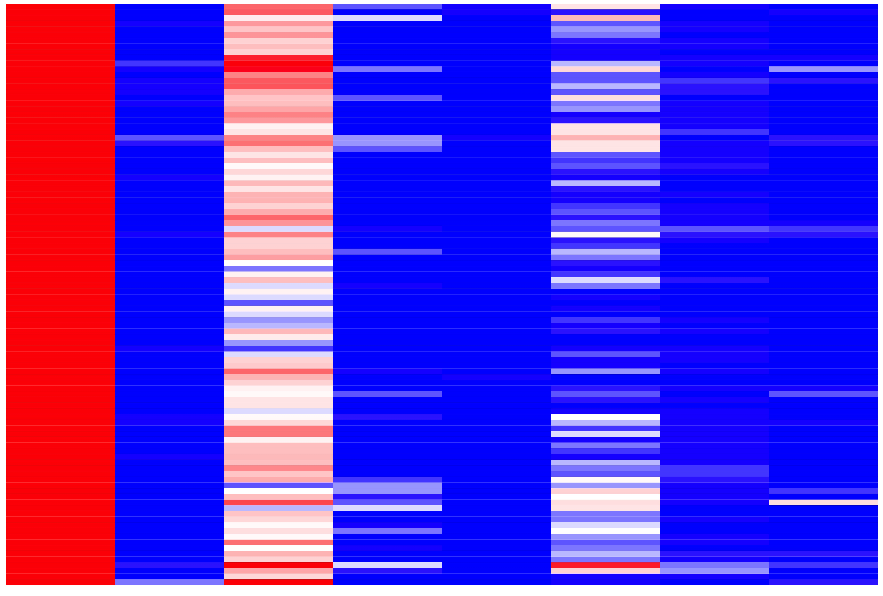
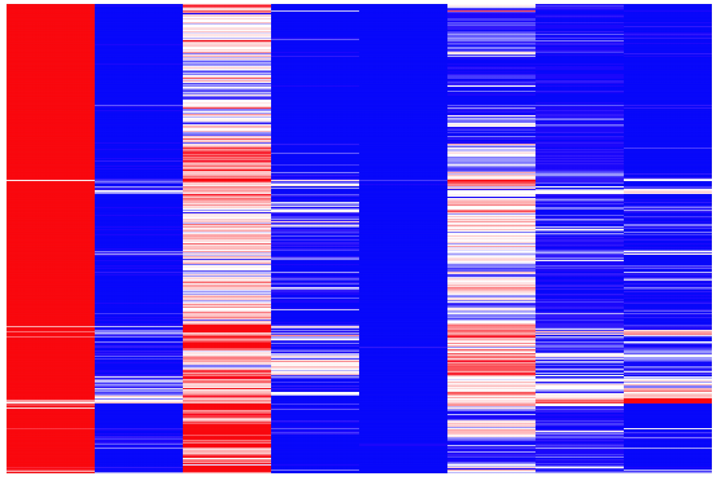
Results – CIBERSORT
Primary melanoma (n = 102)
Metastatic melanoma (n = 348)
NK cells
B cells
NK cells
B cells
Fibroblasts
CD4+ T cells
Fibroblasts
CD4+ T cells
Malignant cells
CD8+ T cells
Macrophages
Malignant cells
CD8+ T cells
Macrophages
Endothelial cells
Endothelial cells

Slide 12
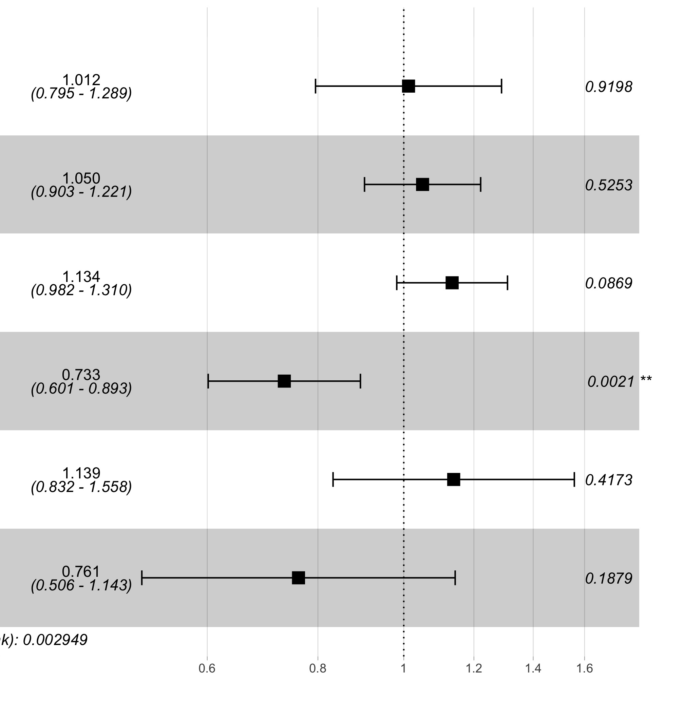
Multivariate Cox regression
Primary melanoma (n = 102)
Metastatic melanoma (n = 348)
Cell type HR (95% CI) P-value
Cell type HR (95% CI) P-value
Notes:
% of Malignant cells and CD8 T cells were negatively and positively correlated with macrophages. Therefore, they were removed from the Cox regression.
Check horizontal axis
HR >1 increasing risk; HR < 1 decrease the risk
warp with a Box to separate two figures
remove a few columns?

Slide 13
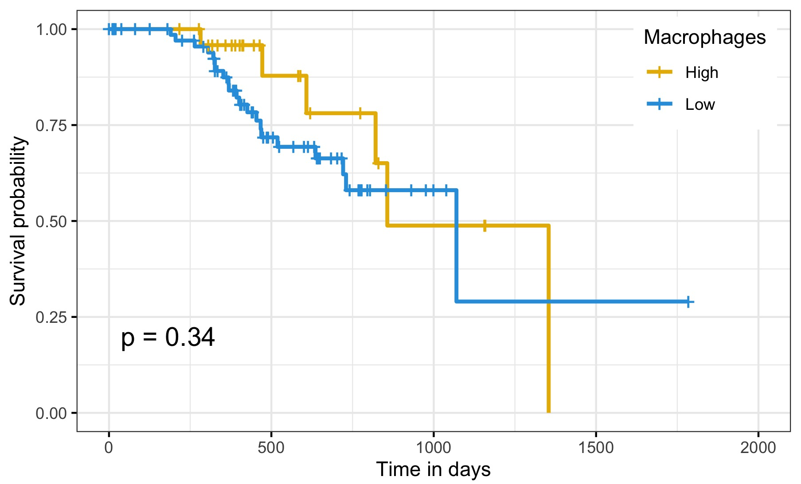
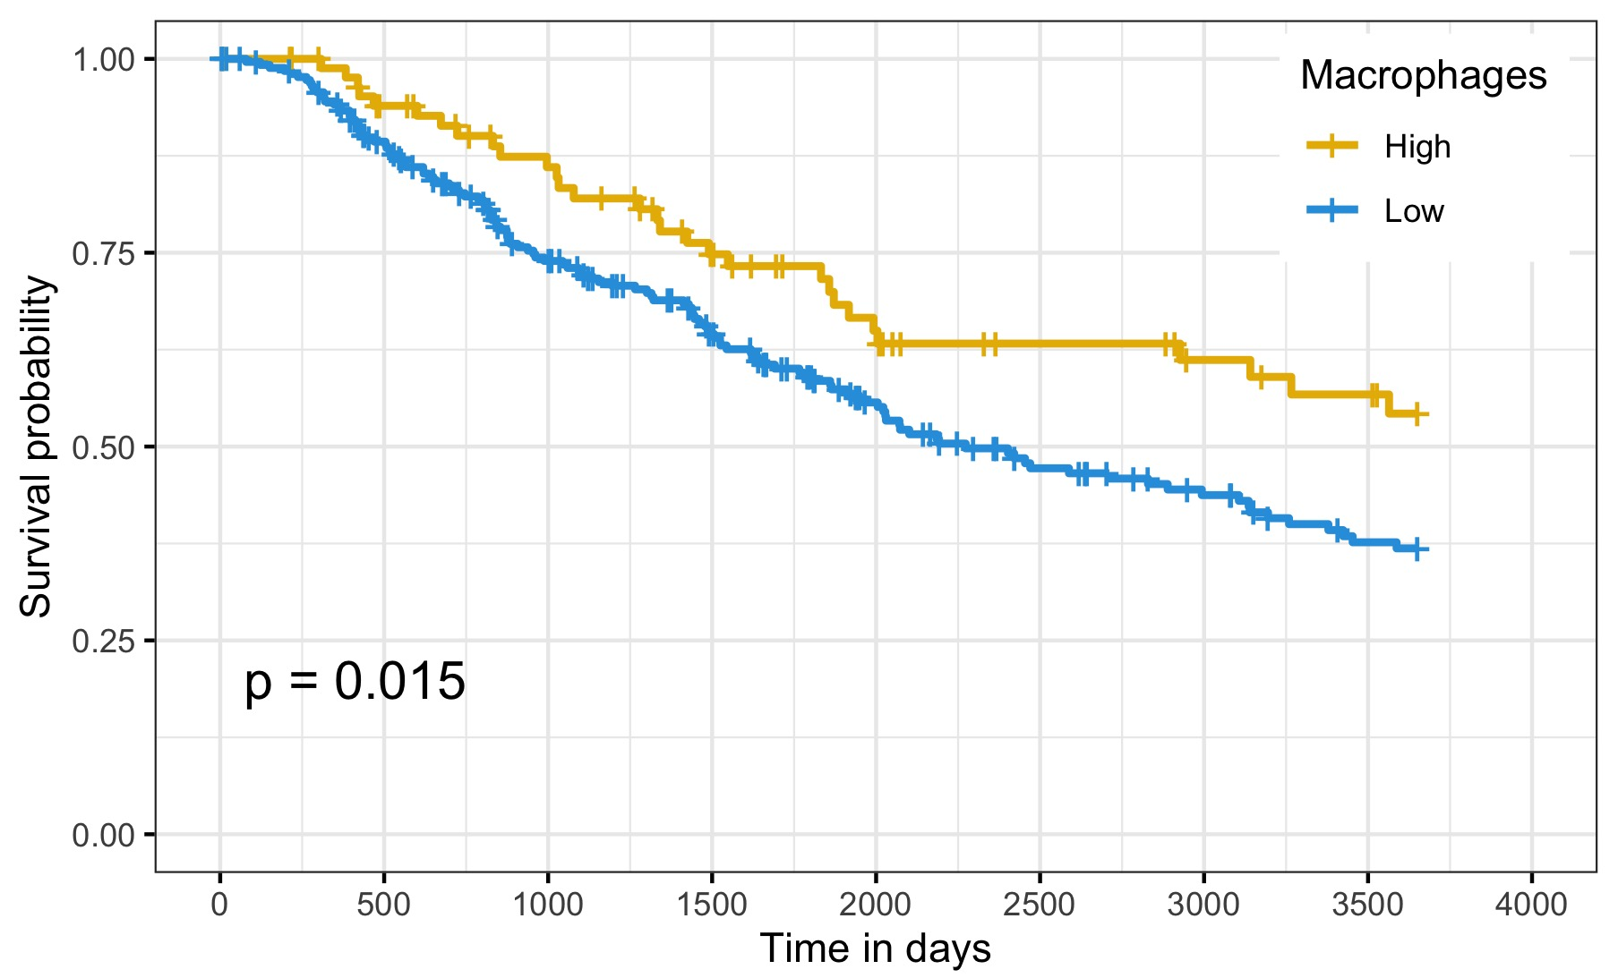
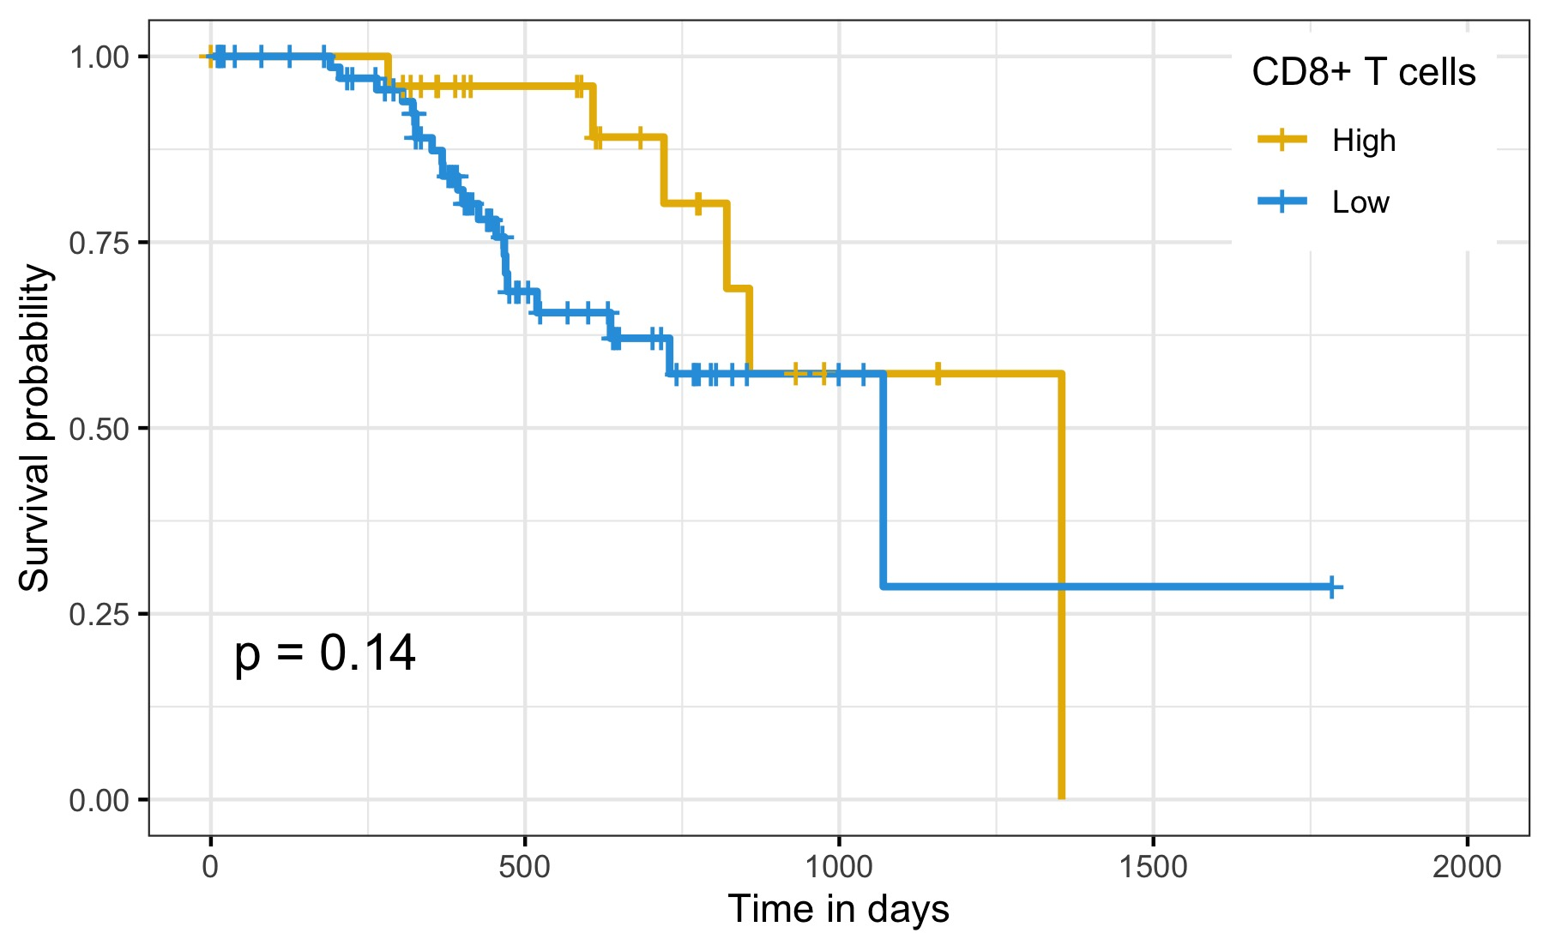
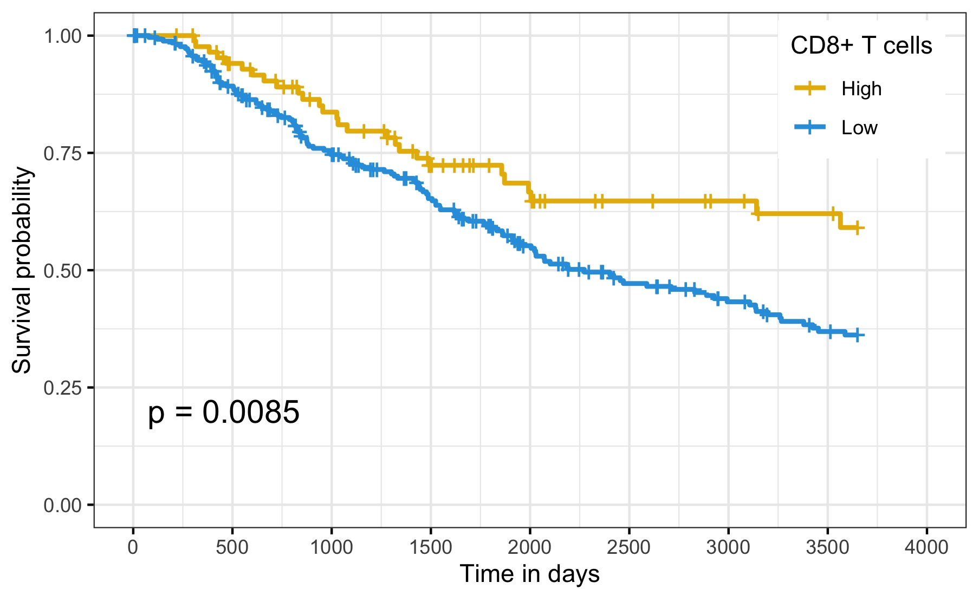
KM analysis
Primary melanoma (n = 102)
Metastatic melanoma (n = 348)
Group 1
Group 2
Group 1
Group 2
Group 1 ≥ 75th percentile of proportion of a cell type
Group 2 < 75th percentile
Higher Macrophages and CD8⁺ T cells: better
Group 1
Group 2
Group 1
Group 2
Notes:
a brief: sentence to explain the cutoff. Medical studies, sometimes median / mean, but if we would like to … the 75th percentile could be used.
Superscript +
Group2: lower survival probability, therefore higher risk.
Primary: could be useful for 5 year survival; small sample size? Split at 50th instead of 75th?
explain first: primary: not separate after 750 days: small sample size? not smooth as the metastatic. sparse data.

Slide 14
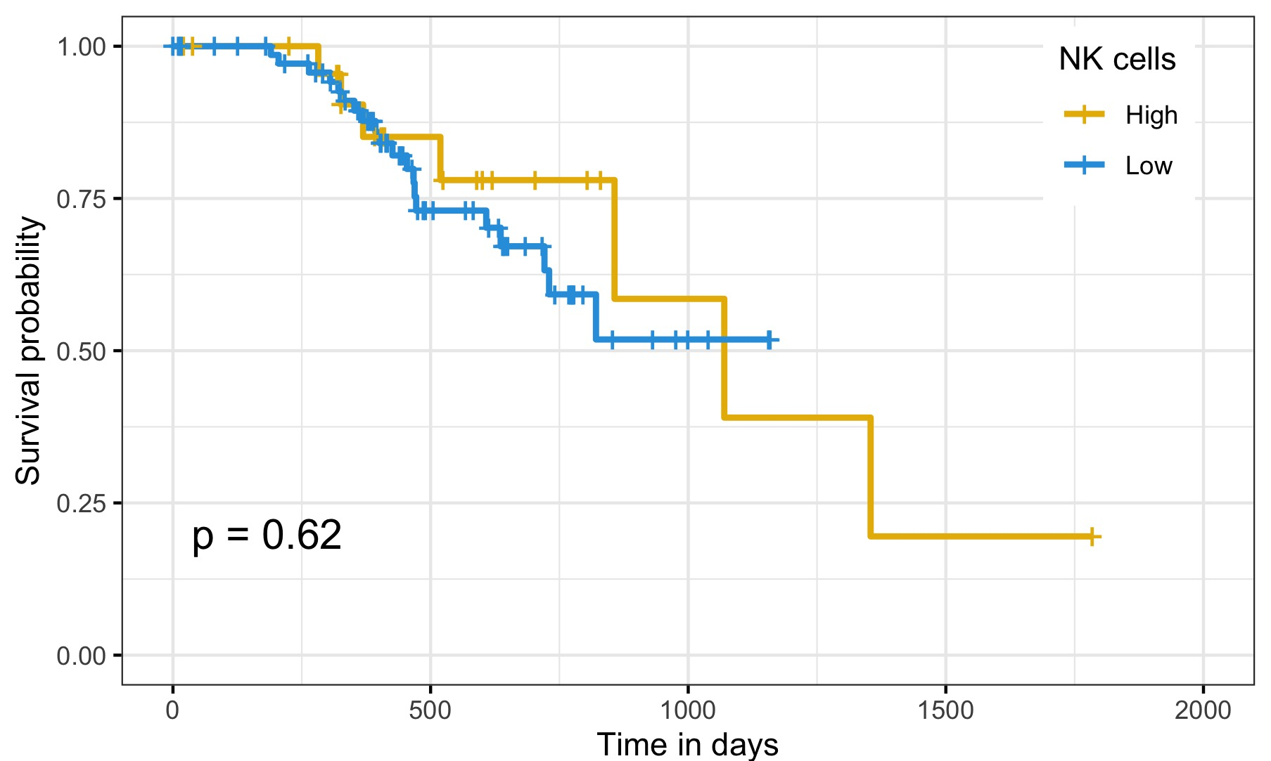
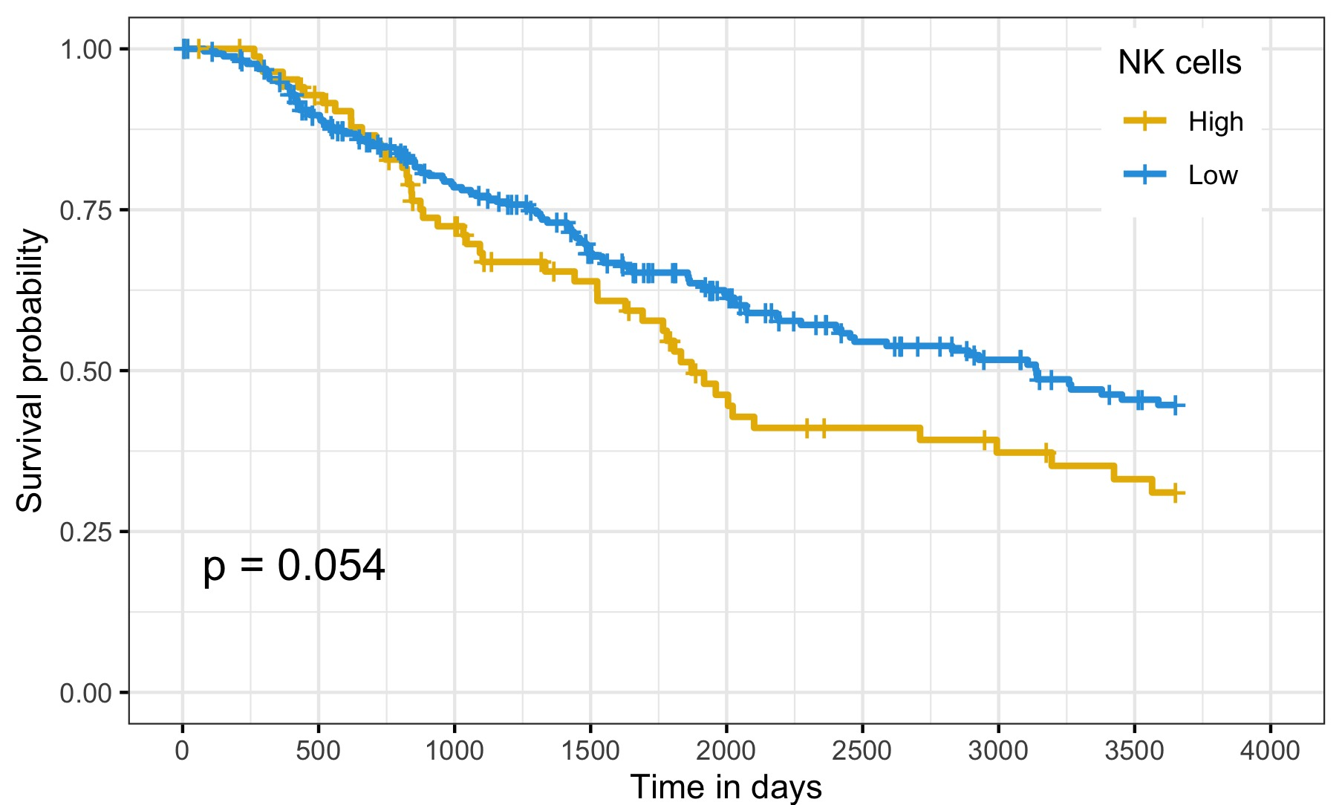
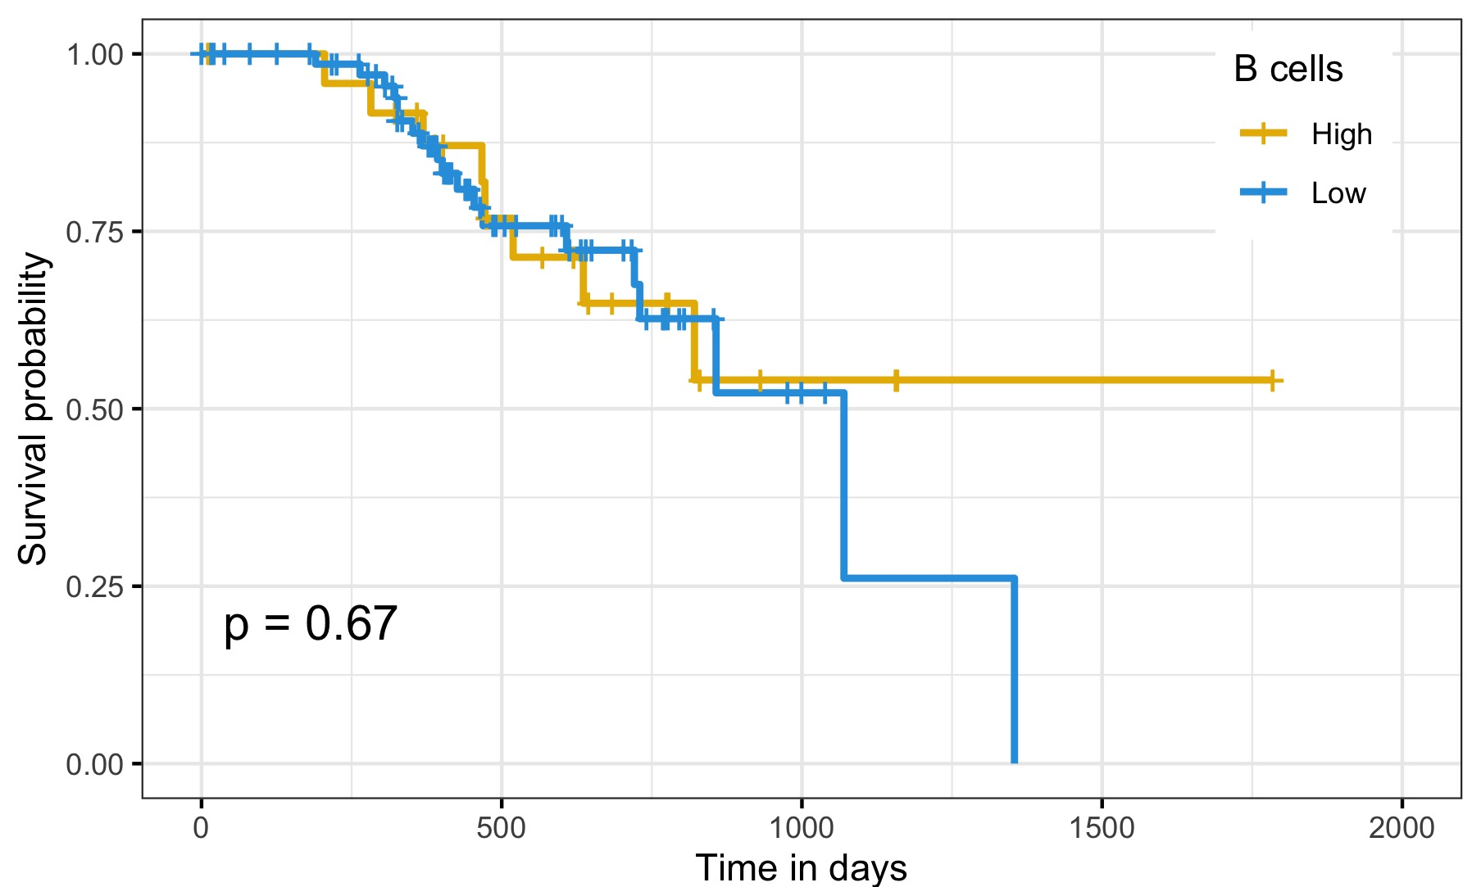
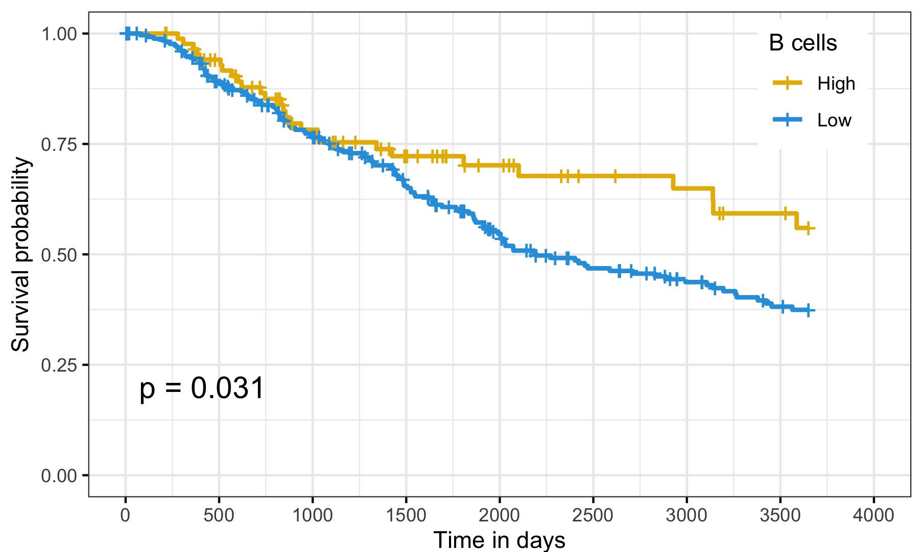
KM analysis
Primary melanoma (n = 102)
Metastatic melanoma (n = 348)
Group 1
Group 2
Group 1
Group 2
Group 1 ≥ 75th percentile of proportion of a cell type
Group 2 < 75th percentile
Higher NK cells: worse
Higher B cells: better
Group 1
Group 2
Group 1
Group 2
Notes:
sample size? after 750 days

Slide 15
Summary
Extracted cellular composition: 8 cell types, three existing melanoma bulk gene expression data sets
Novel combination of CIBERSORT and survival analysis: cellular markers for melanoma patient survival
- Primary: fibroblasts
- Metastatic: immune cells, macrophages and CD8+ T cells
Combination of methods applicable to other cancers and complex diseases
Notes:
Help prediction/prognosis of melanoma
Identified patients with higher risks.

Slide 16
Thank you!

