Slide 1
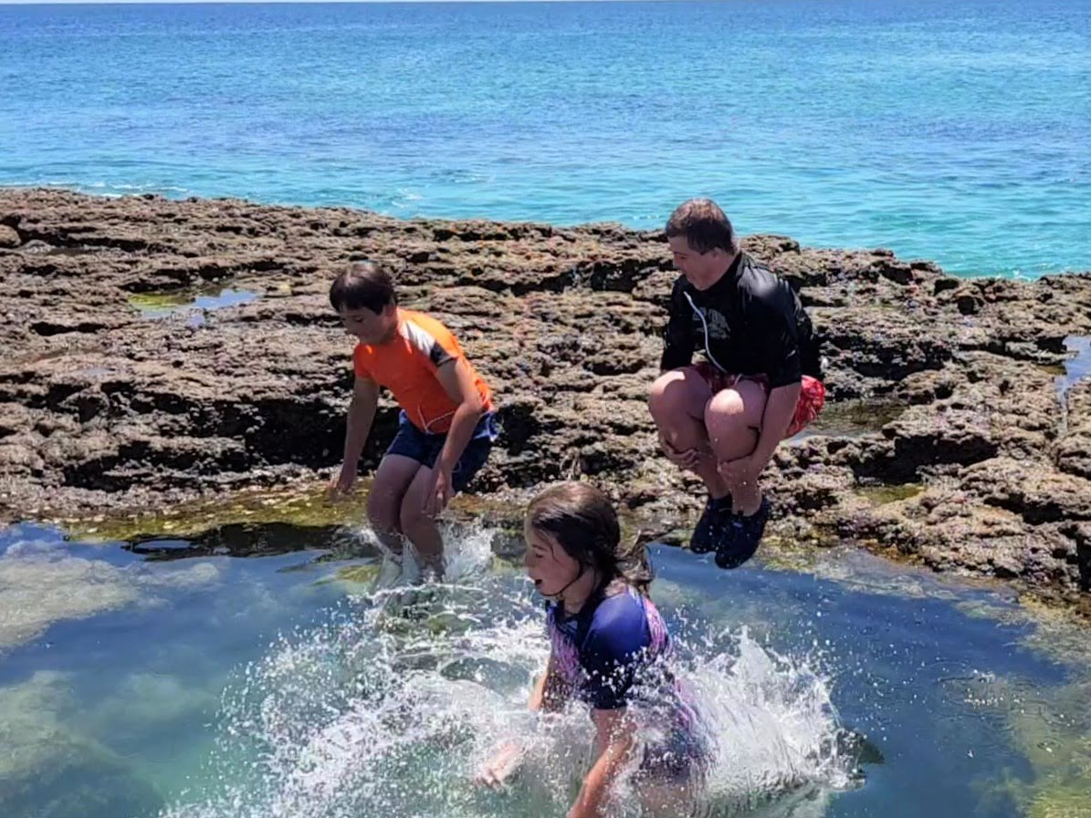

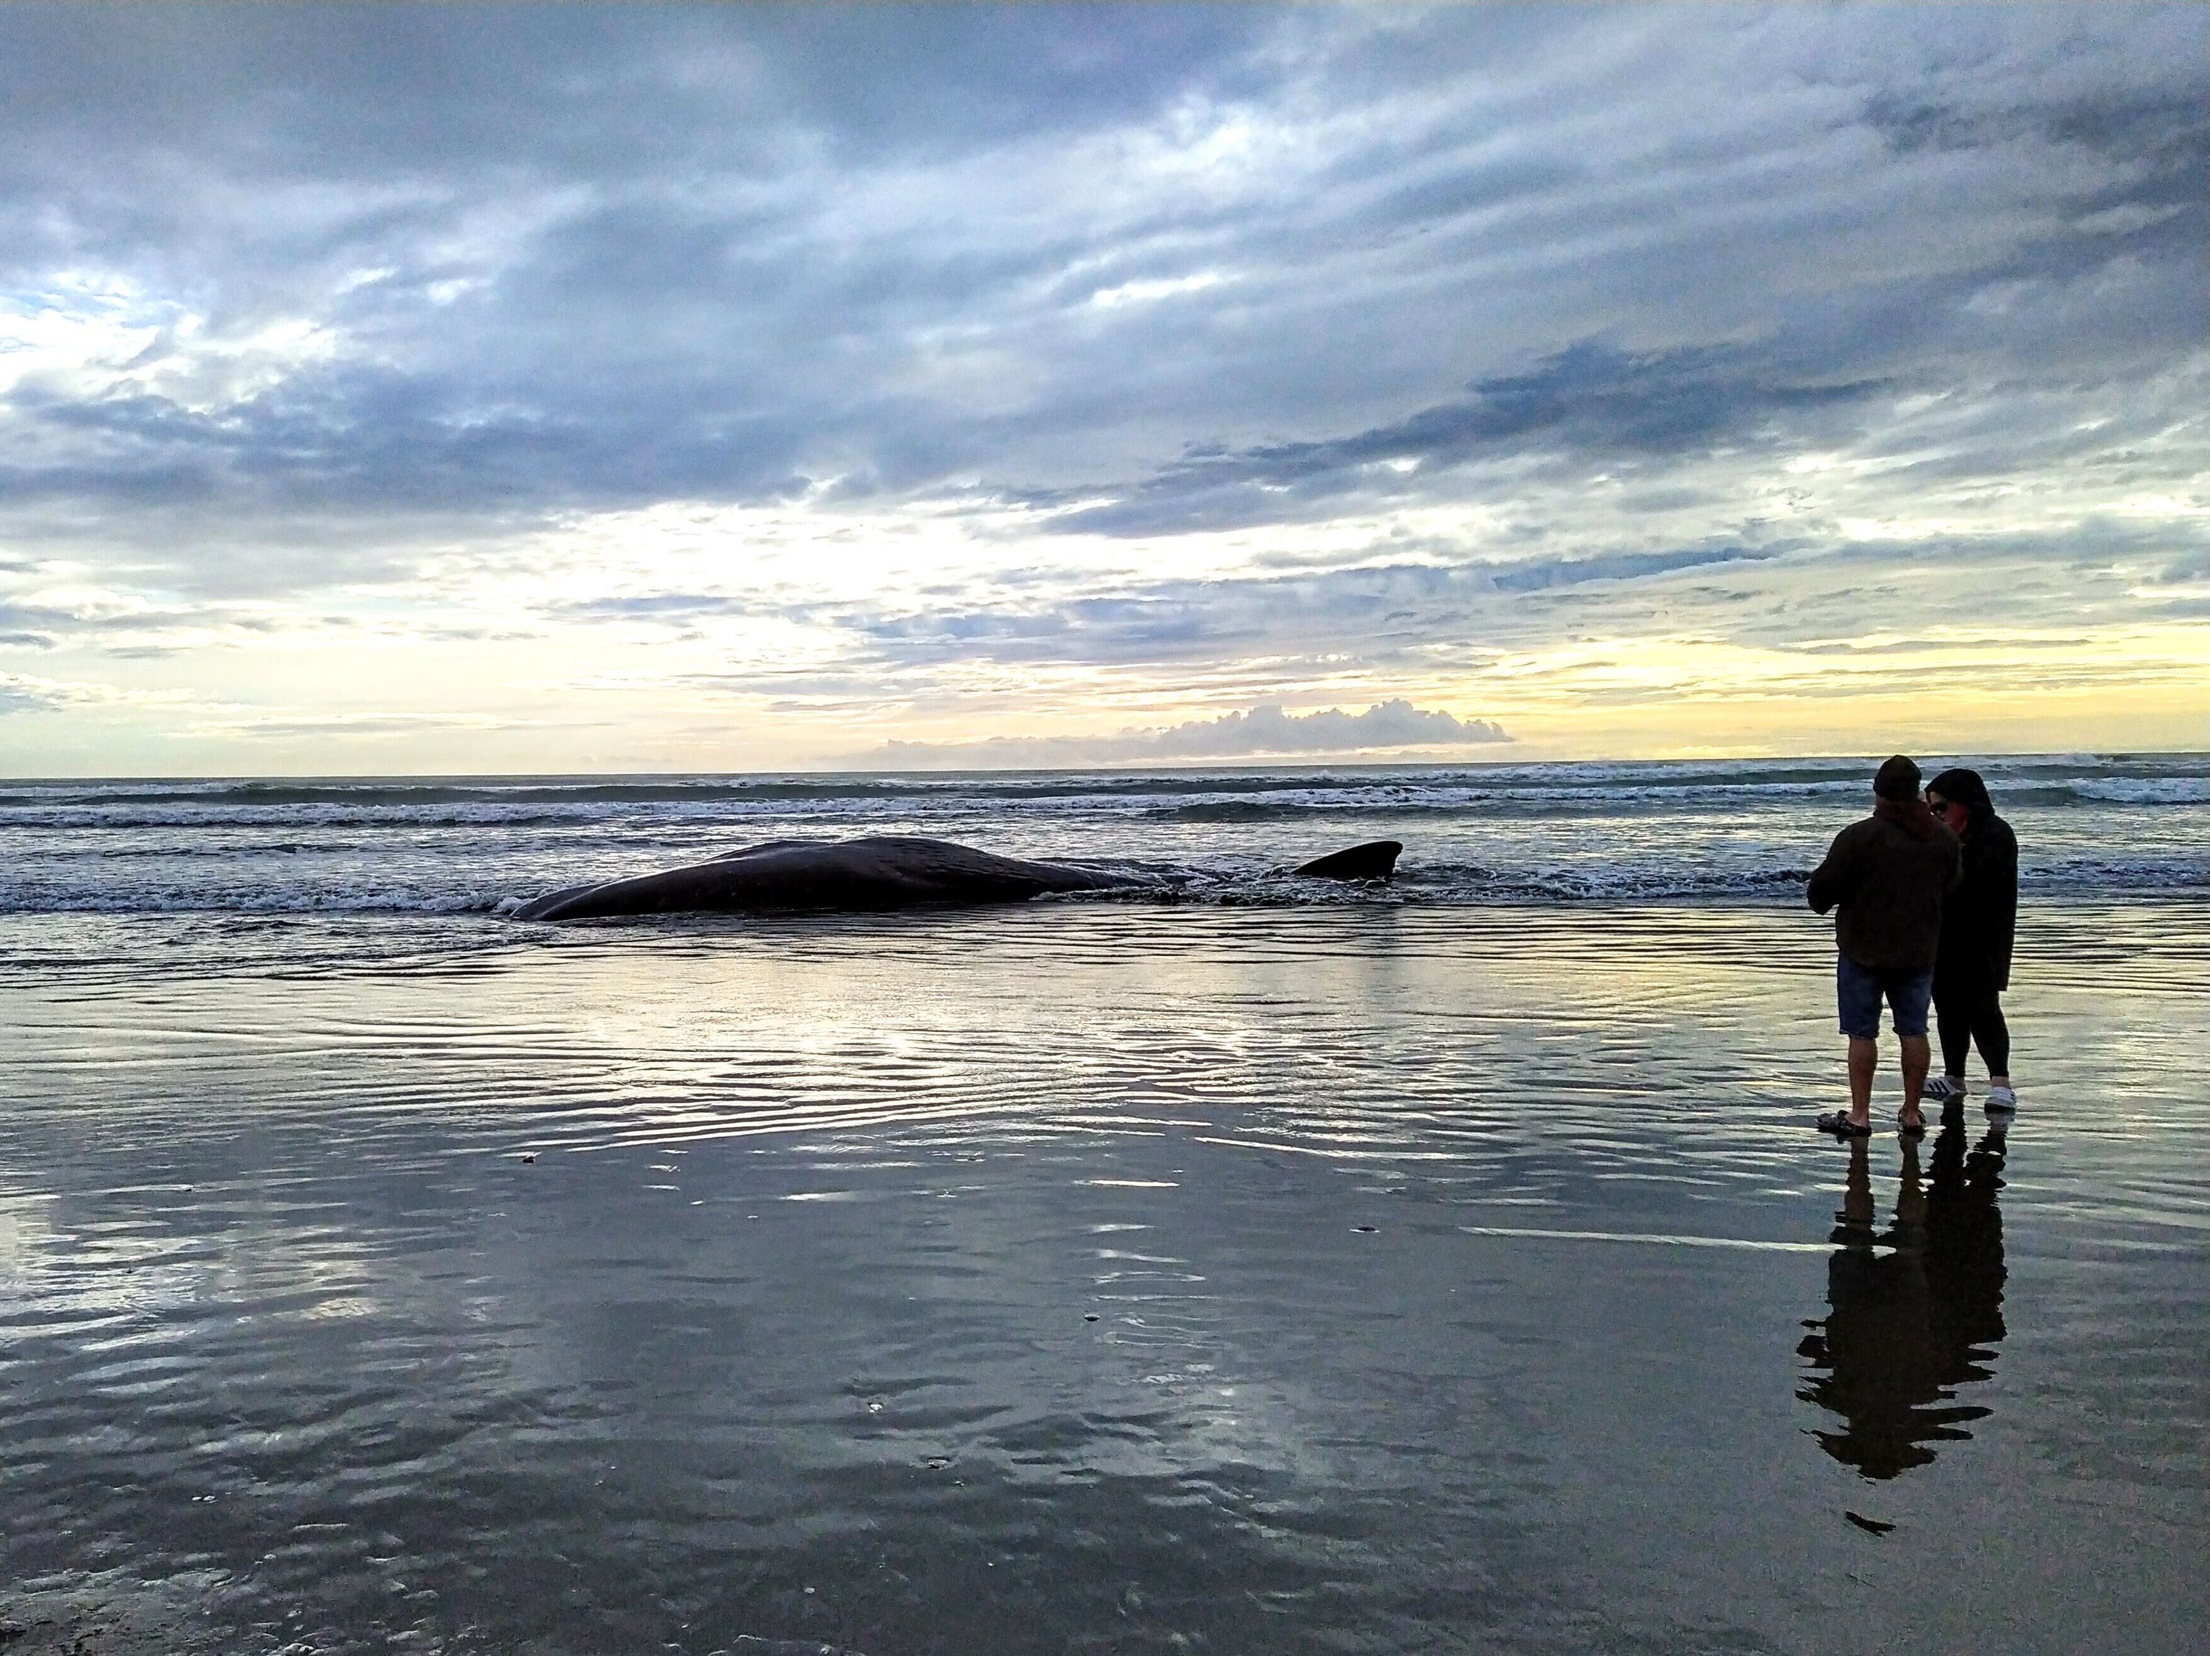
The incidence of early-onset colorectal cancer in Aotearoa New Zealand: 2000 to 2020.
John Pearson | Biometrics 27/11/2023
Oliver Waddell, Andrew McCombie, Harriet Marshall, Rachel Purcell, Jacqui Keenan, Tamara Glyn, Frank Frizelle
Notes:
Abstract: Colorectal cancer is the second most common cancer in Aotearoa New Zealand resulting in over 1,200 deaths each year. While age standardised incidence rates in the total population have been steadily decreasing against a background of static incidence rates and an aging population, incidence rates for early onset colorectal cancer (EOCRC) in those under 50 years old have been increasing in Aotearoa New Zealand, as has been found elsewhere. The New Zealand Cancer Registry data from 2000-2020 was examined by Poisson regression to quantify trends in incidence and age standardised incidence by age group, sex and cancer location for total and Māori ethnicity and projected to 2040 using population projections from Statistics New Zealand. A critical aspect of this research is the production of meaningful statistics in the New Zealand context that are sympathetic to Māori world views, Māori health advancement and indigenous research methodology against a background of global efforts that minimise such considerations..
Keywords: Colorectal cancer, epidemiology, Māori health advancement, indigenous research

Slide 2
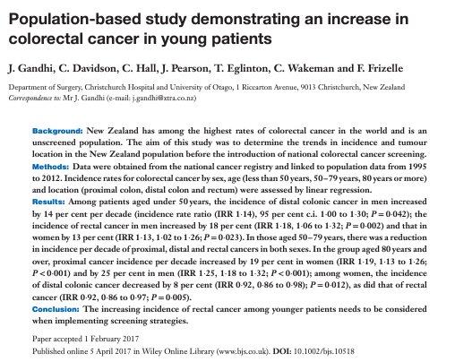
New Zealand 1995 -2012

Slide 3
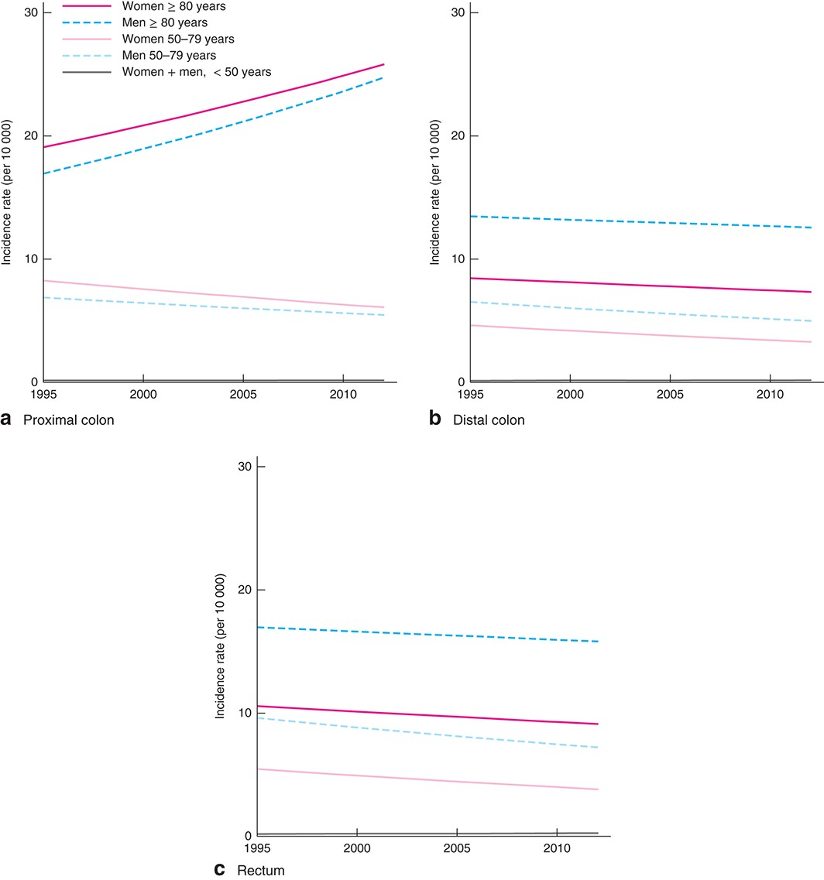

New Zealand 1995 -2012
Fig. 1 Colorectal cancer rates in New Zealand, 1995–2012, modelled by Poisson regression. Trends in incidence rate ...
Br J Surg, Volume 104, Issue 8, July 2017, Pages 1063–1068, https://doi.org/10.1002/bjs.10518
The content of this slide may be subject to copyright: please see the slide notes for details.

Slide 4
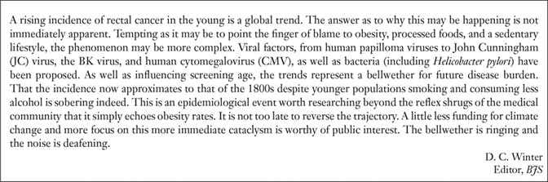
New Zealand 1995 -2012

Slide 5
New Zealand 1995 -2012
“That the incidence now approximates to that of the 1800s despite younger populations smoking and consuming less alcohol is sobering indeed. This is an epidemiological event worth researching beyond the reflex shrugs of the medical community that it simply echoes obesity rates.”

Slide 6
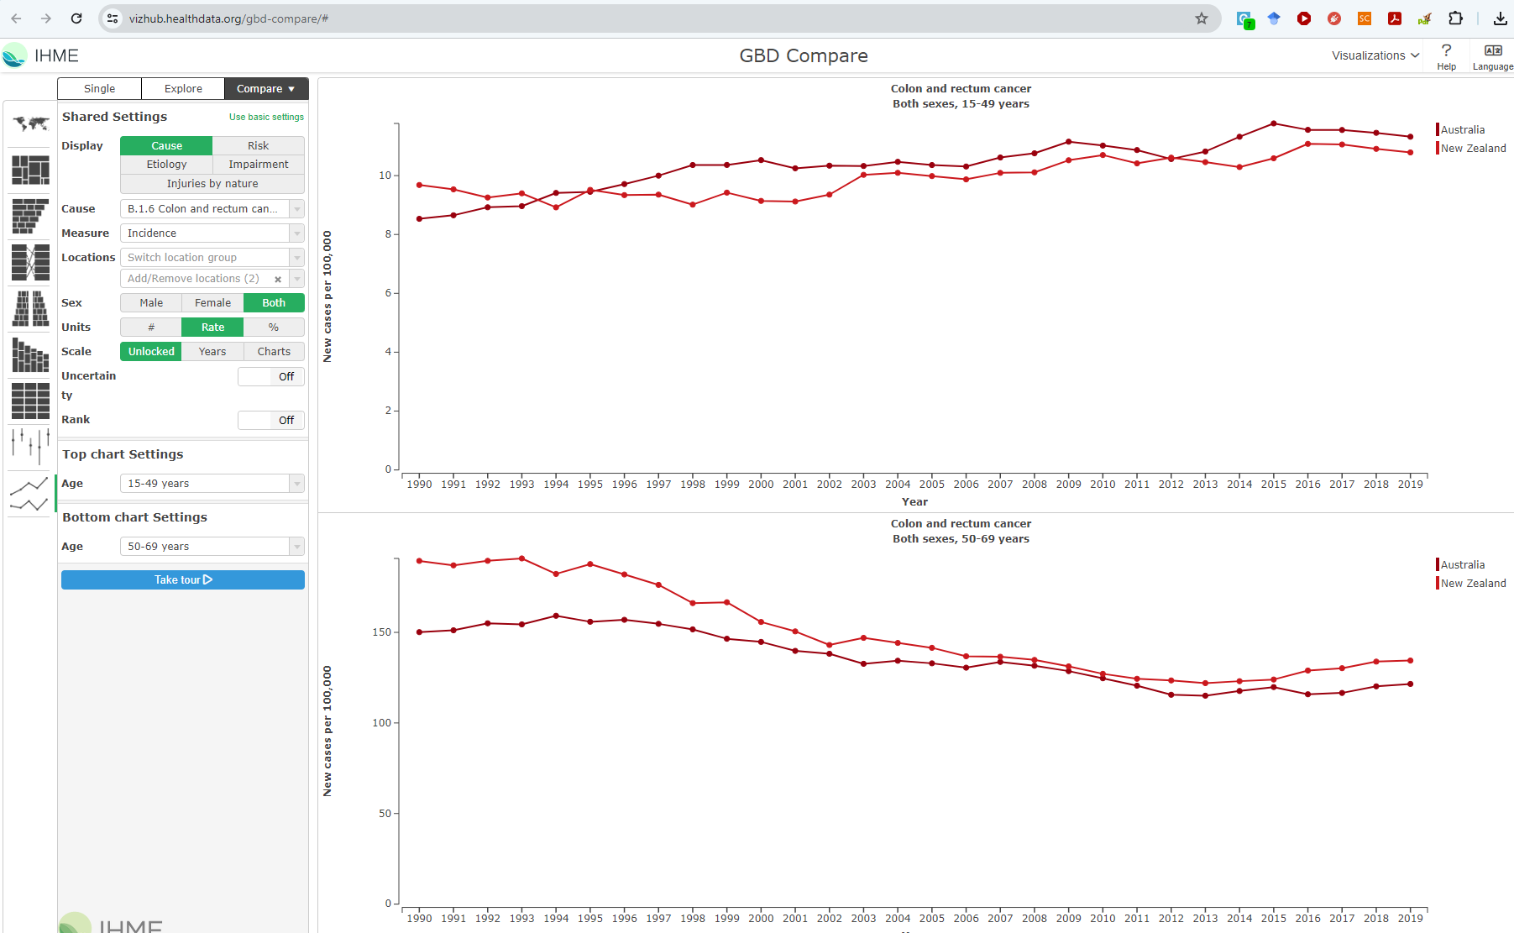
Global burden of disease

Slide 7
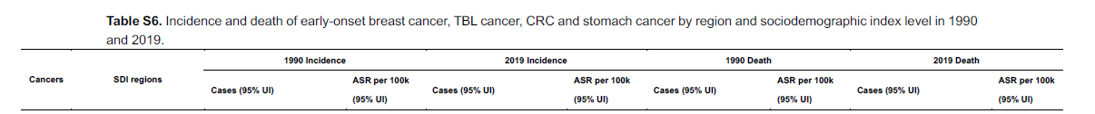
Global burden of disease
Zhao J, Xu L, Sun J,et al. Global trends in incidence, death, burden and risk factors of early-onset cancer from 1990 to 2019. BMJ Oncology 2023;2:e000049. doi:10.1136/
bmjonc-2023-000049

Slide 8
Where to next?
Stats/Epi
Better Health
New Zealand 2000
EOCRC
NZ
Data
Global
Policy
Government
Clinician
$
Patients
TTW
Treatment

Slide 9
Where to next?
Stats/Epi
Better Health
New Zealand 2023 – 2040?
EOCRC
NZ
Data
Global
Policy
Governance
Clinician
TTW
Treatment
$
Px
Px
Px

Slide 10
What does this look like?
More flexible methods
Better reflection of indigenous world view
(TTW and Te Aō Māori)
Better fit of research with purpose
Better understanding and uptake of research

Slide 11
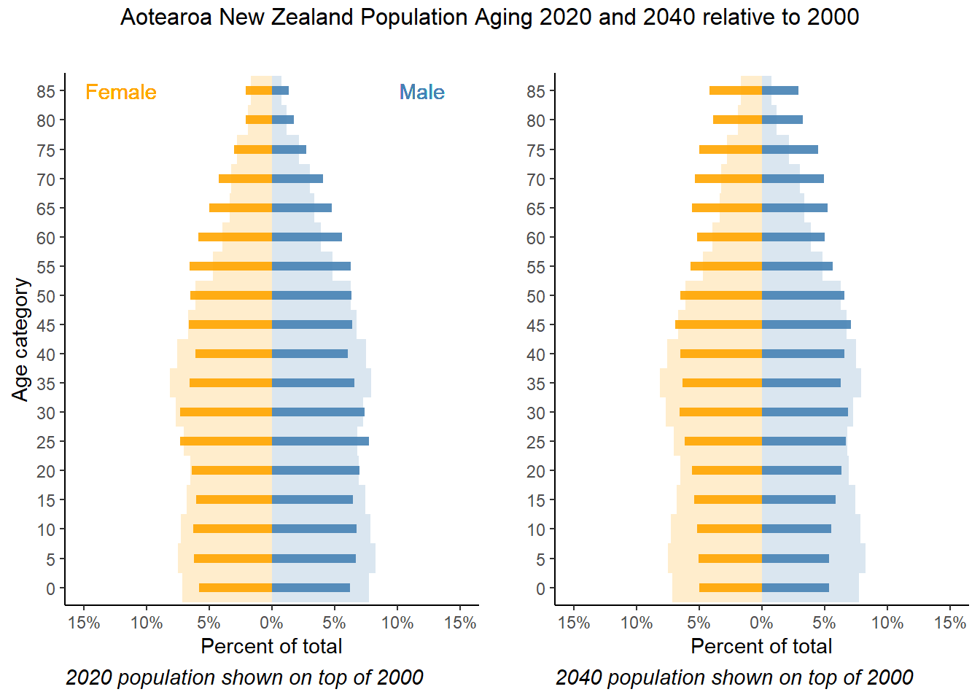
What does this look like?
More flexible methods

Slide 12
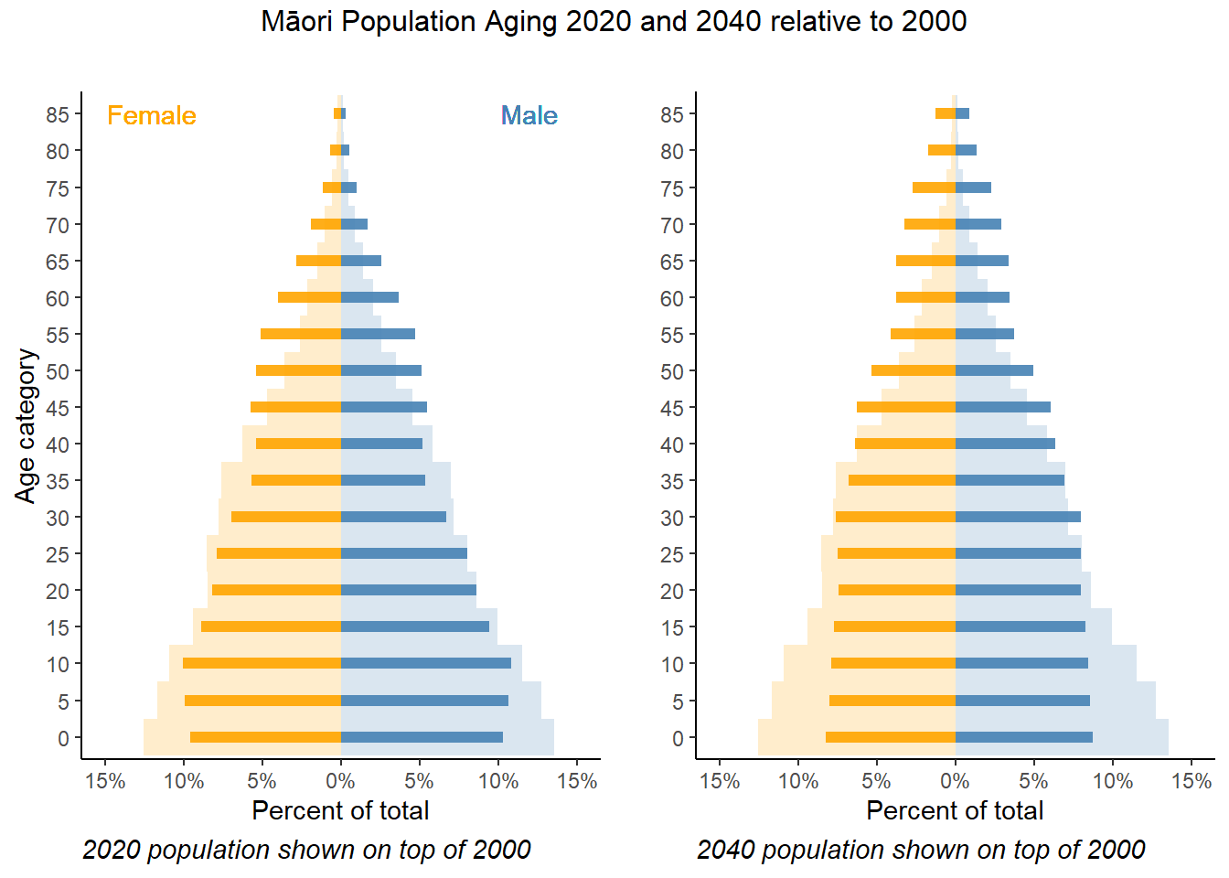
What does this look like?
More flexible methods

Slide 13
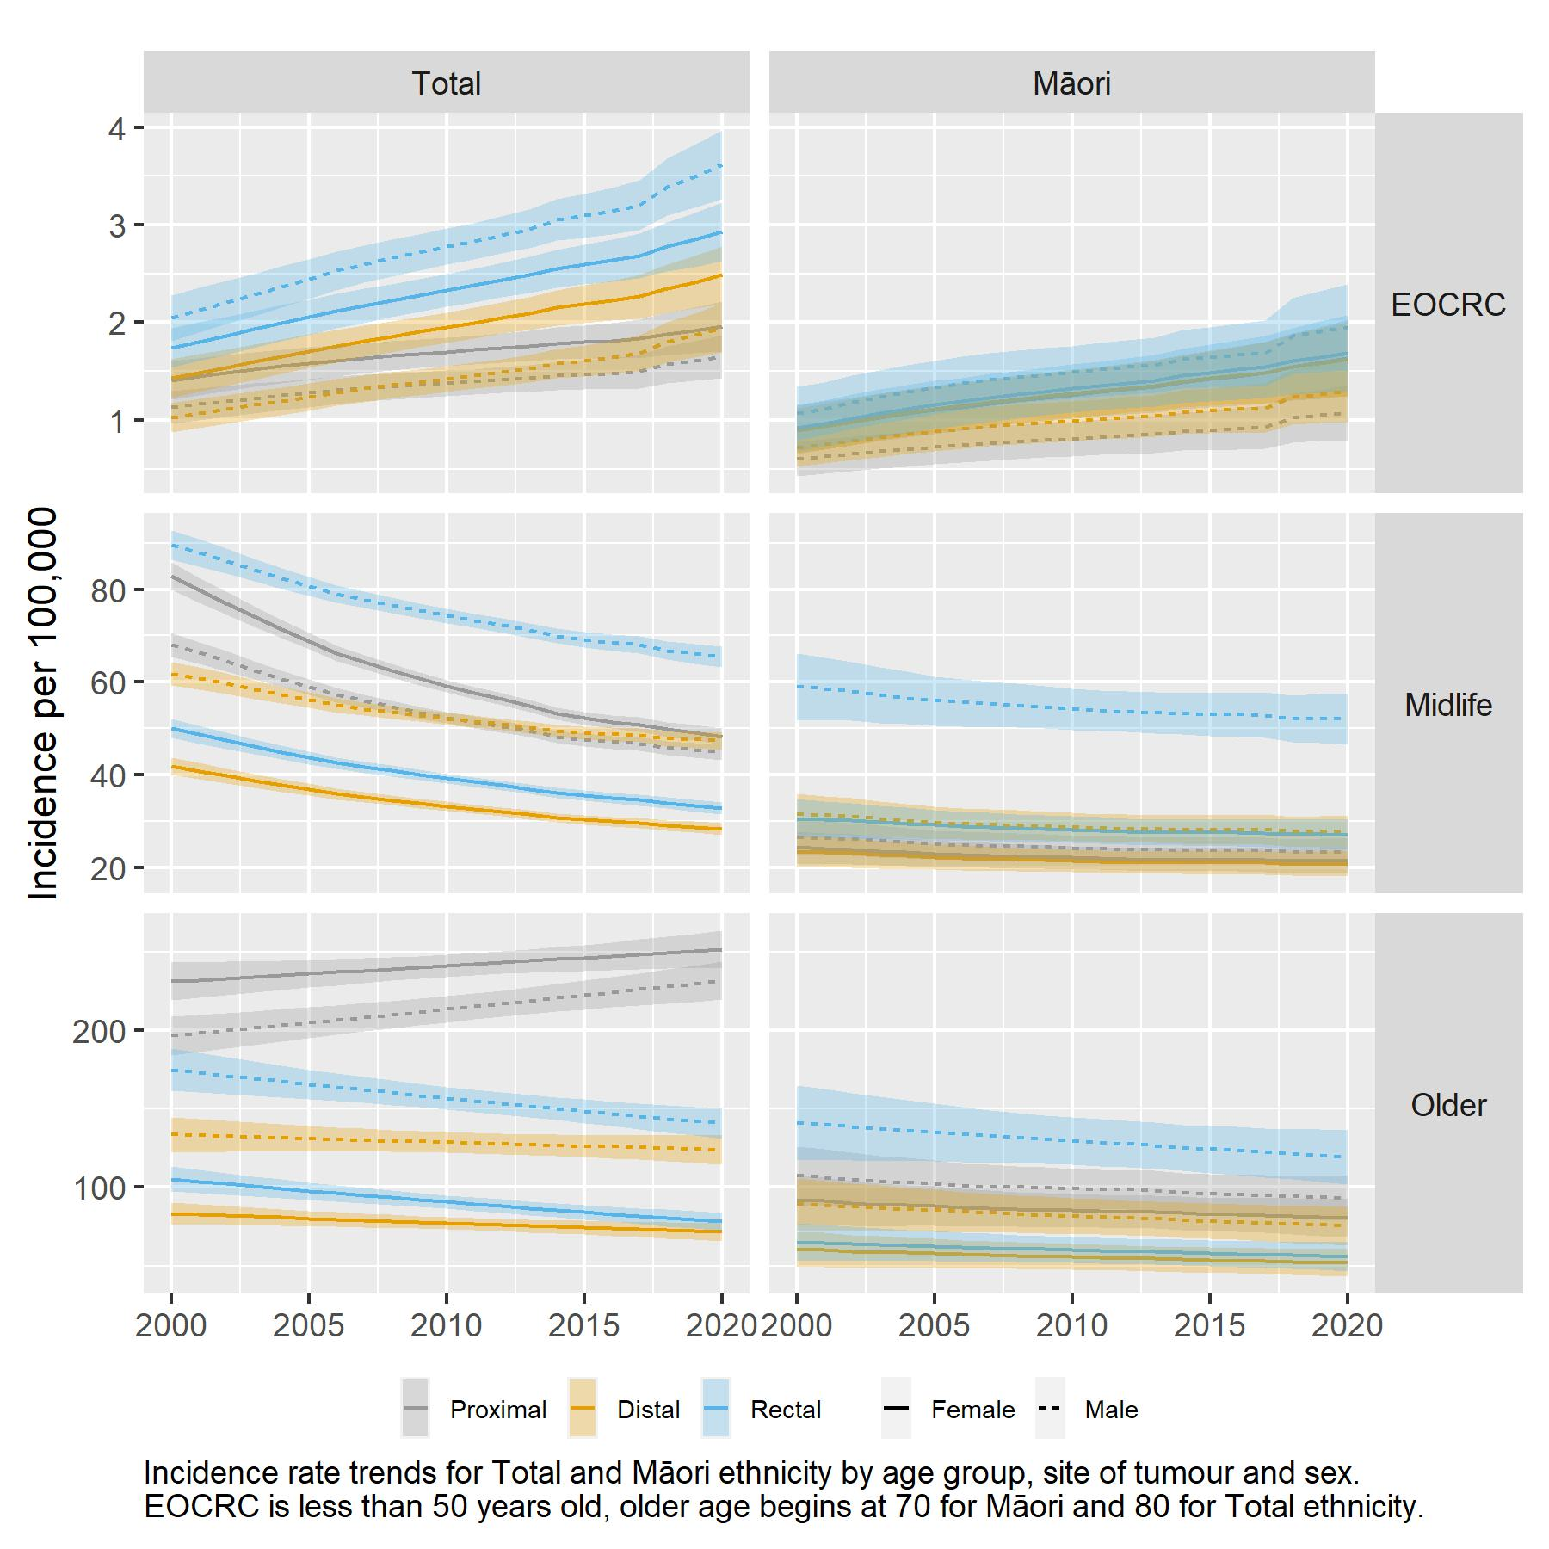
What does this look like?
More flexible methods

Slide 14
What does this look like?
More flexible methods
 | Total | Māori
 | IRR (95% CI) | IRR (95% CI)
All ages | 1.00 (0.98, 1.01) | 1.28 (1.21,1.36)***
EOCRC | 1.26 (1.20, 1.33)*** | 1.36 (1.21,1.54)***
Midlife | 0.82 (0.81, 0.84)*** | 0.97 (0.92,1.03)
Older | 0.99 (0.96, 1.02) | 0.96 (0.89,1.04)
Incidence Rate Ratio over 10 years with 95% confidence intervals. Early onset CRC <50 years, older age begins at 80 years for total ethnicity and 70 years for Māori ethnicity, both approximately 3% of their populations. *** P<0.0005.

Slide 15
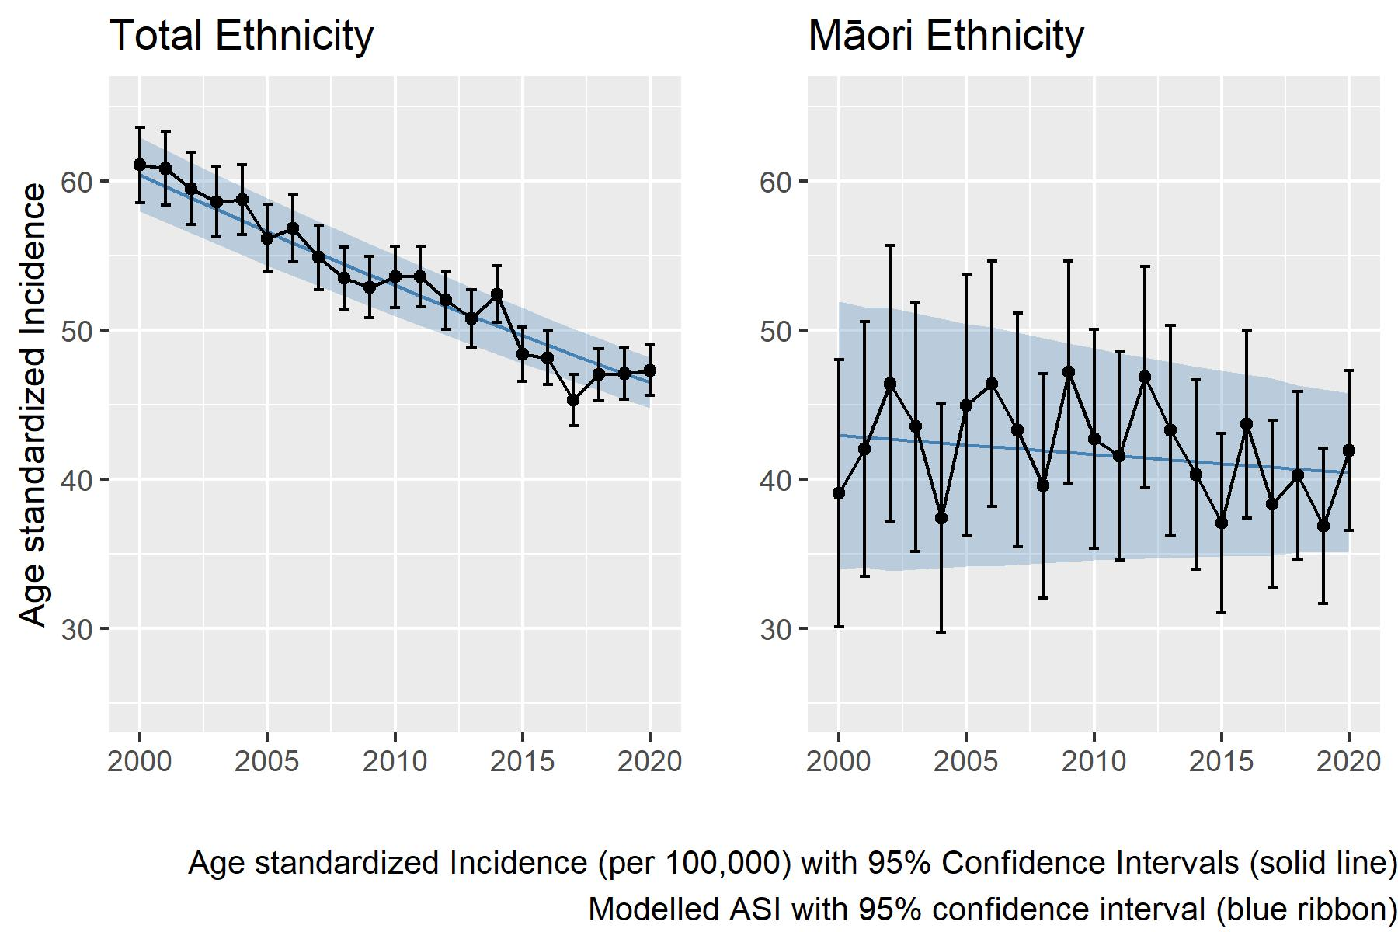
What does this look like?
More flexible methods

Slide 16
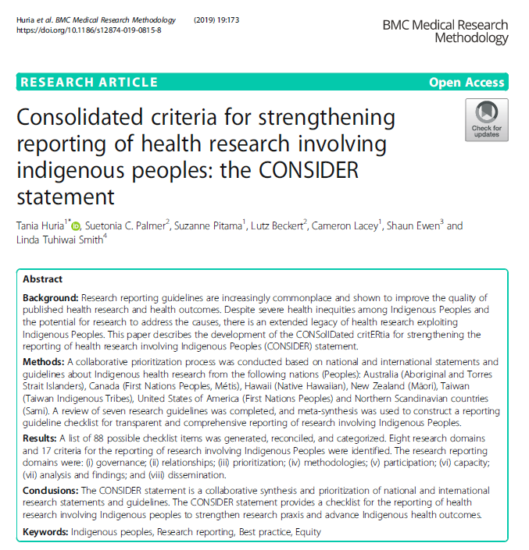
What does this look like?
TTW and Te Aō Māori

Slide 17
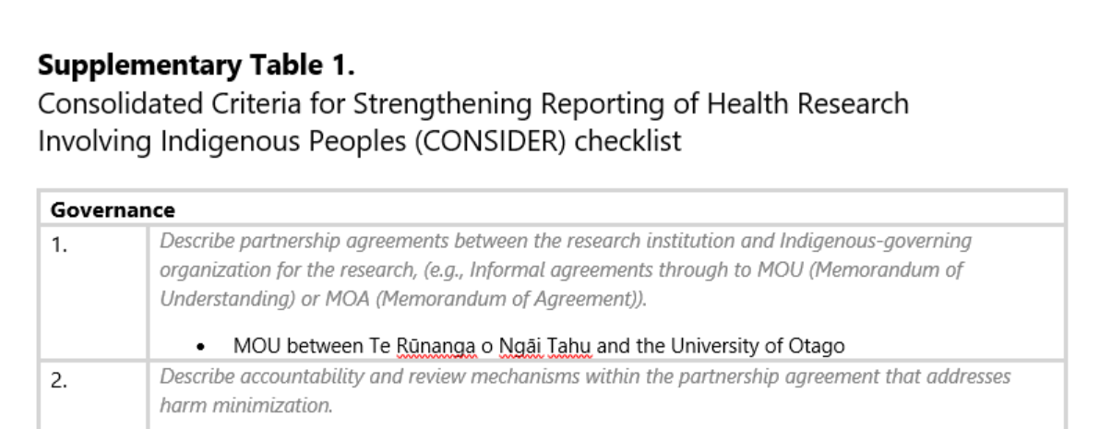
What does this look like?
TTW and Te Aō Māori

Slide 18
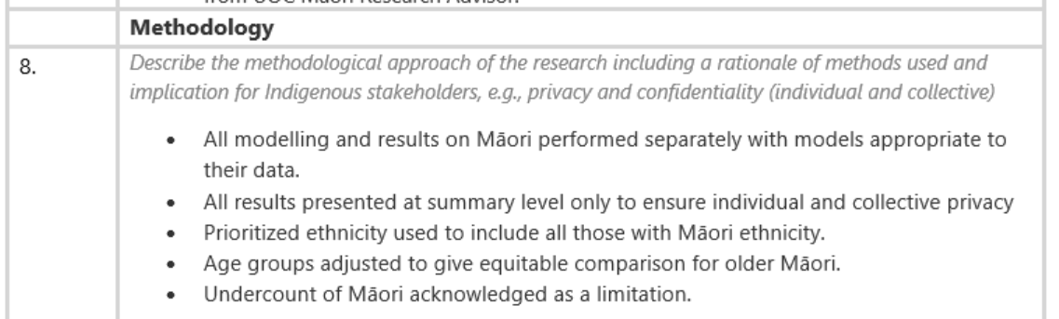
What does this look like?
TTW and Te Aō Māori

Slide 19
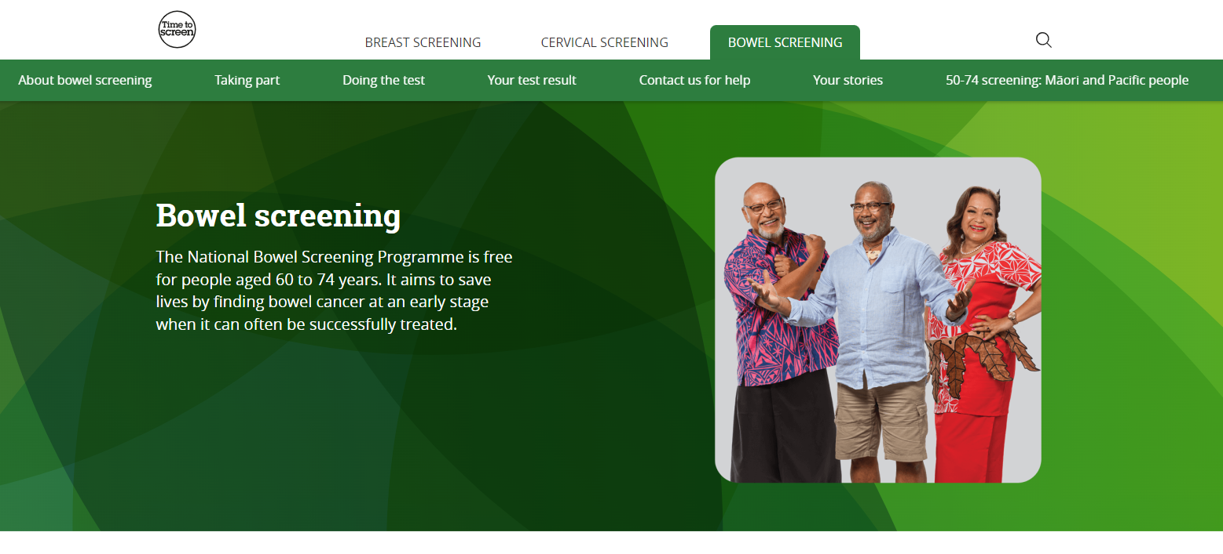
What does this look like?
Impact

Slide 20
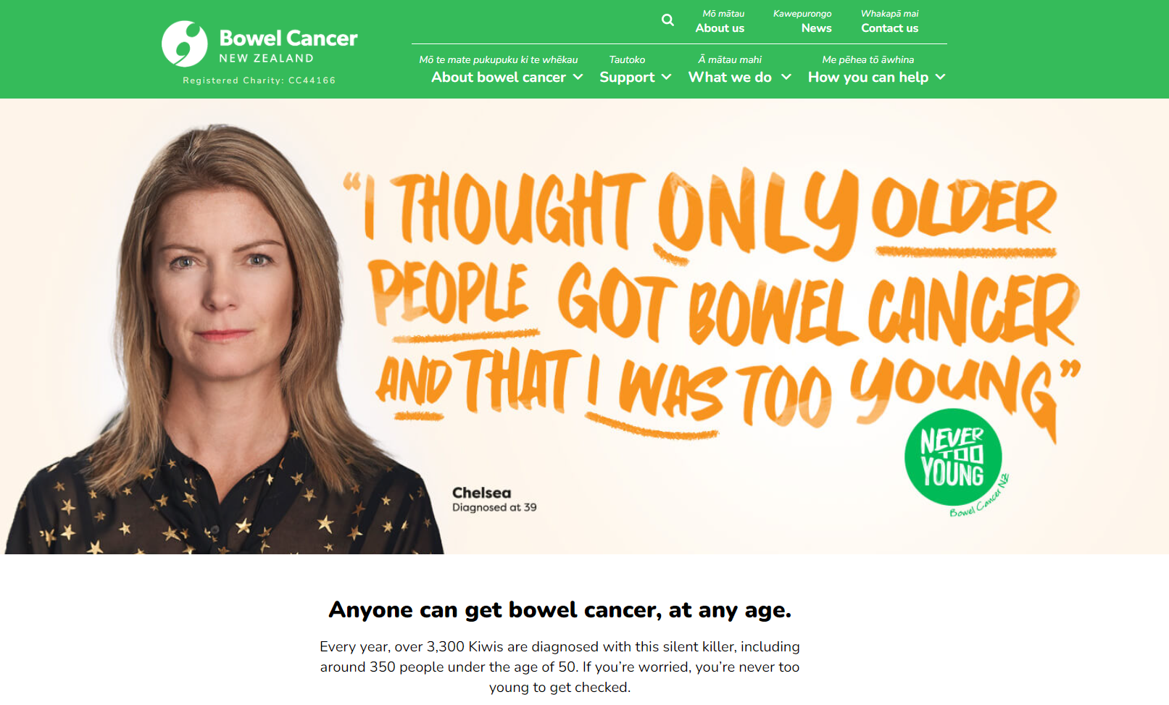
What does this look like?
Impact

Slide 21
What did we learn?
We have some way still to go
Acknowledge and overcome (unconscious) bias
Flexibility
Global research is great but not the answer to everything
Thank you list: UOC MHER, StatsNZ, MoH, NZ Cancer registry, NZ Society of Gastroenterology, clinicians, researchers and patients who donated time and data.

