Slide 1

The ROBUST RCT: a statistical perspective
Alain C. Vandal
Te Kura Tatauranga/
Department of Statistics
Waipapa Taumatau Rau/
The University of Auckland

Slide 2
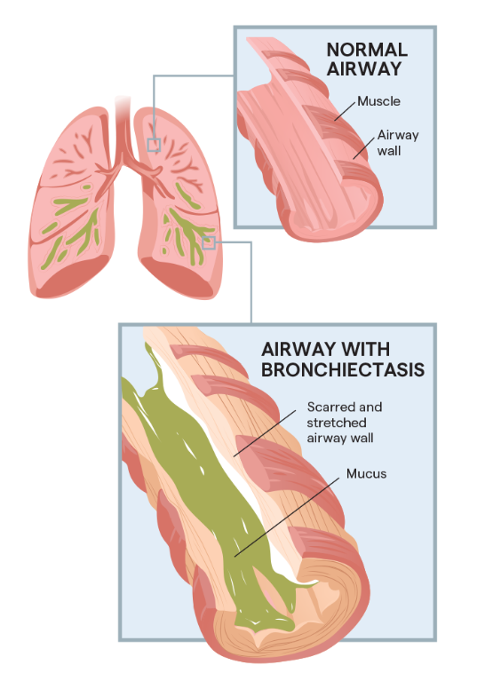
Bronchiectasis
Widening of airways
Accumulation of mucus
Inflammation and infection
Some symptomatic similarities to COPD
livingwithbe.com
Notes:
productive cough, progressive dyspnoea, varying degrees of airflow obstruction and repeated respiratory infections requiring frequent courses of antibiotics.⁴ Exacerbations often require admission to hospital and prolonged courses of intravenous and oral antibiotics.Cystic fibrosis causes Be. Aetiology unclear. Childhood Be sometimes reverses.

Slide 3
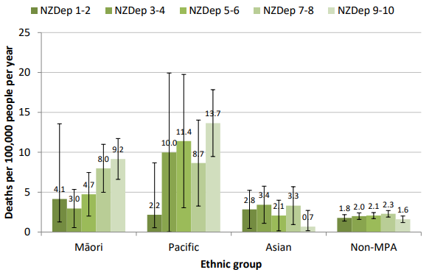
Bronchiectasis
162 cases per 100,000 p-y in Aotearoa New Zealand
  5.6 times more prevalent in Pasifika, and
  3.6 times in Māori, than in non-Māori non-Pasifika non-Asian (non-MPA)
Hospitalisations increased 39% between 2000 and 2019 (~30 per 100,000 p-y)
  6.9 times more common in Pasifika,
  3.8 times in Māori than in non-MPA
Barnard & Zhang, 2021
Notes:
COPD prevalence about 2.8%, severe COPD 1%, about 2.5 times higher in Maaori & Pasifika.

Slide 4

The ROBUST trial
Population: Bronchiectasis patients
Arms
  Intervention: Tiotropium (inhaled corticosteroid)
  Control: Placebo
COPD patients eligible
Primary outcomes
  Pulmonary exacerbations
  Lung function (FEV₁)

Slide 5
The ROBUST trial
PI: Dr Conroy Wong, Te Whatu Ora Counties Manukau
Three centres
  Middlemore Hospital
  Auckland Hospital
  Waikato Hospital
Funding: Health Research Council (HRC) Project
Monitoring: DMC appointed by HRC

Slide 6
Designing the trial (July 2010)
I start as Senior Biostatistician with CCRep (now Middlemore Clinical Trials) in June 2010.
Conroy approaches me (and tons of other people) in July.
Good primary outcome data from the EMBRACE trial.
We settle on a crossover design to keep a lid on the sample size.

Slide 7
The ROBUST trial crossover
Goal: Control
Design: 2-period randomised crossover trial
Stream A
Washout
(4 weeks)
Stream B
Tiotropium
Placebo
Stream B
Stream A
Week
0
4
13
26
30
34
43
56

Slide 8
Sample size
Exacerbation as primary outcome allows information from partial follow-up.
Base attrition probability + Attrition schemes
Targeting detection of a rate ratio Tx/Control of 2/3.
Needed covariance between periods within participant; control of mean; control of overdispersion; allowing for loss to follow-up.

Slide 9

Sample size
Rates simulated as gamma, exacerbation counts as Poisson (negative binomial overall)
Approach enabled control of all simulation parameters (e.g. correlation is $\frac{\sqrt{ρ}β}{\sqrt{\left(1+β\right) (1+ρβ)}}$, with $ρ$ the relative rate of exacerbation).
By generating the conditional Poisson variates as sums of $Y_{1}+Y_{3}$ and $Y_{2}+Y_{3},$ it is possible to simultaneously control mean, overdispersion and correlation.
Sample size analysis used mixed effects NB [nExac~Tx+Period+(1|PID)+offset(logfu)], not quite the generating model.

Slide 10
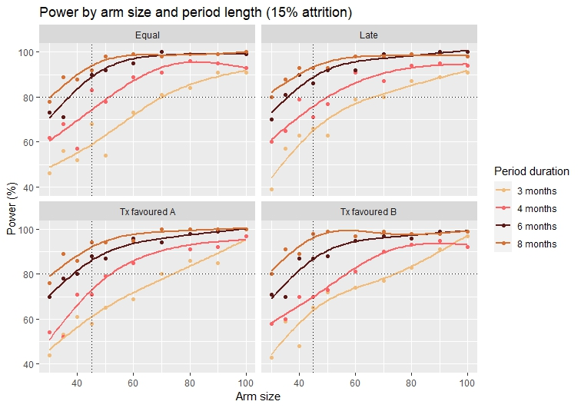

Slide 11
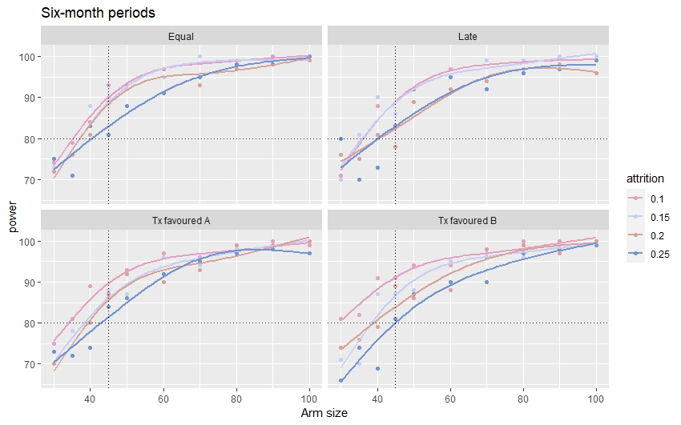

Slide 12
HRC timeline
Oct. 2010
Expression of interest (EOI) submitted
Jan. 2011
EOI results - Invitation to submit a full application (50% of applicants)
Mar. 2011
Full proposal submission
Apr. 2011
External reviews and rebuttal
June 2011
Full proposal results

Slide 13
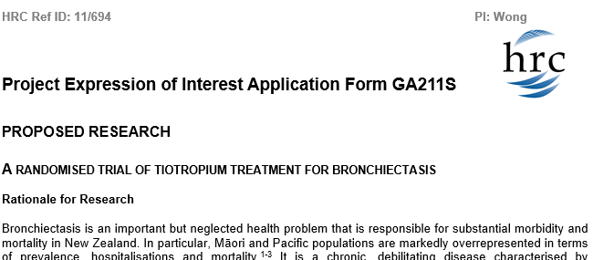
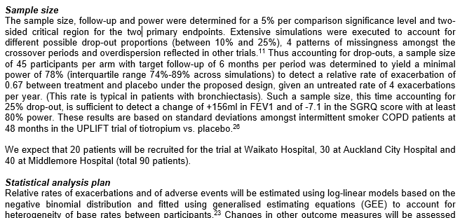


EOI submission (October 2010)

Slide 14
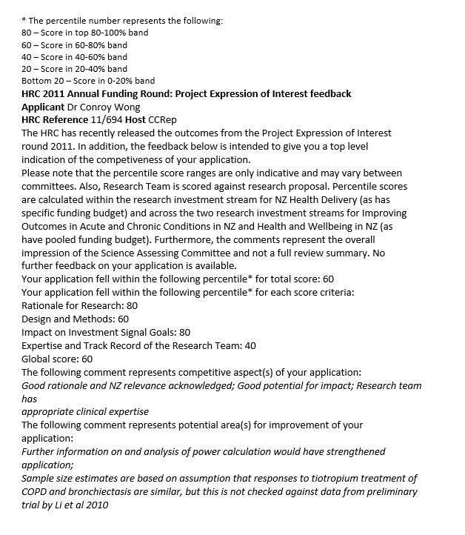


EOI results (December 2010)

Slide 15


Slide 16
EOI results (January 2011)
Teams originally invited to put in a full application pull out.
We are invited to put in a full application.
(The same thing happens to the EOI of the SOLiD trial, in renal medicine [Dr Mark R. Marshall, PI]).
I am trial statistician on two more successful RCT EOIs that year.

Slide 17
HRC Results (June 2011)
We are successful, as you may have guessed.
The SOLiD trial is also funded.
The other two trials for which I am trial statistician are also also funded.
I’m thinking this must happen all the time in New Zealand.
HRC assigns us a Data Monitoring Committee
(Prof. Katrina Sharples, Chair).

Slide 18
Sundries (June 2011 to March 2012)
Ethics application, submitted to Northern Y Regional Ethics Committee September 2011.
Ethics approval granted December 2011.
Three amendments to the protocol.
Initial DMC meeting January 2012.
Recruitment starts in the 3 Centres March 2012.

Slide 19
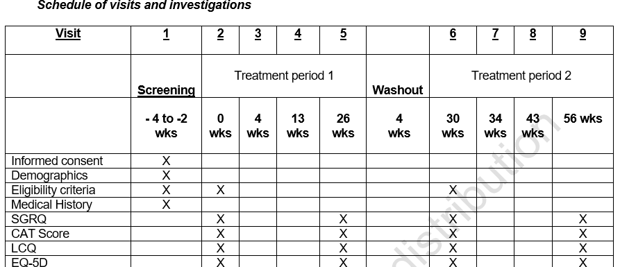
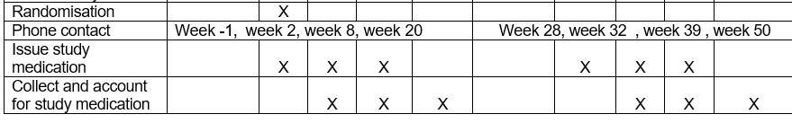



Conduct
. . .
Notes:
Two screening visits to ensure participants are stable. We could delay the washout entering into the 2nd period, if the participant wasn’t clinically stable.

Slide 20
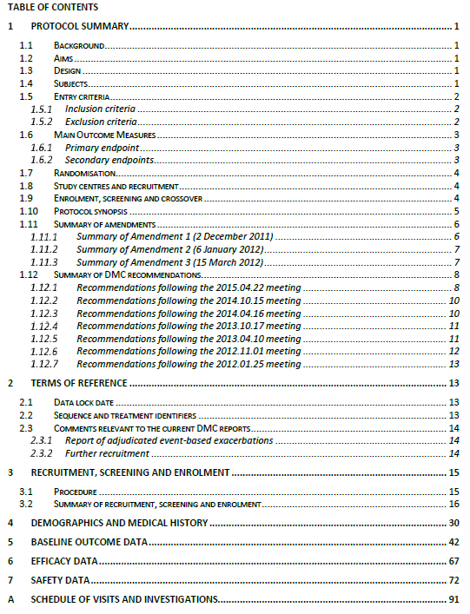
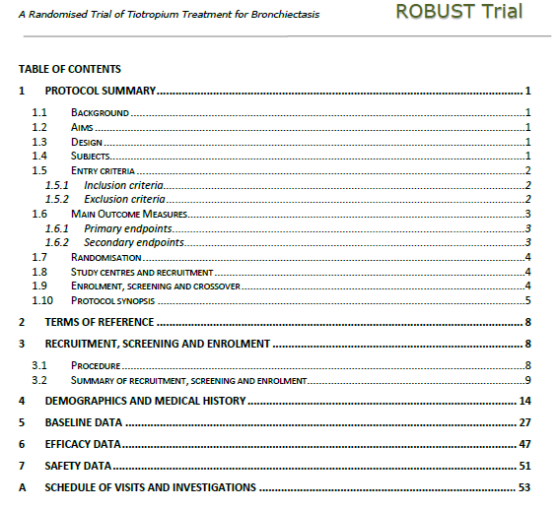




22 October 2015
Data monitoring
1 November 2012
Notes:
Note also the mention of “Data lock date”. One of the great benefits of regular data monitoring was in forcing us to resolve all data queries pending by the data lock date, and improve the quality of the data.

Slide 21

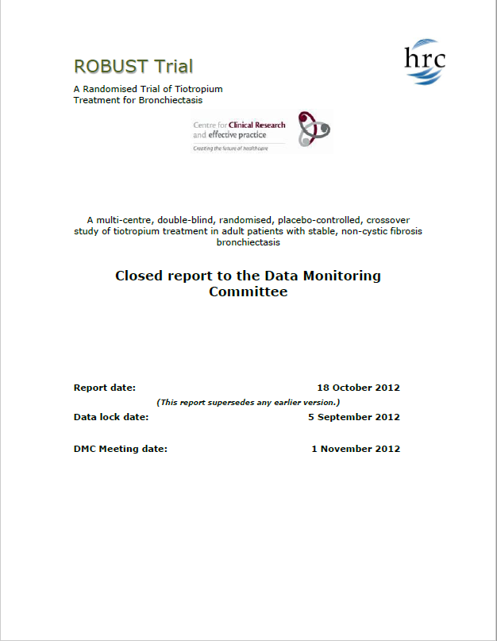
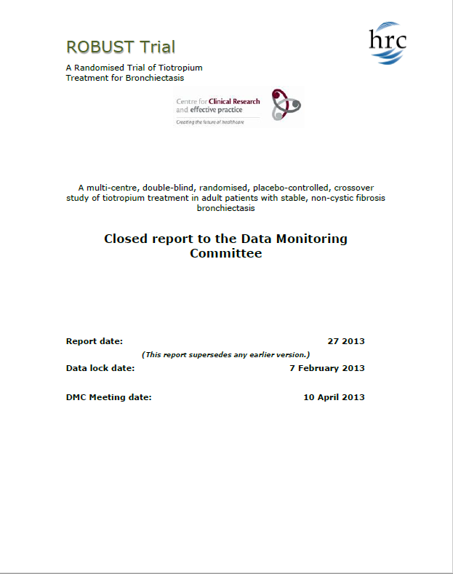
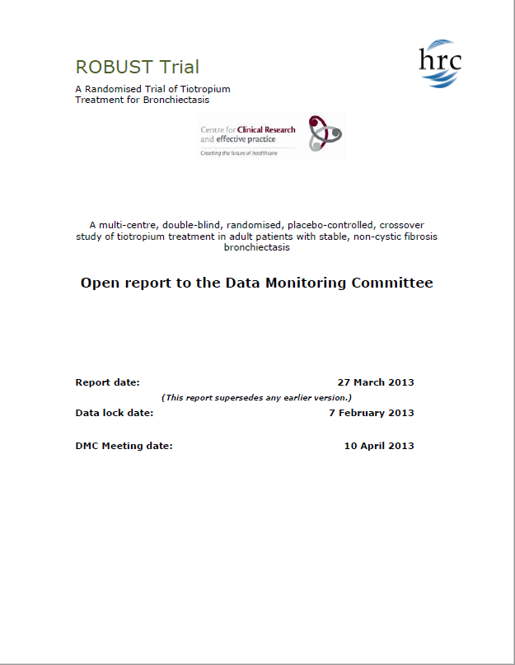










Data monitoring
Open and closed reports
Study accrual (Open & Closed)
  Screening
  Recruitment
Baseline data (Open & Closed)
  Demographic
  Clinical
  Outcomes
Selected efficacy data (Closed)
Safety data (Closed)
Nov 2012
Apr 2013
Oct 2013
Apr 2014
Oct 2014
Apr 2015
Oct 2015

Slide 22
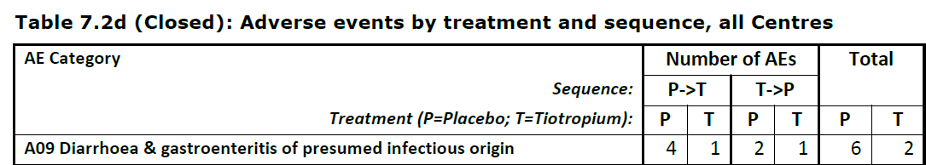

Data monitoring

Slide 23
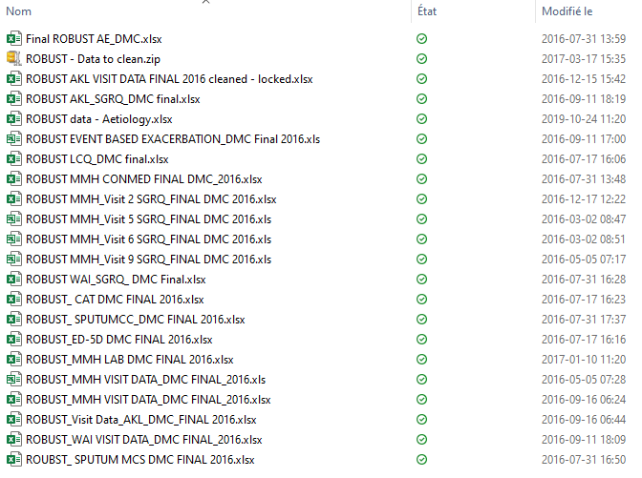
The Data
Last randomisation date:
May 2015
End of follow-up:
May 2016
All data available:
January 2017

Slide 24
Blind Review (January 2017)
Several outcomes longitudinally collected within periods
  FEV₁, FVC
  measures of HRQoL
Find a reasonable covariance structure with masked allocation
Treatment
level
BL
BL
TxA
TxA
TxA
BL
TxB
TxB
TxB
Week
-4
0
4
13
26
30
34
43
56

Slide 25
Analysis plan
Assessment of missingness
Several outcomes longitudinally collected within periods (FEV1
Find best covariance structure absent knowledge of allocation
Tx
BL
BL
Tio
Tio
Tio
BL
Pla
Pla
Pla
Week
-4
0
4
13
26
30
34
43
56

Slide 26
Statistical Analysis Plan
(January 2017)
SAP versions necessary for some journals
Fully specified and locked after unblinding
A good SAP
  Acts as a reference for anyone involved in analysis
  Can be operationalised simply
ROBUST Operationalised Task List

Slide 27

Analysis
(January-September 2017)
Mostly using SAS – PROC GLIMMIX
~500 hours of work
400 of those dealing with Excel files
High stock placed on code readability and reproducibility

Slide 28
Results
90 participants randomised
86 completed both 6-month periods
3 more provided partial data
Adverse event profile similar for tiotropium and placebo
Exacerbation incidence
Tiotropium: 2.17 year ⁻¹
Placebo: 2.27 year ⁻¹
Rate ratio: 0.96, 95% CI [0.72, 1.27], p=0.77
Pre-bronchodilator FEV₁ at 26 weeks
Tiotropium: 1778 ml
Placebo: 1704 ml
Adj. difference: 58 ml 95% CI [23, 92], p=0.002

Slide 29
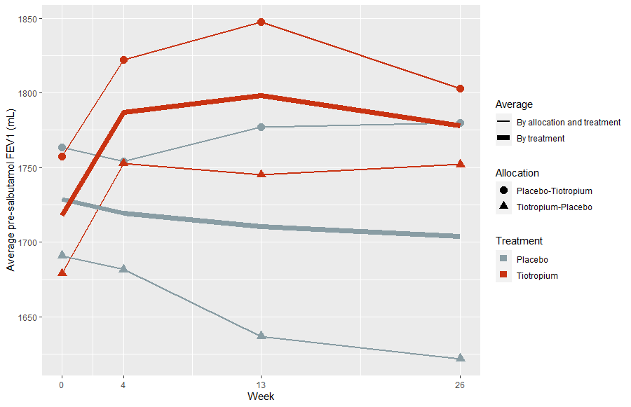
Results
Pre-bronchodilator FEV₁ by Treatment and Allocation

Slide 30
Results
Negative result regarding exacerbations (and all QoL measures)
Subclinical efficacy of tiotropium
Investigations into the aetiology of bronchiectasis are shifting towards microbiome.

Slide 31
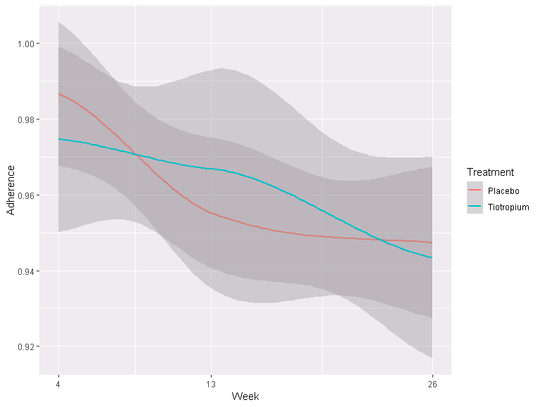
Write-up
(September 2017-November 2020)
Lata, Conroy, Alain are spread thin
We go through several iterations
Some exploratory analyses requested (outcome correlations, adherence,…)

Slide 32

Submission
(December 2020-July 2022)
Submission to AJRCCM December 2020 (2022 IF 24.7)
Rejection June 2021 ☹
Submission to European Respiratory Journal July 2021 (2022 IF 24.9)
Accepted October 2021 ☺
Published with editorial July 2022

Slide 33
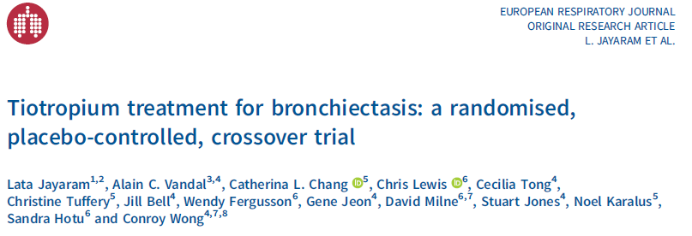
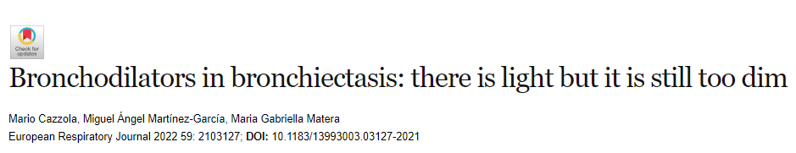
From go to woah: 2010-2022
Take-home message?
Tempus fu*it?
Nothing good was ever done in a hurry?
Time flies when you’re having funds?
Learn to exhale?
Perhaps a reminder that convincingly designed and well-conducted negative trials are still important.

