Slide 1
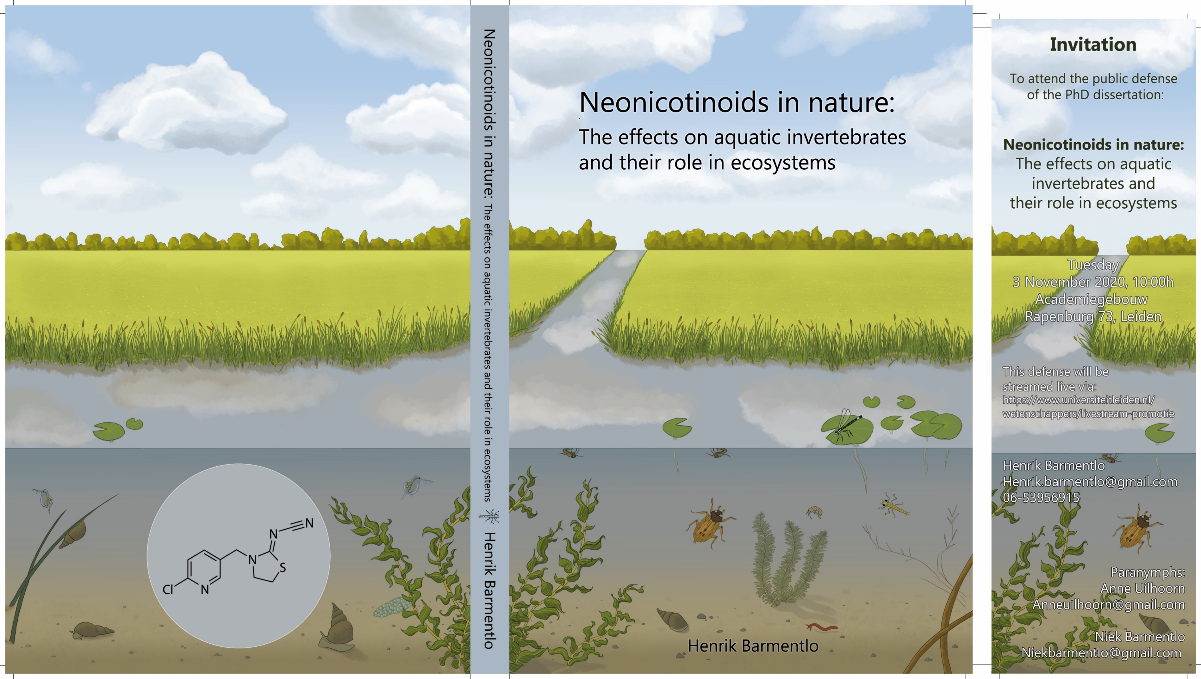


Networks in aquatic communities collapse upon pesticide-induced stress
A mesocosm experiment,
using network analysis and pSEM
H Barmentlo
M Schrama
GR de Snoo
CJM Musters
PM van Bodegom
MG Vijver
Ellen Cieraad
Principal science analyst
IBS – SEEM Conference
Waitangi

Slide 2





Effects of stressors on communities
A stressor may not affect species diversity and evenness,
but do disturbed communities function like undisturbed ones do?
Notes:
We are currently witnessing an unprecedented decline in biodiversity.
At the local level, species richness or α-diversity is often remarkably constant and does not change in absolute values, even after human disturbance^{6,7}.
However, the assemblage of species at this local scale can markedly differ after disturbance due to species replacement⁷. As organisms are responsible for the functioning of an ecosystem⁸, this begs the question: do disturbed communities with a shifted community composition function equally well as undisturbed communities

Slide 3

Notes:
Transport yourselves mentally to…
The Netherlands – 25% of the country below sea level. it’s wet.
Effects of agricultural practice on aquatic communities

Slide 4
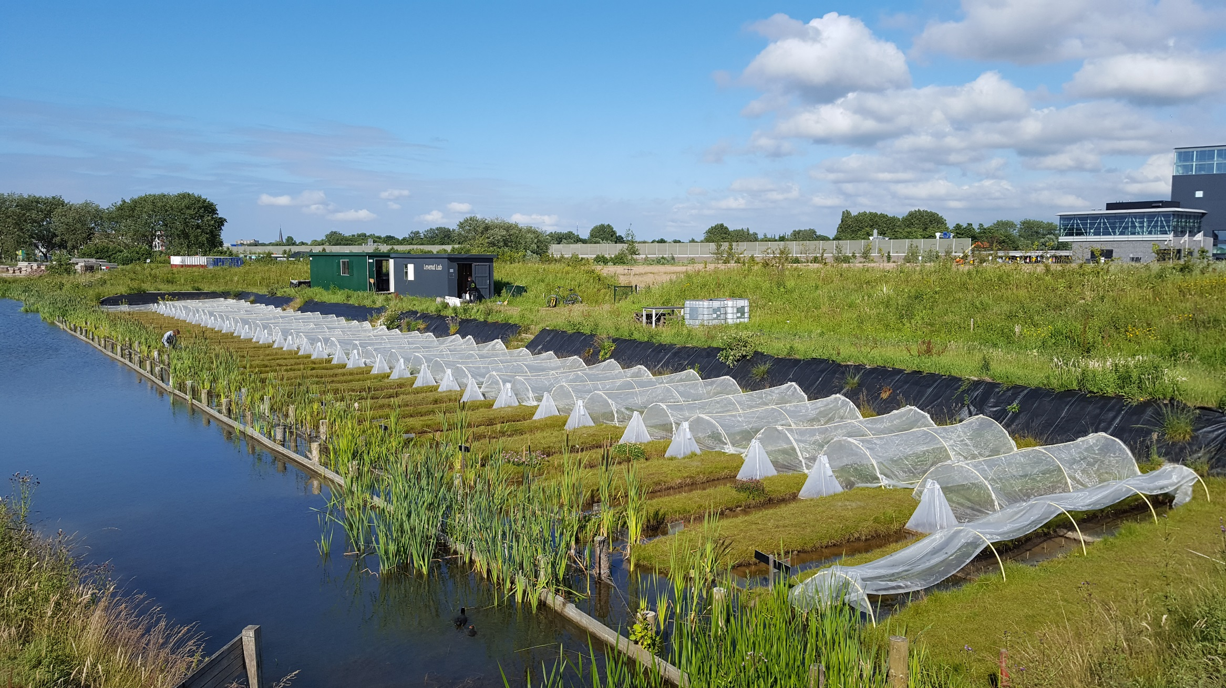
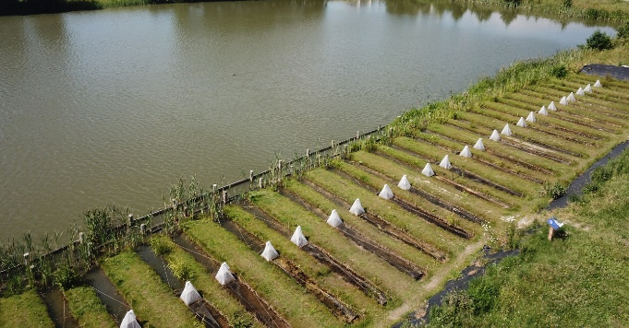

Open mesocosms
Natural colonisation
Notes:
Living lab – Leiden Netherlands.

Slide 5
Environmentally realistic range of
the neonicotinoid thiacloprid
Environmentally realistic range of
the neonicotinoid thiacloprid
0, 0.1, 1 & 10µg/L N=9
Before – After
Notes:
Commonly used pesticide – in the neonicotinoid group called thiacloprid.
Thiacloprid, a neonicitinoid – pesticide used to control mostly aphids and whiteflies. Sprayed onto crops very commonly encountered in aquatic systems – through run off, spraydrift, leaching. Aquatic macroinvt very sensitive to this.
36 ditches – 4 treatments; 9 reps per treatment
Experimental design
4 treatments (levels of pesticide, 0, 0.1, 1, 10 µg/L) x 9 reps in a Block design
Before-After-Control-Impact

Slide 6
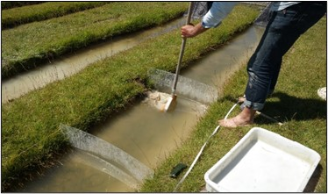

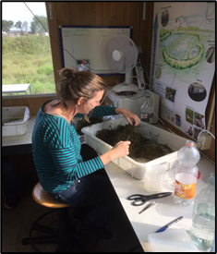
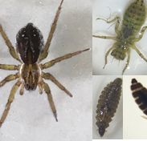
Methods – Measurements
Macroinvertebrate abundance (live identification)
Indices of ecosystem functioning
  primary production
  plant and algal biomass, periphyton, phytoplankton,
  decomposition
Notes:
Measurements Before and after pesticide application
Biotic: Within this 1m compartment, we caught all macroinvertebrates using dipping nets (150µm) for the water column and sieves (500µm) for the top layer (3-5cm) of the sediment. Inverts live-identified and returned.

Slide 7
Methods – Analyses
Do disturbed communities function as undisturbed ones?
Simple indices & community composition
Network approach: species co-occurrence
Causal relationships using SEM
Notes:
3 parts – more traditional, old-fashioned approaches, using simple indices and community composition

Slide 8
Analyses – Part 1
Indices: Abundance, species richness, evenness
Community composition
  Abundance, and presence-absence data
  PCoA, PERMANOVA, beta-dispersion
Notes:
Analyses & results in 3 parts: -simple indices & community composition;
2: network approach; 3: causal relationships using SEM
We then tested for effects of actual neonicotinoid concentration over time on total macroinvertebrate abundance, abundance per taxonomic order, species richness and Shannon diversity (H; being the most commonly used index) using linear mixed effect modelling (function lme, package ‘nlme’).
Explanatory: neonicotinoid concentration (i.e. the four test concentrations) and time (before and after) as explanatory variables: Random factor = ditch ID as a random factor to account for the repeated measures design.
Linear mixed effect model ~ treatment * time
taking into account experimental set-up
In order to identify whether we caught and identified all macroinvertebrates within our ditch system (γ-diversity), we built randomized species accumulation curves per month using the function specaccum (999 permutations, package ‘Vegan’). For both sampling months, less than one new species was found within each ditch after half of the samples (18/36) were processed, indicating that the (near) full range of invertebrate species had been caught
Better understand community composition
Principal Coordinates Analysis is a statistical method that converts data on distances between items into map-based visualization of those items.
The generated mappings can be used for better understanding which items are close to each other, and which are different. It can also allow you to identify groups or clusters.
Can follow up with permutational multivariate anova PERMANOVA to assess whether the groups (treatments) are indeed different from one another.
(PCA = princ components analysis focusses on shared variance (it tries to summarize multiple variables in the minimum number of components so that each component explains the most variance.), PCoA on the other hand focuses on distances, and it tries to extract the dimensions that account for the maximum distances.
Effects of thiacloprid treatment, time and their possible interaction on community composition was assessed using Permutational multivariate analysis of variance (PERMANOVA, function adonis, package ‘Vegan’, 999 permutations) with Ditch ID as a random factor. We analyzed the data both using raw abundances as well as presence/absence in order to identify whether potential shifts in macroinvertebrate communities were due to shifts in relative abundances or because of species turnover. We used Bray-Curtis as measure for dissimilarity for both the raw abundance and presence/absence data but also tested the Jaccard’s index for presence/absence dataset as this is usually preferred for presence/absence data. As Jaccard’s results were highly similar to the Bray-Curtis measure (as also found by others, see for example references 41 and 42) we chose to show Bray-Curtis results to allow comparison with the raw abundance data. We found that time was the single most strongest variable affecting the freshwater macroinvertebrate communities (R² = 0.34, p < 0.001), while the respective interaction of time and thiacloprid was relatively weaker (R² = 0.04, p = 0.014). This is a common observation since freshwater macroinvertebrate communities are highly dynamic over time in terms of β-diversity⁵⁰ and the variable time thus makes it more difficulty to study treatment effects. Therefore, we also investigated potential changes in community composition of the exposed and non-exposed communities per timepoint by using the thiacloprid treatment as an explanatory variable and the block design as a random factor.
Potential community converging or diverging effects of the neonicotinoid were then assessed by analyzing the homogeneity of multivariate dispersion using beta-dispersion tests (function betadisper, package ‘Vegan’, 999 permutations), but no significant effects were found (both April and June: p > 0.05). All statistical analyses were performed using R (version 3.5.1⁵¹).

Slide 9
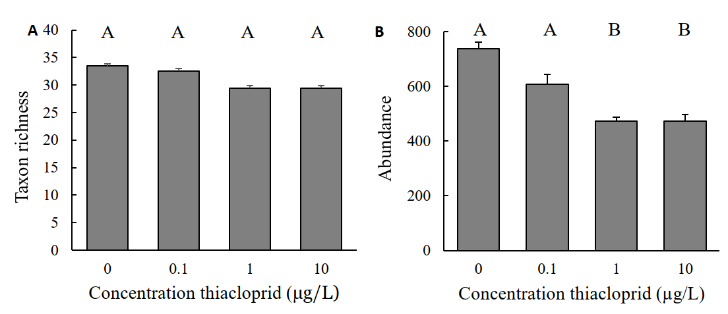
Results – Part 1 Indices
1 month after application: Fewer individuals at high pesticide, but no difference in taxon richness
Barmentlo et al. In review - PNAS
Notes:
For species richness, Shannon diversity and total macrofauna abundance, we observed no significant effects of the thiacloprid treatment in interaction with time (p > 0.05 for all comparisons).
However, Shannon diversity did increase significantly over time from 1.7 before application to 2.3 after application on average (F_{1,34} = 108, p < 0.001). We also independently tested the response variables total macrofauna abundance, species richness and Shannon H per month using one-way ANOVAs with Dunnett’s post-hoc tests to indicate differences between treatments after neonicotinoid application which are presented in the results section. (on this slide)
Figure: Average (N = 9, ±SE) A) Taxon richness and B) total invertebrate abundance (per meter ditch) with increasing concentrations of thiacloprid. 1 month after appolication.
Different letters indicate differences (One-way ANOVA with Dunnett’s post hoc test) at significance level p ≤ 0.05.

Slide 10
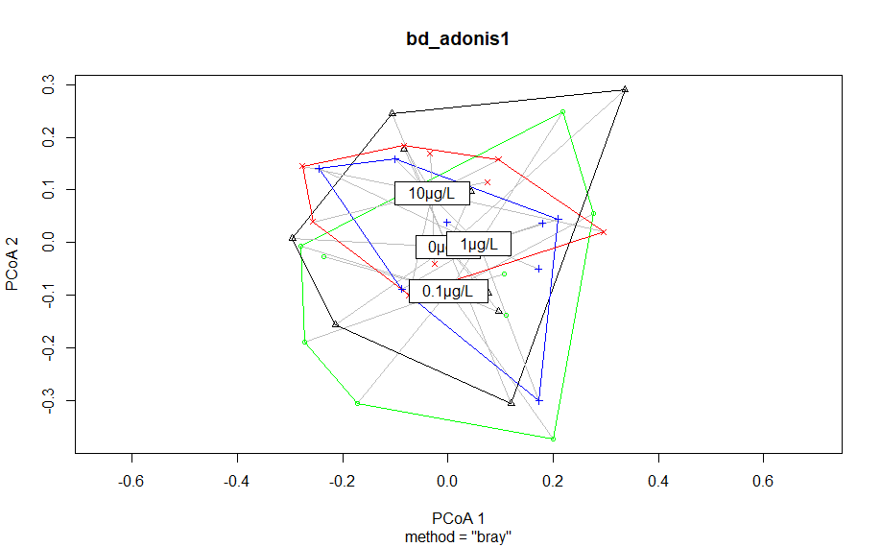
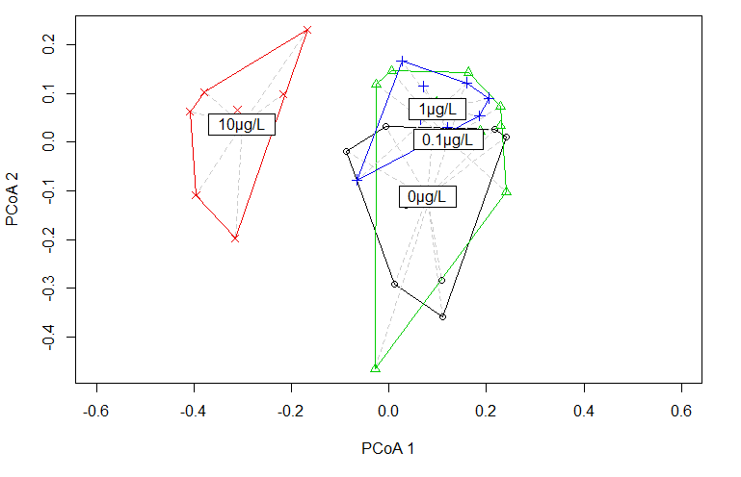
Results – Part 1 Community
Taxon transitions drive difference in community composition at high pesticide level
Before
After
Notes:
Principal coordinate analysis (PCoA; Bray-Curtis dissimilarity) of the prospective treatments (N = 9, black: 0, green: 0.1, blue: 1 and red: 10µg/L thiacloprid). Communities were sampled in April, one month before application of the neonicotinoid thiacloprid. Multivariate analyses (permanova and beta dispersion tests) showed no significant differences (p > 0.05) between the prospective treatments BEFORE.
Increasing thiacloprid concentrations induced increasingly significant dissimilarities in species composition compared to the control. (similar result when tested on Pres/Abs data, also using Jaccard distance), implying that the observed dissimilarity can be largely attributed to taxon replacement (explains lack of effects on total taxon richness and Shannon diversity).
Shannon entropy quantifies the uncertainty in predicting the species identity of an individual that is taken at random from the dataset.

Slide 11
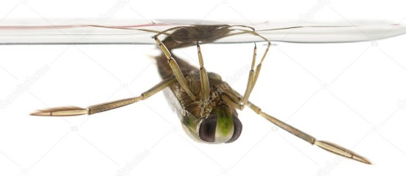
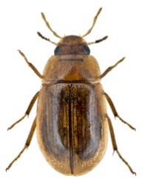
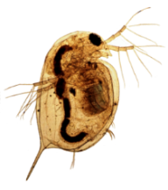
Per species clearly effects, but how to translate to communities?
Ecological
systems:
“organisms
interact with
one another (…)
and their environment”
- Sir. JH Lawton
But difficult/impossible (?) to quantify all relations
Notes:
While there are few actual laws in ecology, at least a simple and perhaps trivial consensus is that in ecological systems “organisms interact with one another (…) and their environment”⁹. Hence, it may not be the species richness of a community per se, but rather the network of interactions between organisms, and the environment, that provides the link between biodiversity and ecosystem functioning^{4,10}.
Pre ious studies have shown that individual links can be altered, and that this can alter ecosystem productivity or fundtioning.
But defining all possible ecol relationships and indivudally analysing how these respond to different stressors within a given system is close to impossible > hampsers the way we understand human-induces stresses to systems.
Network-based analyses of species co-occurrence – have been evaluated theoretically – experimental evidence for the effectivenss of such network approaches in identifying the effect of stressors = lacking.
Can we get a better handle on how the structural complexity of the community has changed?
We assessed community structural complexity using Spearman-rank based correlation network analysis on the abundance data of the invertebrates.
This type of analysis does not provide direct causal linkages between species simply because correlation ≠ causation.
Correlation ≠ causation
But implies a variable governing both species

Slide 12
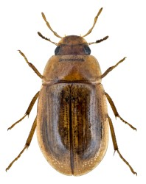
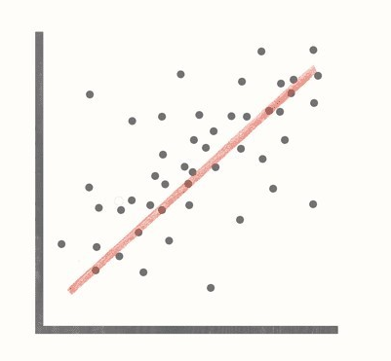

Analyses – Part 2 Network approach
Species co-occurrence networks
  Spearman-rank based correlation analysis
  Measure of “network connectance”
  Proxy for community structural complexity
  Assumption: networks of co-occurring species are, to some extent, structured and non-random
Ochoa-Hueso et al 2021
Notes:
However, a correlation between two species does provide evidence that there are one or more factors (such as other species or abiotic variables) governing the abundance of both species. Inherently, statistical coherence i.e. changes in the number and strength of all correlations relative to a control condition is a proxy of changes in the structural complexity of communities, without the need to identify specific species-species or species-abiotic relationships. The underlying assumption of these approaches is that networks of co-occurring species are, to some degree, structured and non-random⁴⁸.
Thus; Number and strength of corr. indicate community coherence
We analysed variations in species co-occurrence and considered reduced correlations as network loosening, which
we define as a ‘significant decrease in percentage connectance and an decrease in the strong correlations as a percentage of
all possible correlations’

Slide 13
Analyses – Part 2 Network approach
Species co-occurrence networks
  Visualised strong correlations
  (| Spearman’s ρ | > 0.8) – R package circlize
  Compared correlation matrix with null model
    1000 generated random ‘communities’
    abundance randomly distributed across observed taxa within treatment
    zero-inflated poisson using null probability (species non-occurrence probability)
Notes:
Rare spp (<5 indiv) removed Prior to correlation analysis, to avoid effects of random co-occurrences.
1. All strong correlations (| Spearman’s ρ | > 0.8) between species were visualized (next slide).
Finally network ‘connectance’ (see reference¹⁴) was calculated as a percentage by dividing the number of strong correlations (| ρ | > 0.8) and all possible correlations of the respective treatment.
2. compared the correlation matrix of each treatment to null models to identify potential effects of the treatment on biological organization. Null Model = 1000 generated ‘communities’ with abundances randomly distributed across the observed taxa within the treatment (> 5 individuals per species). Abundances generated w zero-inflated Poisson distribution using the null probability (i.e. species non-occurrences probability) and total abundances as observed in nine replicate ditches. i.e. randomly draw all abundances, so that total number of individuals equals the found total abundance. Differences between the number of correlations in the observed communities and median in the randomized control community were assessed for significant correlations (| ρ | > 0.67, p < 0.05) using chi-square tests. More strong correlations than in a randomized community are a clear indication of biological structural complexity. Fewer (strong) correlations point towards a loss in biological organization.

Slide 14
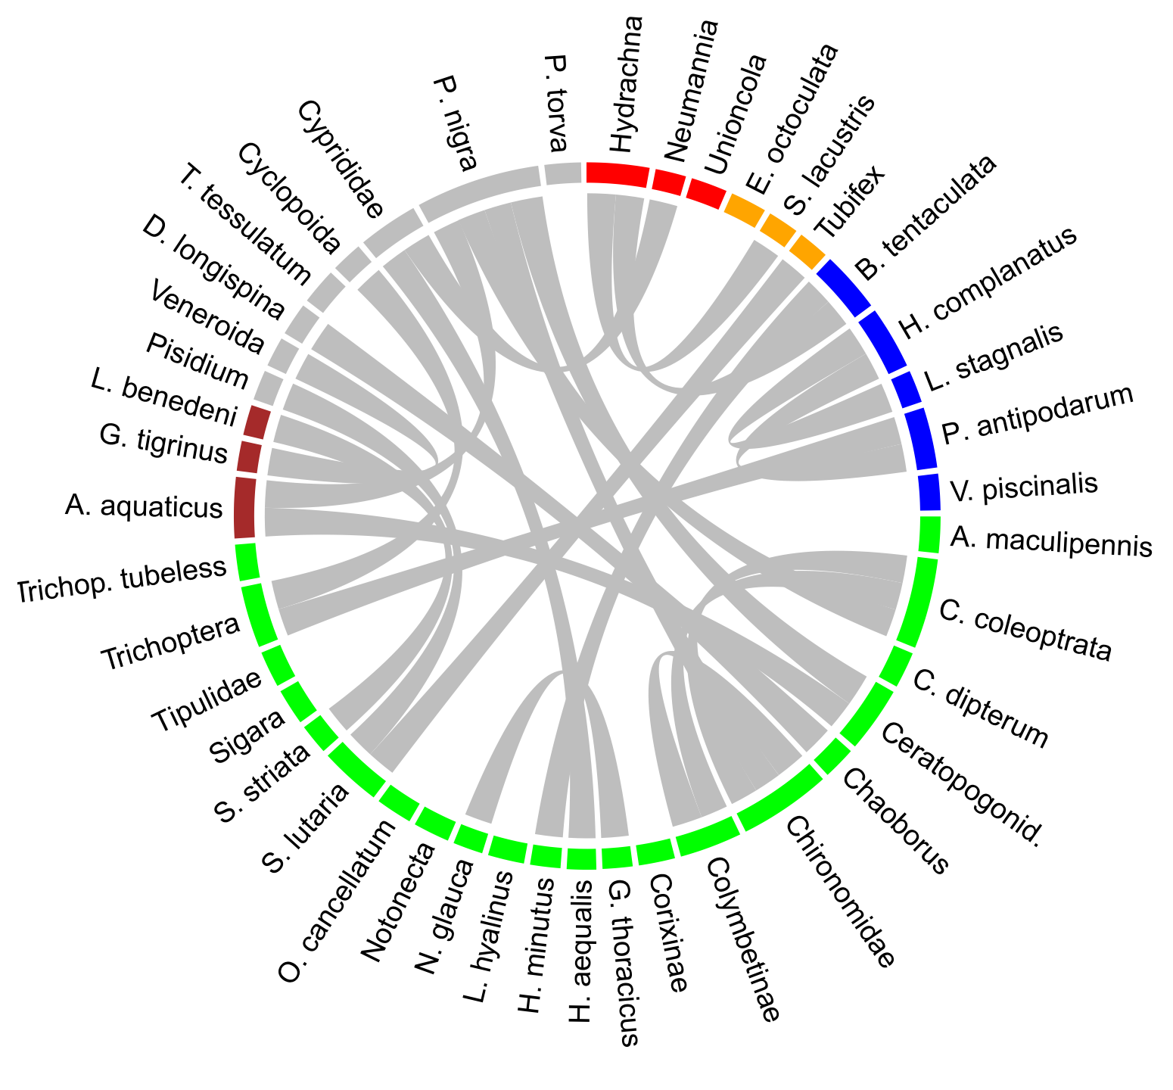
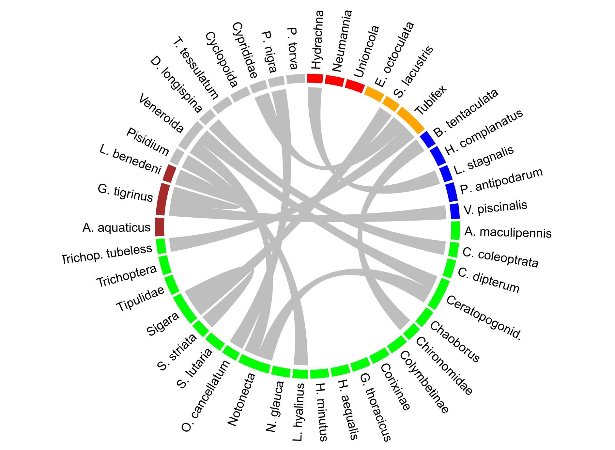
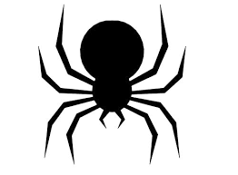
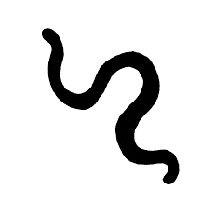

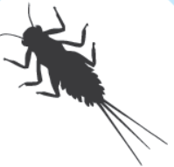
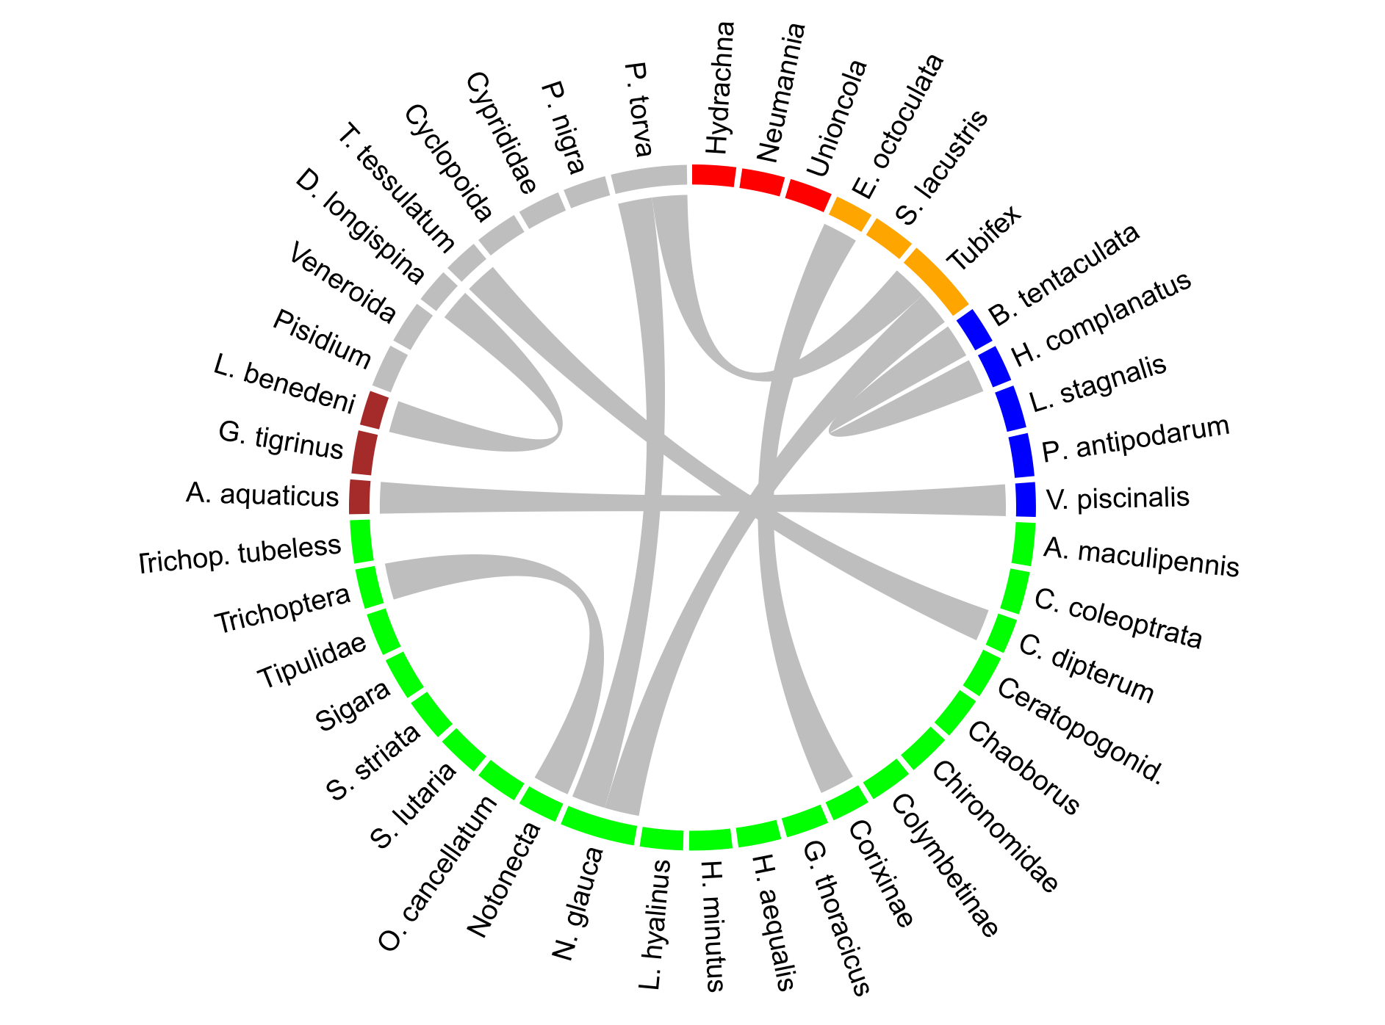
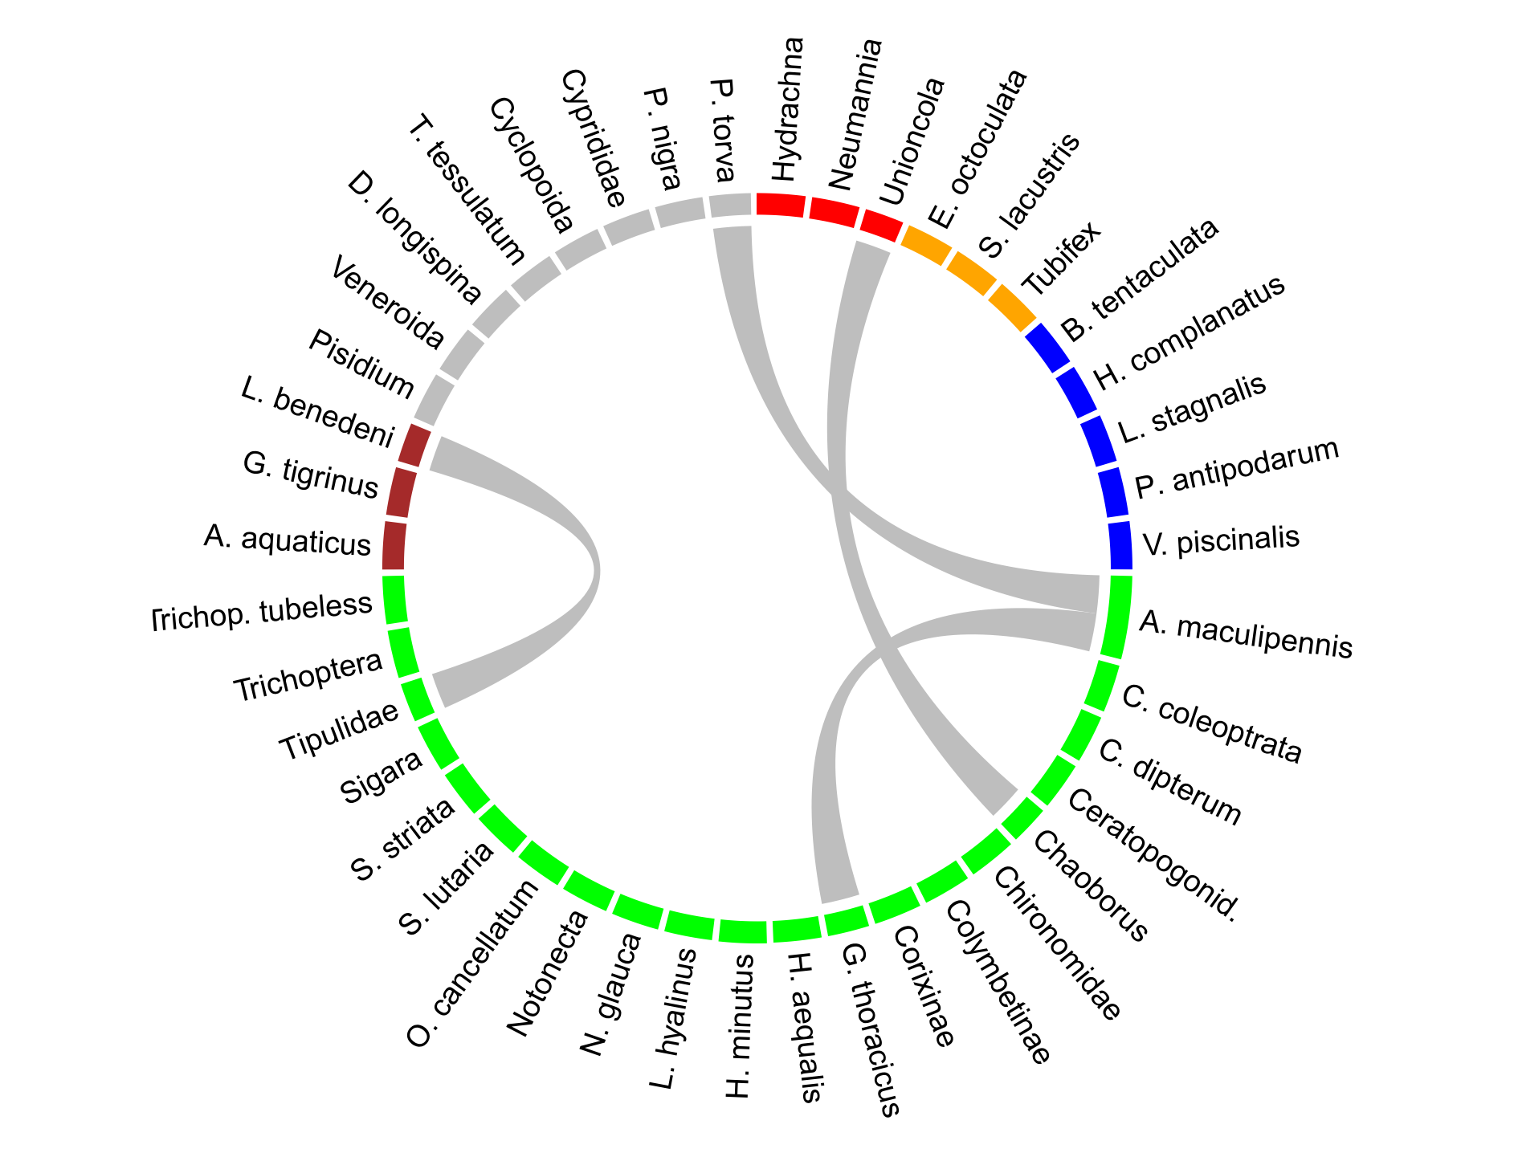

0 µg/L
0.1 µg/L
Connectance
0 2.4%
0.1 1.6%
1.0 1.4%
10.0 0.6%
1.0 µg/L
10.0 µg/L
Barmentlo et al. In review - PNAS
Notes:
Thus; Number and strength of corr. indicate community coherence
We analysed variations in species co-occurrence and considered reduced correlations as network loosening, which
we define as a ‘significant decrease in percentage connectance and an decrease in the strong correlations as a percentage of
all possible correlations’
Networks in aquatic communities collapse upon neonicotinoid-induced stress
Losses in invertebrate abundance also reduced the total number of possible species-species correlations (co-occurrences) relative to the control by 8, 30 and 33% for 0.1, 1 and 10µg/L thiacloprid, respectively (Table 1). Indeed, fewer significant (p < 0.05) Spearman’s rank correlations were observed (20 – 36%) relative to the control (Table 1). The relative strength of the correlations also decreased, with median R² decreasing from 0.60 (control) to 0.55 (0.1µg/L) to 0.53 (1µg/L) to 0.51 (10µg/L). These decreases were especially pronounced in the number of strong correlations (| Spearman’s ρ | > 0.8); 23 strong correlations were observed within the control and this number decreased to 14, 9 and 4 correlations, respectively, with increasing insecticide concentrations (Fig. 3). The actual number of significant correlation between the second highest and highest test concentration was actually similar (43 and 40 respectively), meaning that these differences in losses are probably due to shifts in taxa abundances. The remaining strong species correlations within the neonicotinoid treatments were different from with those observed within the control (i.e. mostly different co-occurrences were found).
Invertebrate community correlation web (Rho > 0.8) between different taxa per
Spike concentration thiacloprid (0, 0.1. 1 and 10µg/L). Green: Insecta, Orange: Clitellata, Blue: Gastropoda, Brown: Malacostraca, Red: Arachnida, Grey: Others.

Slide 15
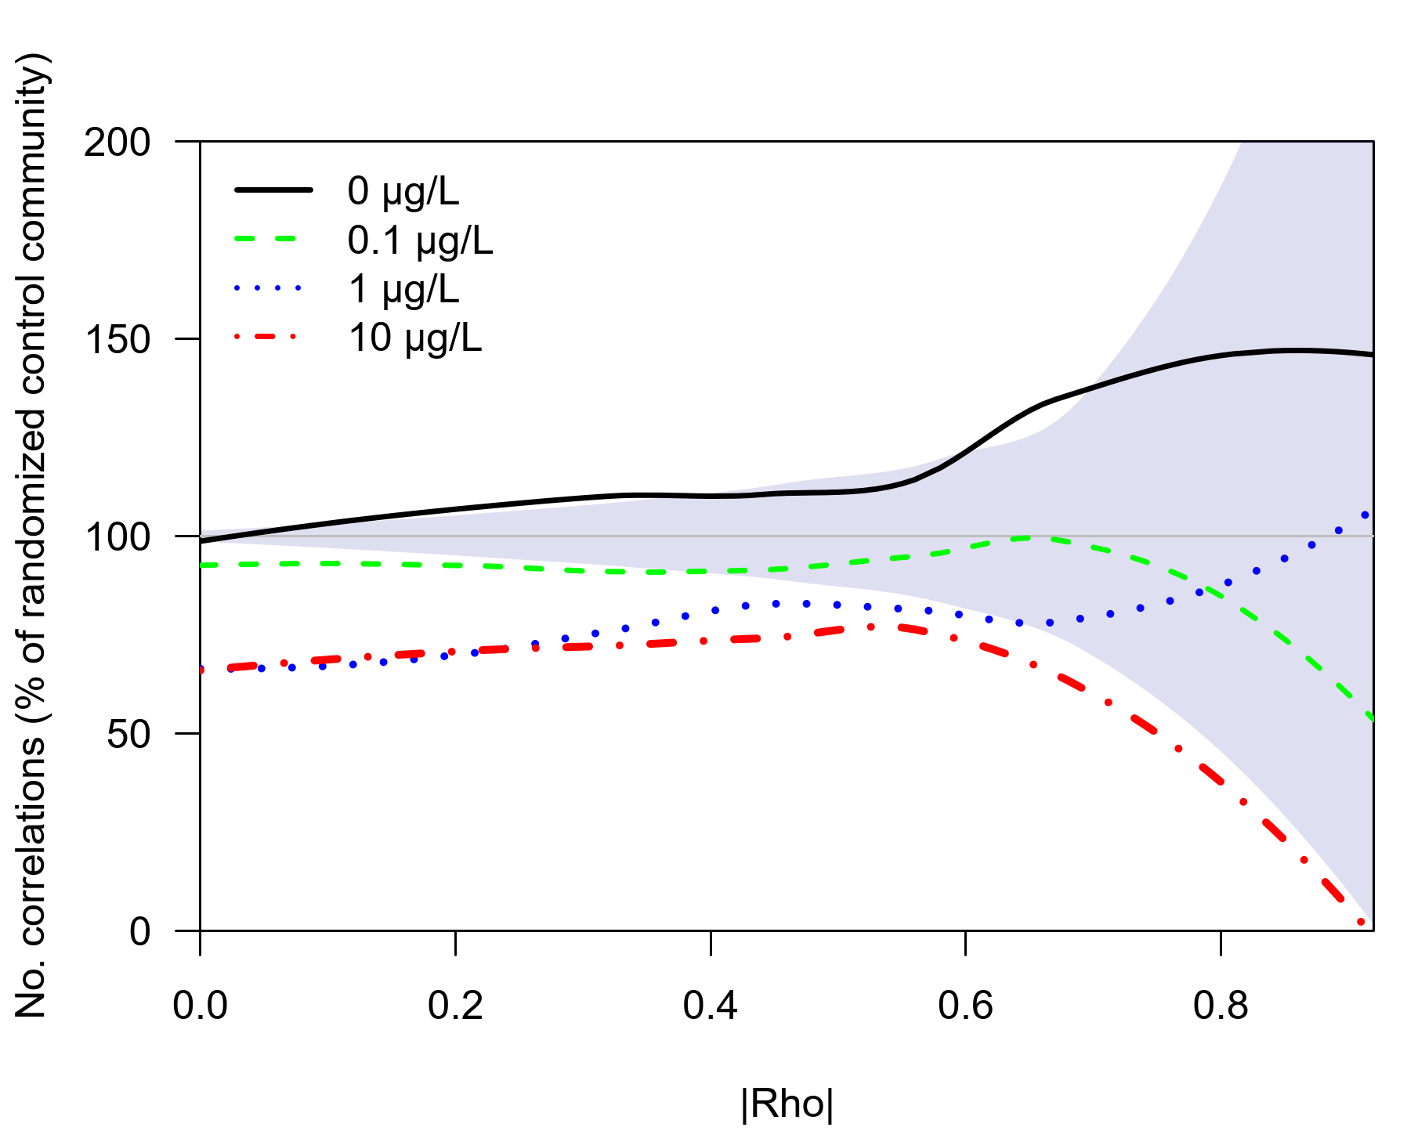
Loss of statistical (biological?) organisation
Control is more
structured than random
Loss in community
coherence with
increasing thiacloprid concentration
Barmentlo et al. In review - PNAS
Notes:
Does this also really mean that the network coherence is affected?
Differences between the number of correlations in the observed communities and in the randomized control community were assessed for significant correlations (| ρ | > 0.67, p < 0.05) using chi-square tests. More strong correlations than in a randomized community are a clear indication of biological structural complexity. Fewer (strong) correlations point towards a loss in biological organization.
Figure here shows: Relative strength of the co-occurrence networks per thiacloprid concentration, expressed as percentage of all observed species co-occurrences compared to the median number of co-occurrences in 1000 randomly generated control communities, with the confidence interval (within 0.025-0.975 quantiles) indicated by the grey-shaded region.
The decline in correlation was both absolute and relative to the number of possible correlations as observed in the decreasing connectance (i.e., the percentage of strong correlations of the total number of correlations, Table 1). Control communities consistently showed more and stronger species’ co-occurrences when compared to randomly generated communities (23% more correlations at ρ ≥ 0.67, p < 0.05, and 74% more at ρ ≥ 0.8, p < 0.05, Fig. 4), which is a clear indication of non-random structure of the control communities.
Treatments 0.1, 1.0 and 10µg/L showed no statistical difference in terms of species’ co-occurrences relative to their generated random communities (p > 0.05).
At 10µg/L we even observed a strong reduction in the number of strong species’ co-occurrences (54% fewer correlations at ρ ≥ 0.80, Fig. 4), compared to the null model generated for the control community, indicating severe impairment of the structural complexity at high neonicotinoid concentrations.

Slide 16
Analyses – Part 3 Ecosystem processes
Do disturbed communities function as undisturbed ones?
  Structural equation modelling (SEM)
  ‘unites two or more structural models
  to model multivariate relationships’
  Piecewise SEM (R package piecewiseSEM)
    Paths estimated in individual models and
    put together into a causal model
      Allows non-normal distribution and non-independence
      of variables
Notes:
Linear models deal with correlation, and we know that correlation doesn’t equal causation.
Insecticide-induced stress might affect ecosystem functioning through many different direct and indirect pathways. We used a piece-wise structural equation model (pSEM) to disentangle direct effects of the neonicotinoid on invertebrate feeding guilds from indirect effects on coherent ecosystem processes (organic matter consumption and primary productivity).
Structural equation modelling (SEM)
‘unites two or more structural models to model multivariate relationships’ in the words of Jim Grace. Here, multivariate relationships refers to the sum of direct and indirect interactions among variables. In practice, it essentially strings together a series of linear relationships.
Traditional SEM attempts to reproduce the entire variance-covariance matrix among all variables, given the specified model. The discrepancy between the observed and predicted matrices defines the model’s goodness-of-fit. Parameter estimates are derived that minimize this discrepancy, typically using something like maximum likelihood.
Assumptions/shortcomings:
all variables are derived from a normal distribution.
all observations are independent. In other words, there is no underlying structure to the data. These assumptions are often violated in ecological research. Count data are derived from a Poisson distribution. We often design experiments that have hierarchical structure (e.g., blocking) or observational studies where certain sets of variables are more related than others (spatially, temporally, etc.)
Finally, traditional SEM requires quite a large sample size: at least (at least!) 5 samples per estimated parameter, but preferably 10 or more. This issue can be particularly problematic if variables are nested, where the sample size is limited to the use of variables at the highest level of the hierarchy. Such an approach drastically reduces the power of any analysis, not to mention the heartbreak of collapsing painstakingly collected data.
These limitations have led to the development of an alternative kind of SEM called piecewise structural equation modeling. Here, paths are estimated in individual models, and then pieced together to construct the causal model. Piecewise SEM is actually a better gateway into SEM because it essentially is running a series of linear models, and ecologists know linear models.
Problems: estimating goodness-of-fit and comparing models is not straightforward. But work arounds (Bill Shipley)
cannot handle latent variables (represent an unmeasured variable that is informed by measured variables (akin to using PCA to collapse environmental data, and using the first axis to represent the ‘environment’).

Slide 17
Analyses – Part 3 cont’d
Piecewise SEM
  Abundance data transformed to feeding guild biomass
  Series of interlinked mixed-effects models
  A-priori model definitions
    Known relationships between feeding guilds and ecosystem processes
    (organic matter consumption & primary productivity)
Notes:
Insecticide-induced stress might affect ecosystem functioning through many different direct and indirect pathways. We used a piece-wise structural equation model (pSEM) to disentangle direct effects of the neonicotinoid on invertebrate feeding guilds from indirect effects on coherent ecosystem processes (organic matter consumption and primary productivity).
SEM is often implemented in a model testing framework (as opposed to a more exploratory analysis). In other words, we are taking a priori models of how we think the world works, and testing them against each other: reversing paths, dropping variables or relationships, and so on.

Slide 18

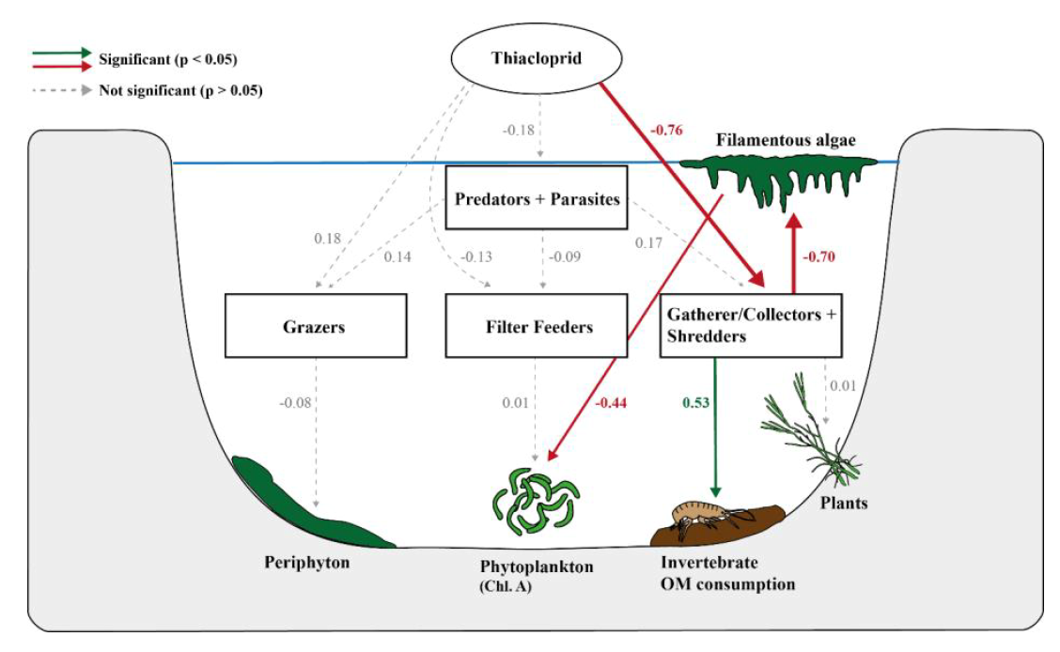
Assumptions:
    Thiacloprid only directly affects invertebrate feeding guilds; and consequently
    All possible effects on ecosystem processes must be through changes in feeding guilds
Notes:
Our base model
4 linear mixed effect models of all direct effects of the neonicotinoid (as actual average spike concentration) on the biomass four different feeding guilds
5 models of direct effects of feeding guild biomass on a specific ecosystem processes (i.e. phytoplankton & Filter Feeder, periphyton & Grazer, FLAB & Shredder + GC, plant growth rates & Shredder + GC, and invertebrate OM consumption & Shredder + GC).
Additional indirect effects of ecosystem processes that could potentially alter other ecosystem processes which were the formation of FLAB on the abundance of periphyton and phytoplankton by the competition for light and resources.

Slide 19
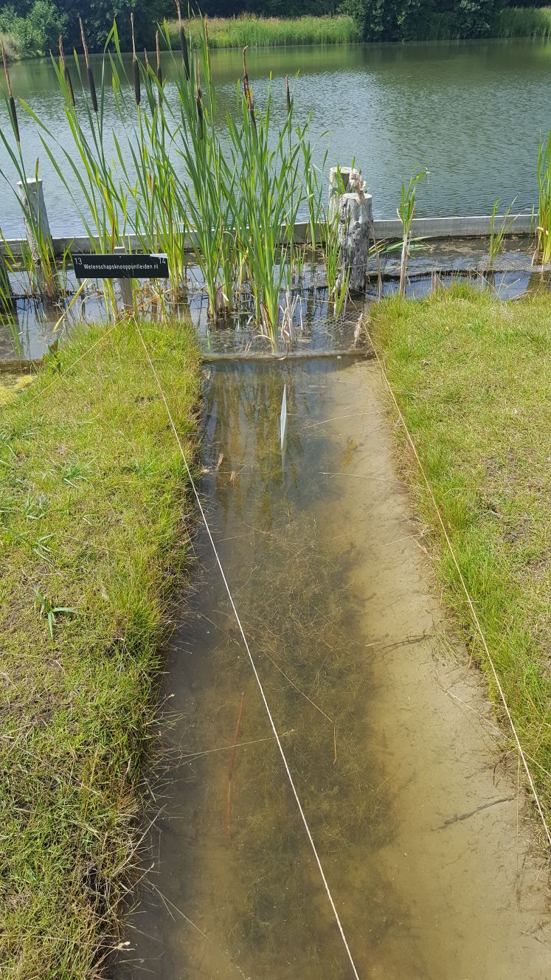
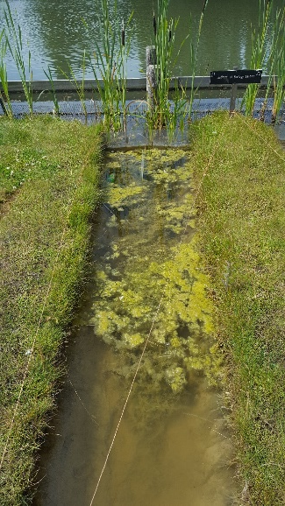
Barmentlo et al. In review - PNAS
Notes:
Loss of interactions in these neonicotinoid-exposed communities coincided with an erosion of ecosystem functioning, exemplified by a near complete loss of organic matter consumption and dominance of floating algal beds, which in turn suppressed phytoplankton growth. Our research thereby illustrates how network analyses identified that neonicotinoids threaten freshwater community structure which in turn caused a cascade that severely impairs the functioning of freshwater ecosystems.
The observed changes in community structural complexity led to shifts in functional groups, as indicated by the pSEM. The biomass of the ‘Gatherer/Collectors + Shredders’ guild decreased significantly (by 15, 46 and 85% cf to control). This coincided with changes in the ecosystem processes fulfilled by these feeding guilds; invertebrate organic matter consumption strongly declined (standardized regression coefficient: 0.53, p < 0.001) and ditches became dominated by floating algal beds (‘FLABs), probably due to a lack of herbivory by the shredder guild. Phytoplankton levels (as Chl. A concentration) also declined (9 and 23% at concentrations 1 and 10µg/L, respectively) due to the increasing presence of FLABs but not due to changes within the filter feeders. This was probably due to competition for light and/or heat as the FLABs covered most of the water surface level (see Suppl. Fig. S6). There were no pronounced differences in the biomass of the other herbivorous feeding guilds and we did not find any significant effects on the different ecosystem processes provided by other guilds.
Insecticide-induced stress might affect ecosystem functioning through many different direct and indirect pathways. We used a piece-wise structural equation model (pSEM) to disentangle direct effects of the neonicotinoid on invertebrate feeding guilds from indirect effects on coherent ecosystem processes (organic matter consumption and primary productivity). The observed changes in statistical coherence led to shifts in functional groups, as indicated by the pSEM. The biomass of the ‘Gatherer/Collectors + Shredders’ guilds decreased significantly by 15, 46 and 85% for the insecticide concentrations 0.1, 1 and 10µg/L relative to the control (standardized regression coefficient estimate: -0.76, p < 0.001; Fig. 5 and Suppl. Fig. S5). This coincided with changes in the ecosystem processes fulfilled by these feeding guilds; invertebrate organic matter consumption strongly declined (standardized regression coefficient: 0.53, p < 0.001) by 80% and 100% at the second highest and highest concentration relative to the control respectively. Through losses in the ‘Gatherer/Collectors + Shredders’ guilds ditches also became dominated by floating algal beds (‘FLABs’; standardized regression coefficient: -0.70, p = 0.012; Fig. 5) with increases in biomass of 341 and 1450% at the second highest and highest concentration relative to the control respectively. Phytoplankton levels (as Chl. A concentration) also declined (9 and 23% at concentrations 1 and 10µg/L, respectively) due to the increasing presence of FLABs (standardized regression coefficient: -0.44, p = 0.008) but not due to changes within the filter feeders (p > 0.05, Fig. 5). This was probably due to competition for light and/or heat as the FLABs covered most of the water surface level (see Suppl. Fig. S6). We observed no significant decline in ecosystem functionality at the lowest test concentration. There were also no pronounced differences in the biomass of the other consumer feeding guilds and we did not find any significant effects on the different ecosystem processes provided by other guilds.
De consumptie was zo laag dat het binnen de foutmarge van de decotab viel. De resultaten waren zelfs negatief van aard.
Nodig? Wel fair

Slide 20
Conclusions
Env. realistic concentrations of pesticides have profound negative effects on community coherence and ecosystem functioning
Loss of the number and strength of species co-occurrences with increasing pesticide
Loss of structural complexity coincided with severely impaired ecosystem functioning
Notes:
Loss of number & strength of spp co-occurrences with increasing pesticide concentration: to a point that almost all strong species correlations are lost and our communities can no longer be distinguished from randomly generated communities
If species co-occurrences indeed reflect species coherence, our observations would imply that a community-specific set of functional coherent relationships between species and their environment, rather than species richness itself, is the key link between biodiversity and ecosystem functioning.
The observed loss of structural complexity coincides with severely impaired ecosystem functioning due to strong losses within the invertebrate ‘Gatherer/Collectors and Shredders’ feeding guild. Importantly, these impacts on community structure and ecosystem functioning were not apparent from relatively simple metrics such as taxon richness or α-diversity as these metrics remained stable even though a clear turnover of taxa occurred.

Slide 21
Conclusions cont’d
Impacts on community structure and ecosystem functioning were not apparent from relatively simple metrics (taxon richness, evenness)
Co-occurrence networks:
  simple mathematical approach
  site-specific null models can evaluate statistical coherence
    identify disturbances in a community
    before ecosystem functioning altered?
pSEM identified cascade of pesticide impacts that severely impairs functioning of freshwater ecosystem
  great gateway into testing of causality
Notes:
We experimentally show that co-occurrence networks, which use a relatively simple mathematical approach based on knowledge of species presence and abundance, can identify disturbances within a community, despite the intrinsic differences in community composition. This method uses the ‘observation’, as described by Hutchinson²¹ and Lawton⁸, that ‘organisms interact with one another’, without analyzing each interaction individually as this has proven to be notoriously difficult.
Disturbances within communities can already be identified before ecosystem functioning becomes impaired. This offers the ability for an early screening for (anthropogenically) disturbed communities.
Using a network approach, our results show that current environmentally relevant levels of neonicotinoid insecticides induce major compositional shifts and degradation of the aquatic food web shortly (i.e. one month) after pulse applications. These effects are well beyond any effects that could be estimated from species-specific effects (as obtained from bioassays) described by standard risk assessment methodology (e.g. reference^{32,33}). In addition, we already observed significantly impaired statistical coherence of invertebrate communities at nominal thiacloprid concentrations as low as 0.1µg/L, which lies well below nearly all recognized toxic concentrations as obtained by standardized risk assessments of aquatic fauna^{23,27,34}. This clearly shows the sensitivity of network analysis as well as that pesticide risk assessment faces major shortcomings since it falls short to predict effects on these substances on the integrity of natural communities.
While previous studies showed the potential of the network approach to assess community vitality in various ecosystems^{14–19}, here we demonstrate the potential of the relationship between this vitality and a common stressor and provide a direct reference to a natural control state, while observational field studies are limited in possibilities in this sense. As shown in the current study, based on this control state, site-specific null models can be built to evaluate the statistical coherence of each network.

Slide 22
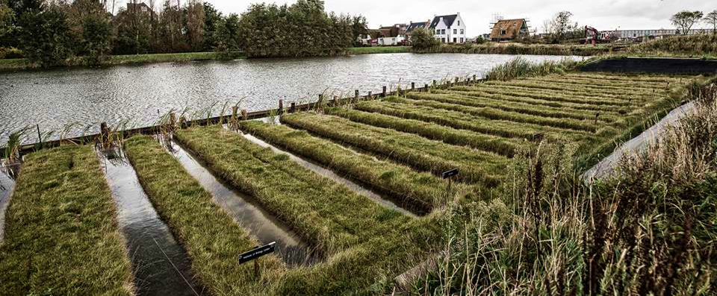



Acknowledgements
Coauthors
Students
Volunteers
Crowd funders!
ASPASIA & VIDI
ecieraad@doc.govt.nz

Slide 24
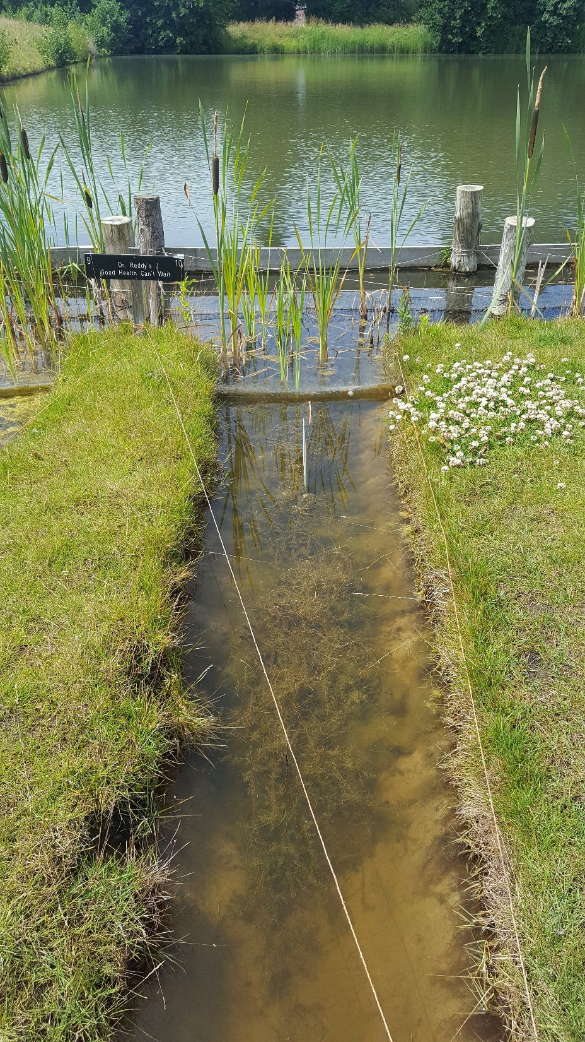
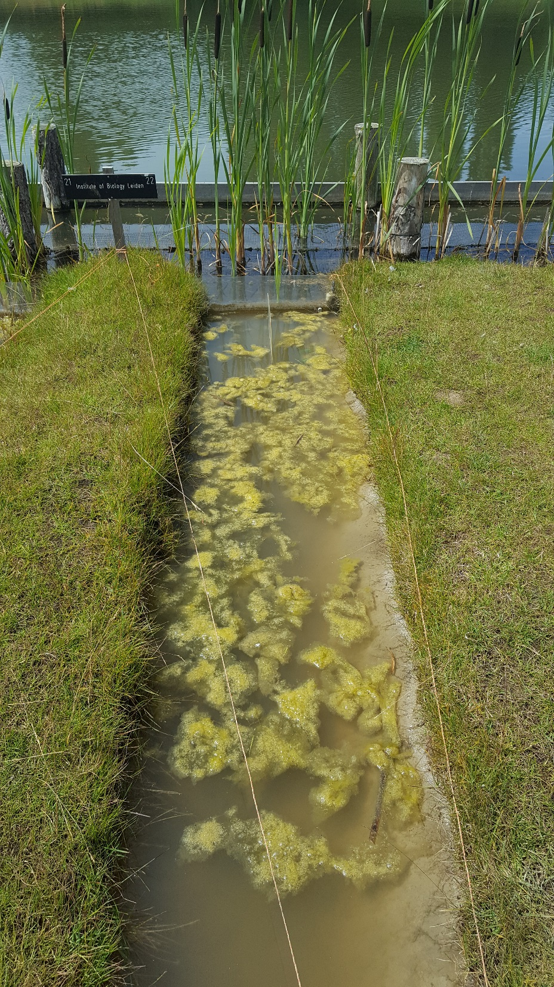
Control Thiacloprid

Slide 25


Biodiversity assay
Functional Feeding Group
Counts
Biomass
Feeding group
Biomass per feeding group
Predators
Parasites
Grazers
Shredders
Gatherer/collectors
Deposit feeders
Filter feeders
Others
$${mass}_{k}=0.11×{{length}_{k}}^{1.79}$$

Slide 26
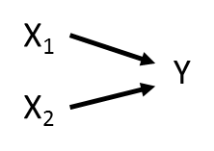

Analyses – Part 3 Ecosystem processes
  Structural equation modelling (SEM)
  ‘unites two or more structural models to model multivariate relationships’
  Essentially strings together a series of linear relationships
  Often used for model testing (as opposed to exploratory)
Y ~ X₁ + X₂
X₂ ~ X₁
Y ~ X₂
Notes:
These relationships can be represented using a path diagram with arrows denoting which variables are influencing (and influenced by) other variables. Take a very simple path diagram:
Which is described by the equation: Y ~ X1 + X2.
Now consider a different arrangement of the same variables:
* Which is now described by two equations: X2 ~ X1 and Y ~ X2. These two equations make up the SEM.
Assumption: relationships above are causal. i.e. X1 directly affects Y , and not the other way around. This is a big leap from more traditional statistics where we the phrase ‘correlation does not imply causation’ is drilled into our brains. The reason we can infer causative relationships has to do with the underlying philosophy of SEM. SEM is designed principally to test competing hypotheses about complex relationships.
In other words, I might hypothesize that Y is directly influenced by both X1 and X2 , as in the first example above. Alternately, I might suspect that X1 indirectly affects Y through X2 . (hypotheses through prior experimentation or expert knowledge of the system, or theory.
Mathematically specified a series of causal assumptions in a causal model (e.g., Y ~ X1 + X2 ) which we test with data. Path significance, the goodness-of-fit, and the magnitude of the relationships all then have some bearing on which logical statements can be extracted from the test: X1 does not directly affect Y , etc.
Third, in the second example, we have not estimated a direct effect of X1 on Y (i.e., there is no arrow from X1 to Y , as in the first example). We can, however, estimate the indirect effect as the product of the effect of X1 on X2 and the effect of X2 on Y . Thus, by constructing a causal model, we can identify both direct and indirect effects simultaneously, which could be tremendously useful in quantifying cascading effects.
directed acyclic graphs (DAG),
D-separation - A test of directional separation (d-sep) asks whether the causally independent paths are significant while statistically controlling for variables on which these paths are conditional.

Slide 27
Analyses – Part 3 cont’d
SEM
  Traditional (e.g. R package lavaan)
    Attempts to reproduce var-covar matrix among all variables, given the model
      Normally distributed variables
      Independent observations
      Large sample size
  Piecewise SEM (e.g. package piecewiseSEM)
    Paths estimated in individual models and
    put together into a causal model
      More flexible, powerful
      Own restrictions
Notes:
Traditional SEM attempts to reproduce the entire variance-covariance matrix among all variables, given the specified model. The discrepancy between the observed and predicted matrices defines the model’s goodness-of-fit. Parameter estimates are derived that minimize this discrepancy, typically using something like maximum likelihood.
Assumptions/shortcomings:
all variables are derived from a normal distribution.
all observations are independent. In other words, there is no underlying structure to the data. These assumptions are often violated in ecological research. Count data are derived from a Poisson distribution. We often design experiments that have hierarchical structure (e.g., blocking) or observational studies where certain sets of variables are more related than others (spatially, temporally, etc.)
Finally, traditional SEM requires quite a large sample size: at least (at least!) 5 samples per estimated parameter, but preferably 10 or more. This issue can be particularly problematic if variables are nested, where the sample size is limited to the use of variables at the highest level of the hierarchy. Such an approach drastically reduces the power of any analysis, not to mention the heartbreak of collapsing painstakingly collected data.
These limitations have led to the development of an alternative kind of SEM called piecewise structural equation modeling. Here, paths are estimated in individual models, and then pieced together to construct the causal model. Piecewise SEM is actually a better gateway into SEM because it essentially is running a series of linear models, and ecologists know linear models.
Problems: estimating goodness-of-fit and comparing models is not straightforward. But work arounds (Bill Shipley)
cannot handle latent variables (represent an unmeasured variable that is informed by measured variables (akin to using PCA to collapse environmental data, and using the first axis to represent the ‘environment’).

Slide 28
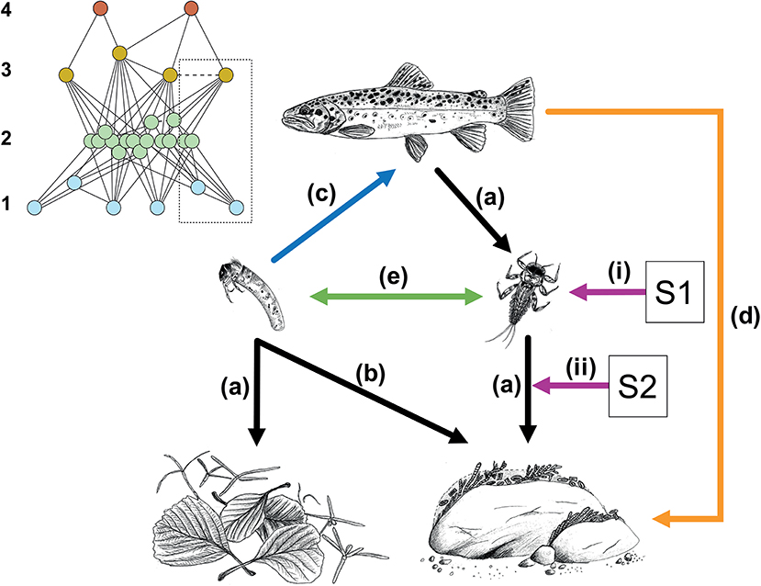
Network of interactions
Ecological
systems:
“organisms
interact with
one another (…)
and their environment”
- Sir. JH Lawton
Bruder et al. 2019 Frontiers Env Sci

