Slide 1
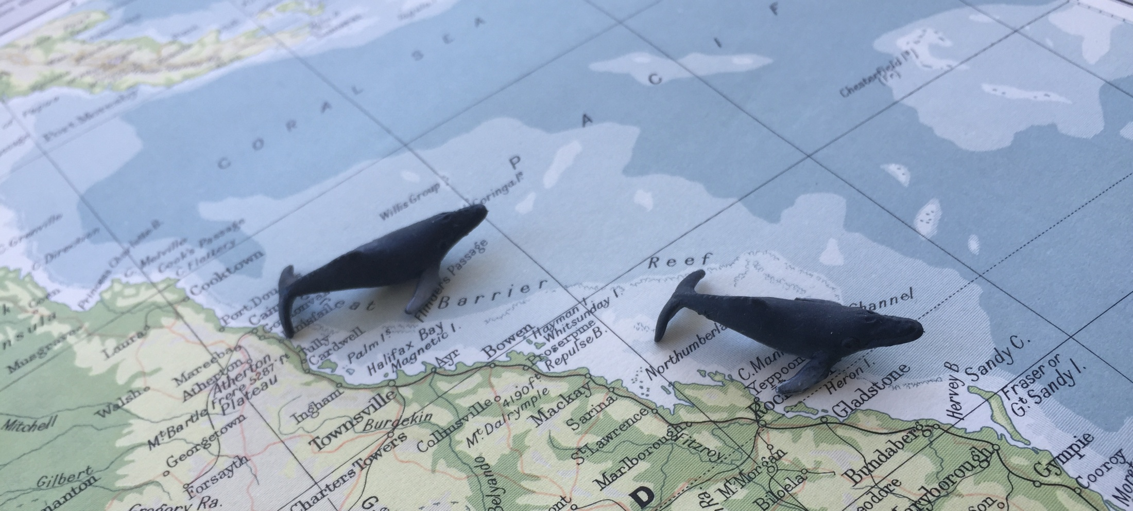
Humpback whales in the Great Barrier Reef
Model-based inferences on distribution and abundance
Nat Kelly, Josh Smith and David Peel
2 December 2015

Slide 2
Humpback whales of the Southern Hemisphere
Baleen whales: south to feed, north to breed
East coast Australian humpback whales: where they go in winter.
Increasing population of East Coast humpback whales (~10.5% p.a.)

Slide 3
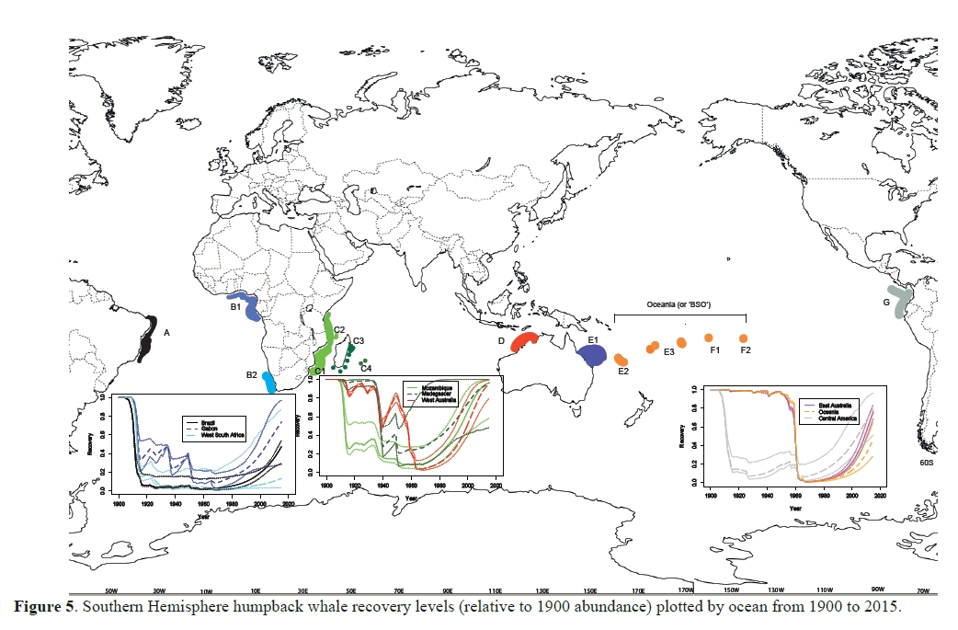
Humpback whales of the Southern Hemisphere

Slide 4
Humpback whales of the Southern Hemisphere
Baleen whales: south to feed, north to breed
East coast Australian humpback whales: where they go in winter.
Increasing population of East Coast humpback whales (~10.5% p.a.)
Increasing shipping…

Slide 5
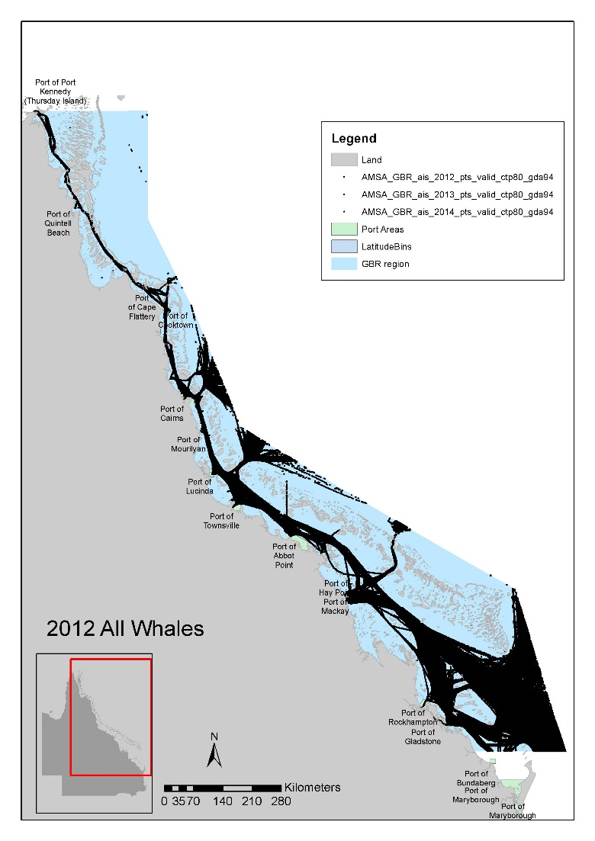
Humpback whales of the Southern Hemisphere
Baleen whales: south to feed, north to breed
East coast Australian humpback whales: where they go in winter.
Increasing population of East Coast humpback whales (~10.5% p.a.)
Increasing shipping…

Slide 6
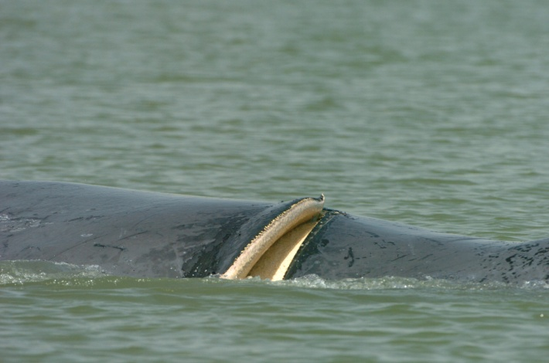
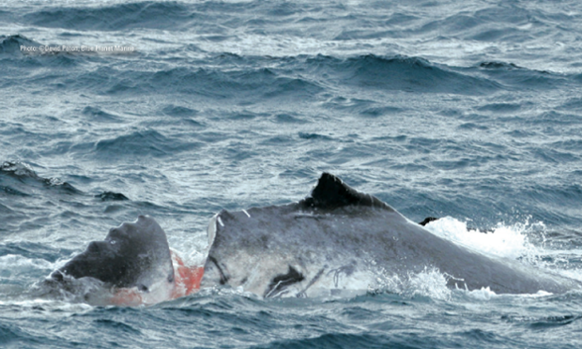
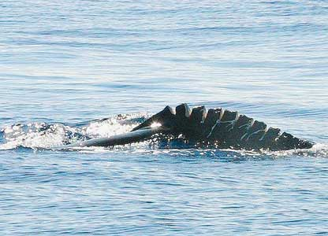
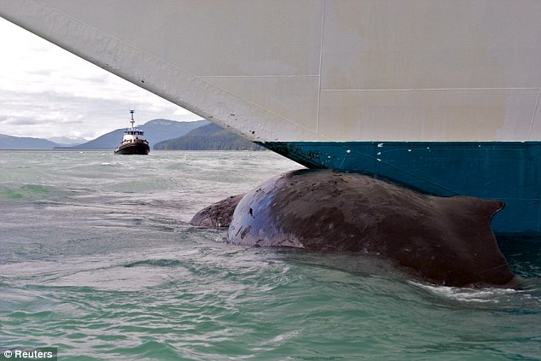

Slide 7
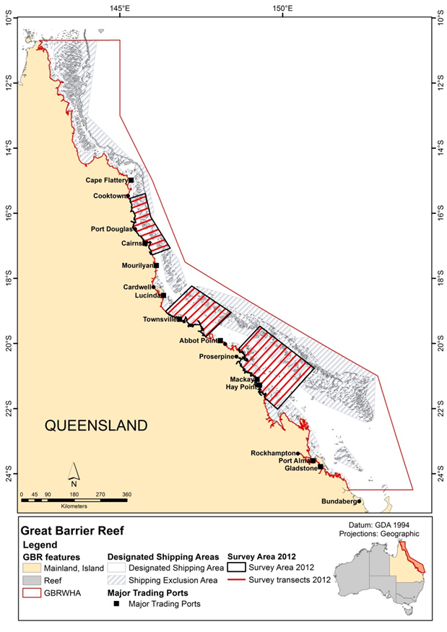
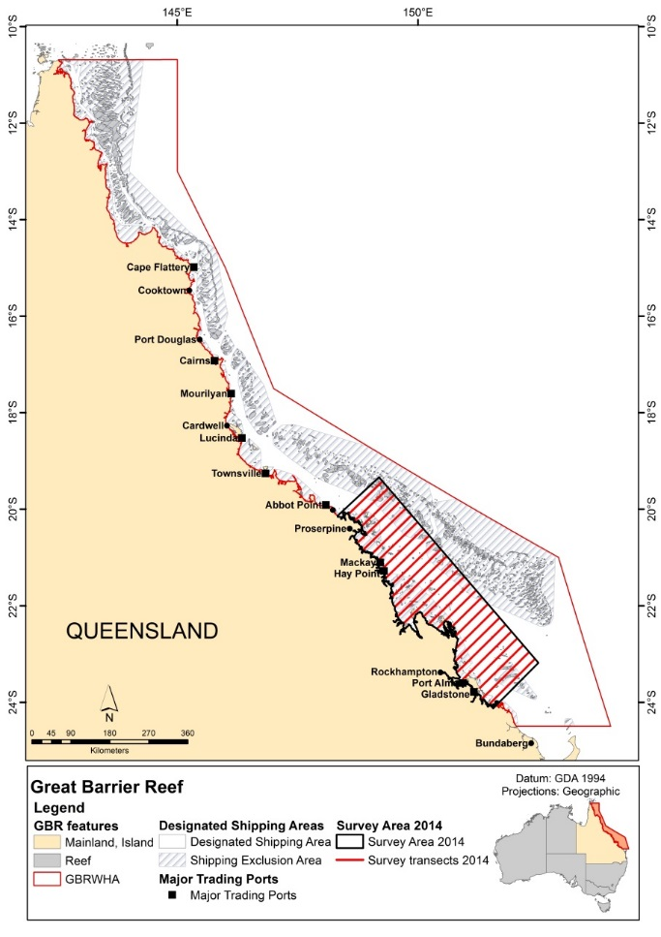
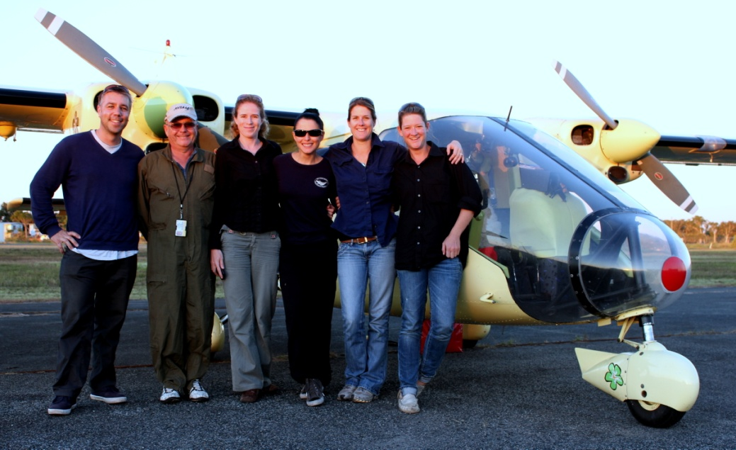
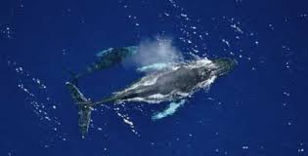
Aerial surveys
Aug 2012
Sept 2012

Slide 8
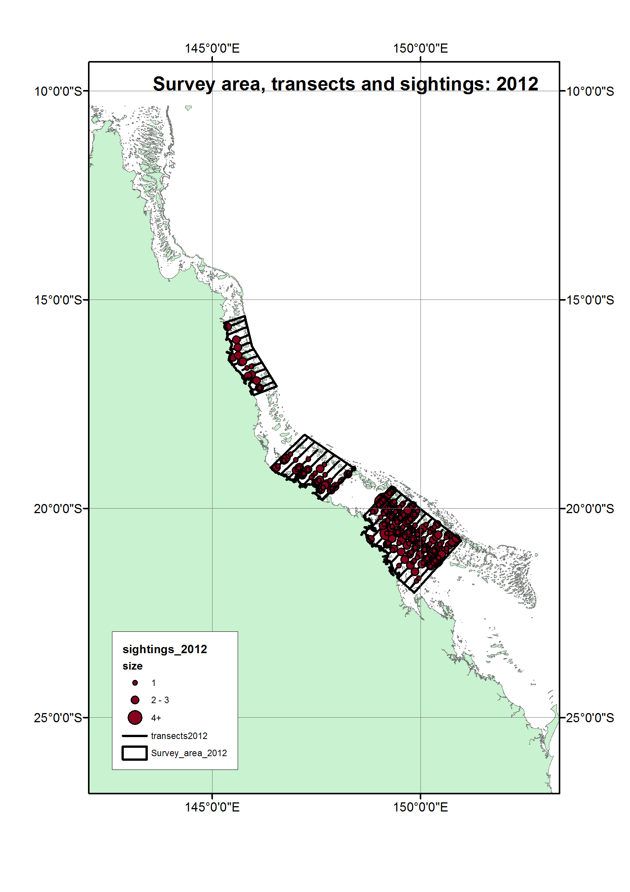
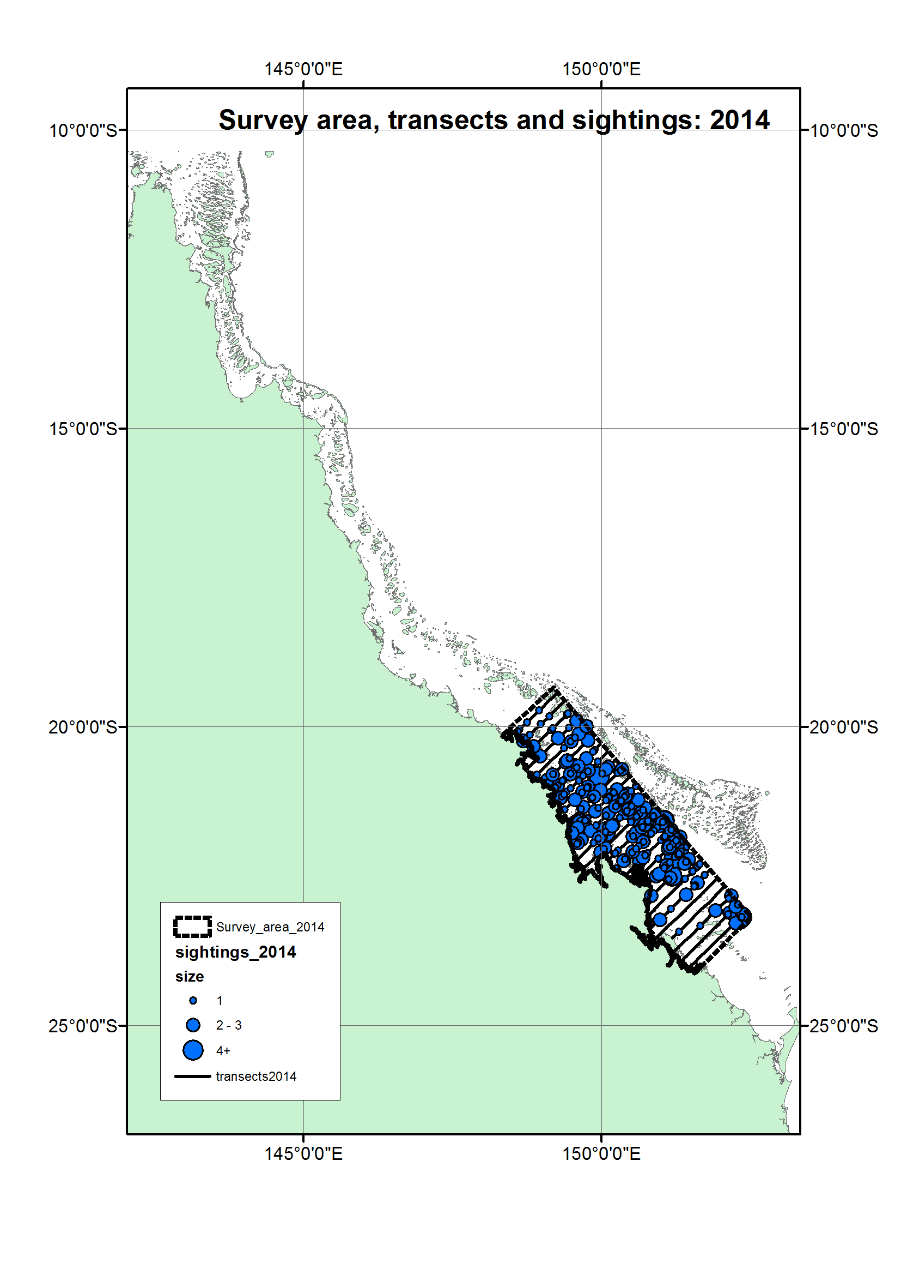
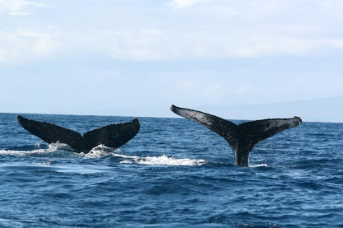
N = 365, 3037 km, 0.143 groups per km
N = 272, 3612 km, 0.122 groups per km
Notes:
Reef ecology and breeding humpback whales

Slide 9
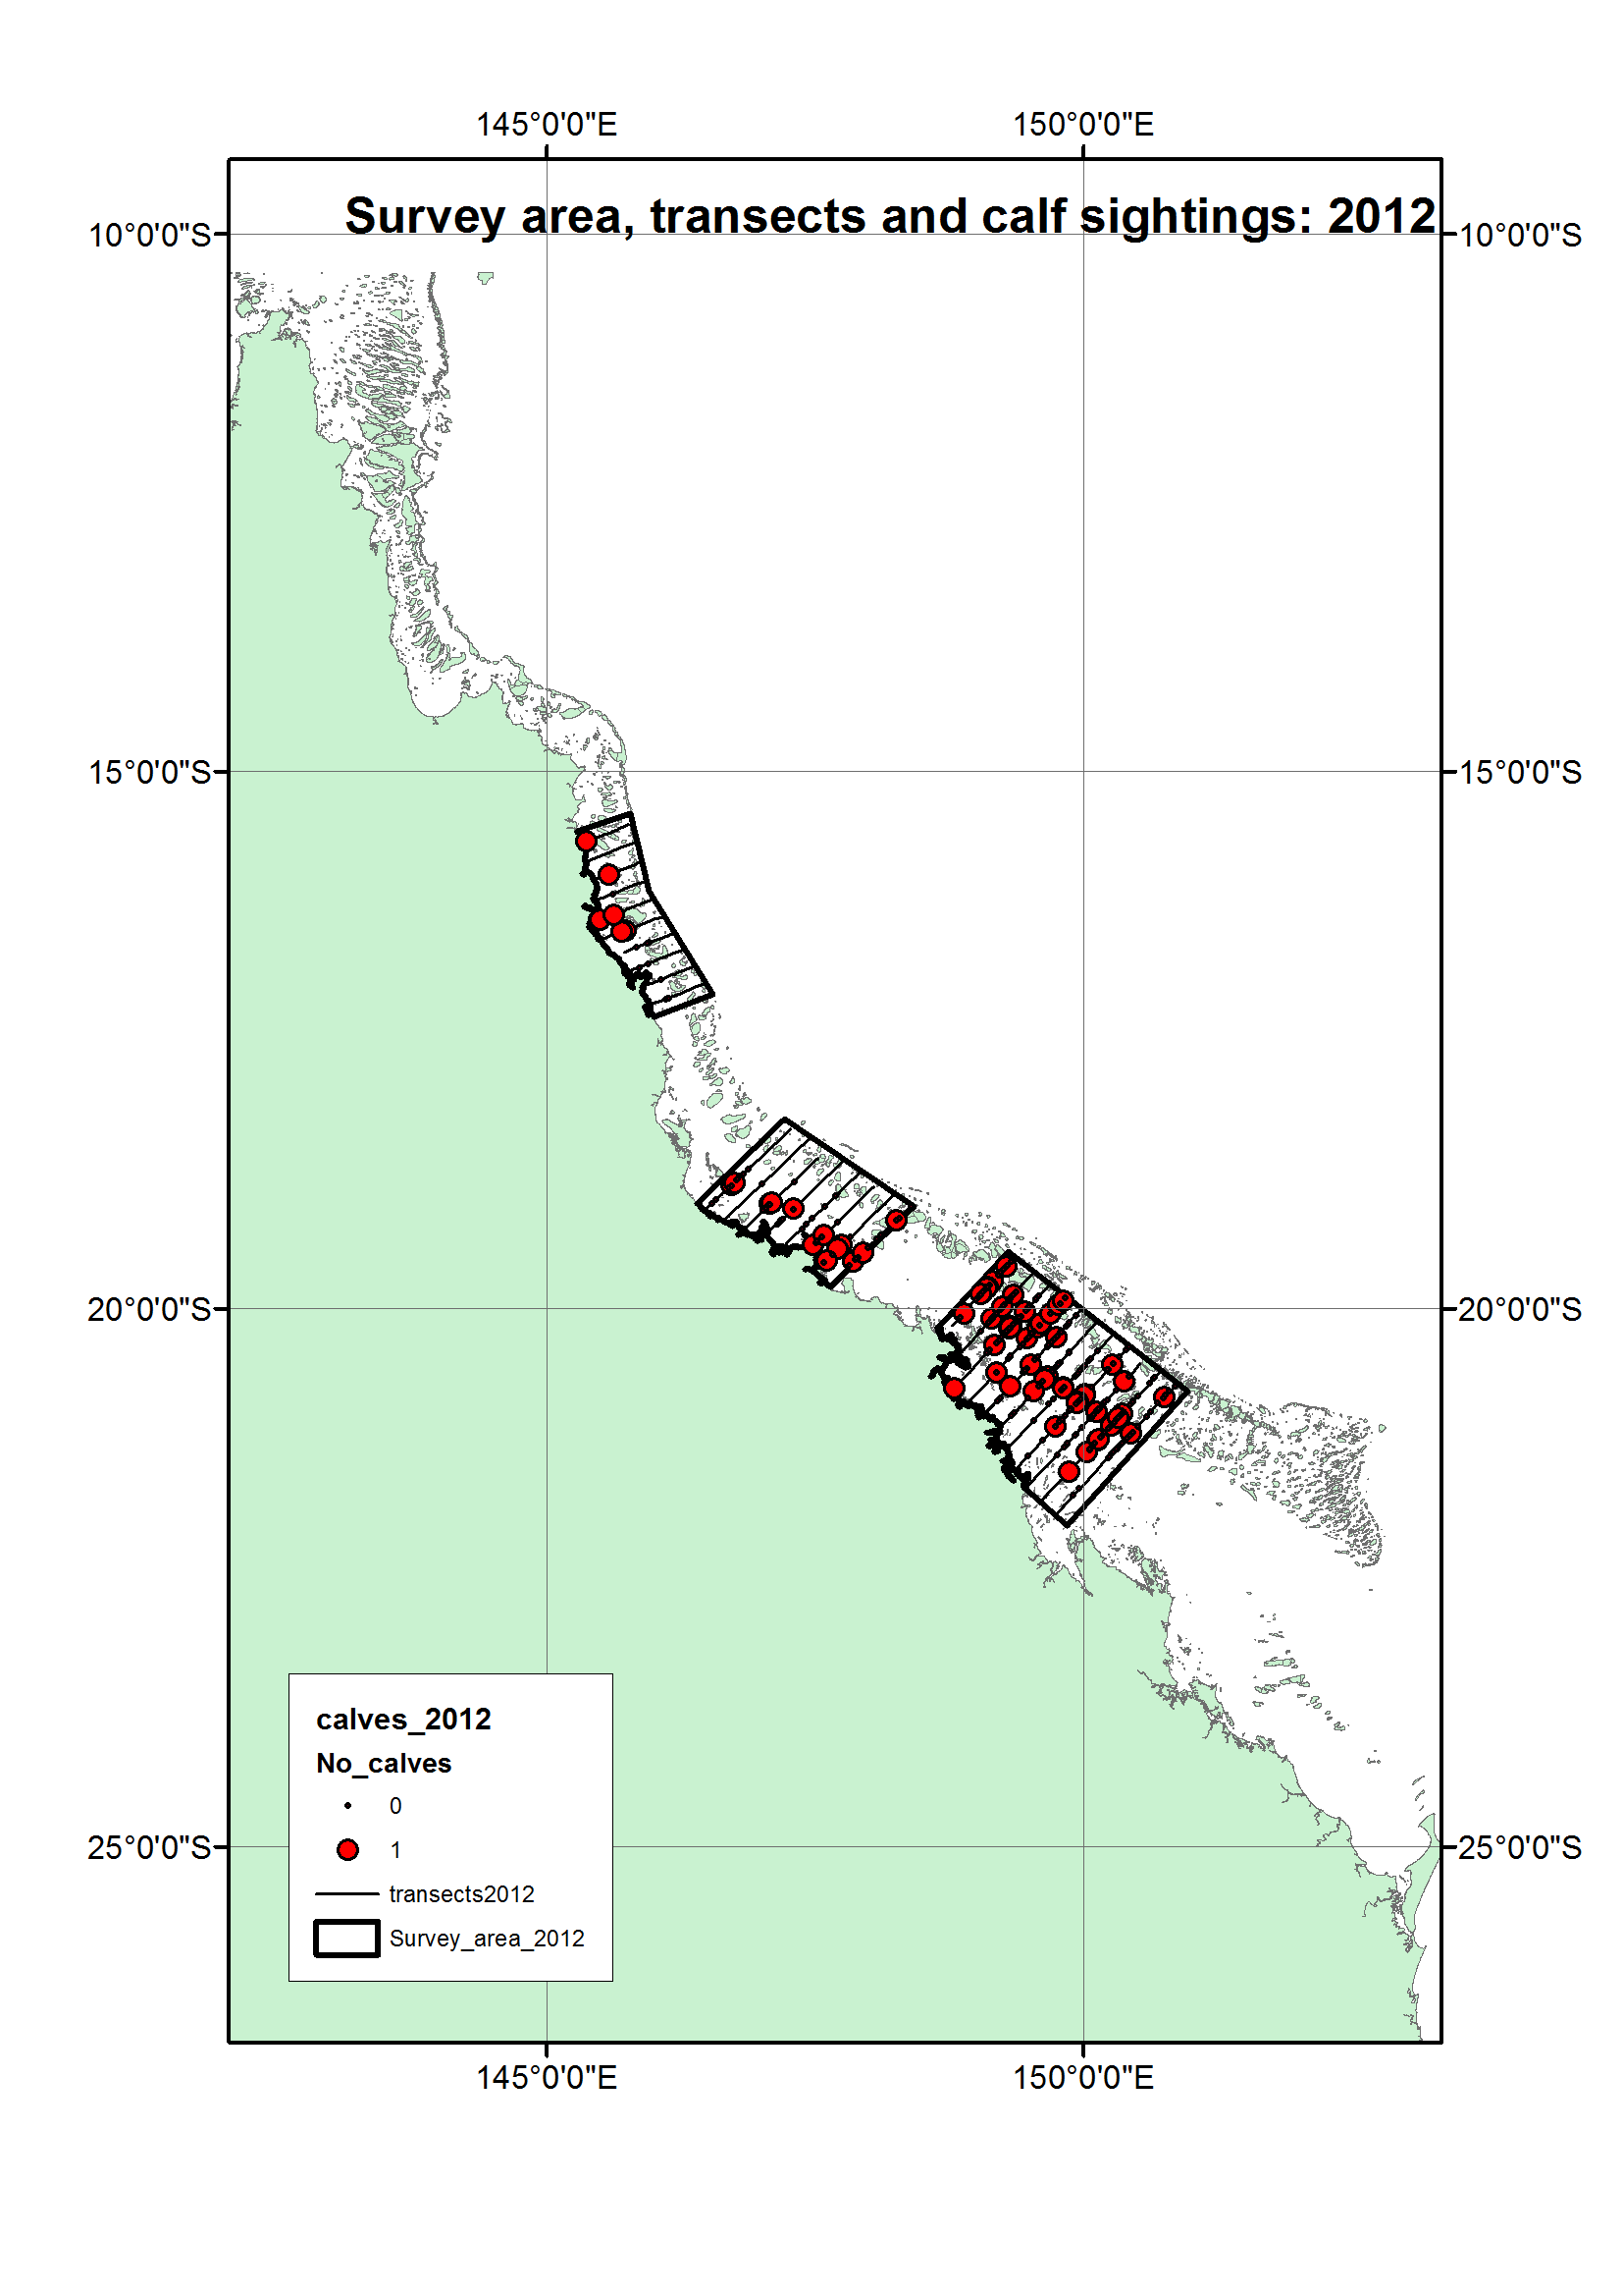
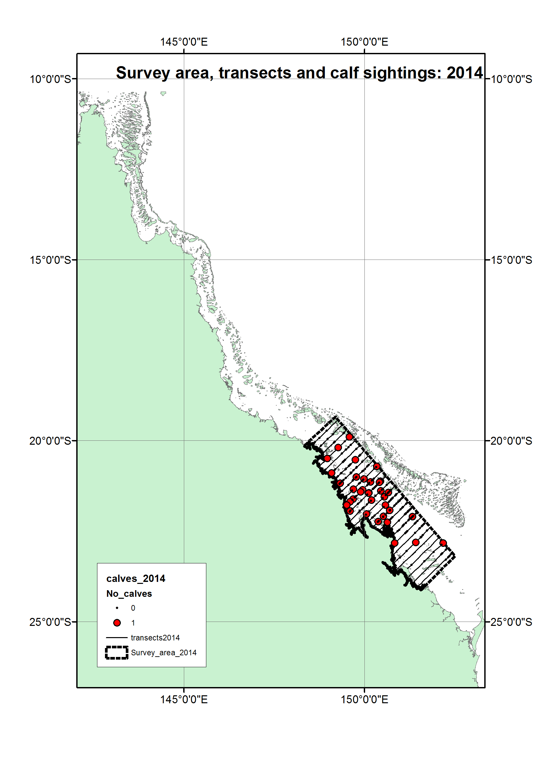
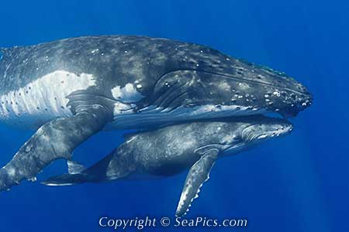
0.033 groups per km
0.016 groups per km

Slide 10
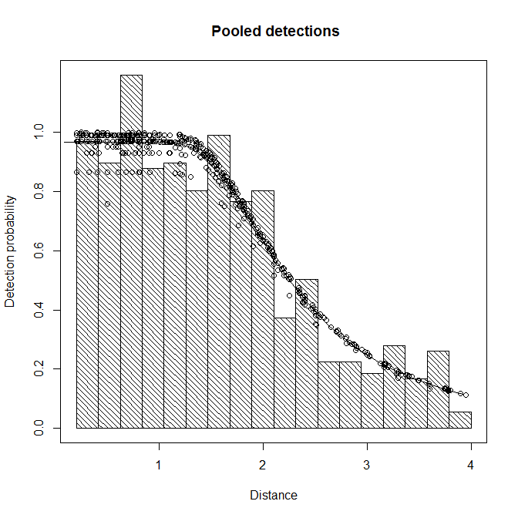
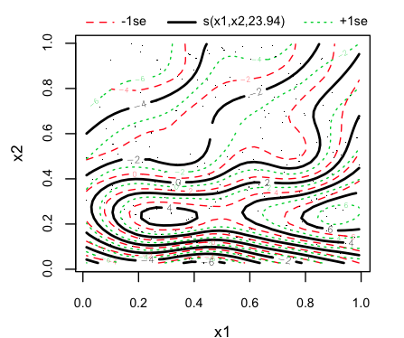
Distance sampling and spatial modelling
Hedley and Buckland 2004
Miller et al. 2013
Wood (2006)

Slide 11
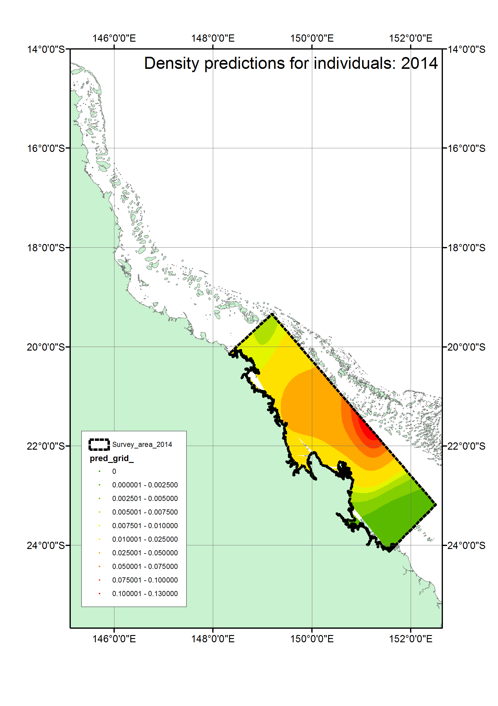
Notes:
Spatial modelling
Then, extrapolating across the GBR as much as possible, beyond the survey region
Alberts equal area
Happy that the survey design has helped ensure reasonable coverage across that region
Yearly output (so, not averaging over the two seasons)

Slide 12
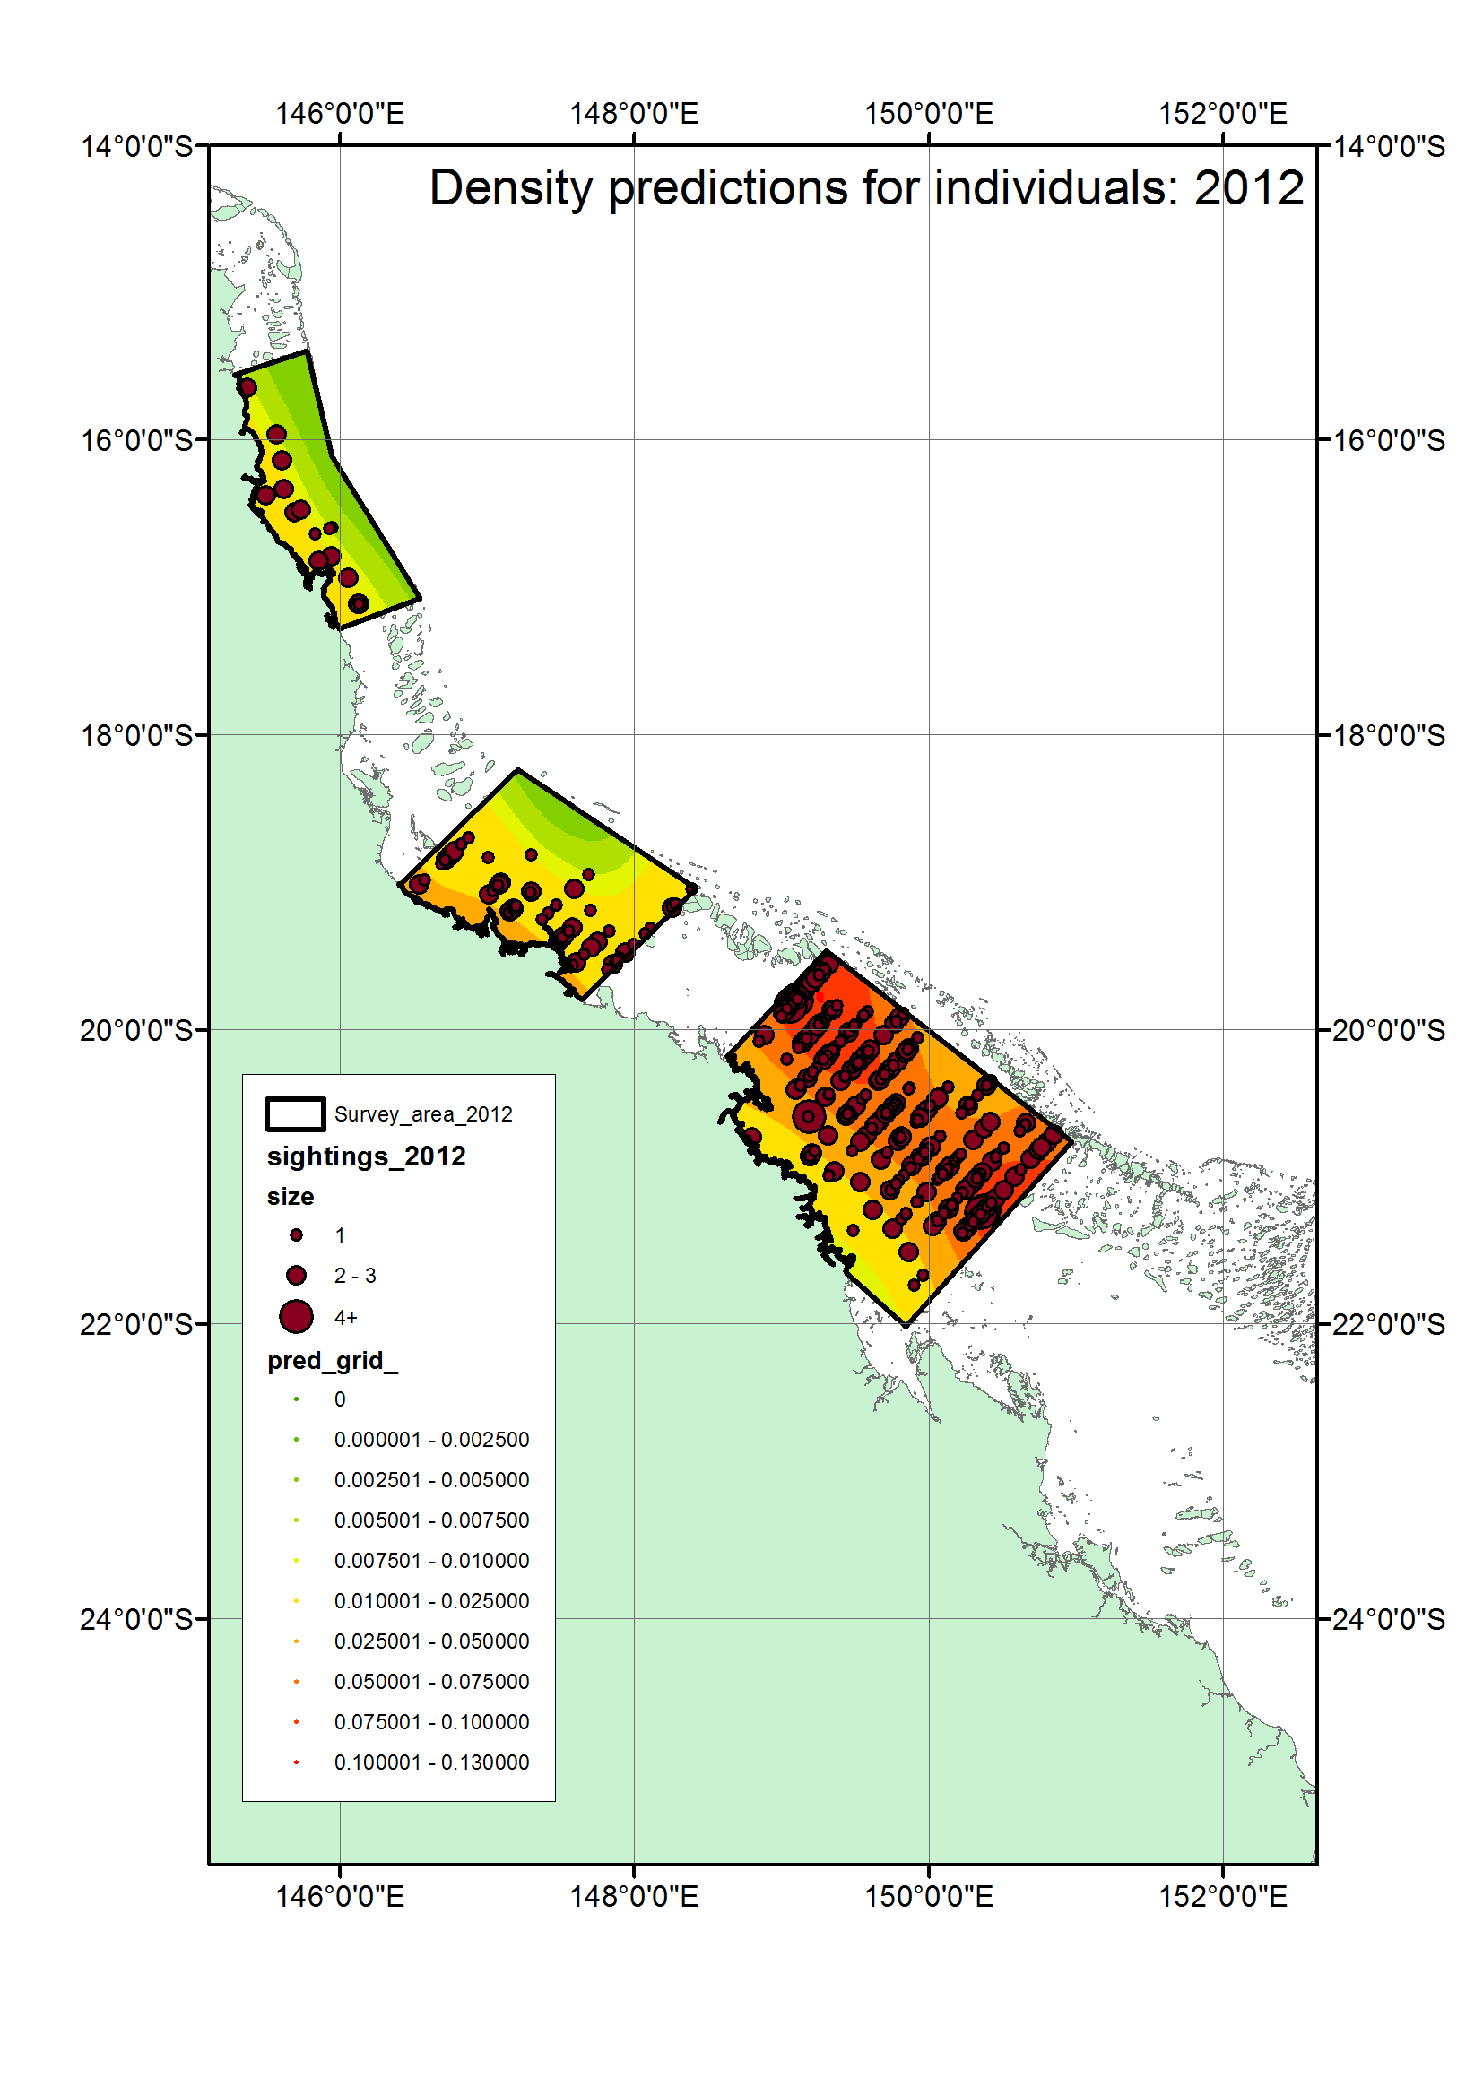
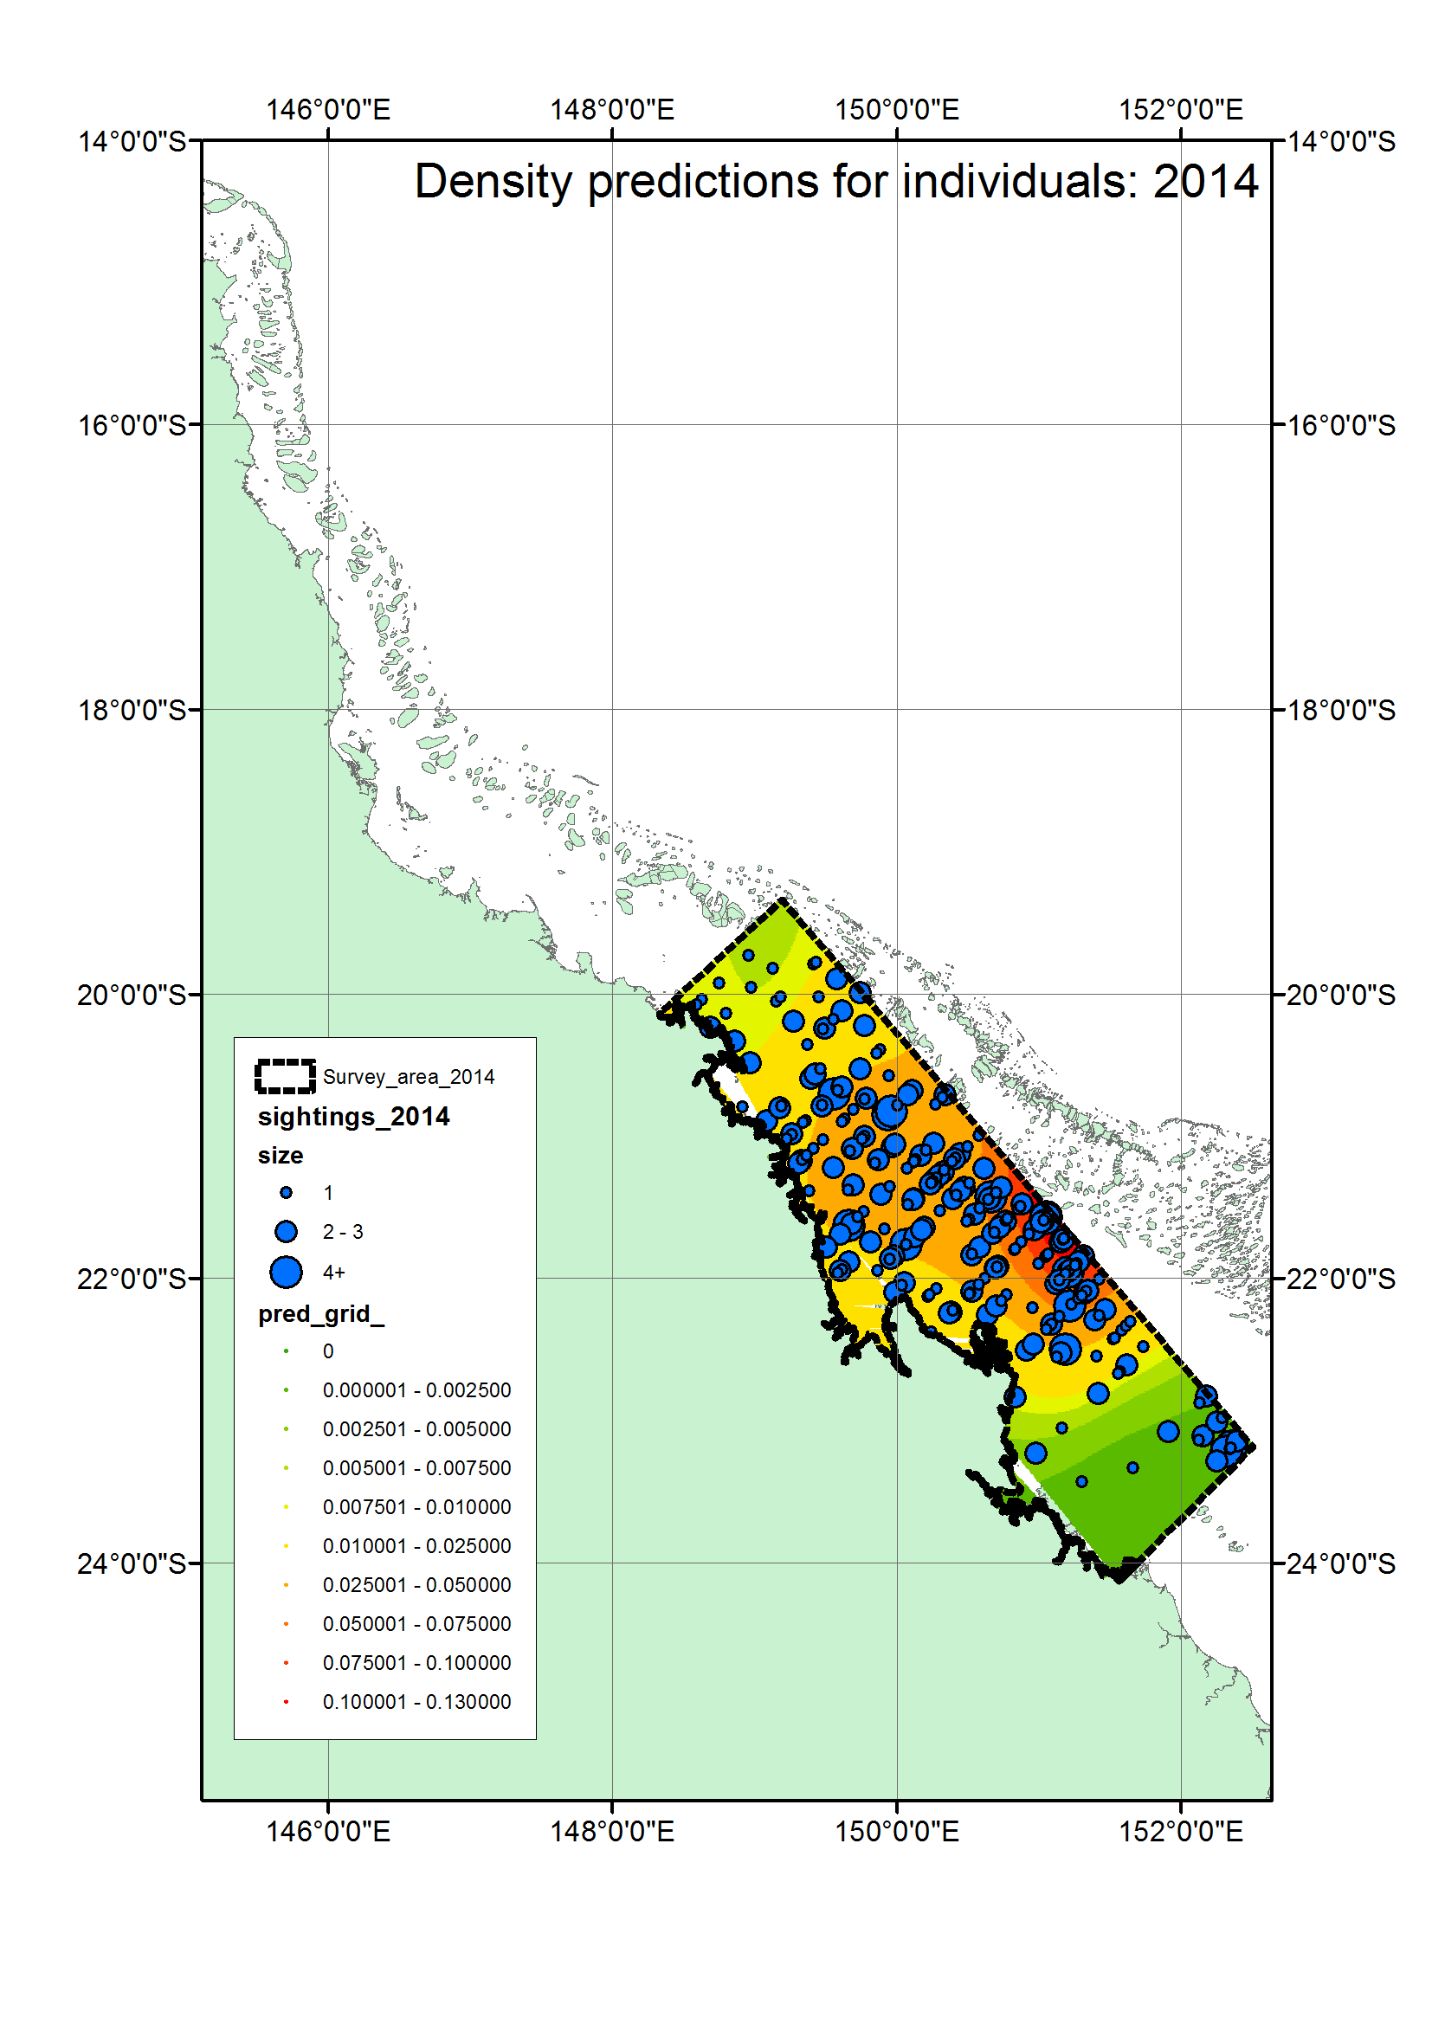

Slide 13
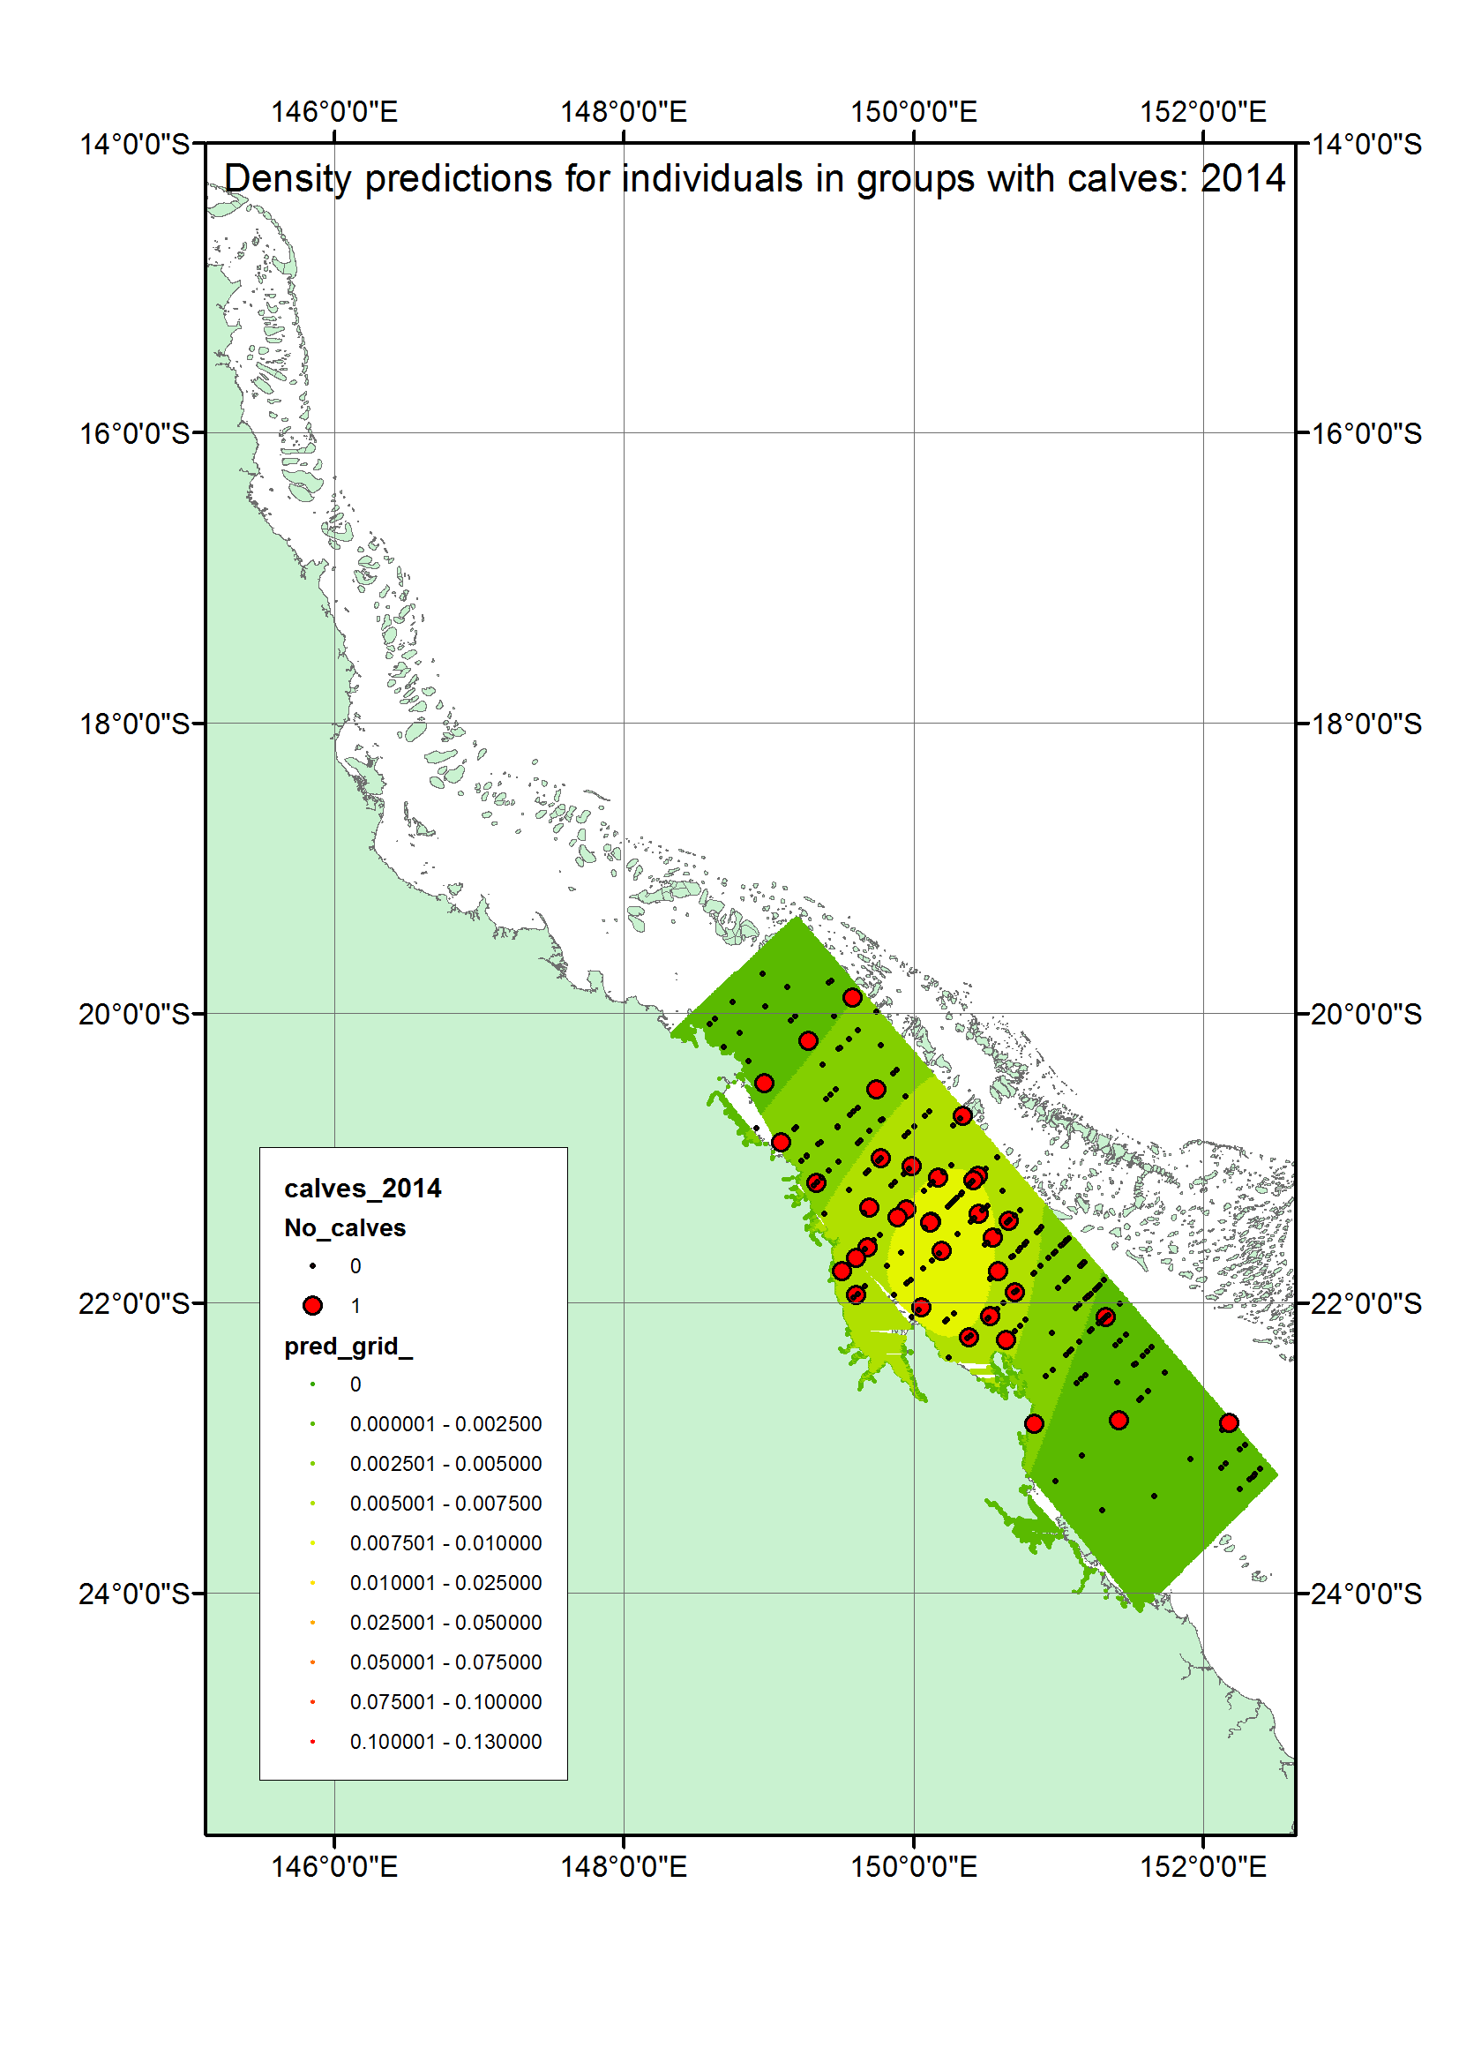

Slide 14
Notes:
Spatial modelling
Then, extrapolating across the GBR as much as possible, beyond the survey region
Alberts equal area
Happy that the survey design has helped ensure reasonable coverage across that region
Yearly output (so, not averaging over the two seasons)

Slide 15
Notes:
Spatial modelling
Then, extrapolating across the GBR as much as possible, beyond the survey region
Alberts equal area
Happy that the survey design has helped ensure reasonable coverage across that region
Yearly output (so, not averaging over the two seasons)

Slide 16
Notes:
Spatial model for calves

Slide 17
Notes:
Spatial model for calves

Slide 18
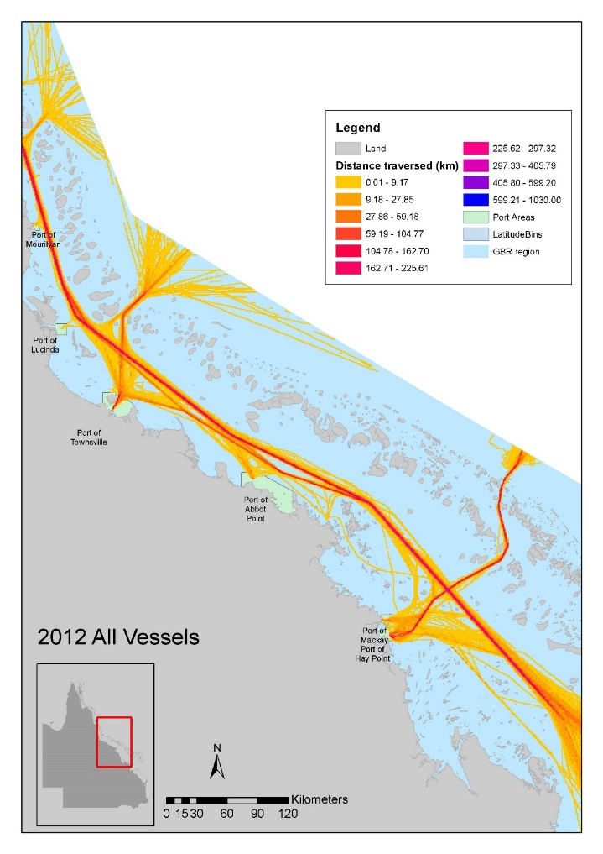
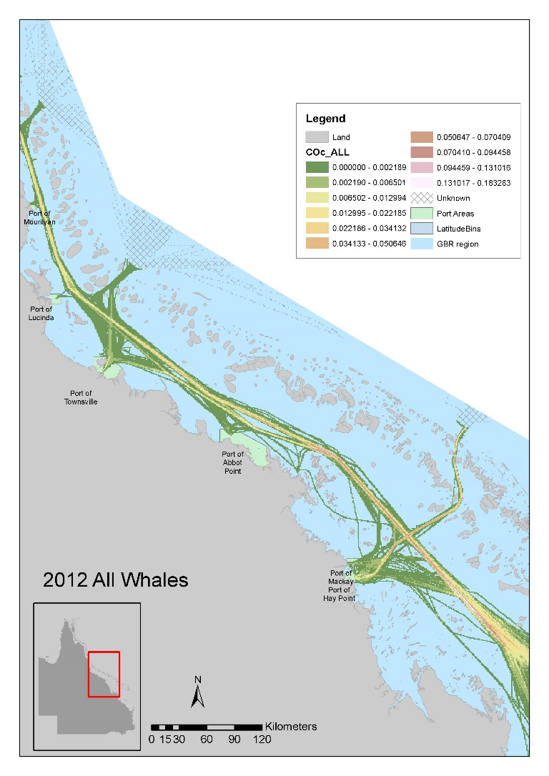
Notes:
Co-occurrence model

Slide 19
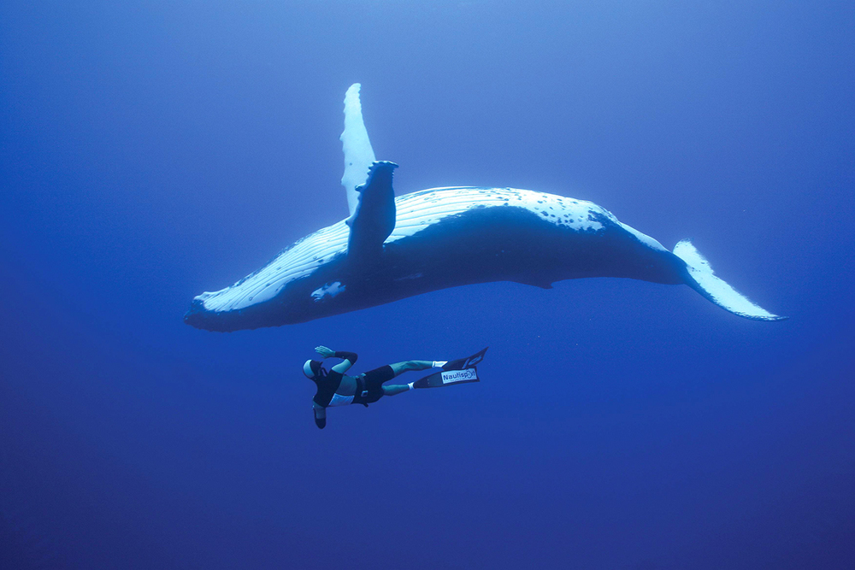

Slide 20
Smooth over space or environmental covariates?

Slide 21
Smooth of space or environmental covariates?

Slide 22
Smooth of space or environmental covariates?
Environmental covariates tested: SST, bathymetry, chl-a, distance tos,
Enviros usually worse fit than space
Space will tend to soak up the variance; enviros are left out
Philosophical and practice differences:
Space: easy covariate, integrates over ecology
Environment: explanation and ecology; allows extrapolation; spatial autocorrelation; can be error-prone

Slide 23
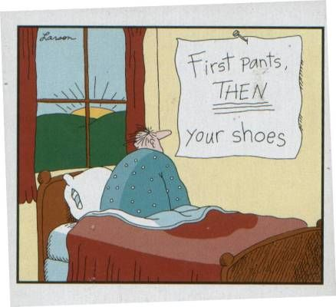
Smooth of space or environmental covariates?
Environmental covariates tested: SST, bathymetry, chl-a, distance tos,
Enviros usually worse fit than space
Space will tend to soak up the variance; enviros are left out
Philosophical and practice differences:
Space: easy covariate, integrates over ecology
Environment: explanation and ecology; allows extrapolation; spatial autocorrelation; can be error-prone

Slide 24
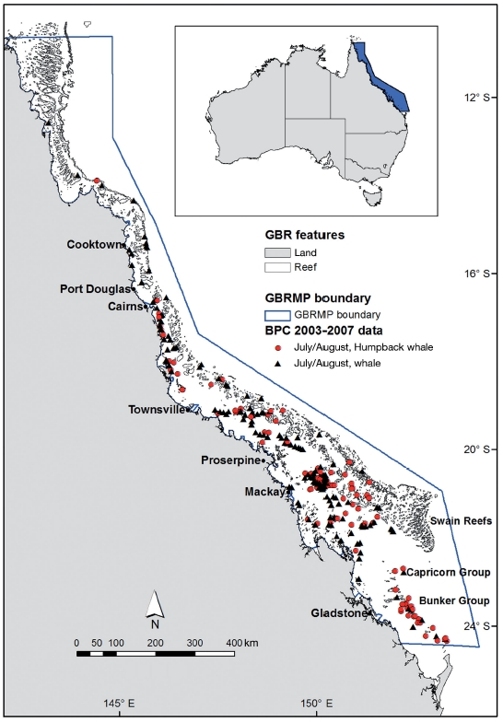
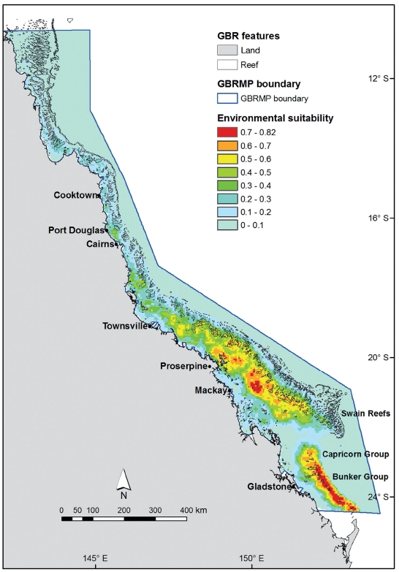
Maxent versus line transect data
Presence-only
Maxent
Line-transect/sighting data
Smith et al. 2012

Slide 25
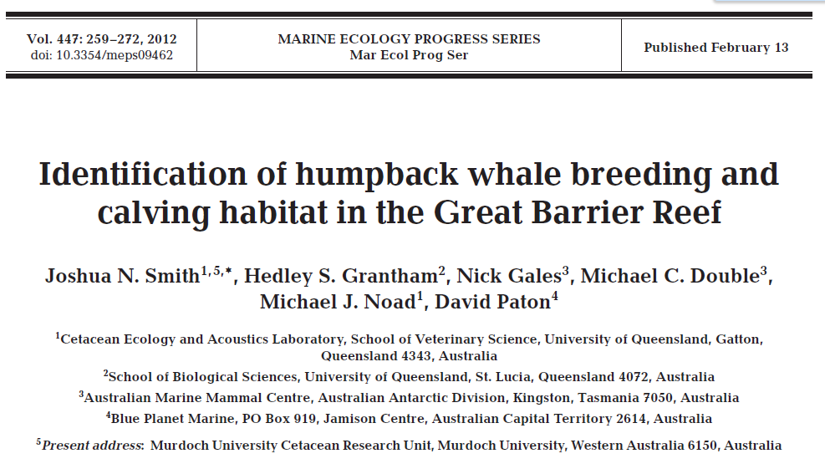
Maxent versus line transect data
Presence-only
Maxent

Slide 26
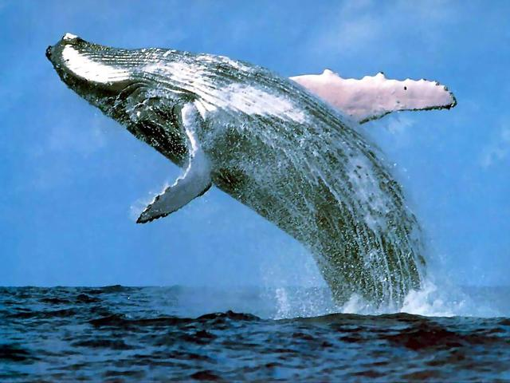
Thank you

Slide 27
Maxent versus line transect data
Presence-only
Maxent
Line-transect/sighting data
Smith et al. 2012

