Slide 1
Assessing a species distribution model’s performance for sparse and patchy presence data.
Samantha Peel

Slide 2
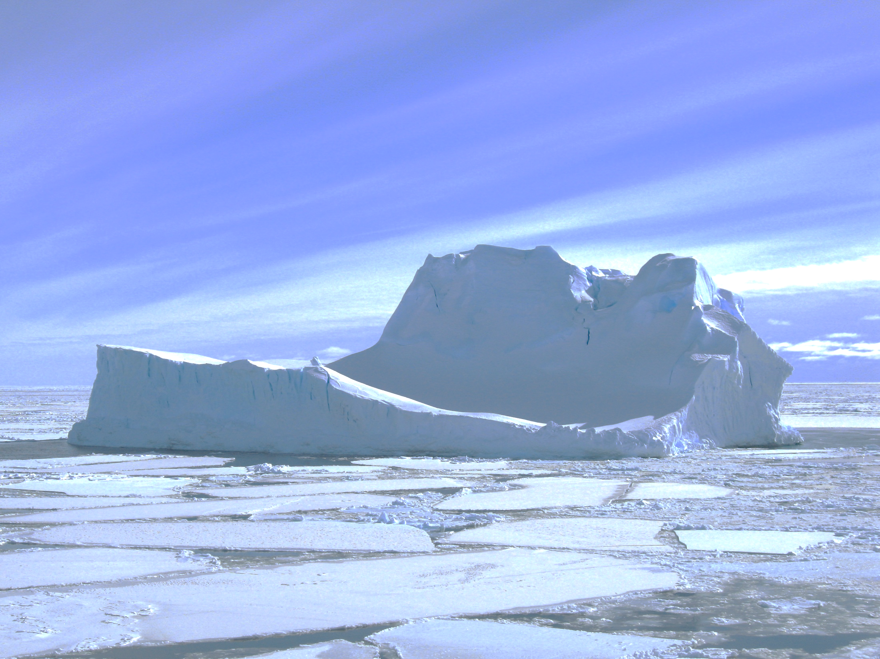
Background …

Slide 3
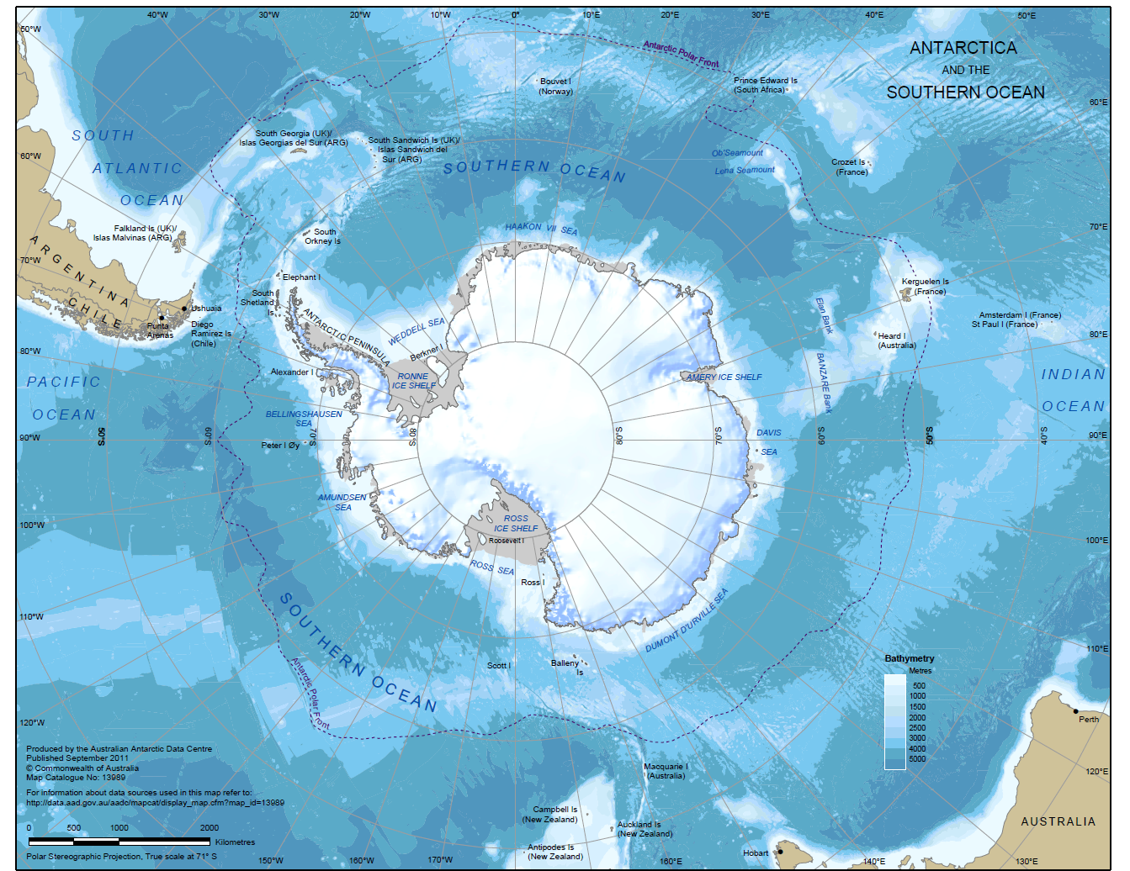
What is the Southern Ocean?
Ocean between the Polar Front and the Antarctic continent
Southern Ocean is large ( ~ 20 million km² )
Extreme environment
high winds
large waves
cold temperatures
ice-bergs
seasonal sea-ice
Unique ecosystems
Unique species
Increasing pressures
Tourism
Fishing
Climate
MAP: Published by the Australian Antarctic Data Centre – September 2011
Notes:
Australia ~ 7 million square kms

Slide 4
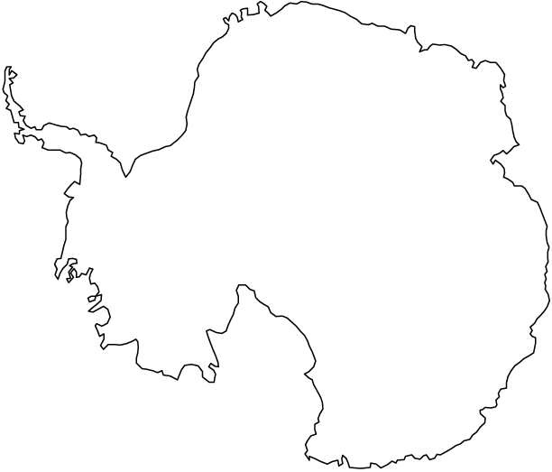
Southern Ocean data
Data collection more difficult
Costly
Logistically complicated
Working conditions challenging
Patchy and sparse presence-absence data coverage
Different gear types used
Presence-only data available
Environmental data at $0.1°×0.1°$
50$°$S ~ 80 km²
80$°$S ~ 20 km²
Species A data
Presence-only
Presence-absence

Slide 5
Big question:
Is this ecosystem sustainable under change A?
The first question:
How many of species x, y, and z are in the area and where are they located?
The answer:
For some species … ?
Getting an “answer”:
Species distribution models (SDMs)

Slide 6
Species distribution models …

Slide 7
Accurate estimation – which model?
Data
SDM for Presence-Absence (PA) data
GLMs
We don’t have enough PA data or “coverage”
Not using all our available data
SDM for Presence-Only (PO) data
GLMs with pseudo-absence data, PPM, MAXENT
Our PO data has sampling bias – effects estimate
Not using all our available data
SDM for both PA and PO data?
MultispeciesPP by Fithian, Elith, Hastie, and Keith (2015)
Could use all available data
Could account for sampling bias in PO data
?

Slide 8
Poisson point SDM
Presence-only SDM
Set of individuals’ locations $𝒮\sim IPP(λ\left(s\right))$
Inhomogeneous Poisson point process (IPP) model
Intensity function $λ\left(s\right), s=(\text{longitude}\text{, }\text{latitude})$
Intensity ~ likely number of $s_{i}∈𝒮$ near $s$
Model intensity function as
$$\ln{λ\left(s\right)}=α+β^{′}x\left(s\right)$$
Warton and Shepherd (2010)
Notes:
- True individuals locations are inhomogeneous Poisson point process
- Characterised by an intensity function $λ\left(s\right), s=(\text{longitude}\text{,}\text{latitude})$
- Model intensity function as <equation>

Slide 9
Pooled Poisson point SDM
Presence-only and presence-absence data
Start with Poisson point SDM
Add in sampling bias as a probability function $b\left(s\right)∈[0,1]$
Set of biased samples $𝒯\sim IPP(λ\left(s\right)b\left(s\right))$
Model intensity and bias functions as
$$\begin{aligned}\ln{λ\left(s\right)}&=α+β^{′}x\left(s\right) \\ \ln{b\left(s\right)}&=γ+δ′z\left(s\right)\end{aligned}{}$$
Fithian, Elith, Hastie, and Keith (2015)
Notes:
Where x(s) are the values of the environment variables at the location s and
z(s) are the values of the sampling bias variables at the location s.

Slide 10
Testing the pooled SDM
Why test?
Case study used large amount of dense PA data
Small amount of PO data to large amount of PA data
Simulate and compare!
Why simulate?
Know the “true” population
Control the PA data “patchiness”
Control the PO sample bias

Slide 11
Simulation …

Slide 12
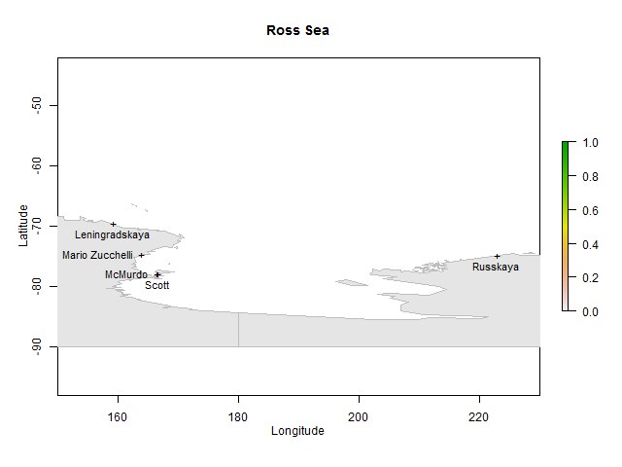
Simulation in the Ross Sea

Slide 13
Simulation in the Ross Sea – “true” population
Environment Data:

Slide 14
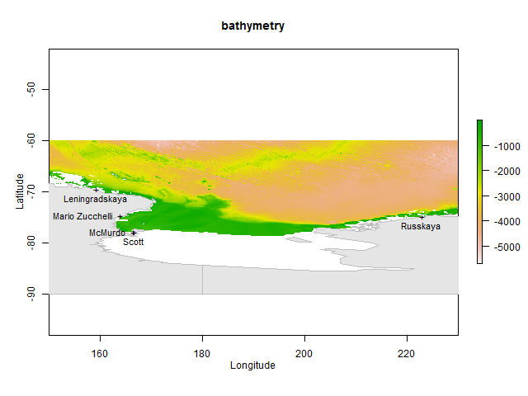
Simulation in the Ross Sea – “true” population
Environment Data:
Bathymetry

Slide 15
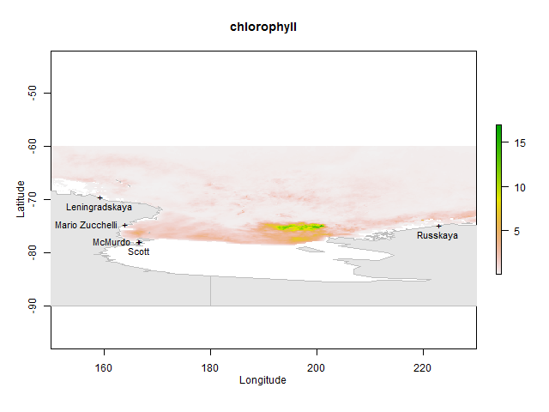
Simulation in the Ross Sea – “true” population
Environment Data:
Bathymetry
Chlorophyll

Slide 16
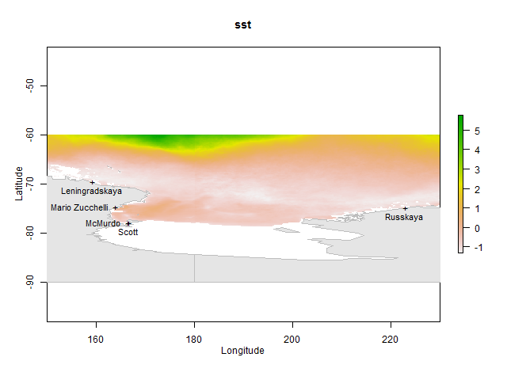
Simulation in the Ross Sea – “true” population
Environment Data:
Bathymetry
Chlorophyll
SST

Slide 17
Simulation in the Ross Sea – “true” population
Environment Data:
Bathymetry
Chlorophyll
SST
Model:
$\ln\left(λ\right)=α+β^{′}x$

Slide 18
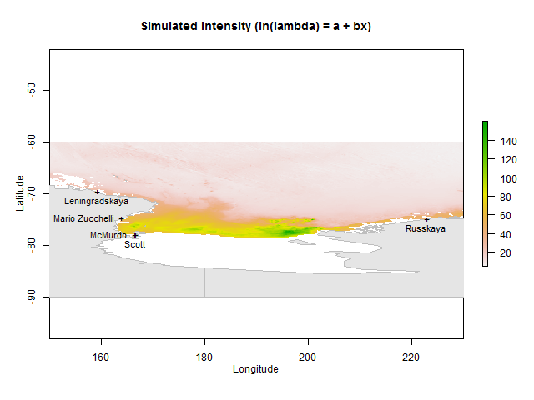
Simulation in the Ross Sea – “true” population
Environment Data:
Bathymetry
Chlorophyll
SST
Model:
$\ln\left(λ\right)=α+β^{′}x$
$α=$-3.3
$β=\left[\begin{matrix}0 \\ −0.1 \\ 0.0003 \\ 0.12 \\ 0.17\end{matrix}\right]$

Slide 19
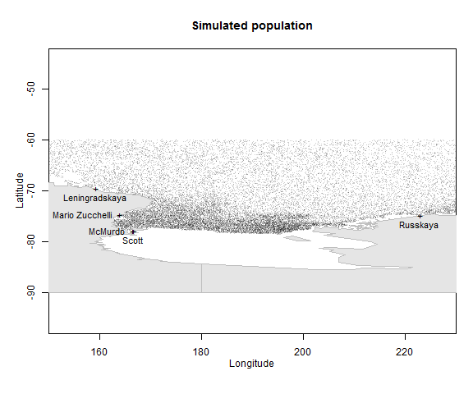
Simulation in the Ross Sea – “true” population
Environment Data:
Bathymetry
Chlorophyll
SST
Model:
$\ln\left(λ\right)=α+β^{′}x$
$α=$-3.3
$β=\left[\begin{matrix}0 \\ −0.1 \\ 0.0003 \\ 0.12 \\ 0.17\end{matrix}\right]$

Slide 20
Simulation in the Ross Sea – sample bias
Sample Bias Data:

Slide 21
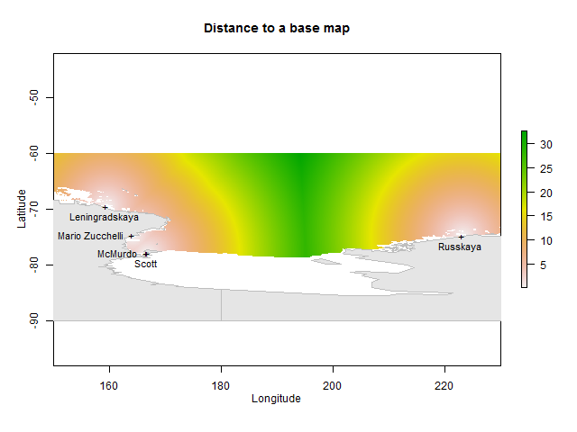
Simulation in the Ross Sea – sample bias
Sample Bias Data:
Distance to base

Slide 22
Simulation in the Ross Sea – sample bias
Sample Bias Data:
Distance to base
Model:
$\ln\left(b\right)=γ+δ^{′}z$
$b=\frac{pr}{1−pr}$

Slide 23
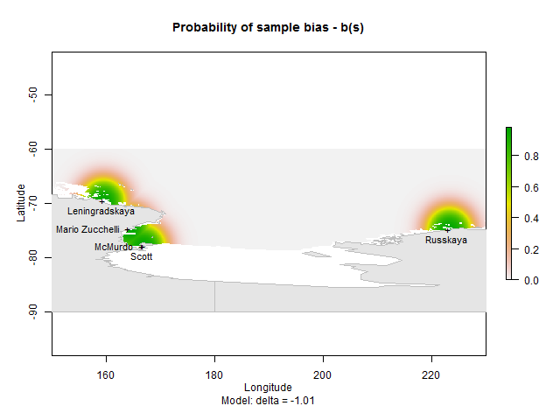
Simulation in the Ross Sea – sample bias
Sample Bias Data:
Distance to base
Model:
$\ln\left(b\right)=γ+δ^{′}z$
$b=\frac{pr}{1−pr}$
$γ=4$
$δ=−1.01$

Slide 24
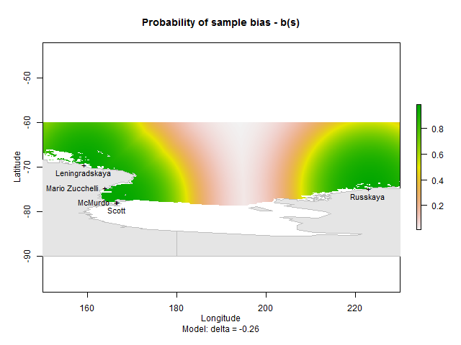
Simulation in the Ross Sea – sample bias
Sample Bias Data:
Distance to base
Model:
$\ln\left(b\right)=γ+δ^{′}z$
$b=\frac{pr}{1−pr}$
$γ=4$
$δ=−0.26$

Slide 25
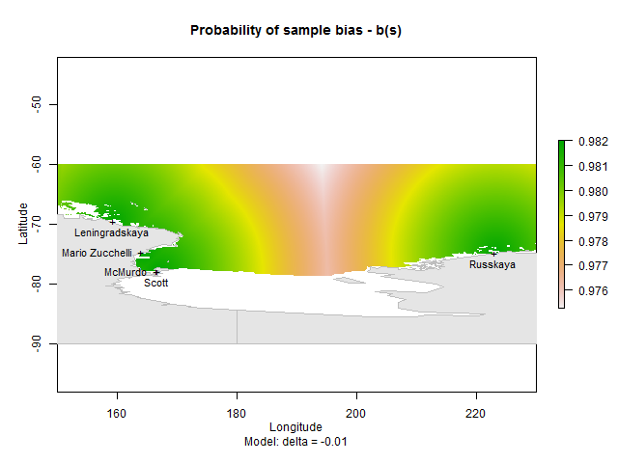
Simulation in the Ross Sea – sample bias
Sample Bias Data:
Distance to base
Model:
$\ln\left(b\right)=γ+δ^{′}z$
$b=\frac{pr}{1−pr}$
$γ=4$
$δ=−0.01$

Slide 26
Simulation in the Ross Sea – sample bias
Sample Bias Data:
Distance to base
Model:
$\ln\left(b\right)=γ+δ^{′}z$
$b=\frac{pr}{1−pr}$
$γ=4$
$δ=−1.01$
PO points:
$N_{λ}\left(s\right)∗b\left(s\right)≥1$

Slide 27
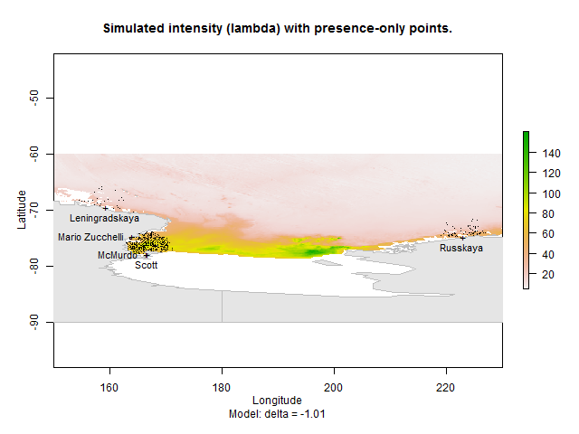
Simulation in the Ross Sea – sample bias
Sample Bias Data:
Distance to base
Model:
$\ln\left(b\right)=γ+δ^{′}z$
$b=\frac{pr}{1−pr}$
$γ=4$
$δ=−1.01$
PO points:
$N_{λ}\left(s\right)∗b\left(s\right)≥1$

Slide 28
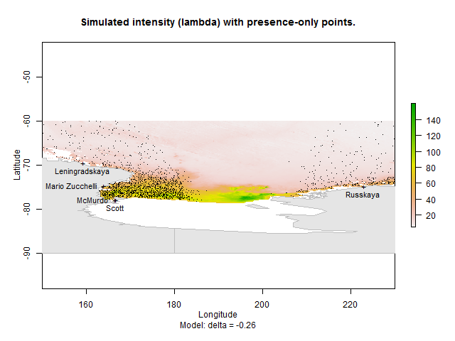
Simulation in the Ross Sea – sample bias
Sample Bias Data:
Distance to base
Model:
$\ln\left(b\right)=γ+δ^{′}z$
$b=\frac{pr}{1−pr}$
$γ=4$
$δ=−0.26$
PO points:
$N_{λ}\left(s\right)∗b\left(s\right)≥1$

Slide 29
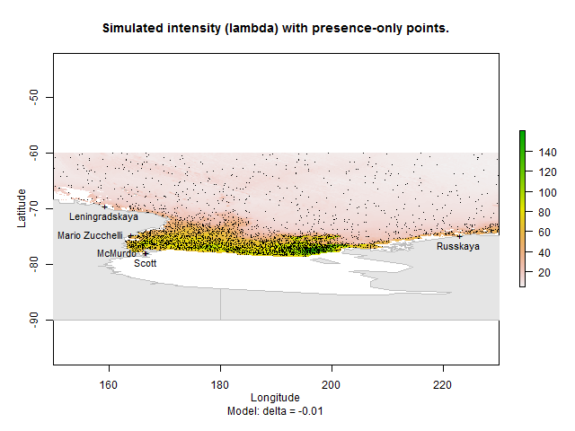
Simulation in the Ross Sea – sample bias
Sample Bias Data:
Distance to base
Model:
$\ln\left(b\right)=γ+δ^{′}z$
$b=\frac{pr}{1−pr}$
$γ=4$
$δ=−0.01$
PO points:
$N_{λ}\left(s\right)∗b\left(s\right)≥1$

Slide 30
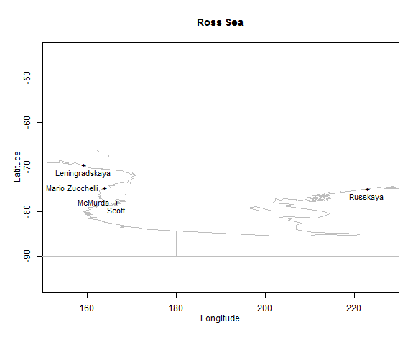
Simulation in the Ross Sea – other data
PA points:
100 surveys
100% detection
uniform random
survey = cell

Slide 31
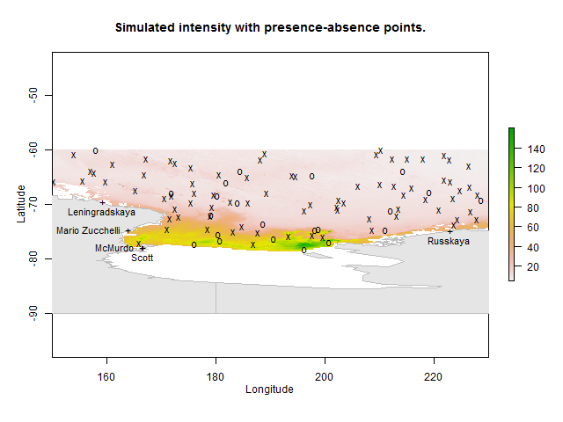
Simulation in the Ross Sea – other data
PA points:
100 surveys
100% detection
uniform random
survey = cell

Slide 32
Simulation in the Ross Sea – other data
PA points:
100 surveys
100% detection
uniform random
survey = cell
Background data:
all cells

Slide 33
Estimation by SDMs …

Slide 34
Estimation of intensity – presence-only SDM
Data:
Environment
Sample Bias
PO
SDM:
PPM (R - spatstat)

Slide 35
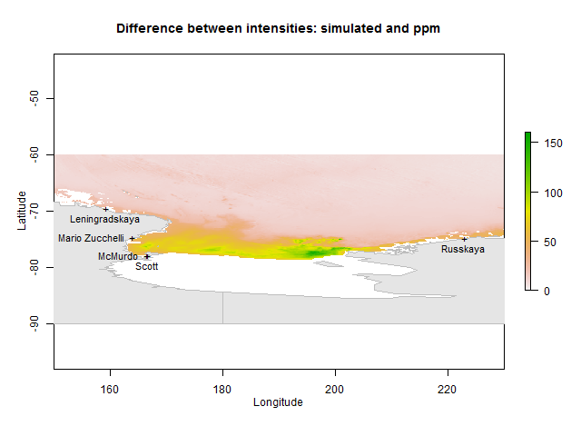
Estimation of intensity – presence-only SDM
Data:
Environment
Sample Bias
PO
SDM:
PPM
Change:
$δ=−1.01$

Slide 36
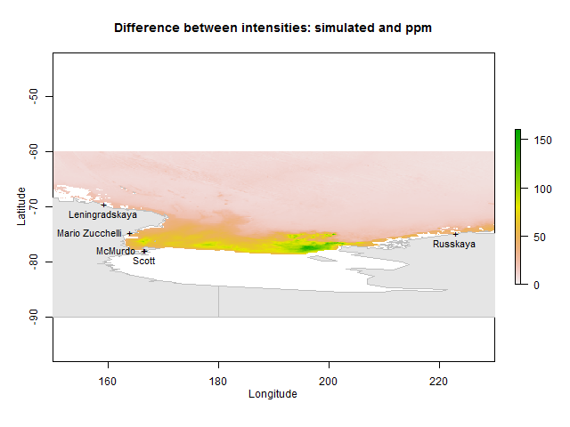
Estimation of intensity – presence-only SDM
Data:
Environment
Sample Bias
PO
SDM:
PPM
Change:
$δ=−0.26$

Slide 37
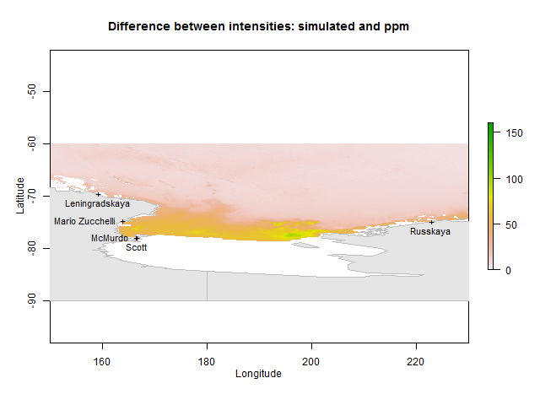
Estimation of intensity – presence-only SDM
Data:
Environment
Sample Bias
PO
SDM:
PPM
Change:
$δ=−0.01$

Slide 38
Estimation of intensity – pooled SDM
Data:
Environment
Sample Bias
PO
PA
SDM:
multispeciesPP (R package)

Slide 39
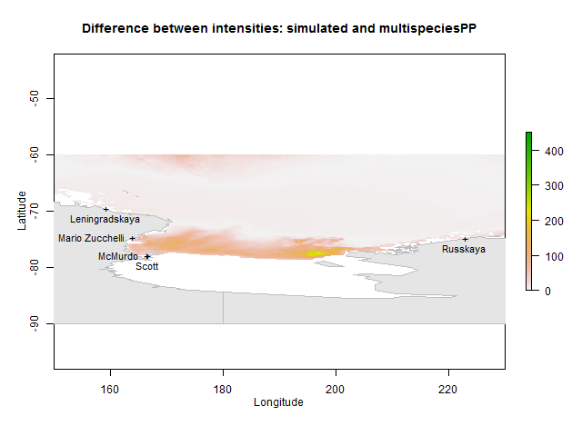
Estimation of intensity – pooled SDM
Data:
Environment
Sample Bias
PO
PA
SDM:
multispeciesPP
Change:
$δ=−1.01$

Slide 40
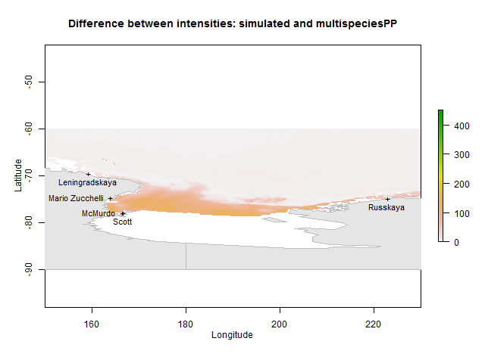
Estimation of intensity – pooled SDM
Data:
Environment
Sample Bias
PO
PA
SDM:
multispeciesPP
Change:
$δ=−0.26$

Slide 41
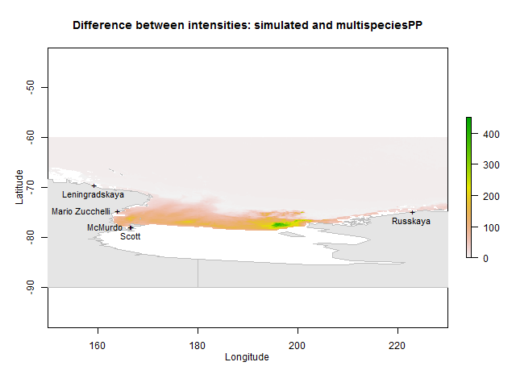
Estimation of intensity – pooled SDM
Data:
Environment
Sample Bias
PO
PA
SDM:
multispeciesPP
Change:
$δ=−0.01$

Slide 42
Where to from here
How many of species x, y, and z are in the area and where are they located?
Better understanding of multispeciesPP
Simulate patchy PA data
Real area of cells / better approximate shape of earth
More than one species
Interaction between species
Better sampling bias estimation
Differences in sampling effort (gear type, etc) included
Real Ross Sea data
Bigger region … Southern Ocean

Slide 43
Thanks
Nicole Hill (University of Tasmania)
Simon Wotherspoon (University of Tasmania)
Scott Foster (CSIRO)
Piers Dunstan (CSIRO)
John McKinlay (Australian Antarctic Division)
Ben Raymond (Australian Antarctic Division)
Mike Sumner (Australian Antarctic Division
PHOTO: Nicole Hill

Slide 44
References
Fithian, W., Elith, J., Hastie, T., & Keith, D. A. (2015). Bias correction in species distribution models: pooling survey and collection data for multiple species. Methods in Ecology and Evolution, 6(4), 424-438.
Warton, D. I., & Shepherd, L. C. (2010). Poisson point process models solve the "pseudo-absence problem" for presence-only data in ecology. The Annals of Applied Statistics, 4(3), 1383-1402. doi:10.1214/10-AOAS331
“spatstat” R package available from CRAN at www.r-project.org
“multispeciesPP” R package available at github.com/wfithian/multispeciesPP

